Slide 1

Profit-Aware Telecom Churn
& Retention Targeting
Introduction to Business Analytics · Capstone Topic 7 · Assoc. Prof. Nguyen Binh Minh
Group 1
Pham Tuan Kiet · 20252751M
Nguyen Trung Hieu · 20261059M
Bui Tien Dung · 20261204M
Pham Hung Phong · 20261061M
Notes:
[Kiet | 0:00-0:15 | 15 s]
Good morning, Professor, and everyone. We are Group 1, presenting Topic 7: profit-aware telecom churn and retention targeting. Hieu, Dung and I will present, and Phong will demo our dashboard at the end.

Slide 2
Outline
I. Business problem
Decision, data, risk versus value
II. Model and decision rule
Calibrated churn model, expected value, optimiser
III. Results and robustness
Same-budget comparison, budget size, sensitivity
IV. Recommendation and demo
Randomised pilot, live dashboard
Notes:
[Kiet | 0:15-0:25 | 10 s]
We follow CRISP-DM: the business problem and the data, then the model and the decision rule, then results and robustness, and finally our recommendation.

Slide 3
The Decision: Who Gets a Retention Offer?
Given a limited retention budget, which customers should receive an offer when both churn risk and expected value count?
26.5% of customers left; churn puts about $468,468 of 12-month margin at risk
Today the fixed budget goes to the customers most likely to leave
But every offer costs money, and not every risky customer is worth saving
Churn risk
p, from the model
×
Save rate
q, assumed per offer
×
Customer value
V, 12-month margin
−
Cost
offer + contact
→
Offer if EV > 0
EV = p × q × V − cost
Save rate = share of would-be leavers an offer keeps. Money in USD of the fictional sample company.
3
Notes:
[Kiet | 0:25-1:15 | 50 s]
In our sample company 26.5% of customers left, which puts about $468,468 of twelve-month margin at risk. The retention team has a fixed budget, and today it calls the customers with the highest churn risk. But every offer costs money, and a risky customer with a small bill may not be worth saving. So our question is: with a limited budget, who should receive an offer when both risk and value count? Our answer is to score each customer and offer by expected value: churn probability, times the save rate, the share of would-be leavers an offer keeps, times customer value, minus the cost. We contact a customer only when it is positive.

Slide 4
Data and Validation Design
7,043
customers, IBM Telco sample (fictional US operator)
Item | Decision
Unit of analysis | One customer
Target | Churn: left during the sample window (yes / no)
Decision | Offer or not, and which offer, within the budget
Data quality | 0 duplicates; 11 blank TotalCharges (tenure 0) set to 0
Leakage control | Churn reasons and IBM score excluded; TotalCharges dropped
Validation | 4,225 / 1,409 / 1,409; test used once
Fairness | Gender and senior status audited, never model inputs
26.5%
churned in the sample window
60 / 20 / 20
train / validation / test, stratified
4
Notes:
[Kiet | 1:15-2:00 | 45 s]
We use the IBM Telco Customer Churn sample from Kaggle: 7,043 customers of a fictional US operator. The unit of analysis is the customer, the target is churn, and the decision is whether to make an offer, and which one, within the budget. Quality checks found no duplicates and only 11 blank total charges, all for brand-new customers, which we set to zero. The data is one snapshot without dates, so we used a stratified 60/20/20 split: every choice is made on validation, and the test set is used once. To avoid leakage we excluded churn reasons and IBM's churn score, which are known only after a customer leaves.

Slide 5
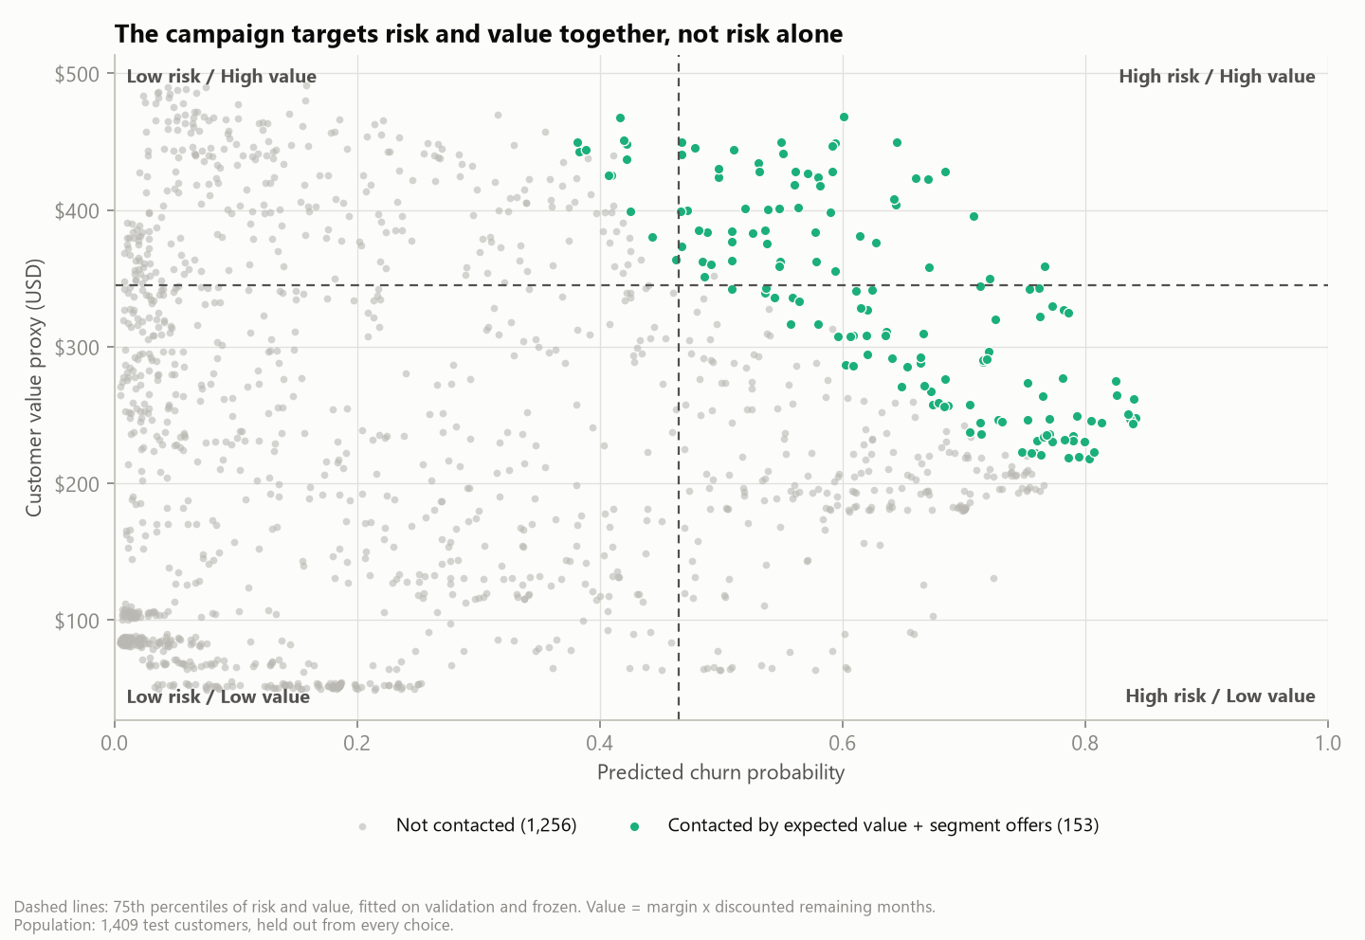
Key Insight: Churn Risk Is Not Customer Value
46%
of value at risk sits with high-risk, low-value customers, each worth little
57
test customers are high-risk and high-value; risk-only targeting reaches 12%
Churn: month-to-month 43% vs two-year 3%
New customers 48%, fibre 42%, electronic check 46%
Associations, not causes
5
Notes:
[Kiet | 2:00-2:40 | 40 s]
The exploratory analysis gave us our key insight. Churn is highest for month-to-month contracts, new customers, fibre internet and electronic-check payers. But risk and value only partly overlap. The high-risk, low-value group holds 46% of the value at risk, yet each of these customers is worth little. Only 57 test customers are both high-risk and high-value, and today's risk-only rule reaches just 12% of them. So ranking by risk alone spends the budget in the wrong place. Hieu will now show how we fix that.

Slide 6
Outline
I. Business problem
Decision, data, risk versus value
II. Model and decision rule
Calibrated churn model, expected value, optimiser
III. Results and robustness
Same-budget comparison, budget size, sensitivity
IV. Recommendation and demo
Randomised pilot, live dashboard
Notes:
[Hieu | 2:40-2:45 | 5 s]
Thank you, Kiet. I will start with the churn model.

Slide 7
Churn Model: Simple, Calibrated, Good Enough
Model (test split) | PR-AUC | ROC-AUC | Brier | ECE
Prior-only baseline | 0.265 | 0.500 | 0.195 | 0.022
Logistic regression | 0.620 | 0.830 | 0.142 | 0.019
Random forest | 0.621 | 0.832 | 0.144 | 0.045
XGBoost | 0.613 | 0.826 | 0.145 | 0.044
0.83
ROC-AUC; PR-AUC 0.62 vs 0.27 baseline
0.019
calibration error: probabilities fit to multiply by money
1,409 test customers held out from every choice; calibrated models; the baseline predicts the churn rate for everyone
Logistic regression chosen by a rule fixed in advance: tree models did not rank better
Drivers are associations, not causes
×3.7
odds: month-to-month vs two-year contract
×2.9
odds: fibre vs no internet
×0.69
odds per extra 12 months of tenure
7
Notes:
[Hieu | 2:45-3:35 | 50 s]
We compared three model families: logistic regression as the baseline, a random forest as the required tree model, and XGBoost. Each was tuned with five-fold cross-validation and calibrated. On the untouched test set they rank customers almost equally well, so, by a rule we fixed in advance, we deploy the simplest: calibrated logistic regression. Its ROC-AUC is 0.83 and its PR-AUC 0.62, against 0.27 for a model that knows nothing. Calibration is essential here, because we multiply the probability by money: the calibration error is only 0.019. The strongest drivers are month-to-month contracts, which multiply the odds of churn by about 3.7, and fibre internet; longer tenure lowers the risk.

Slide 8
From Probability to Offer: Expected Value
EV = p(churn) × save rate × customer value − (offer cost + contact cost)
Customer value
Monthly bill × 30% margin × discounted 12 months
Horizon ×0.75 for new and ×1.25 for loyal customers
10% annual discount rate
Offer catalogue (assumed)
$35 credit for moving to a 1-year contract: save rate 30%
6 months free TechSupport + OnlineSecurity: 15%
One-time $20 bill credit: 20%
Plus $5 contact cost per customer
Optimiser
Integer program maximises total EV within the budget
One offer per customer; eligibility rules
At most 30% of customers contacted
EV ≤ 0: never contacted
Save rates and costs are visible assumptions, not measurements: the data contain no randomised campaign, so no causal uplift is claimed.
8
Notes:
[Hieu | 3:35-4:30 | 55 s]
Next we turn a probability into a decision. The expected value of an offer is the churn probability, times the save rate, times the customer's value, minus the offer and contact cost. Customer value is the monthly bill times a 30% margin over a discounted twelve-month horizon, longer for loyal customers and shorter for new ones. We defined a small catalogue of offers, for example a $35 credit for moving to a one-year contract, or six months of free tech support. An integer program then chooses which customers get which offer to maximise total expected value within the budget, with one offer per customer, eligibility rules and a contact cap. The save rates are assumptions, not measurements, and we treat them that way.

Slide 9
Same Budget, $1,368 More Expected Value
+$1,368
vs the highest-risk rule; ROI 76% vs 37%
+$1,077
valued with actual churn; 95% interval $229 to $2,002
Risk-only is more precise (71% vs 60%) but spends on customers worth little
Targets: 100% fibre, 97% month-to-month, median bill $89
Expected values under the stated assumptions (USD, fictional sample company), not realised profit.
9
Notes:
[Hieu | 4:30-5:20 | 50 s]
Here is the result on the 1,409 test customers, all with the same $3,500 budget. Calling random customers, or the most valuable ones, loses money, because most of them would have stayed anyway. Today's highest-risk rule earns about $1,301. Expected-value targeting with segment offers earns $2,668: that is $1,368 more for the same spend, $1,039 from choosing better customers and $328 from matching offers. When we revalue the lists with customers' actual churn, the gain is still positive, with a 95% interval from $229 to $2,002. Dung will now explain how much to spend and how sure we are.

Slide 10
Outline
I. Business problem
Decision, data, risk versus value
II. Model and decision rule
Calibrated churn model, expected value, optimiser
III. Results and robustness
Same-budget comparison, budget size, sensitivity
IV. Recommendation and demo
Randomised pilot, live dashboard
Notes:
[Dung | 5:20-5:25 | 5 s]
Thanks, Hieu. Let me turn to the budget and to risk.

Slide 11
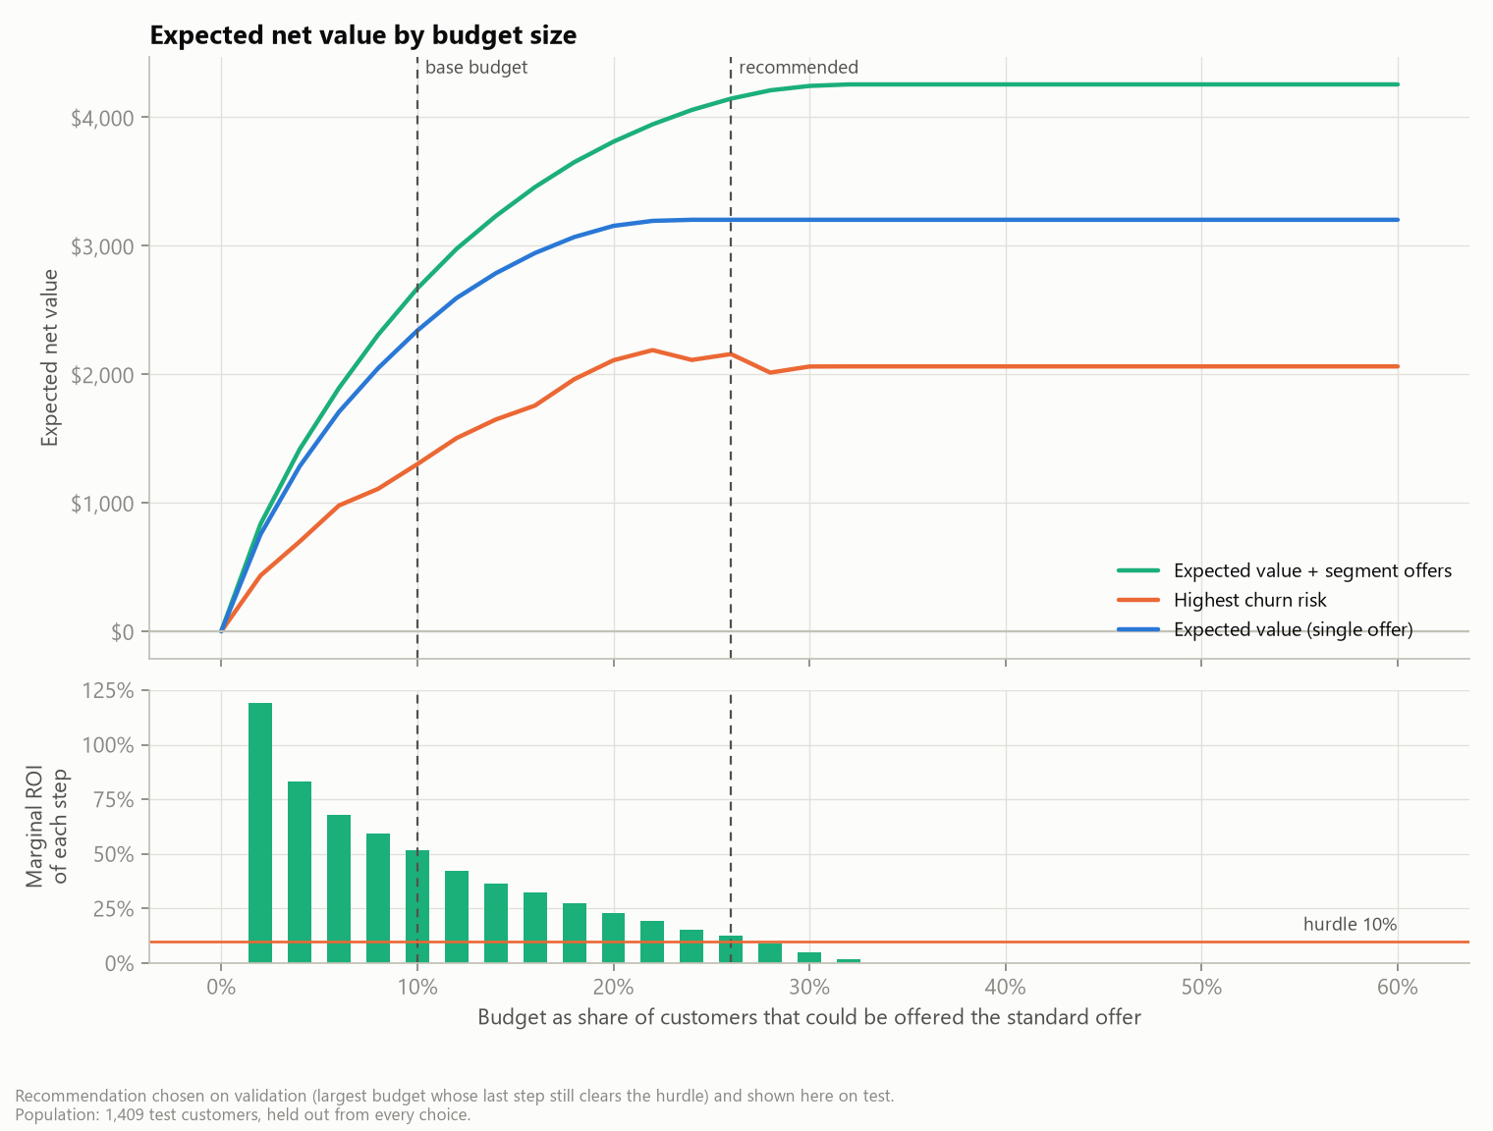
How Much to Spend: The Profit Curve
26%
budget share chosen on validation: the last step must still return ≥ 10%
$4,145
expected net value on test: 324 offers for $9,150 (ROI 45%)
About $45,737 for the 7,043-customer base ($6.49 per customer)
Positive EV runs out at 371 test customers ($11,318); the hurdle stops earlier, where extra steps barely pay
11
Notes:
[Dung | 5:25-6:05 | 40 s]
How big should the budget be? Each extra step of budget returns less. Our rule, fixed on validation data, keeps adding budget only while the last step still returns at least 10%. That gives enough budget for the standard offer to 26% of customers. On the test customers this buys 324 offers for $9,150, with an expected net value of $4,145. For the whole base of 7,043 customers that is about $45,737, or $6.49 per customer. The rule stops a little before the point where no customer has a positive expected value, because the last steps barely pay for themselves.

Slide 12
How Sure Are We?
99.96%
of 5,000 draws: EV targeting beats risk-only
13.8%
break-even save rate of the standard offer for the recommended list (assumed 20%)
17%
chance the recommended list loses money
46%
of churners left for price or a competitor: what an offer can address
Who to target is robust; how much an offer saves is not, so measure it before scaling
Biggest sources of uncertainty
Value horizon (months), save rate of the standard offer and contribution margin
Fairness check
Seniors contacted 3.3× as often (1.7× after adjusting for risk); age and gender are not model inputs; every wave is reviewed
12
Notes:
[Dung | 6:05-7:00 | 55 s]
How sure are we? We varied every assumption one at a time, and then all of them at once in 5,000 Monte Carlo draws. In 99.96% of the draws, expected-value targeting beats the risk-only rule: who to target is robust. How much an offer saves is not. The recommended list breaks even if the standard offer saves 13.8% of would-be leavers, while we assumed 20%, and it loses money in 17% of the draws. IBM's churn reasons add a warning: only 46% of churners left for price or a competitor, which an offer can address. Finally, our fairness audit shows that seniors are contacted 3.3 times as often as other customers, partly because of higher risk and partly because of higher bills, so every wave is reviewed.

Slide 13
Recommendation: A Randomised Pilot Before Scaling
Set-up
4 weeks
Retention, Legal/DPO, IT
→
Pilot wave
13 weeks
Call centre, Retention
→
Read-out
2 weeks
Retention analytics
→
Scale or stop
4 weeks
Head of Retention, Finance
1,620
customers: 810 offered, 810 held out at random
$22,875
cost of the offered half; expected net value $10,363
≥ 15.6%
measured save rate of the offer mix needed to go (assumed 22.6%); P(go) = 97% if it holds
Adopt expected-value targeting with segment offers, launched as a randomised pilot;
scale only if the measured save rate clears break-even
13
Notes:
[Dung | 7:00-7:55 | 55 s]
So our recommendation to the Head of Retention is to adopt expected-value targeting with segment offers, but to launch it as a randomised pilot. One wave of 1,620 customers from the recommended list is split at random: half receive the offer, half are held out. After 90 days we measure the real save rate of this offer mix, which we assume to be 22.6%. The decision rule is agreed now: go if the effect is significant and at least the break-even of 15.6%; stop if it is clearly below. The offered half costs about $22,875, and if our assumption holds, the rule says go 97% of the time. A decision is ready about 19 weeks after approval. Phong will now show our dashboard.

Slide 14
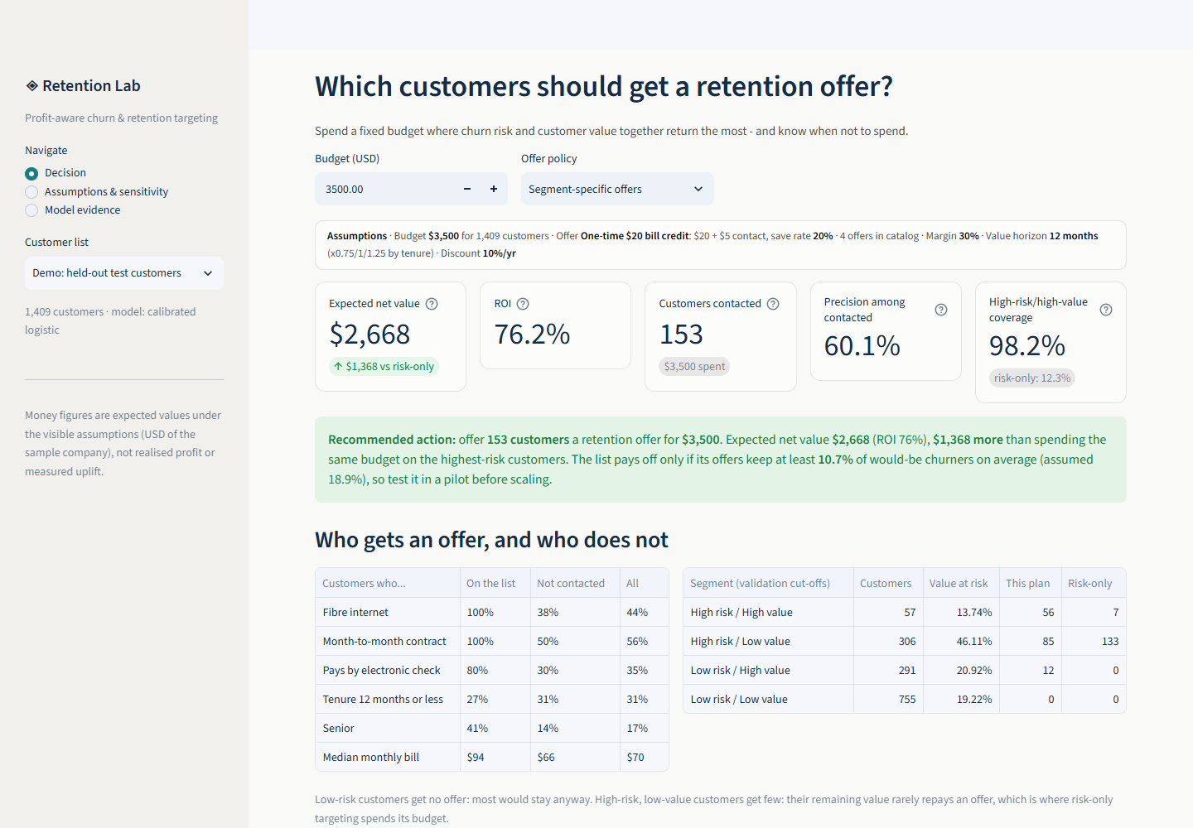
Live Demo: Retention Lab Dashboard
Decision
Five KPIs, recommendation, who gets an offer, action list and export
Assumptions & sensitivity
Change save rates and costs; break-even, live chance of a loss, stress test
Model evidence
Performance, points scorecard, SHAP challenger, score an uploaded customer file
14
Notes:
[Phong | live demo before the closing words, not part of the 8-minute talk | full timed steps in demo-script.md]
Short version of reports/presentation/demo-script.md (Streamlit app, default assumptions, held-out test customers):
1. Decision page: read the five KPIs (expected net value $2,668, ROI 76%, 153 customers contacted, precision, high-risk/high-value coverage) and the green recommendation sentence.
2. Scroll to 'Who gets an offer': fibre, month-to-month and bill profile, then the risk x value scatter.
3. Set the budget to 0 and back to $3,500: KPIs and the action list update at once.
4. Action list: search one customer ID, open 'Why is a customer in or out of the list?', then click 'Export campaign' (CSV + assumptions).
5. Assumptions & sensitivity: lower the save rate to 10%; the plan shrinks and the live chance of a loss rises; point at the break-even save rate.
6. Model evidence: performance table and points scorecard; upload data/examples/customers_unlabeled.csv to score new customers.
Hand back: 'That is the tool a retention manager would use for every wave. Back to Dung.'

Slide 15
THANK YOU !
Questions and discussion
Notes:
[Dung | 7:55-8:00 | 5 s]
Thank you for your attention. We are happy to take your questions.

Slide 16
Notes:
[No speaker]
Closing slide: leave it on screen during questions.

