Slide 1


FUFO overview
Confidential document

Slide 2

Contents
1
Introduction
2
Hardware & Software
3
Algorithms
4
Experiments and results
5
Conclusion

Slide 3
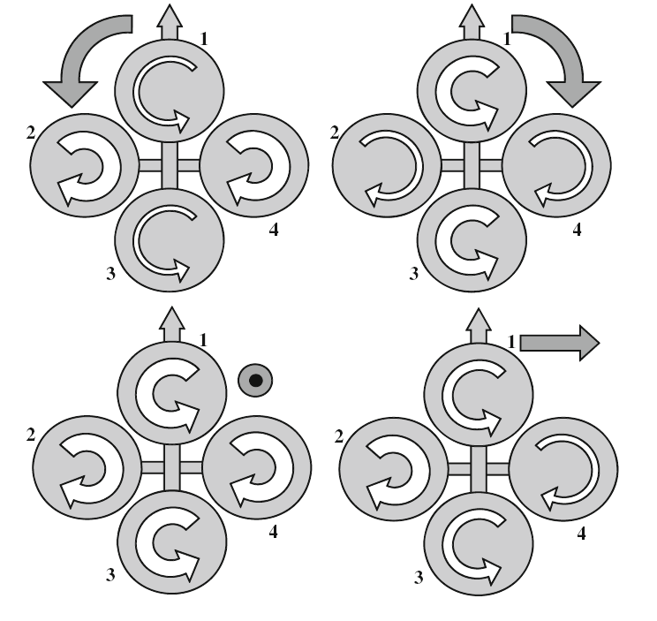
History
Introduction
Definition:
A Vertical Take-Off and Landing aircraft.
Has 4 rotors.

Slide 4
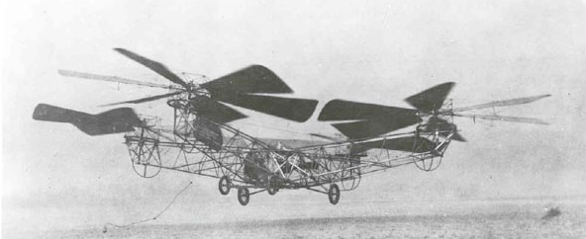
History
Introduction
The first Quadrocopter was developed in 1920.
No commercialized Quadrocopter because: Limitation of technology and science at that time.

Slide 5
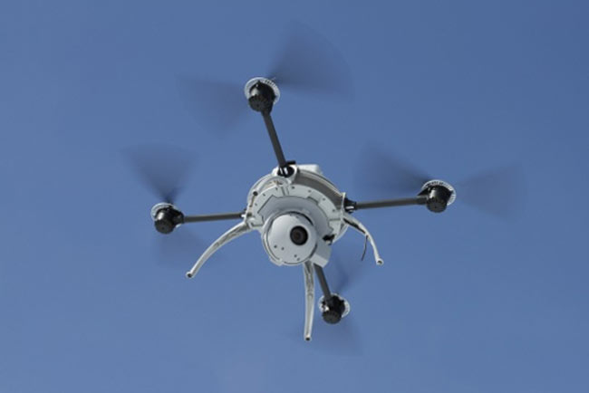
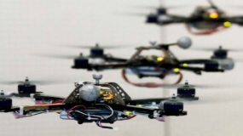
History
Introduction
8 years before 2012, many institutes and companies began to research on this platform as a small UAV.

Slide 6
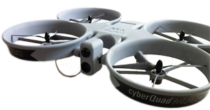
Commercialized product
Introduction
Airbot X600-BKPP (€ 34,500)
Radio control unit (2.4 GHz)
Live video stream
GPS waypoint navigation
CyberQuad Maxi ($ 36,000)
Radio control unit
GPS waypoint navigation
Live video stream

Slide 7
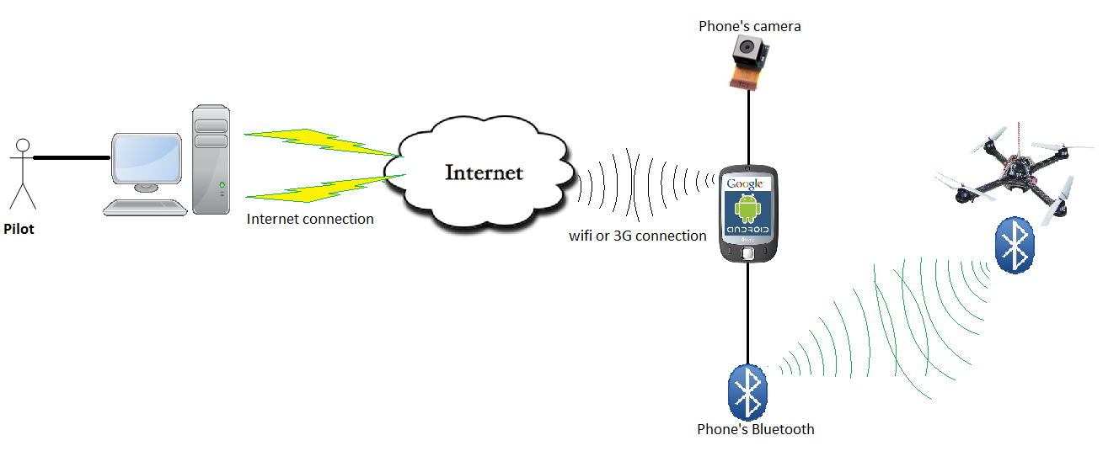
Idea
Introduction
Develop a Quadrocopter for observation purpose.

Slide 8
Idea
Introduction
Why choosing Quadrocopter platform?
 | Quadrocopter | Helicopter | Fixed-Wing aircraft
Aerodynamics mechanical design | No | Yes | Yes
Control method | Medium | Medium | Complicated
Runway | No | No | Yes
➔ Quadrocopter is more suitable for embedded Engineering students who are not familiar with aerospace issue and mechanical design.

Slide 9
Idea
Introduction
Why choosing Android Phone?
 | Android phone | In-circuit designs
Software development | Android SDK | Linux, C30…
Evaluation of controlling by phone/tablet via Bluetooth? | Yes | No
Risk and complexity in hardware design | Low | High
Cost | Low | High
Has built-in camera, Wi-Fi, 3G module
Phone is still usable after this Capstone project

Slide 10
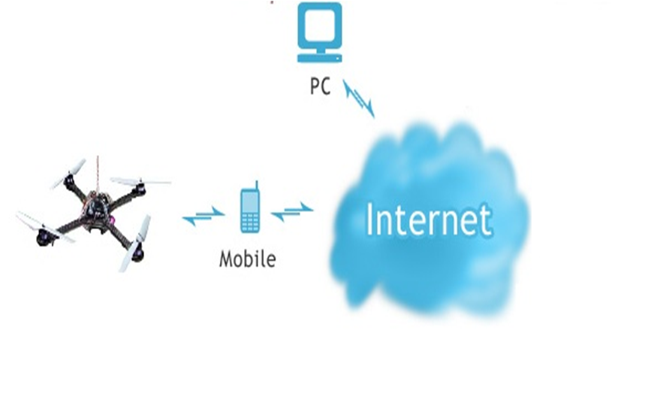
Idea
Introduction
Command
Sensor data
Bluetooth

Slide 11
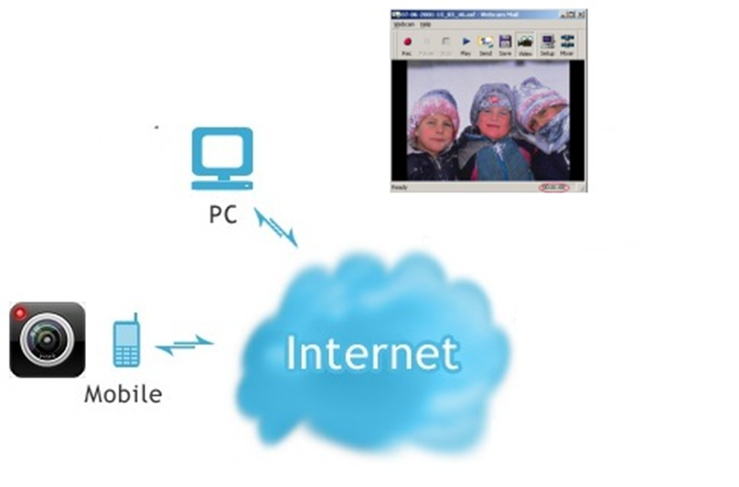
Idea
Introduction
Picture
Picture
JPEG
JPEG

Slide 12
Idea
Introduction
Control Mode
Autonomous(Dynamic Stabilization)
Manual

Slide 13
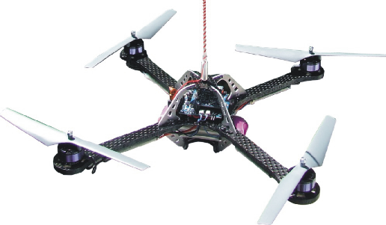
Idea
Introduction
Wind
Manual mode

Slide 14
Idea
Introduction
Dynamic stabilization
Wind
Dynamic Stablization
SAFE
Go to 1m

Slide 15
Hardware study
Hard & Soft
No. | Components | Quantity | Description
1 | dsPIC30f4012 | 1 | Microcontroller
2 | HC-06 | 1 | Bluetooth module
3 | BMP085 | 1 | Barometer
4 | L3G4200D | 1 | Gyroscope
5 | ADXL345 | 1 | Accelerometer
6 | HW 30A ESC | 4 | Electronic speed Controller
7 | Himodel 2212 1400kv | 4 | Brushless motor
8 | Turnigy 3000mAh 11.1v 3s | 2 | Li-Po battery pack.
9 | HTC HD2 | 1 | Android 2.3 phone

Slide 16
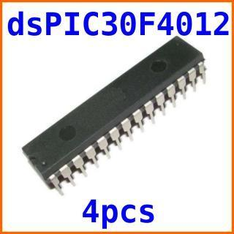
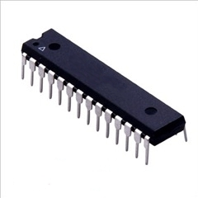
Hardware study
Hard & Soft
dsPIC30f4012 Microcontroller
Max speed: 30 MIPS
16x16 bit working arrays
5 timers, 3 PWM generators
Programmable by C30.

Slide 17
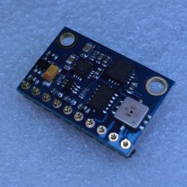
Hardware study
Hard & Soft
BMP085 + ADX345 + L3G4200D
All-in-one module:
3-axis accelerometer.
3-axis gyroscope.
-300m to 9000m altimeter.

Slide 18
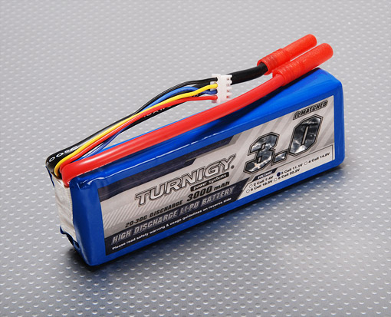
Hardware study
Hard & Soft
Turnigy 3000mAh battery pack
3000mAh x 2
253 grams x 2
11.1v
Discharge rate: 20C

Slide 19
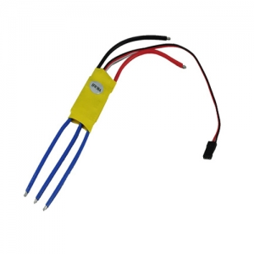
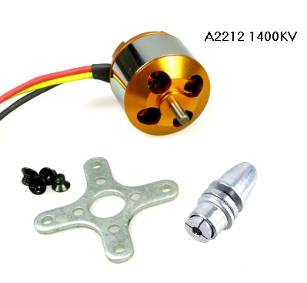
Hardware study
Hard & Soft
Motor and ESC
1400kv Brushless motors
8x4” propellers
ESC PWM range: 1ms – 2ms

Slide 20

Hardware study
Hard & Soft
HTC HD2 Android 2.3
320x240 camera.
Has Bluetooth and Wi-Fi connection
Run on Android 2.3

Slide 21
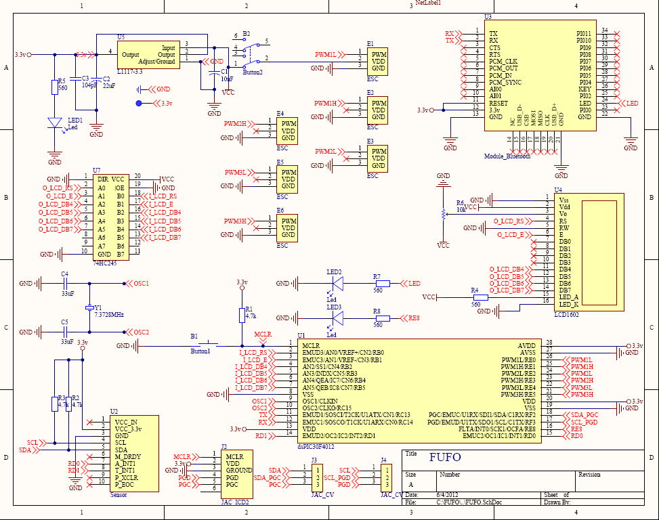
Hardware design
Hard & Soft

Slide 22
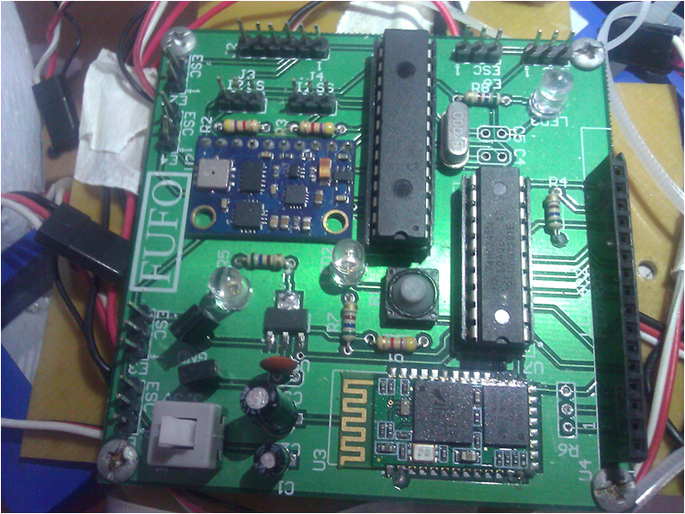
Hardware design
Hard & Soft

Slide 23
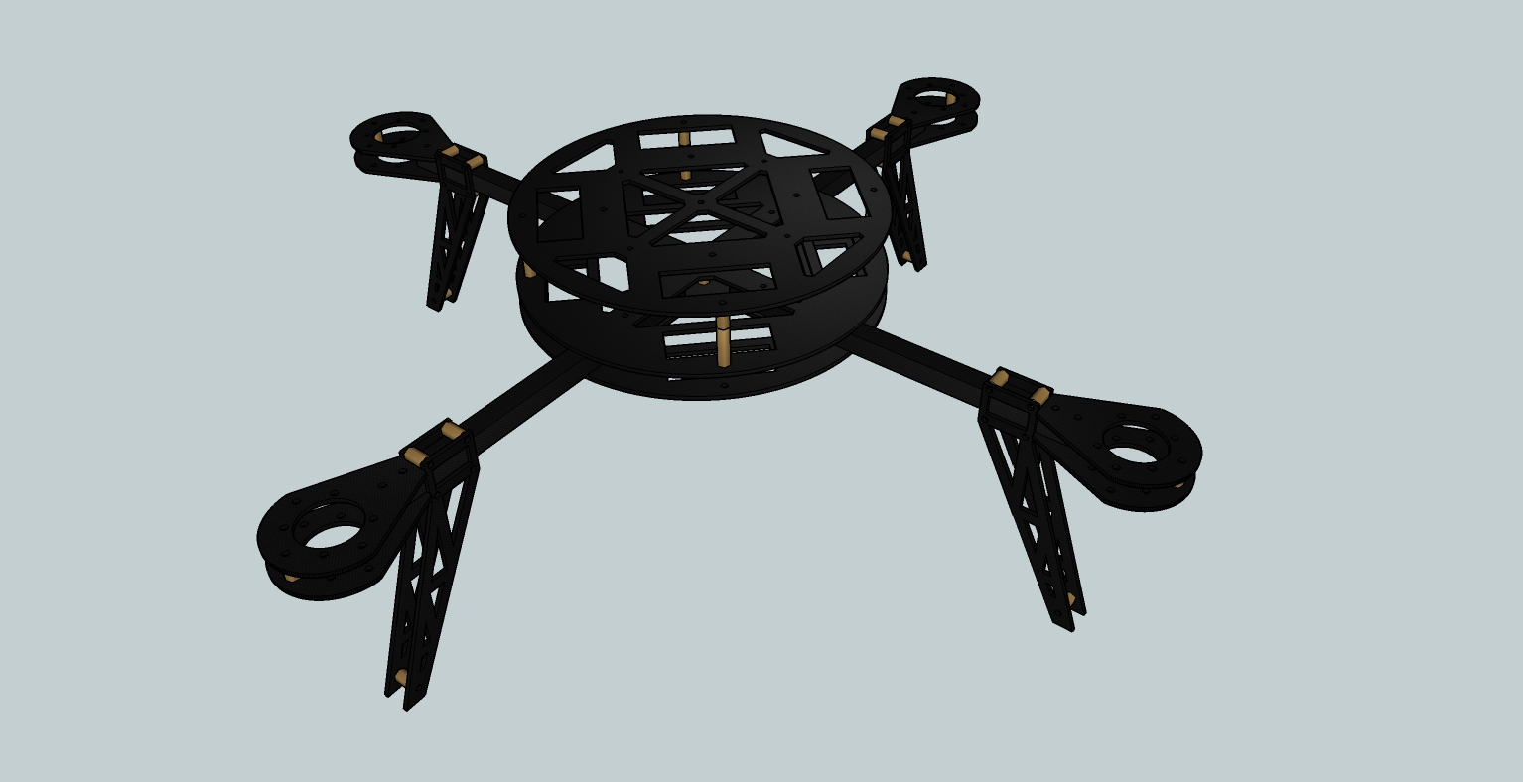
Frame design
Hard & Soft
Circuit mount
440 mm
Motor mount
Fiber Glass & Fiber Carbon

Slide 24
Software study
Hard & Soft
Turnigy 3000mAh battery pack
3000mAh x 2
253 grams x 2
11.1v
Discharge rate: 20C

Slide 25
Software study
Hard & Soft

Slide 26

www.themegallery.com
Thank You !
Confidential document

