Slide 1
Scope
Confidential document

Slide 2
Contents
1
Overview
2
High level scope
3
Video over IP - VP
4
Quadrocopter - FUFO

Slide 3
1.Overview
The project name is: FUFO
The aim of this project:
  Make a Quadrocopter (a 4 rotors flying robot) and name it FUFO.
  Program a smartPhone as FUFO’s brain.
  Control the smartPhone over internet protocol:
    Receive real-time video from smartPhone
    Receive real-time status and condition of FUFO.
    Send human command from main computer to smartPhone

Slide 4
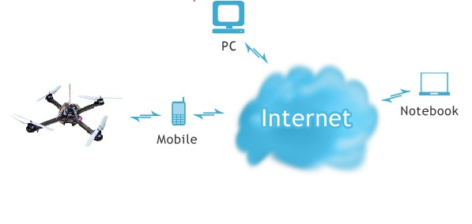
1.Overview (Cont.)

Slide 5
2. Detail scope
This project contains 3 subprojects:
  Video over IP – VP
  Quadrocopter – FUFO
Each of the subprojects will be discussed in the following slides.

Slide 6
3. Video over IP - VP
Aim:
  One computer receive real-time video from smartPhone through Internet Protocol.
  Delay < 0.5s
  FPS >= 10
  No sound
  Compressed by H.263 & H.264

Slide 7
3. Video over IP – VP (Cont.)
  Create an desktop Application for controlling FUFO via Internet Protocol.
  Easy to use and good looking is important.
  Integration of FUFO and VP:
    Receives video and sensor’s statuses from smartPhone and displays them.
    User can send basic commands to smartPhone for controlling FUFO.
  smartPhone also has an Application for connecting with desktop Application.
  Easy to maintain and update.

Slide 8
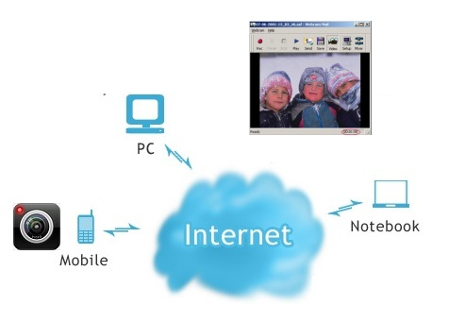
3. Video over IP - VP (Cont.)

Slide 9
4. Quadrocopter - FUFO
Aim:
  Develop a flying platform that uses 4 rotors as its flying module and hover as a normal quadrotor:
    Max speed < 60 km/h under “good condition”(*)
    Can hover and keep stable in “light wind” (**)
    Under good condition can capture stable video stream.
  (*) good condition is a condition where wind speed ~ 0m/s, temperature 10 - 30 Celsius, acceptable humidity.
  (**) what is “light wind” will be investigated during the project time.

Slide 10
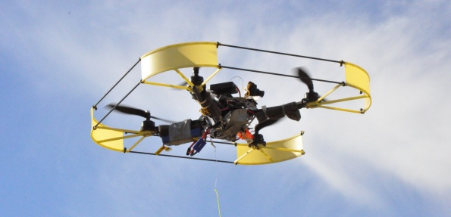
4. Quadrocopter – FUFO (Cont.)
    Can carry >500 grams and hover >30m high.
    Batteries last ~30 mins without carrying anything.
    Control by a smartPhone via Bluetooth:
      Send sensors status (if needed)
      Receive basic control command.
    Not so easy to break, tolerant to small collision.
    Good looking.

Slide 11
www.themegallery.com
Thank You !
Confidential document

