Slide 1


FUFO overview
Confidential document

Slide 2

Contents
1
Idea
2
Overview
3
Scope
4
Detail

Slide 3
The needs
Idea
The need of security observation from above. E.g.:
  Olympic Game Events.
  Independence Day Event.
  Protection Activities of Government’s important guest.
Daily protection of the Nation boundary. E.g.:
  Cross-border smuggling control.
  Detect maritime boundary violation early.

Slide 4
The facts
Idea
 | Static Cam | Human patrol | Air plane | UAV
Cost | Low | Medium | Ultra High | Ultra High
Mobilization | No | Yes | Yes | Yes
Speed | N/A | Low | High | High
Safety critical | No | Yes | Yes | No
Terrain barrier | Yes | Yes | No | No
➔ The modern solution should be Unmanned Aerial Vehicle (UAV) but in a cheaper price.

Slide 5

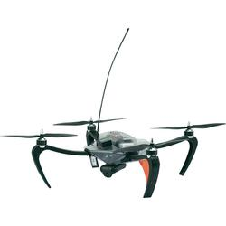
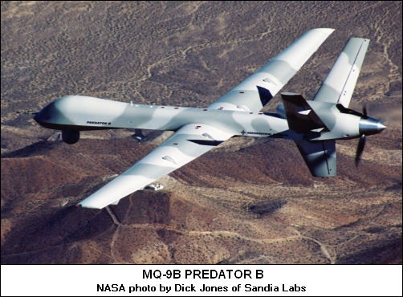
The facts
Idea
 | RC UAV | Military UAV
Flight Time | Short | Long
Size | Small | Big
Cost | Low | Ultra High
Infrastructure needed | Low | Ultra High
Reliability | Low | High
Mass production | Possible | Impossible

Slide 6
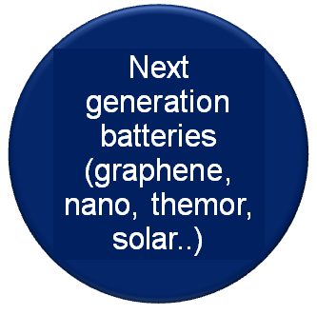

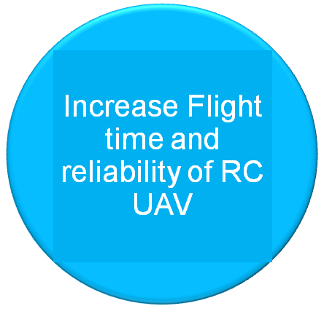


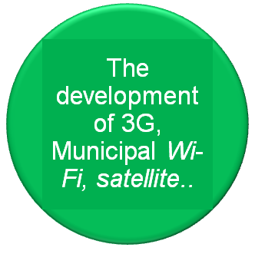
The future
Idea
Near future

Slide 7
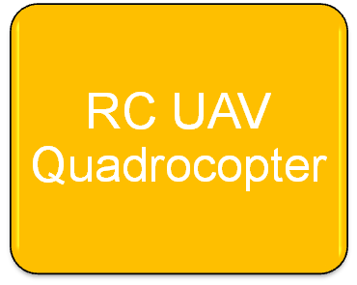

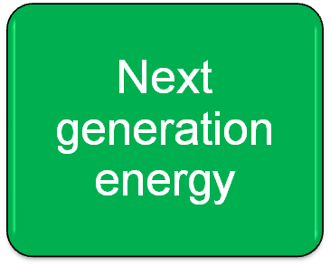
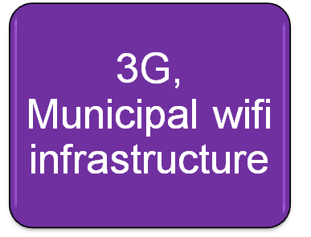



The innovation
Idea

Slide 8
FUFO Overview
Overview
Project name: FUFO
Project type: Research and Development
Project purpose: Develop a commercialized Quadrocopter.
Base on observation on the similar projects, a project this big may need four phases, each phase will be a relevant project to lead to the final product.
  <More detailed requirement information will be specify in the next slide>

Slide 9

FUFO Overview
Overview
FUFO phases:
  Evaluation Phase
  Development Phase
  Optimization Phase
  Commercial Phase
Our FPT University Capstone project just focuses on the first phase of FUFO project.
  <More detailed requirement information will be specify in the next slide>
Capstone project

Slide 10
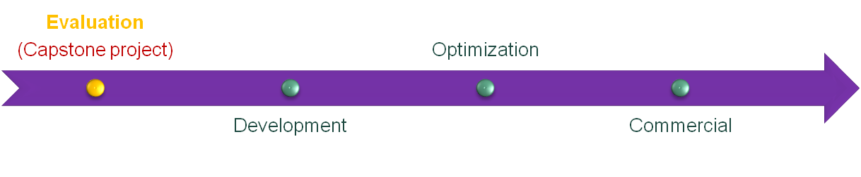
FUFO Overview
Overview
No. | Name | Estimated duration (Month) | Success criteria
1 | Evaluation phase (Capstone Project) | 4 | Evaluation report and a Quadrocopter with basic functions that might meet customer needs.
2 | Development phase | 12 | A system whose functional requirements meet customer needs.
3 | Optimization phase | 12 | A system whose functional and non-functional requirement meet customer needs.
4 | Commercial phase | 12 | A system that are able to be mass-produced.

Slide 11
Why Quadrocopter?
Overview
 | Quadrocopter | Helicopter | Fixed-Wing aircraft
Aerodynamics mechanical design | No | Yes | Yes
Control method | Medium | Medium | Complicated
Runway | No | No | Yes
➔ Quadrocopter is more suitable for Computer Engineering students who are not familiar with aerodynamic issue and mechanical design.

Slide 12
Capstone project’s aim
Scope
The aims of this Capstone project are:
  Make a simple Quadrocopter.
  Use Bluetooth & Internet protocol to communicate.
  Evaluate the application of Android Phone & PC in controlling UAV.
  Make two study reports:
    Study report on hovering capability of Quadrocopter.
    Study report on real-time video transmission.

Slide 13
Why Android Phone?
Scope
 | Android phone | In-circuit designs
Software development | Android SDK | Linux, C30…
Evaluation of controlling by phone/tablet via Bluetooth? | Yes | No
Risk and complexity in hardware design | Low | High
Cost | Low | High
Has built-in camera, Wi-Fi, 3G module
Phone is still usable after this Capstone project

Slide 14
Quadrocopter
Scope
Quadrocopter:
  Max speed < 60 km/h under “good condition”(*)
  Can hover and keep stable in “light wind” (**)
  Under good condition can capture stable video stream.
  Can carry >500 grams and hover >30m high.
  Batteries last ~15 minutes without carrying anything
  (*) good condition is a condition where wind speed ~ 0m/s, temperature 10 - 30 Celsius, acceptable humidity.
  (**) what is “light wind” will be investigated during the project time.

Slide 15

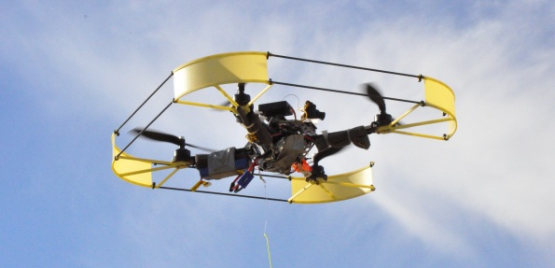
Quadrocopter
Scope

Slide 16
Communication system
Scope
Communication system:
  Communicate via Bluetooth:
    Quadrocopter sends Sensor data (angle rate, acceleration rate..) to Android Smart Phone.
    Android Smart Phone sends Control commands to Quadrocopter.
  Communicate via Internet Protocol:
    PC sends Control command to Android Smart Phone
    Android Smart Phone sends Real-time video (no sound) and Quadrocopter Sensor data to PC.

Slide 17
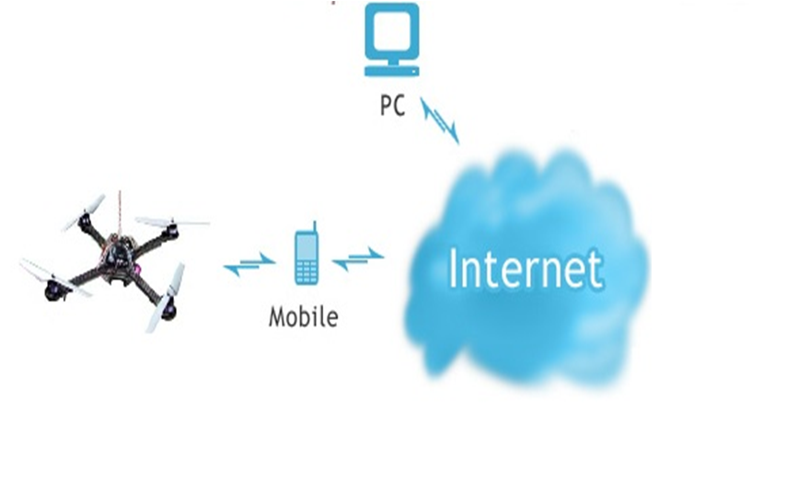


Communication system
Scope
Command
Sensor data
Bluetooth

Slide 18
Real-time video
Scope
Real-time video transmission:
  Protocol: UDP/IP.
  Latency < 0.5 seconds
  FPS ~ 10 *
  No sound *
  Images are compressed into JPEG. *
  * Reference:
  UAV Imagery Frame Rate and Resolution Requirements Study – Advanced Technology Department, Vitro Corporation - 1991
  Real-Time Video Compression Techniques and Algorithms - Raymond Westwater and Borko Furht – 1997
  http://developer.android.com

Slide 19
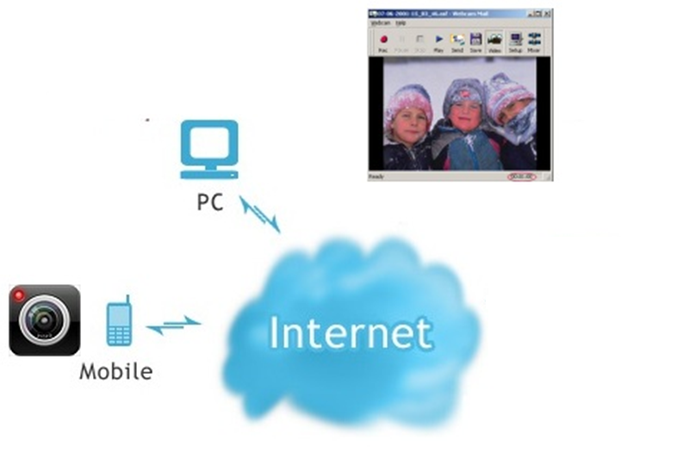
Real-time video
Scope
Picture
Picture
JPEG
JPEG

Slide 20
Control
Scope
Control:
  The Quadrocopter has two control mode:
    Autonomous
    Manual
  Autonomous mode:
    Dynamic stabilization.
  Manual mode:
    Pilot can control the Quadrocopter with little effort.

Slide 21
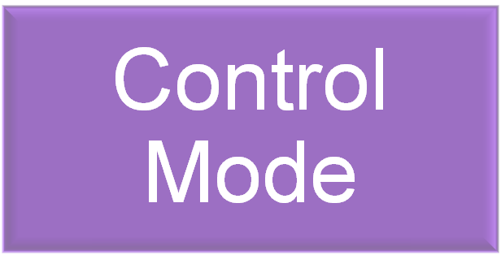


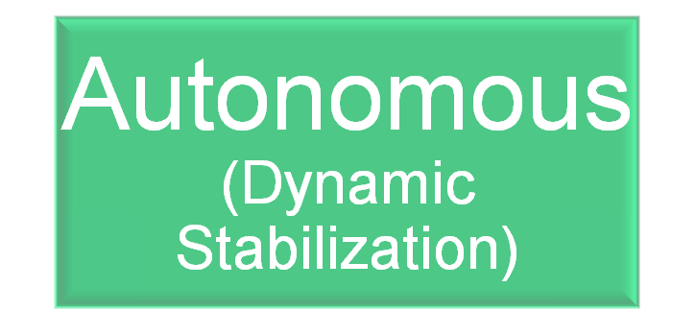

Control
Scope

Slide 22



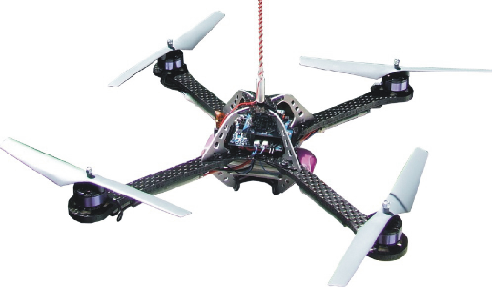
Control
Scope
Wind
Manual mode

Slide 23
Control
Scope
Enter Autonomous mode
Wind
Dynamic Stablization
SAFE
Manual mode

Slide 24
Comparison
Scope
 | FUFO Quadrocopter v1.x | Mikrocopter Quadro | Parrot Ar Drone
Carrying capacity | 500gr | 500gr | 0gr
3G network | Yes | No | No
Wifi network | Yes | No | Yes
Bluetooth | Yes | No | No
RF | No | Yes | No
Real-time video | Yes | No | Yes
Dynamic stability | Yes | Yes | Yes
Controller | PC & Smart Phone | RF Controller | Iphone, Ipad, Ipod Touch
Auto-pilot | No | No | No

Slide 25
PC application
Detail
PC application:
  Receives video and Sensor’s statuses from Android Smart Phone and display them.
  Sends control commands to Android Smart Phone.
  Easy to use and good looking.
  Easy to maintain and update.

Slide 26
Android application
Detail
Android application:
  Receives control commands from PC.
  Sends control commands to Quadrocopter.
  Send video and Sensor’s statuses to PC.
  Easy to use.
  Easy to maintain and update.

Slide 27
Embedded Software
Detail
Embedded Software:
  Receive control command from Android Smart Phone and control the motors.
  Send Sensor’s output to Android Smart Phone at a desirable rate.
  Go into Autonomous Mode when no control command is received from pilot.
  Use Bluetooth RS232 communication method to communicate with Android Smart Phone.
  Easy to maintain and update.

Slide 28
Embedded Hardware
Detail
Embedded Hardware:
  Build a Quadrocopter frame which has space for a 150gr Smart Phone.
  Design a PCB board for controlling the Quadrocopter, it should has:
    Bluetooth module.
    At least 4 PWM generators
    Tri-angle Accelerometer and Gyroscope sensors.
  Motors, ESCs, Batteries can be bought from the market.
    Motor’s thrust > 800gr
    Batteries: 4400mAh

Slide 29

www.themegallery.com
Thank You !
Confidential document

