Slide 1


FUFO overview
Confidential document

Slide 2

Contents
1
Introduction
2
Hardware & Software Study
3
Algorithms
4
Experiments and results
5
Conclusion

Slide 3
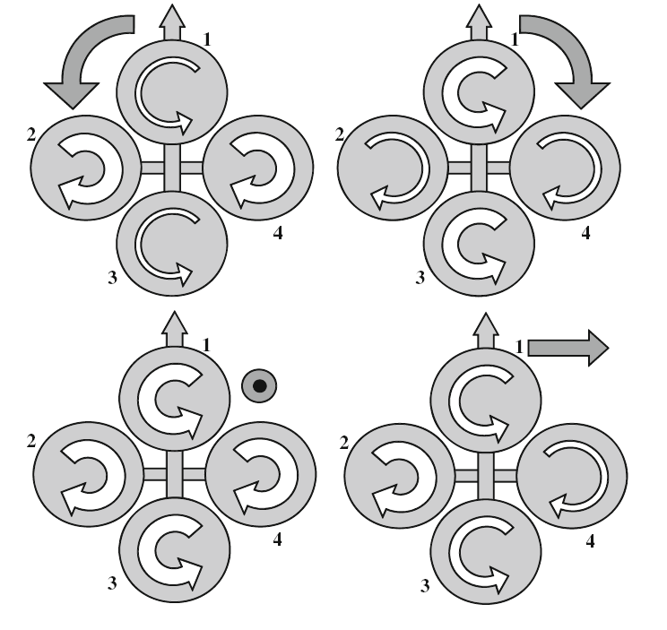
History
Introduction
Definition:
A Vertical Take-Off and Landing aircraft.
Has 4 rotors.

Slide 4
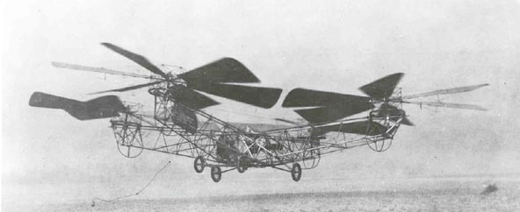
History
Introduction
The first Quadrocopter was developed in 1920.
No commercialized Quadrocopter because: Limitation of technology and science at that time.

Slide 5
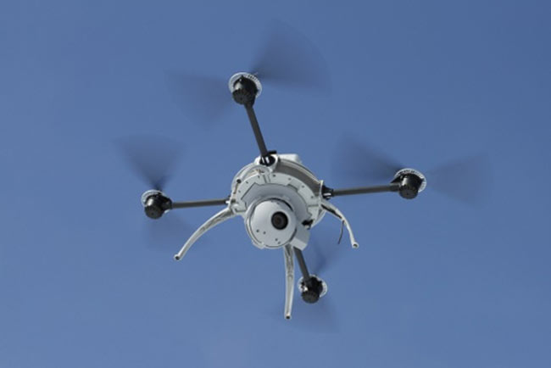
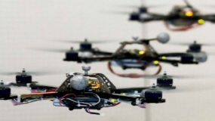
History
Introduction
8 years before 2012, many institutes and companies began to research on this platform as a small UAV.

Slide 6
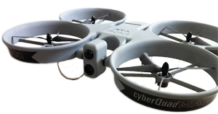
Commercialized product
Introduction
Airbot X600-BKPP (€ 34,500)
Radio control unit (2.4 GHz)
Live video stream
GPS waypoint navigation
CyberQuad Maxi ($ 36,000)
Radio control unit
GPS waypoint navigation
Live video stream

Slide 7
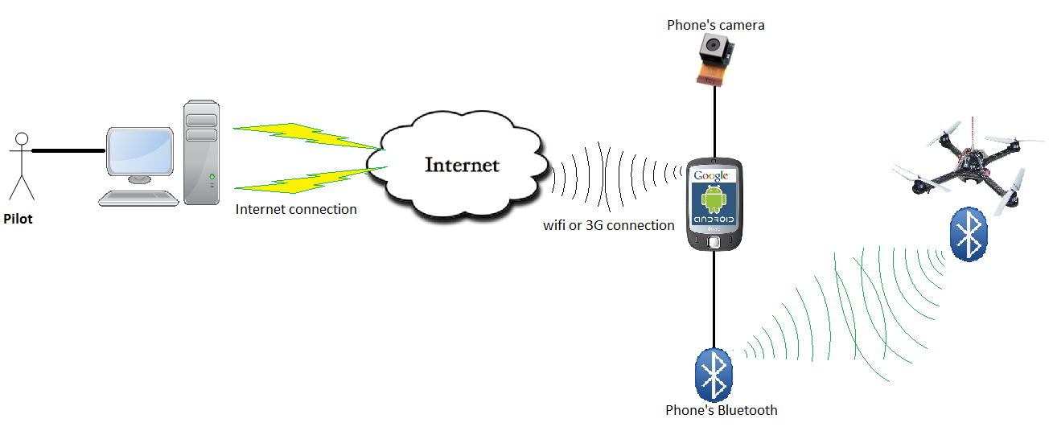
Idea
Introduction
Develop a Quadrocopter for observation purpose.

Slide 8
Idea
Introduction
Why choosing Quadrocopter platform?
 | Quadrocopter | Helicopter | Fixed-Wing aircraft
Aerodynamics mechanical design | No | Yes | Yes
Control method | Medium | Medium | Complicated
Runway | No | No | Yes
➔ Quadrocopter is more suitable for embedded Engineering students who are not familiar with aerospace issue and mechanical design.

Slide 9
Idea
Introduction
Why choosing Android Phone?
 | Android phone | In-circuit designs
Software development | Android SDK | Linux, C30…
Evaluation of controlling by phone/tablet via Bluetooth? | Yes | No
Risk and complexity in hardware design | Low | High
Cost | Low | High
Has built-in camera, Wi-Fi, 3G module
Phone is still usable after this Capstone project

Slide 10
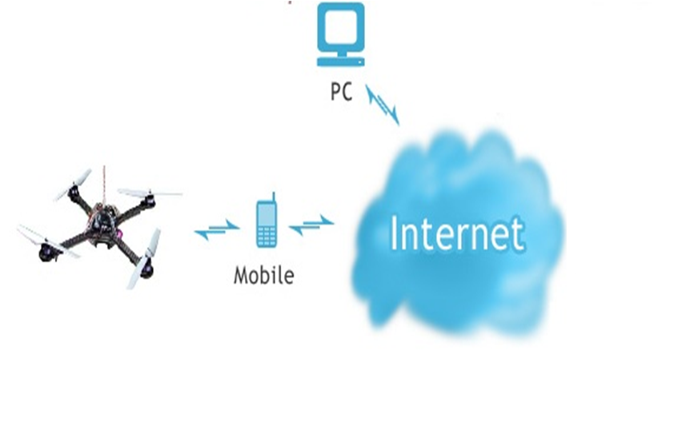
Idea
Introduction
Command
Sensor data
Bluetooth

Slide 11
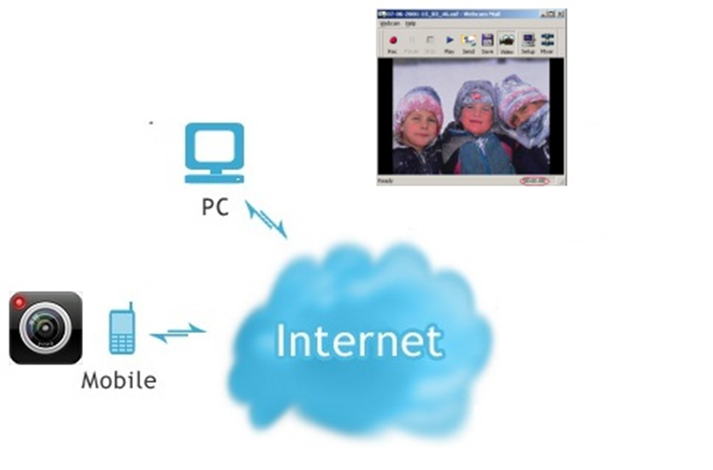
Idea
Introduction
Picture
Picture
JPEG
JPEG

Slide 12
Idea
Introduction
Control Mode
Autonomous(Dynamic Stabilization)
Manual

Slide 13
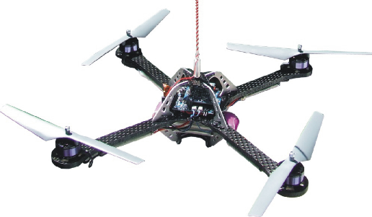
Idea
Introduction
Wind
Manual mode

Slide 14
Idea
Introduction
Dynamic stabilization
Wind
Dynamic Stablization
SAFE
Go to 1m

Slide 15
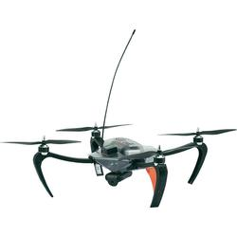
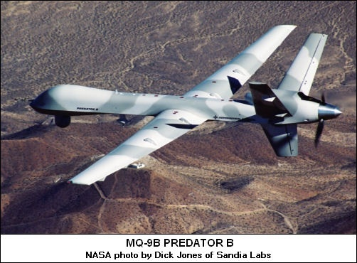
The facts
Idea
 | RC UAV | Military UAV
Flight Time | Short | Long
Size | Small | Big
Cost | Low | Ultra High
Infrastructure needed | Low | Ultra High
Reliability | Low | High
Mass production | Possible | Impossible
VS

Slide 16
The future
Idea
Next generation batteries (graphene, nano, themor, solar..)
Near future
Increase Flight time and reliability of RC UAV
The development of 3G, Municipal Wi-Fi, satellite..

Slide 17
The innovation
Idea
RC UAV Quadrocopter
Next generation energy
3G, Municipal wifi infrastructure
FUFO

Slide 18
FUFO Overview
Overview
Project name: FUFO
Project type: Research and Development
Project purpose: Develop a commercialized Quadrocopter.
Base on observation on the similar projects, a project this big may need four phases, each phase will be a relevant project to lead to the final product.
<More detailed requirement information will be specify in the next slide>

Slide 19
FUFO Overview
Overview
FUFO phases:
Evaluation Phase
Development Phase
Optimization Phase
Commercial Phase
Our FPT University Capstone project just focuses on the first phase of FUFO project.
<More detailed requirement information will be specify in the next slide>
Capstone project

Slide 20
FUFO Overview
Overview
No. | Name | Estimated duration (Month) | Success criteria
1 | Evaluation phase (Capstone Project) | 4 | Evaluation report and a Quadrocopter with basic functions that might meet customer needs.
2 | Development phase | 12 | A system whose functional requirements meet customer needs.
3 | Optimization phase | 12 | A system whose functional and non-functional requirement meet customer needs.
4 | Commercial phase | 12 | A system that are able to be mass-produced.
Evaluation
(Capstone project)
Development
Optimization
Commercial

Slide 21
Capstone project’s aim
Scope
The aims of this Capstone project are:
Make a simple Quadrocopter.
Use Bluetooth & Internet protocol to communicate.
Evaluate the application of Android Phone & PC in controlling UAV.
Make two study reports:
Study report on hovering capability of Quadrocopter.
Study report on real-time video transmission.

Slide 22
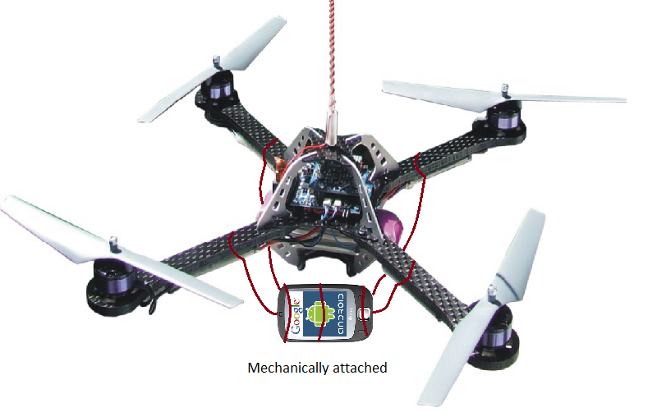
System overview
Scope

Slide 23
Quadrocopter
Scope
Quadrocopter:
Max speed < 60 km/h under “good condition”(*)
Can hover and keep stable in “light wind” (**)
Under good condition can capture stable video stream.
Can carry >500 grams and hover >30m high.
Batteries last ~15 minutes without carrying anything
(*) good condition is a condition where wind speed ~ 0m/s, temperature 10 - 30 Celsius, acceptable humidity.
(**) what is “light wind” will be investigated during the project time.

Slide 24
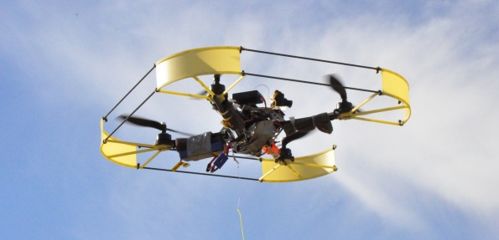
Quadrocopter
Scope

Slide 25
Communication system
Scope
Communication system:
Communicate via Bluetooth:
Quadrocopter sends Sensor data (angle rate, acceleration rate..) to Android Smart Phone.
Android Smart Phone sends Control commands to Quadrocopter.
Communicate via Internet Protocol:
PC sends Control command to Android Smart Phone
Android Smart Phone sends Real-time video (no sound) and Quadrocopter Sensor data to PC.

Slide 26
Real-time video
Scope
Real-time video transmission:
Protocol: UDP/IP.
Latency < 0.5 seconds
FPS ~ 10 *
No sound *
Images are compressed into JPEG. *
* Reference:
UAV Imagery Frame Rate and Resolution Requirements Study – Advanced Technology Department, Vitro Corporation - 1991
Real-Time Video Compression Techniques and Algorithms - Raymond Westwater and Borko Furht – 1997
http://developer.android.com

Slide 27
Control
Scope
Control:
The Quadrocopter has two control mode:
Autonomous
Manual
Autonomous mode:
Dynamic stabilization.
Manual mode:
Pilot can control the Quadrocopter with little effort.

Slide 28
Comparison
Scope
 | FUFO Quadrocopter v1.x | Mikrocopter Quadro | Parrot Ar Drone
Carrying capacity | 500gr | 500gr | 0gr
3G network | Yes | No | No
Wifi network | Yes | No | Yes
Bluetooth | Yes | No | No
RF | No | Yes | No
Real-time video | Yes | No | Yes
Dynamic stability | Yes | Yes | Yes
Controller | PC & Smart Phone | RF Controller | Iphone, Ipad, Ipod Touch
Auto-pilot | No | No | No

Slide 29
PC application
Detail
PC application:
Receives video and Sensor’s statuses from Android Smart Phone and display them.
Sends control commands to Android Smart Phone.
Easy to use and good looking.
Easy to maintain and update.

Slide 30
Android application
Detail
Android application:
Receives control commands from PC.
Sends control commands to Quadrocopter.
Send video and Sensor’s statuses to PC.
Easy to use.
Easy to maintain and update.

Slide 31
Embedded Software
Detail
Embedded Software:
Receive control command from Android Smart Phone and control the motors.
Send Sensor’s output to Android Smart Phone at a desirable rate.
Go into Autonomous Mode when no control command is received from pilot.
Use Bluetooth RS232 communication method to communicate with Android Smart Phone.
Easy to maintain and update.

Slide 32
Embedded Hardware
Detail
Embedded Hardware:
Build a Quadrocopter frame which has space for a 150gr Smart Phone.
Design a PCB board for controlling the Quadrocopter, it should has:
Bluetooth module.
At least 4 PWM generators
Tri-angle Accelerometer and Gyroscope sensors.
Motors, ESCs, Batteries can be bought from the market.
Motor’s thrust > 800gr
Batteries: 4400mAh

Slide 33

www.themegallery.com
Thank You !
Confidential document

