Slide 1
First Plan
Confidential document

Slide 2
Contents
1
Norms in project
2
Project hierarchy
3
Team hierarchy
4
Project Phase

Slide 3
1.Norms in project
  Regular meeting:
    Every week, all team members will be gathered at a weekly meeting.
    Follow the guide in FUFO_Weekly_Meeting_Guideline.doc.
  Occasional meeting:
    Can be held at any time, depend on the situation.
    Not need to have all team members.
  Team building:
    Depend on the mood.

Slide 4
1.Norms in project
Daily report:
  Report work of each individual in each working day.
  Follow the guide in FUFO_Daily_Report_Guideline.doc
Weekly report:
  Report work of each team every week.
  Done by Team Leader.
  Review by Project Manager.
  Follow the guide in FUFO_Weekly_Report_Guideline.doc

Slide 5
1.Norms in project
Tools and templates in project:
  Follow the guide in FUFO_Tools_And_Templates_Guideline.doc
Project process:
  Follow the Water-fall process and V-model of FPT Software.
How to write email in team:
  Follow the guide in FUFO_Email_Guideline.doc

Slide 6
1.Norms in project
Naming document:
  Follow the guide in FUFO_Naming_Guideline.doc
Coding convention:
  Follow the guide in FUFO_Coding_Guideline.doc
Improvement:
  Any creative idea is respected and appreciated.
  New idea will need to be approved by all team members before applying in project.

Slide 7
1.Norms in project
Manner in teamwork:
  Commitment.
  Respectful.
  Thankful.
  Helpful.
  Calm.
  Fun.

Slide 8
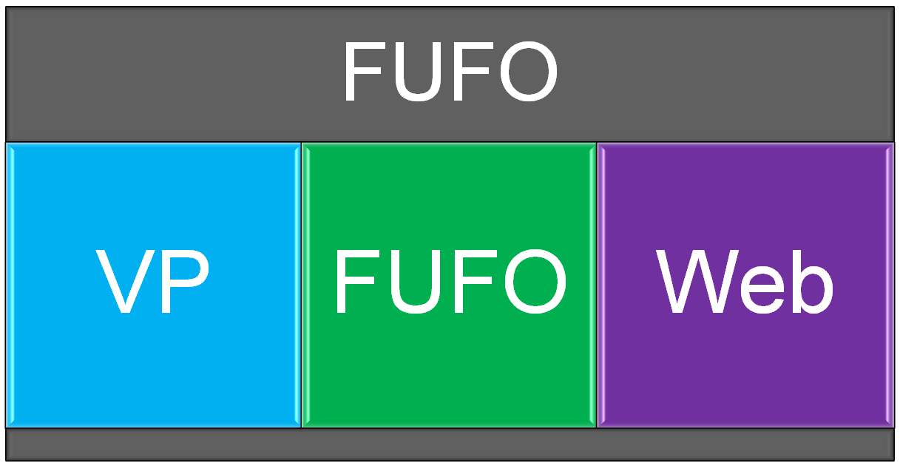
2.Project hierarchy
FUFO project contains 3 sub-projects (differentiated by color):
  Video over iP – FUFO - Web interface.

Slide 9
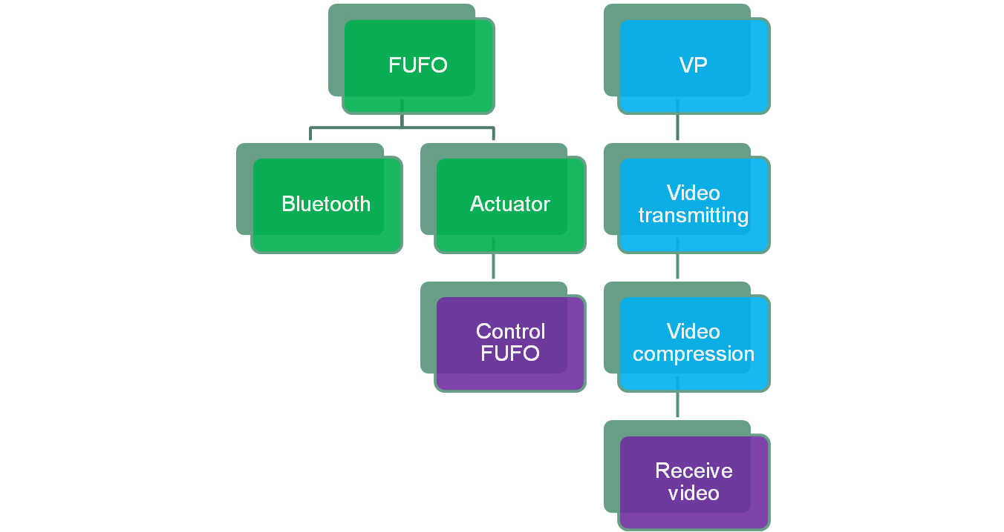
2.Project hierarchy
  These trees show relationship between the sub-projects.

Slide 10
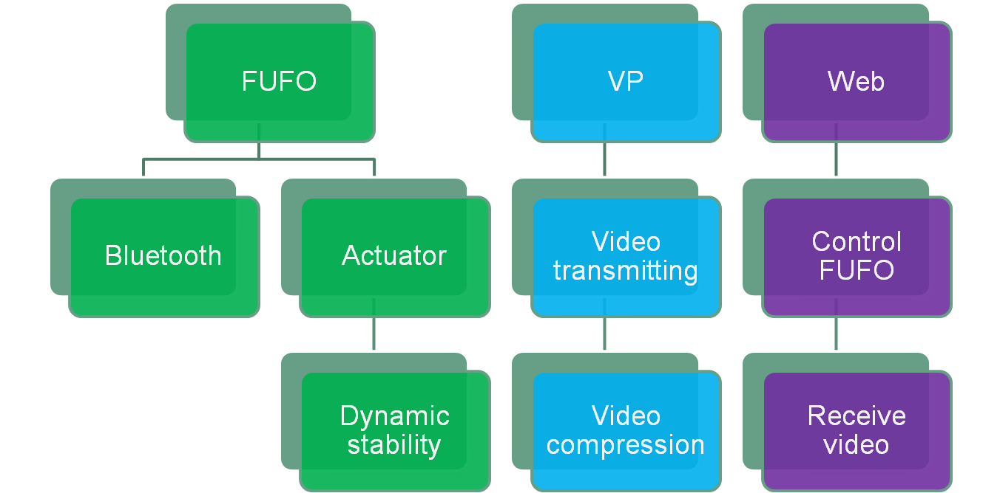
2.Project hierarchy
  These trees show the order of which work to be done first in each sub-projects.

Slide 11
3.Team hierarchy
How the team work:
  Project manager will be the highest authority of this FUFO project.
  There are 3 sub-projects in this project, each has its own sub-project Leader and members.
  Sub-project leader will be the highest authority of their sub-project.
  QC team has QC leader and its member.
  QC team will be in charge of testing and quality control for all projects.

Slide 12
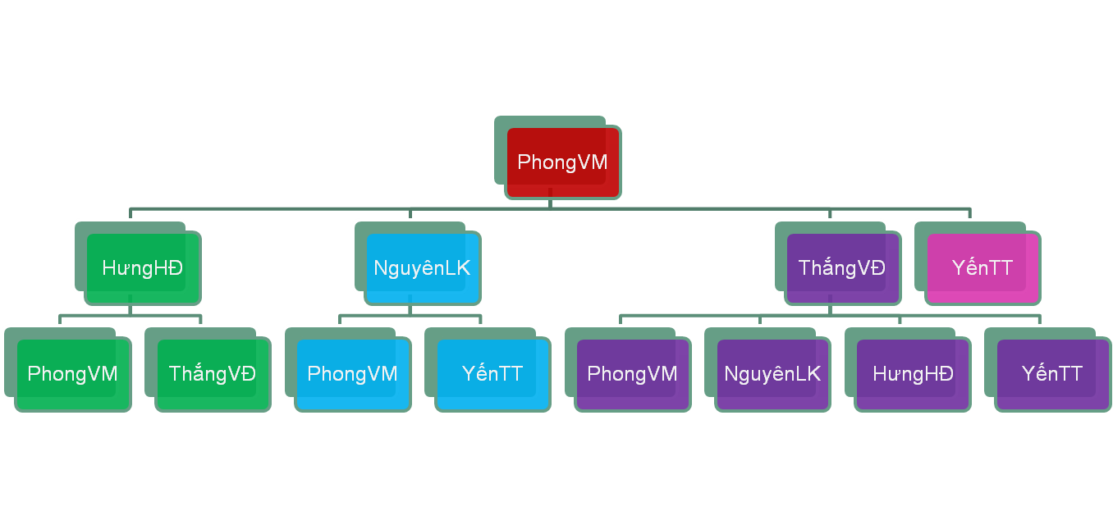
3.Team hierarchy
The teams is differentiated by color:
  Project Manager – FUFO – VP – Web – QC

Slide 13
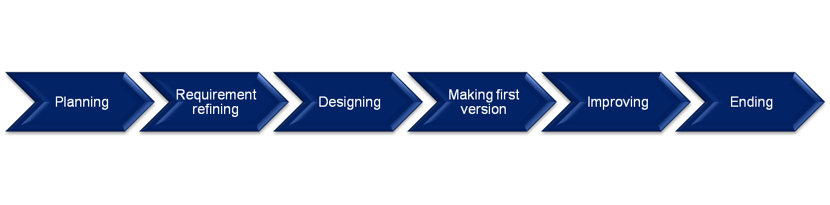
4.Project Phase
There are 6 phases for this project, each phase will be presented in the high-level plan document.
This is an experimental project, therefore Improving Phase will take the longest duration.

Slide 14
www.themegallery.com
Thank You !
Confidential document

