Slide 1
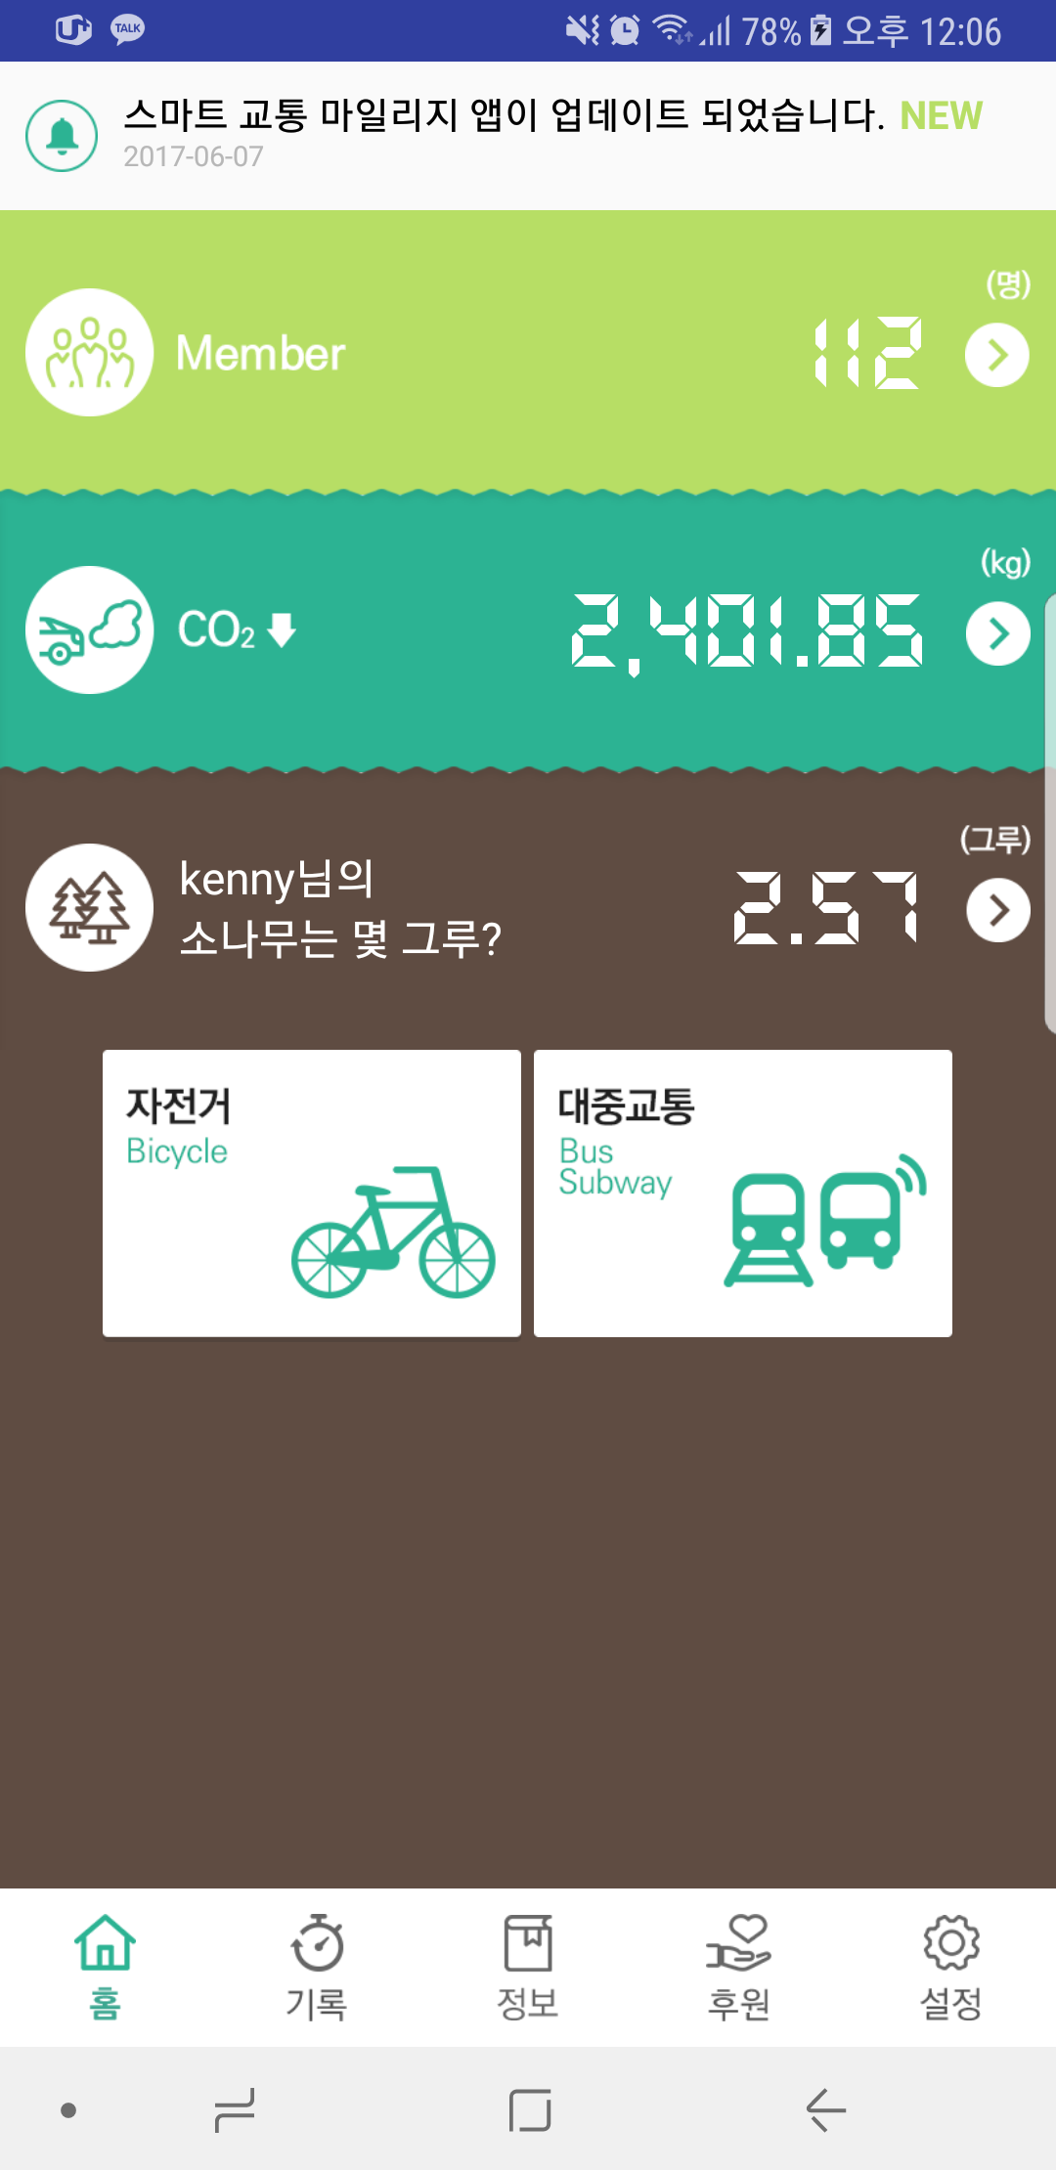
main
1
1. Joined member count of total. (exept admin)
2
2. Co2 amount of total.
3. android, ios should be same this value. (now different)

Slide 2
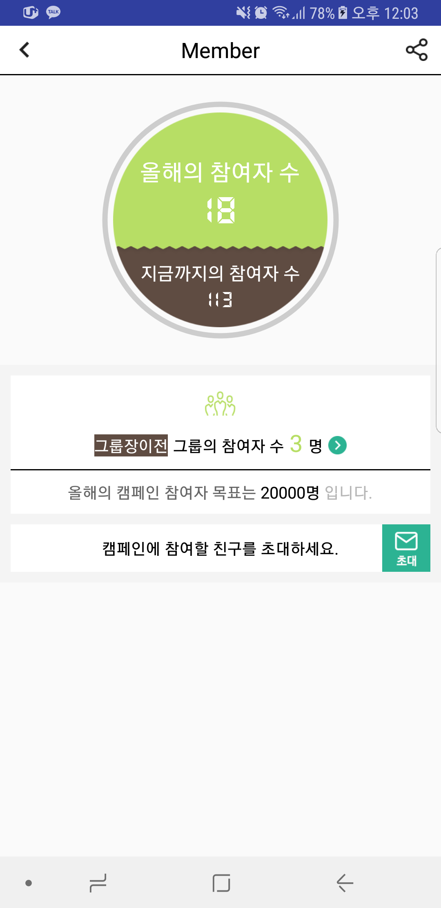
member
1. Joined member count of this year.
1
2. Joined member count of total. (exept admin)
2

Slide 3
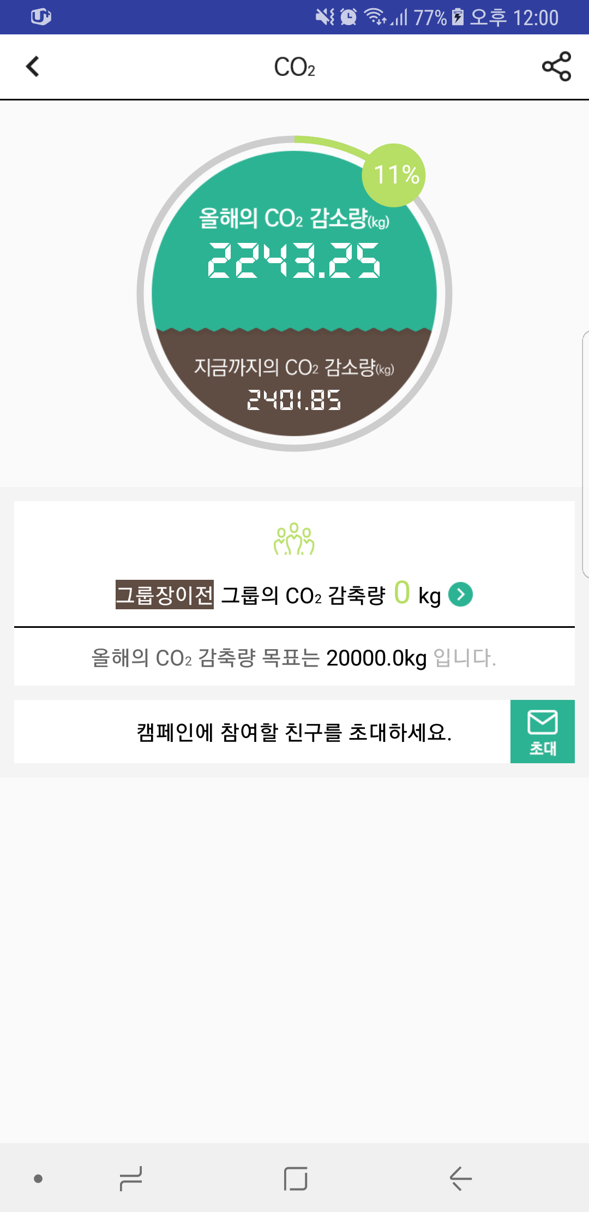
CO2
1. Co2 amount of this year.
1
2. Co2 amount of total.
2

