Slide 1

IoC

Slide 2

IoC: Definition
Inversion of control (IoC) is a design principle which inverts the flow of control as compared to traditional control flow to achieve loose coupling between application classes (wiki).
In traditional programming: the custom code that expresses the purpose of the program calls into reusable libraries to take care of generic tasks
In IoC: the framework that calls into the custom, or task-specific, code.
Example:
No IoC
IoC
print “enter your name”
read name
…
store in DB
MS-DOS: your code control the
flow of user interaction
GUI Application: window control the
flow of user interaction using events
Notes:
You drive a car to your work place -> you control the car. You hire a cab, where another person will drive the car -> control invert from you to driver
“Don't call us, we'll call you"

Slide 3
IoC: a simple implementation
public class TextEditor {
private SpellChecker checker;
public TextEditor() {
this.checker = new SpellChecker();
}
}
➔ TextEditor directly depends on SpellChecker
public class TextEditor {
private ISpellChecker checker;
public TextEditor(ISpellChecker checker) {
this.checker = checker;
}
}
Use IoC
VNSpellChecker sc1 = new VNSpellChecker();
ENSpellChecker sc2 = new ENSpellChecker();
TextEditor textEditor1 = new TextEditor(sc1);
TextEditor textEditor1 = new TextEditor(sc2);
➔IoC container control which SpellChecker implementation to use

Slide 4
IoC
Pros
Loose coupling, easier to test, maintain and extend.
Greater modularity of a program
Centralized configuration
Take care of long nested dependency chains and lifetime of dependencies
Cons
Need framework
Hard to figure out the flow of the application
No build errors
Require dependency management

Slide 5
IoC vs DI
IoC
principal
pattern
Service Locator
Events
Delegates
Dependency Injection (DI)
Constructor Injection
Dependency Injection (DI) is a design pattern used to implement IoC.
Setter Injection
Interface Injection

Slide 6
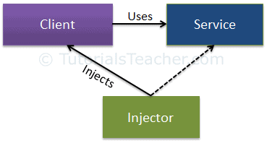
DI
Client class: The client class (dependent class) is a class which depends on the service class.
Service Class: The service class (dependency) is a class that provides service to the client class.
Injector Class: The injector class injects the service class object into the client class.
➔ The injector class creates an object of the service class, and injects that object to a client object.

Slide 7
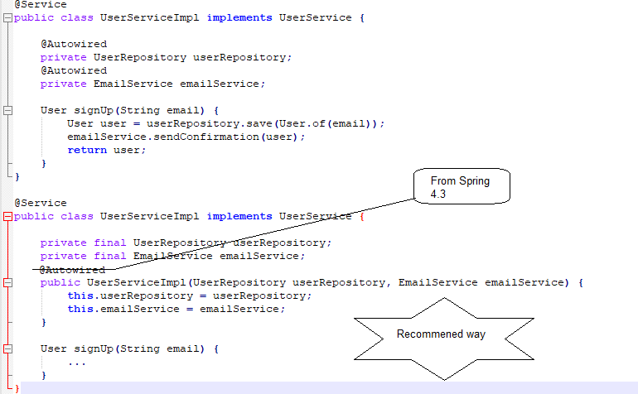
DI in Spring: Field & Constructor Injection

Slide 8
DI in Spring: Setter Injection
@Service
public class UserService implements UserService {
private UserRepository userRepository;
private EmailService emailService;
@Auto wired
public void setRepository(UserRepository userRepository) {
this.userRepository = userRepository;
}
@Autowired
public void setEmail(EmailService emailService) {
this.emailService = emailService;
}
…
}

Slide 9
DI in Spring: Best practice
For mandatory dependencies or when aiming for immutability, use constructor injection
For optional or changeable dependencies, use setter injection
Avoid field injection in most cases

Slide 10
Modular Design
Modular design is a design principle that subdivides a system into smaller parts called modules, which can be independently created, modified, replaced, or exchanged with other modules or between different systems.
Easy to customize products
Faster to market
Cost efficiency
Sustainability
Allows incremental upgrades
Notes:
Lego

Slide 11
AOP defenition
Aspect-Oriented Programming (AOP) is a programming paradigm which complements Object-Oriented Programming (OOP) by separating concerns of a software application to improve modularization (Spring doc).
OOP: key modularity is the class
AOP: key modularity is the aspect
Before AOP
After AOP
User Service
Admin Service
User Service
Admin Service
Security
Transactions
Logging
Security
Transactions
Logging
Security
Transactions
Logging
Cross-cutting concerns (Aspects)

Slide 12
AOP Concepts
Aspect: a modularization of a concern that cuts across multiple classes.
Joint point: a point during the execution of a program, such as the execution of a method (Spring) or the handling of an exception.
Advice: action taken by an aspect at a particular join point: before, after returning, after throwing, after finally, around
Pointcut: a predicate that matches join points.
Target object (advised object): object being advised by one or more aspects.
AOP proxy: an object created by the AOP framework in order to implement the aspect contracts.
Weaving: linking aspects with other application types or objects to create an advised object. This can be done at compile time, load time, or at runtime (Spring).

Slide 13
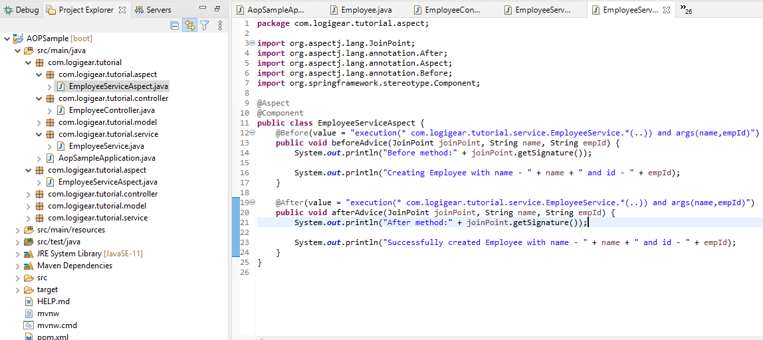
AOP in Spring Sample
Source: \doc\material\demo\Chapter 1\AOPSample

Slide 14
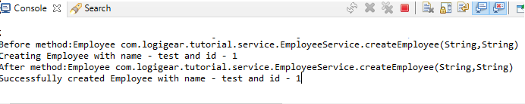
AOP in Spring Sample (cont.)
Source: \doc\material\demo\Chapter 1\AOPSample
Open http://localhost:8080/add/employee?empId=1&name=test and check the output

Slide 15
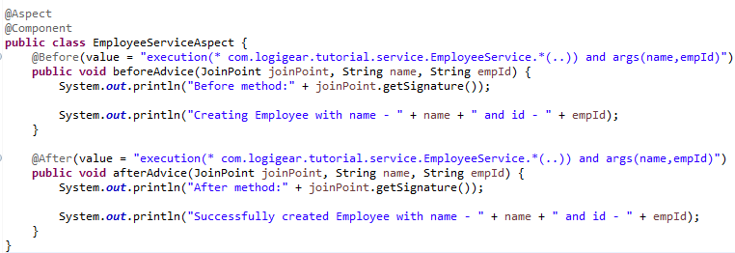
AOP in Spring Sample (cont.)
Aspect

Slide 16

Thank you!

