Slide 1

Basic Concept
[By Author]

Slide 2
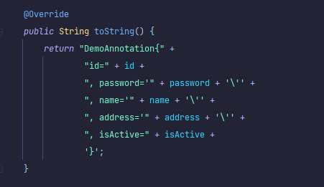
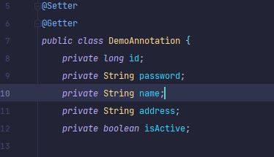
1. Annotation
1.1 Annotation in Java
Spring Boot Annotations is a form of metadata that provides data about a program. In other words, annotations are used to provide supplemental information about a program. It is not a part of the application that we develop. It does not have a direct effect on the operation of the code they annotate. It does not change the action of the compiled program.

Slide 3
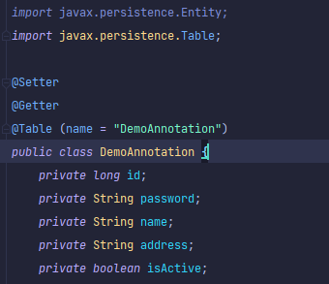
1. Annotation
1.1 Overview
Annotations start with ‘@’.
Annotations do not change action of a compiled program.
Annotations help to associate metadata (information) to the program elements i.e. instance variables, constructors, methods, classes, etc.
Annotations are not pure comments as they can change the way a program is treated by compiler
1.2 Categories of Annotations
Marker Annotations (Ex: @TestAnnotation() )
Single Value Annotation ( Ex: @TestAnnotation(“testing”) )
Full Annotations (Ex: @TestAnnotation(owner=“BanhsBao”, Value=“Logigear”) )
Type Annotations
Repeating Annotations
Standard Annotations
Custom Annotations

Slide 4
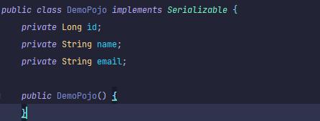
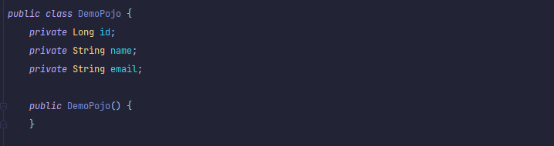
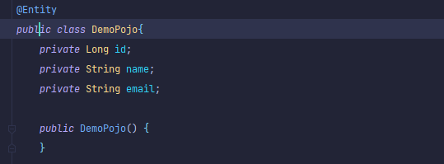
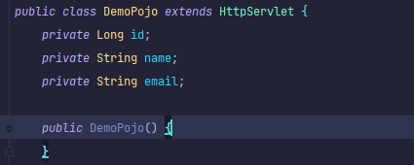
2. POJO & POJI
2.1 POJO Overview
2.1.2 Not POJO (Implement prespecified interfaces)
This is NOT
a POJO
2.1.1 This is a POJO
POJO stands for Plain Old Java Object.
It is an ordinary Java object, not bound by any special restriction other
than those forced by the Java Language Specification and not requiring any class-path.
2.1.3 Not POJO (Contain prespecified annotations)
2.1.4 Not POJO (Extend prespecified classes)

Slide 5
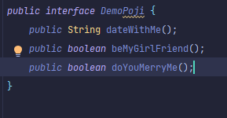
2. POJO & POJI
2.2 POJI Overview
2.2.1 This is a POJI
If a java interface is not coupled with any technology (or) any frame work then such java interface is called “POJI” (plain old java interface)

Slide 6

3. Spring Bean
3.1 Overview
Spring Bean is nothing special, any object in the Spring framework that we initialize through Spring container is called Spring Bean . Any normal Java POJO class can be a Spring Bean if it’s configured to be initialized via container by providing configuration metadata information.
3.1.1 Spring Bean

Slide 7
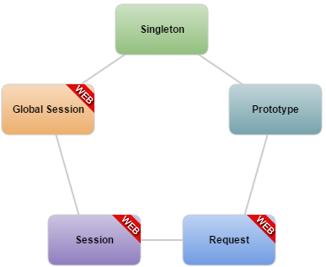
3. Spring Bean
3.2 Bean Scopes
Singleton Scope: This scopes the bean definition to a single instance per Spring IoC container (default).
Prototype Scope: This scopes a single bean definition to have any number of object instances.
Request Scope: This scopes a bean definition to an HTTP request. Only valid in the context of a web-aware Spring ApplicationContext.
Session Scope: This scopes a bean definition to an HTTP session. Only valid in the context of a web-aware Spring ApplicationContext.
Global Session Scope: This scopes a bean definition to a global HTTP session. Only valid in the context of a web-aware Spring ApplicationContext.
3.2.1 Bean Scope

Slide 8
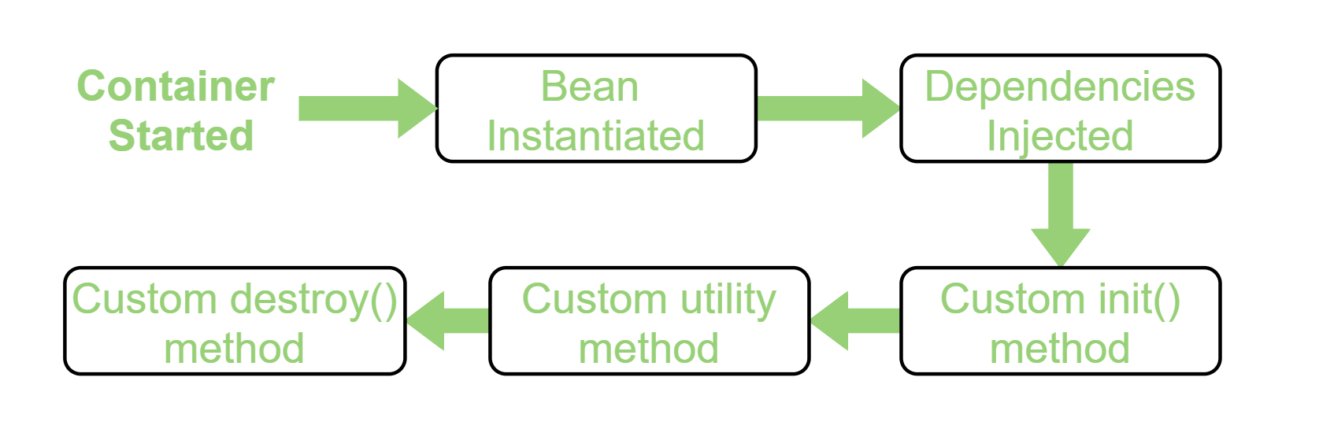
4. Spring Bean
3.3 Spring Bean life cycle
3.3.2 Spring Bean Life-Cycle
Bean life cycle is managed by the spring container.
When we run the program then, first of all, the spring container gets started. After that, the container creates the instance of a bean as per the request and then dependencies are injected.
And finally, the bean is destroyed when the spring container is closed.

Slide 9
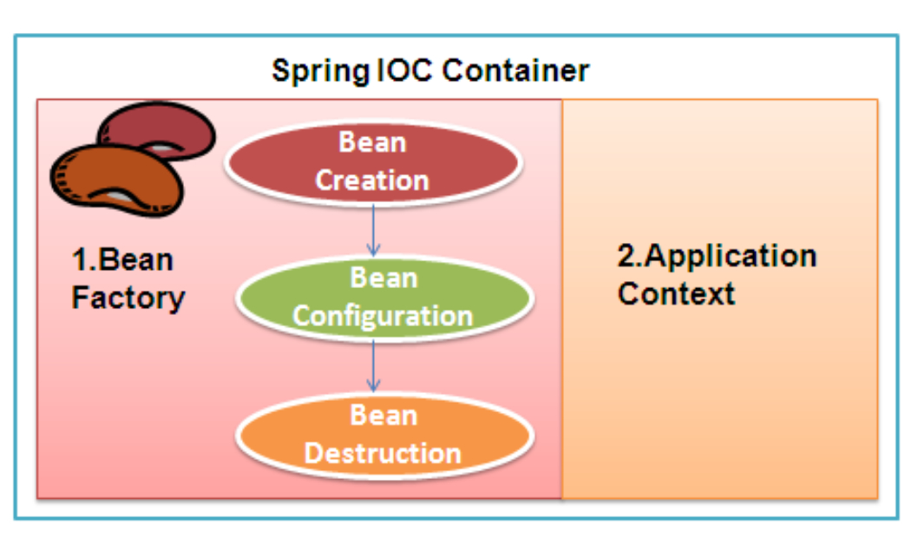
4. Spring Container
4.1 BeanFactory Overview
BeanFactory is the actual container which instantiates, configures, and manages a number of bean's. These beans are typically collaborate with one another, and thus have dependencies between themselves. These dependencies are reflected in the configuration data used by the BeanFactory.
4.1.1 Spring IOC Container

Slide 10
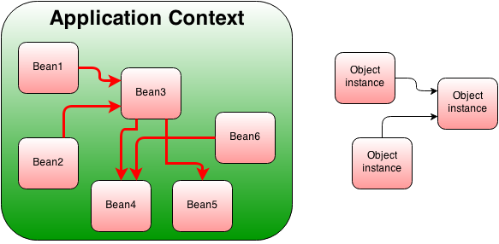
4. Spring Container
4.2 Application Context Overview
BeanFactory and ApplicationContext both are Java interfaces and ApplicationContext extends BeanFactory. Both of them are configuration using XML configuration files. In short BeanFactory provides basic Inversion of control(IoC) and Dependency Injection (DI) features while ApplicationContext provides advanced features.
4.2.1 Application Context

Slide 11
4. Spring Container
3.2 Compare BeanFactory and ApplicationContext
BeanFactory
ApplicationContext
BeanFactory instantiate bean when you call getBean() method.
ApplicationContext instantiate Singleton bean when container is started, It doesn't wait for getBean() to be called.
BeanFactory doesn't provide support for internationalization.
ApplicationContext provides support for it.
BeanFactory ability to publish event to beans that are registered as listener.
One of the popular implementation of BeanFactory interface is XMLBeanFactory.
One of the popular implementation of ApplicationContext interface is ClassPathXmlApplicationContext.
BeanFactory by default its support Lazy loading.
ApplicationContext by default support Aggresive loading.

Slide 12

Thank You!

