Slide 1

Spring Boot
[By BaoHuynh]

Slide 2
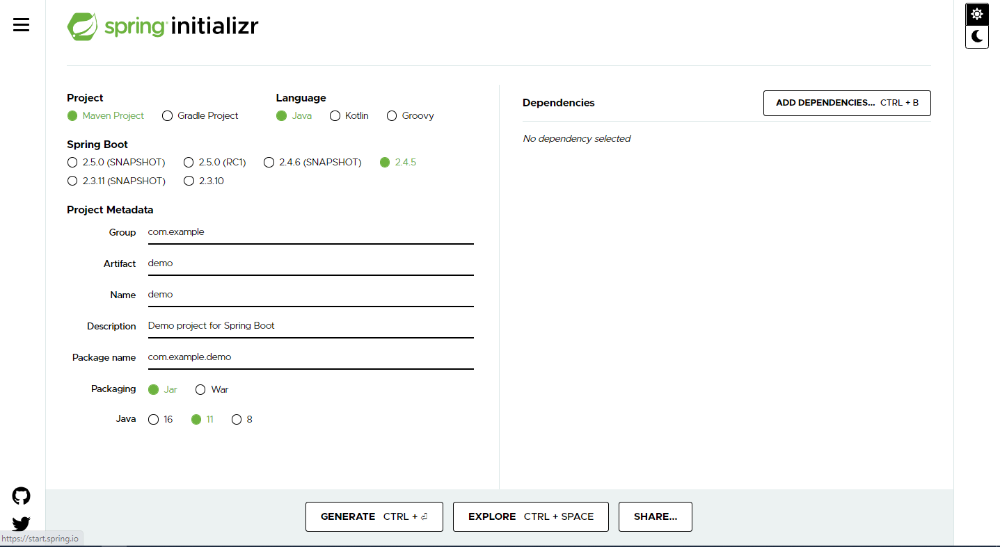
1. Spring Initializr
Go to https://start.spring.io/ to build Demo Spring Boot Project.
1.1.1 Spring initializr home page

Slide 3
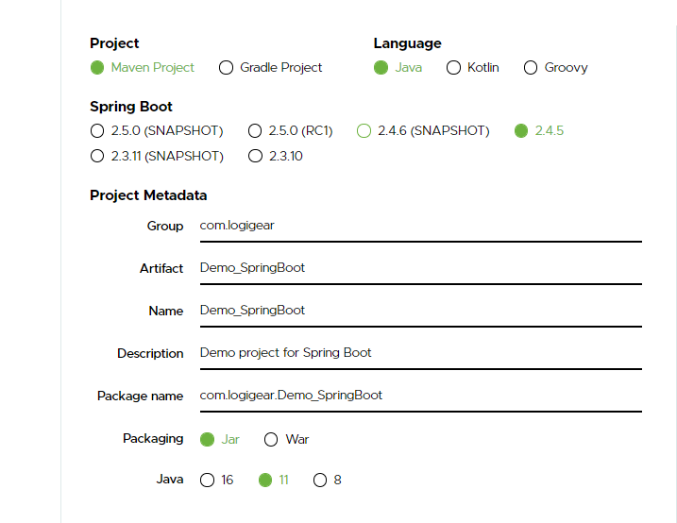
1. Spring Initializr
Create new Spring Boot project with the following configuration.
Spring Version
Latest stable version (at the time of this tutorial, the lastest one is 2.4.5)
Group
Your own group name - usual practice is com.[your name]
Artifact
Your project name
Name
Use the generated default name
Description
Use the generated default name
Package name
Use the generated default name
1.1.2 Spring initializr configuration

Slide 4
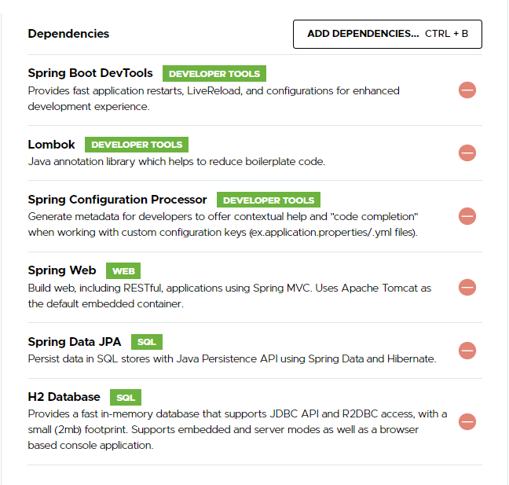
1. Spring Initializr
Add Dependencies
1.1 Spring boot DevTools
1.2 Lombok
1.3 Spring Configuration Processor
1.4 Spring Web
1.5 Spring Data JPA
1.6 H2 Database
1.1.3 Dependencies Configuration

Slide 5
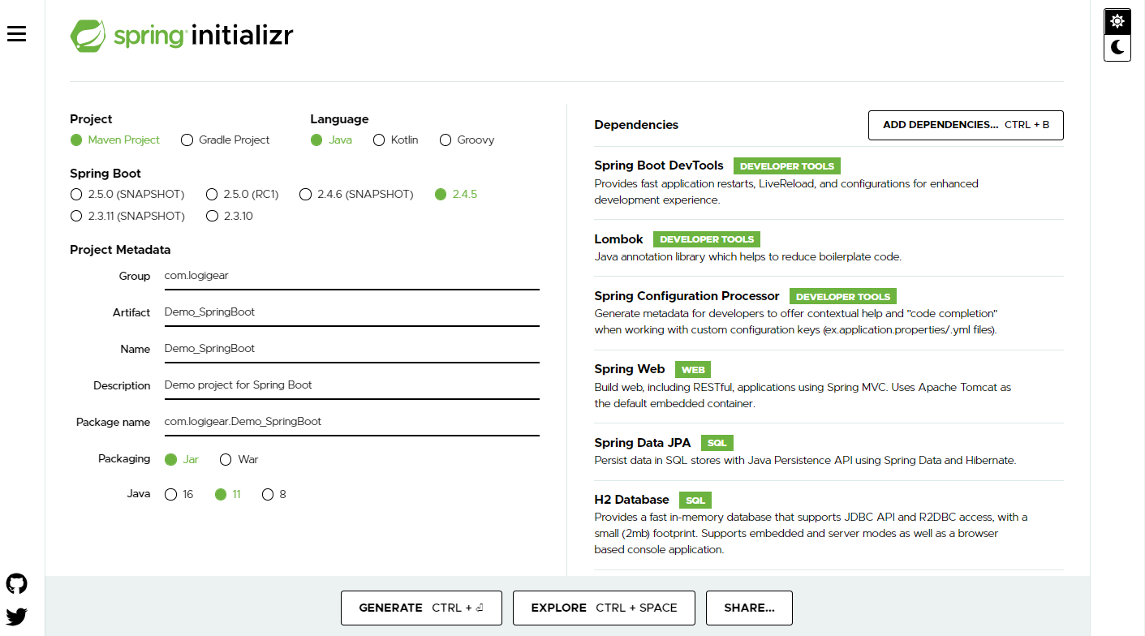
1. Spring Initializr
Generate Configuration
1.1.4 Spring Boot Configuration

Slide 6
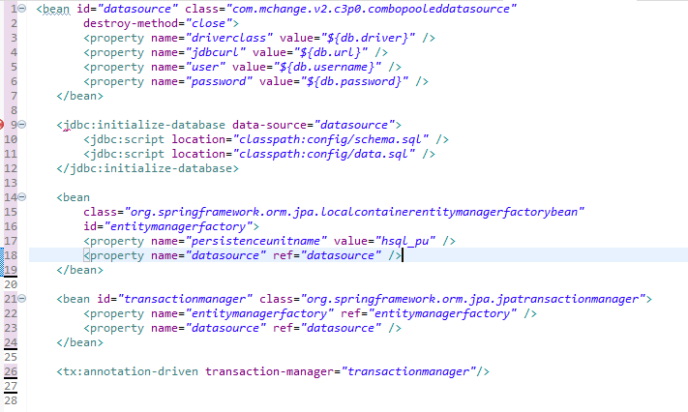
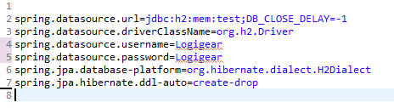
2. Spring Boot
2.1 Auto-Configuration
2.1.2 Spring-Boot Configuration
Auto-Configuration help you configure your spring application automatically. More precisely create beans for you. “Save your time when you create beans”
2.1.1 Spring-MVC Configuration

Slide 7

2. Spring Boot
2.2.1 What is Embedded Server?
An embedded server is embedded part of the deployable application.
With Spring Boot, the default embedded server is Tomcat. Other options available are jetty and UnderTow.
Embedded servers are quite scalable, and can host applications that support millions of users. These are no less scalable than conventional fat servers.
2.2.1 Tomcat Server

Slide 8
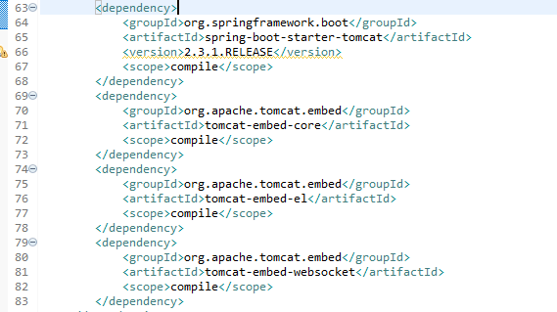
2. Spring Boot
2.2.2 Embedded Server
2.2.2 Embedded Tomcat Log
2.2.3 Embedded TomcatConfiguration

Slide 9
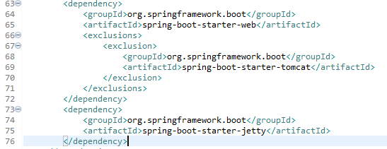

2. Spring Boot
2.2.2 Embedded Server
2.2.4 Embedded Jetty Log
####Jetty specific properties########
server.jetty.acceptors= # Number of acceptor threads to use.
server.jetty.max-http-post-size=0 # Maximum size in bytes of the HTTP post or put content.
server.jetty.selectors= # Number of selector threads to use.
2.2.3 Embedded Jetty Configuration

Slide 10
2. Spring Boot
2.2 Embedded Server
2.2.2 Embedded Jetty Log
2.2.1 Embedded Jetty Configuration

Slide 11

Thank You!

