Slide 1

REST APIs with Spring

Slide 2
REST
Representational state transfer (REST) is a software architectural style which uses a subset of HTTP that defines a set of rules in order to create Web Services.
A REST API (also known as RESTful API) is an application programming interface that conforms to the constraints of REST architectural style and allows for interaction with RESTful web services.

Slide 3
REST API
HTTP Method | CRUD | Description | HTTP Status
POST | Create | Create new resources | 201 (Created) 404 (NOT FOUND) 409 (Conflict)
GET | Read | Read (or retrieve) resources | 200 (OK) 404 (NOT FOUND) 400 (BAD REQUEST)
PUT | Update/Replace | Update resources | 200 (OK) 204 (No Content) 404 (Not Found) 405 (Method Not Allowed)
PATCH | Update/Modify | Modify resources | 200 (OK) 204 (No Content) 404 (Not Found) 405 (Method Not Allowed)
DELETE | Delete | Delete resources | 200 (OK) 204 (No Content) 404 (Not Found) 405 (Method Not Allowed)

Slide 4
Build REST service with Spring boot (cont.)
Code:
\doc\material\demo\Section 2\RESTFul Service

Slide 5
Build REST service with Spring boot (cont.)
Create project:
Use Initializr
Use SpringToolSuite
Add Spring Web dependency

Slide 6
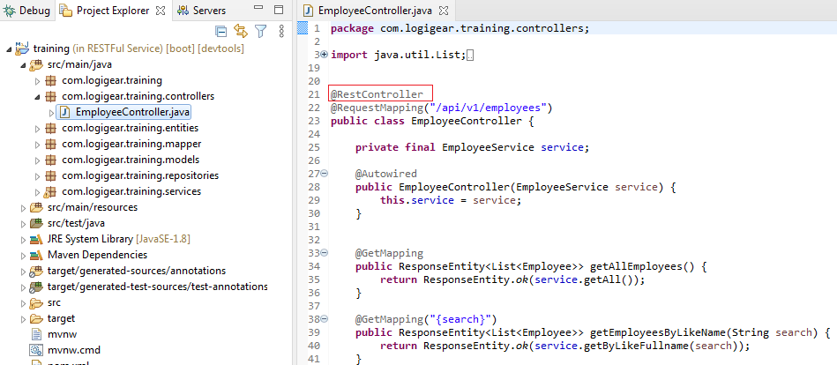
Build REST service with Spring boot (cont.)
Create Controller
@RestController: support JSON, XML, custom response

Slide 7
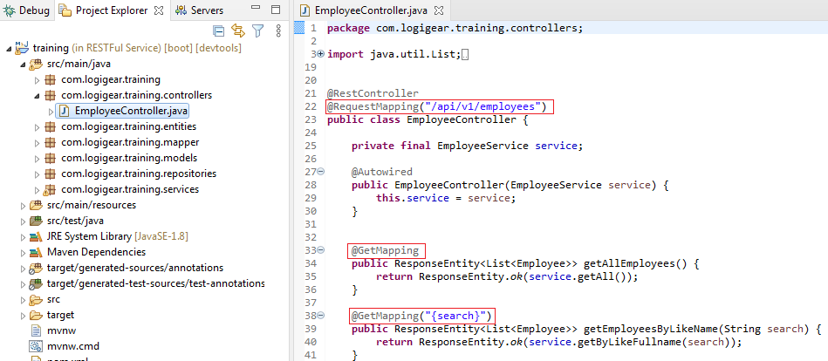
Build REST service with Spring boot (cont.)
Mapping
@RequestMapping: define the Request URI to access the REST Endpoints (default is GET)

Slide 8
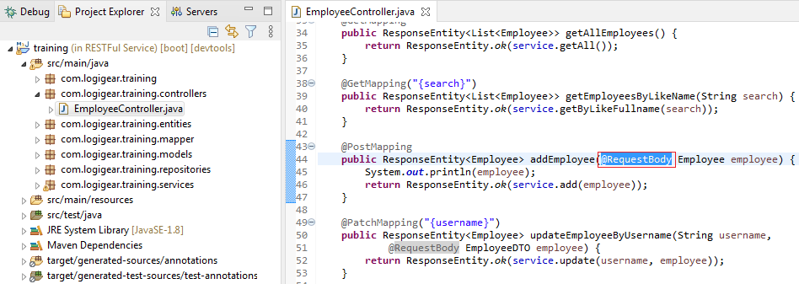
Build REST service with Spring boot (cont.)
Body
@RequestBody: define the request body content type

Slide 9
Build REST service with Spring boot (cont.)
Path Variable
@PathVariable: define the custom or dynamic request URI, default = true
@GetMapping(value = { "/api/employee/{id}" })
public String getEmployeesById(@PathVariable(required = false) String id) {
…
}
Request Param
@RequestParam: read the request parameters from the Request URL
@GetMapping(value = { "/api/employee" })
public String getEmployeesById(@RequetParam (name = "id") String empId) {
//// http://localhost:8080/api/employee?id=abc
}

Slide 10
Support Swagger
What Is Swagger?
Swagger allows you to describe the structure of your APIs so that machines can read them (swagger.io).
Source code
\doc\material\demo\Section 2\RESTFul Service with Swagger

Slide 11
Support Swagger
Add dependency to project (maven)
<dependency>
<groupId>org.springdoc</groupId>
<artifactId>springdoc-openapi-ui</artifactId>
<version>1.5.2</version>
</dependency>
Configure swagger uri in application.properties file
springdoc.api-docs.path=/api-docs
springdoc.swagger-ui.path=/swagger-ui.html
Access swagger
http://localhost:8080/api-docs/
http://localhost:8080/swagger-ui.html

Slide 12
Handle exception with Spring boot
Before Spring 3.2
HandlerExceptionResolver
@ExceptionHandler annotation
Since 3.2
@ControllerAdvice annotation
Spring 5
ResponseStatusException class

Slide 13
Handle exception with Spring boot
Solution 1: the Controller-Level @ExceptionHandler
Only active for that particular Controller (not globally)
Solution 2: the HandlerExceptionResolver
Solution 3: the @ControllerAdvice
Support global @ExceptionHandler
Solution 4: ResponseStatusException
One exception type can lead to multiple different responses

Slide 14
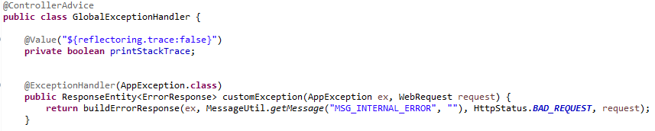
Handle exception with Spring boot
Best practice: @ControllerAdvice & @ExceptionHandler
Source code:
\doc\material\demo\Section 2\RESTFul Service with Swagger and Exception

Slide 15
Class RestTemplate
Synchronous client to perform HTTP requests
GET
Plain JSON/POJO/Headers
POST
Object/Location/Submit Form Data
OPTIONS
PUT
DELETE
Support Timeout

Slide 16

Thank you!

