Slide 1

Spring Security
MWD

Slide 2
Agenda
What is Spring Security?
Spring Security Fundamental
Spring Security Workflow
Some spring core annotation
Spring unit test
Exercise

Slide 3
What is Spring Security?
Spring Security is a powerful and highly customizable authentication (who are you?) and access-control (what are you allowed to do?) framework. It is the de-facto standard for securing Spring-based applications (spring.io).
Features
Comprehensive and extensible support for both Authentication and Authorization
Protection against attacks like session fixation, clickjacking, cross site request forgery, etc
Servlet API integration
Optional integration with Spring Web MVC
Support Basic Authentication, In-Memory Authentication, JDBC Authentication, LDAP Authentication, OAuth2, Security Assertion Markup Language (SAML), OpenID…
Much more…

Slide 4
Spring Security Fundamentals
Principal
User that performs the action
Authentication
Confirming truth of credentials
Authorization
Define access policy for principal
GrantedAuthority
Application permission granted to a principal
SecurityContext
Hold the authentication and other security information
SecurityContextHolder
Provides access to SecurityContext
AuthenticationManager
Controller in the authentication process
AuthenticationProvider
Interface that maps to a data store which stores your user data.
Authentication Object
Object is created upon authentication, which holds the login credentials.
UserDetails
Data object which contains the user credentials, but also the Roles of the user.
UserDetailsService
Collects the user credentials, authorities (roles) and build an UserDetails object.

Slide 5
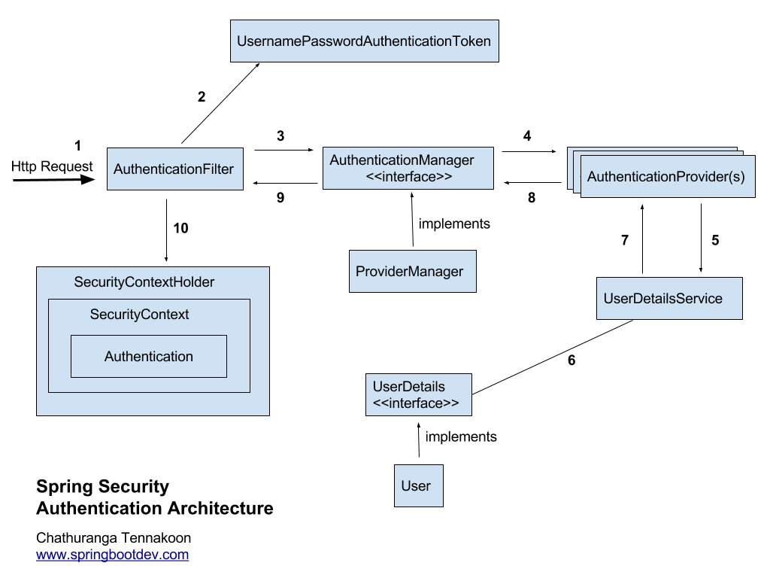
Spring Security Architecture

Slide 6
Spring Security Workflow
1. Received the Http Request
2. Creates AuthenticationToken based on user credentials
3. Delegating created AuthenticationToken for AuthenticationManagager
4. Trying to authenticate with list of AuthenticationProvider(s)
5,6,7. AuthenticationProvider use UserDetailsService for retrieving the user details
8. If the user is successfully authenticated, then the fully populated Authentication object will be returned. Otherwise an AuthenticationException will be thrown.
9. Authentication is done. AuthenticationManager will return the obtained fully populated Authentication object back to the relevant AuthenticationFilter.
10. AuthenticationFilter will store the obtained authentication object in the SecurityContext for future filter uses. (Use for Authorization Filters)

Slide 7
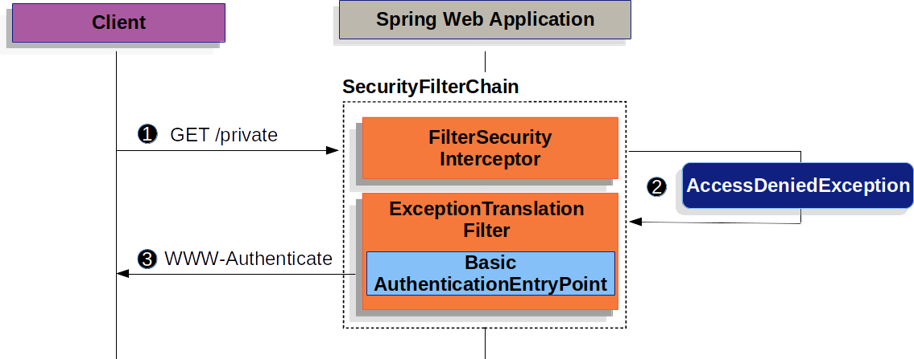
Basic Authentication with Spring Boot
Source: spring.io

Slide 8
Basic Authentication with Spring Boot
A user makes an unauthenticated request to the resource /private
FilterSecurityInterceptor indicates that the unauthenticated request is denied by throwing an AccessDeniedException.
Since the user is not authenticated, ExceptionTranslationFilter initiates Start Authentication. The configured AuthenticationEntryPoint is an instance of BasicAuthenticationEntryPoint which sends a WWW-Authenticate header.
When a client receives the WWW-Authenticate header it knows it should retry with a username and password

Slide 9
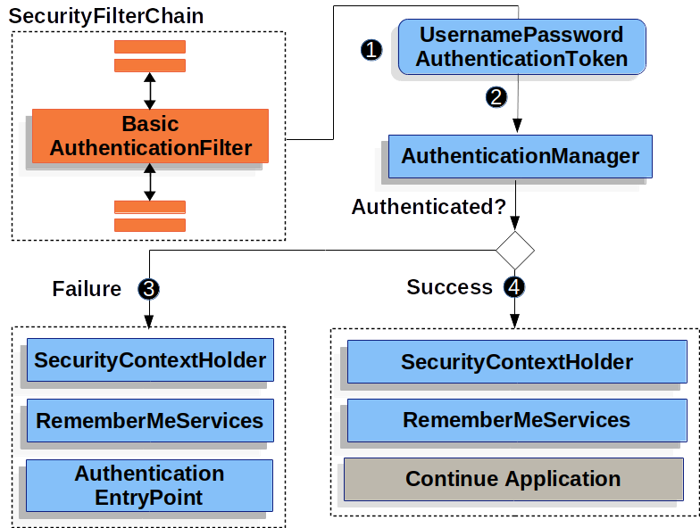
Basic Authentication with Spring Boot
Source: spring.io

Slide 10
Basic Authentication with Spring Boot
When the user submits their username and password, the BasicAuthenticationFilter creates a UsernamePasswordAuthenticationToken which is a type of Authentication by extracting the username and password from the HttpServletRequest
UsernamePasswordAuthenticationToken is passed into the AuthenticationManager to be authenticated.
If authentication fails
The SecurityContextHolder is cleared out.
AuthenticationEntryPoint is invoked to trigger the WWW-Authenticate to be sent again.
If authentication is successful
The Authentication is set on the SecurityContextHolder.
The BasicAuthenticationFilter invokes FilterChain.doFilter(request,response) to continue with the rest of the application logic.

Slide 11
Build Basic Authentication with Spring Boot
1. Add dependencies
<dependency>
<groupId>org.springframework.boot</groupId>
<artifactId>spring-boot-starter-security</artifactId>
</dependency>
<dependency>
<groupId>org.springframework.security</groupId>
<artifactId>spring-security-test</artifactId>
<scope>test</scope>
</dependency>

Slide 12
Build Basic Authentication with Spring Boot
2. Configure security
@Configuration
@EnableWebSecurity
public class WebSecurityConfig extends WebSecurityConfigurerAdapter {
@Override
protected void configure(HttpSecurity http) throws Exception {
http.authorizeRequests()
.antMatchers("/", "/home").permitAll() /* / and /home no need authentication */
.anyRequest().authenticated() /* all others need authentication */
.and()
.formLogin()
.loginPage("/login") /* use custom login page */
.permitAll()
.and()
.logout()
.permitAll();
}
}

Slide 13
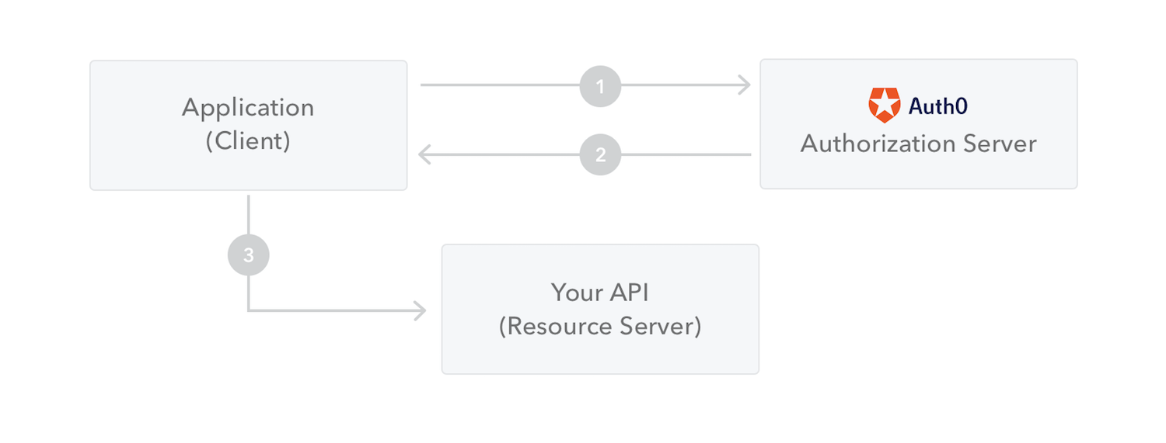
What is JWT Authentication?
JSON Based Token (JWT) is a JSON-based open source standard (RFC7519) for creating access tokens that allow us to secure communications between client and server.
How does JWT work?
Source: jwt.io

Slide 14
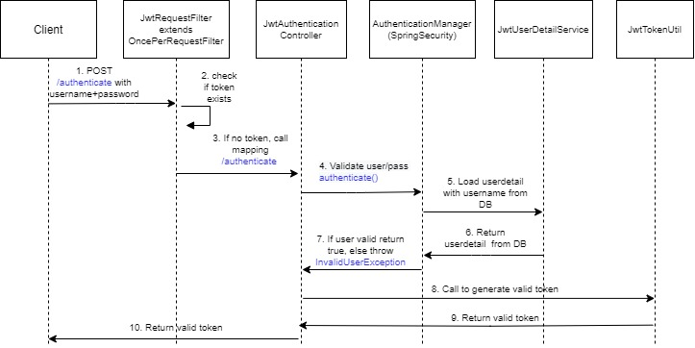
Build JWT Authentication with Spring Boot
Generate
JWT

Slide 15
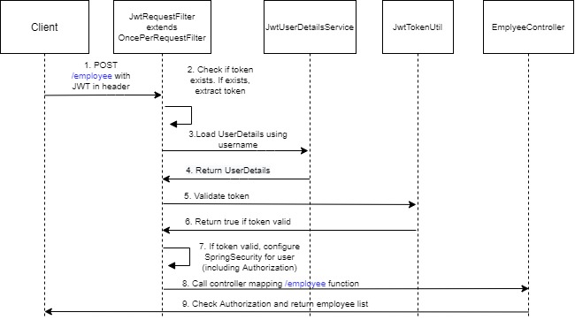
Build JWT Authentication with Spring Boot

Slide 16
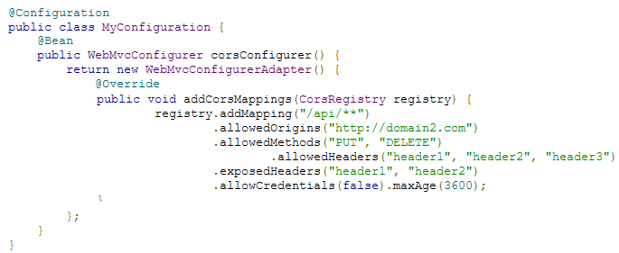
Cross-Origin Resource Sharing (CORS)
Cross-origin resource sharing (CORS) is a W3C specification implemented by most browsers that allows you to specify in a flexible way what kind of cross domain requests are authorized (spring.io)
Enable CORS in Spring Boot
Controller level: use @CrossOrigin annotation
Ex: @CrossOrigin(origins = "http://domain2.com", maxAge = 3600)
Global: create WebMvcConfigurer bean and overwrite corsConfigurer() function

Slide 17
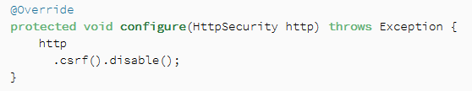
Cross-Site Request Forgery (CSRF)
Cross-site request forgery, also known as one-click attack or session riding and abbreviated as CSRF or XSRF, is a type of malicious exploit of a website where unauthorized commands are submitted from a user that the web application trusts (wiki)
For example: user login without logout, other evil website can send request with the authenticated info in cookies.
Enable by default in Spring Security 5. We can still disable it if we need to:

Slide 18

Thank You!

