Slide 1

Swagger API Documentation
[BANG NGO]

Slide 2
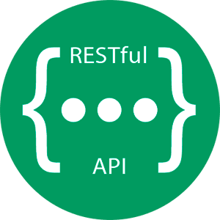
The use of API Documentation
By developing a RESTful API application, the number of endpoints increasing dramatically when the application is large enough.
We need a technical content deliverable that containing instructions about how to effectively use and integrate with an API.
API Documentation is a concise reference manual containing all the information required to work with the API, with details about the functions, classes, return types, arguments and more, supported by tutorials and examples.
API Documentation has traditionally been done using regular content creation and maintenance tools and text editors.
Swagger.io

Slide 3
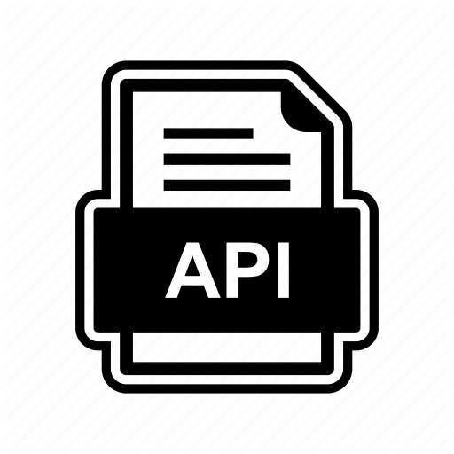
Why do we need API Documentation?
Improved User Adoption.
Increased Awareness.
Saves Support Time and Costs.
Easier Maintenance.

Slide 4
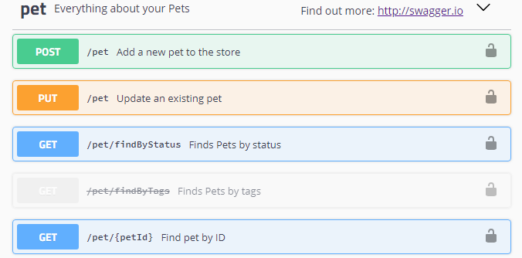
Introduction to Swagger API Documentation
Swagger is an Interface Description Language for describing RESTful APIs expressed using JSON.
Swagger is used together with a set of open-source software tools to design, build, document, and use RESTful web services.

Slide 5
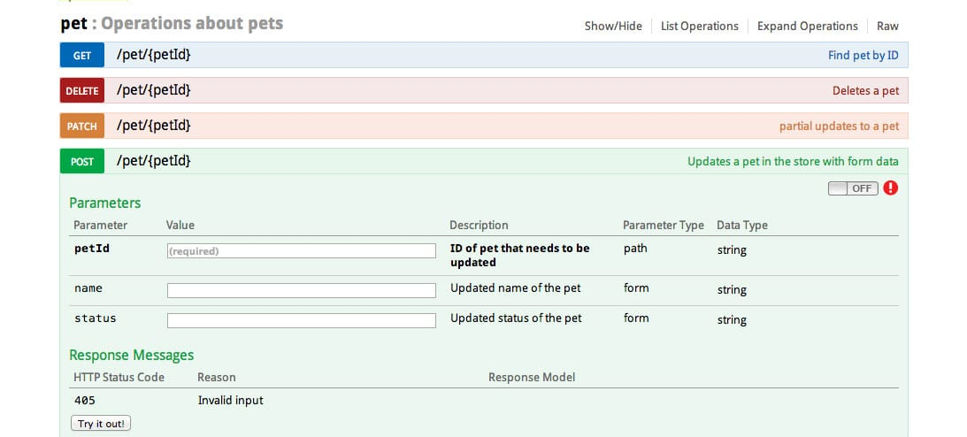
Introduction to Swagger API Documentation
Like Postman, Swagger provides exactly the same way that we can interact to produce/consume the API endpoints.

Slide 6

Integrating Swagger into Spring Boot app
In the pom.xml file. Add the following dependencies.
<dependencies>
<!-- Add below the existed dependencies -->
<dependency>
<groupId>io.springfox</groupId>
<artifactId>springfox-boot-starter</artifactId>
<version>3.0.0</version>
</dependency>
<dependency>
<groupId>io.springfox</groupId>
<artifactId>springfox-swagger2</artifactId>
<version>3.0.0</version>
</dependency>
<dependency>
<groupId>io.springfox</groupId>
<artifactId>springfox-swagger-ui</artifactId>
<version>3.0.0</version>
</dependency>
</dependencies>

Slide 7
Integrating Swagger into Spring Boot app
@Configuration //Create a new class with name SwaggerConfiguration
public class SwaggerConfiguration {
private static final String API_NAME = "CDO_SPRING API DOCUMENTATION";
private static final String API_VERSION = "v1.0.0";
private static final String API_DESCRIPTION = "API Documentation for Employees CRUD";
private static final String API_TOS = "Terms of service";
private static final String API_LICENSE_OF = "CDO_SPRING API DOCUMENTATION";
private static final String API_LICENSE_URL = "CDO_SPRING API DOCUMENTATION";
private static final Contact API_AUTHOR_CONTACT = new Contact("Bang Ngo", "logigear.com", "bang.ngo@logigear.com");
private static final String BASE_API_PACKAGE = "com.logigear.training.controller";
@Bean
public Docket api() {
return new Docket(DocumentationType.SWAGGER_2).select()
.apis(RequestHandlerSelectors.basePackage(BASE_API_PACKAGE))
.paths(PathSelectors.any()).build().apiInfo(apiInfo()).useDefaultResponseMessages(false);
}
private ApiInfo apiInfo() {
return new ApiInfo(API_NAME, API_DESCRIPTION, API_VERSION, API_TOS, API_AUTHOR_CONTACT, API_LICENSE_OF,
API_LICENSE_URL, Collections.emptyList());
}
}

Slide 8
Integrating Swagger into Spring Boot app
After having finished setting up the Swagger API Documentation. When you start the application, a new endpoint exposes via URL (which contains UI):
http://localhost:8080/swagger-ui/

Slide 9
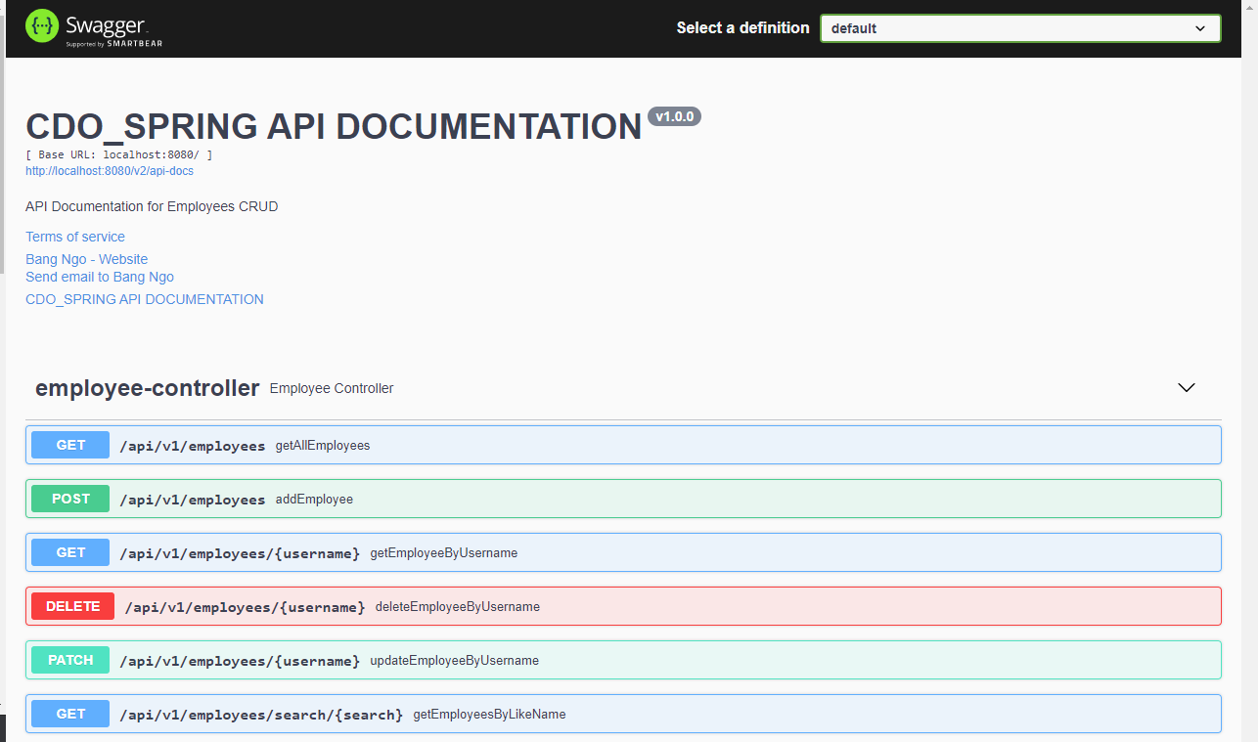
Integrating Swagger into Spring Boot app

Slide 10
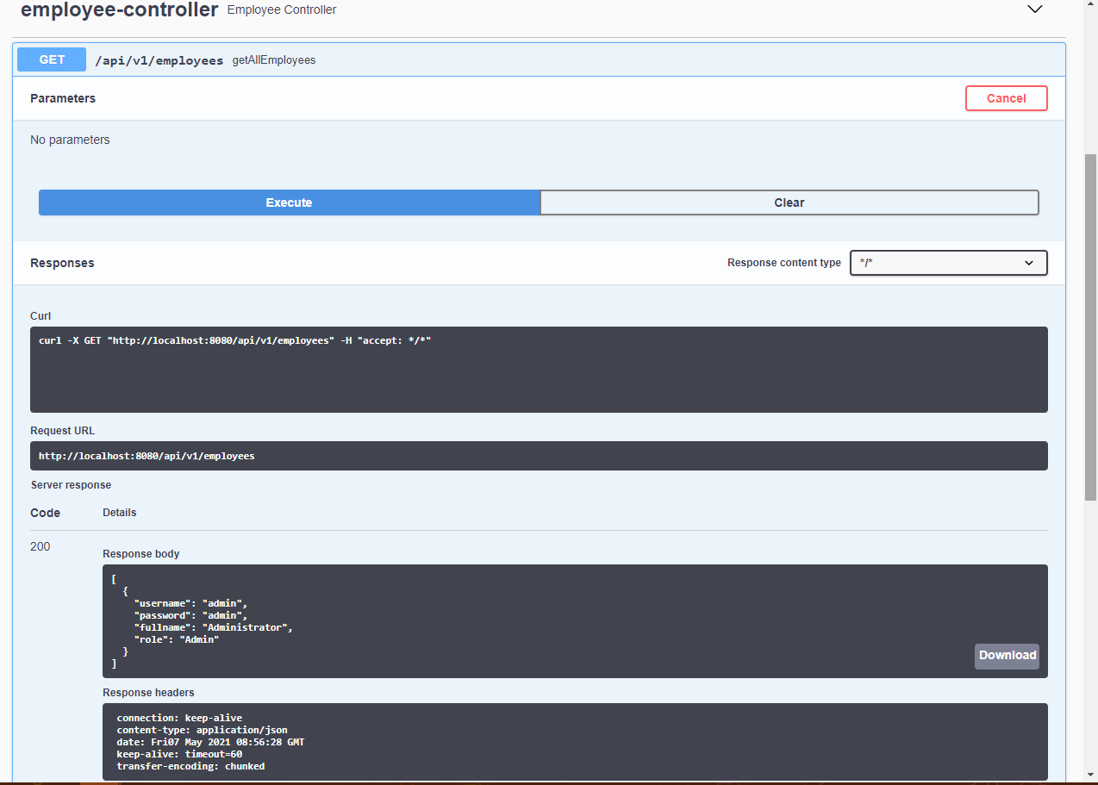
Integrating Swagger into Spring Boot app

Slide 11

Thank You!

