Slide 1

Spring WebFlux
[BANG NGO]

Slide 2

Web on Reactive Stack
Spring Web MVC was purpose-built for the Servlet API and Servlet containers but the reactive-stack web framework, Spring WebFlux, was added later in Spring 5.
Not depending on Servlet API anymore.
Providing fully non-blocking I/O, supports Reactive Streams back pressure.
Running on non-blocking I/O servers.

Slide 3
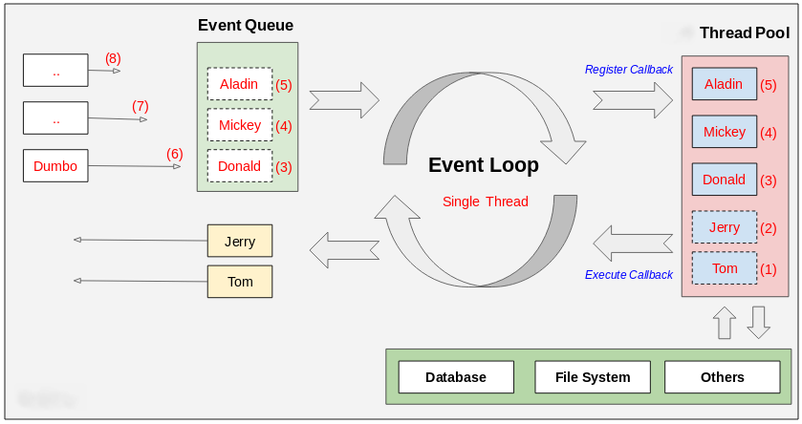
Event-loop architecture

Slide 4
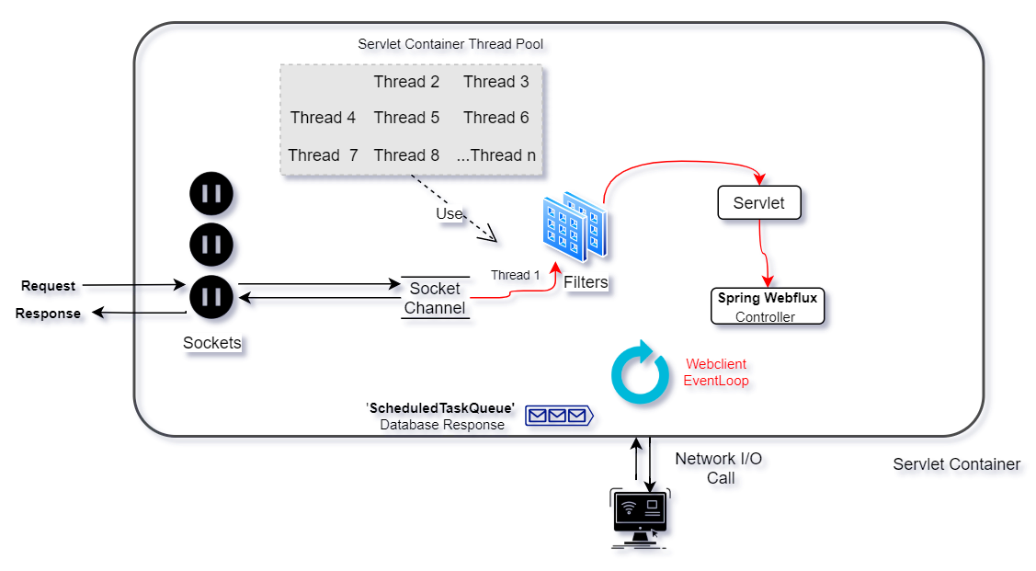
Thread-per-request Model

Slide 5
Spring WebFlux versus. Spring MVC
Spring WebFlux
Built on non-blocking web stack.
Using non-blocking I/O servers such as Netty.
Handle concurrency with a small number of threads.
Using the cooperation with Functional Programming and Reactive Programming.
Spring MVC
Built on Servlet API stack.
Using blocking I/O servers like Apache Tomcat.
Handle concurrency using Thread-per-request terminology.

Slide 6
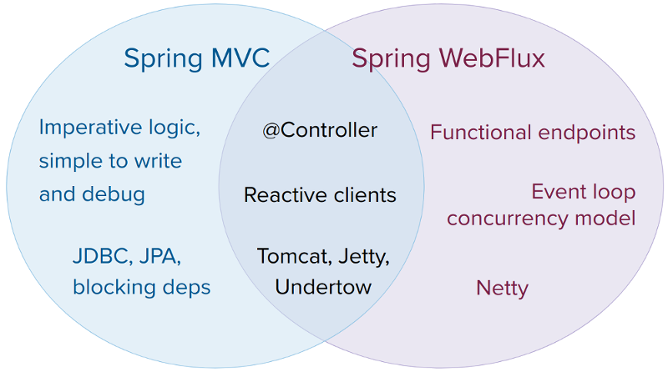
Spring WebFlux or Spring MVC

Slide 7
Introduction to Project Reactor
A framework open sourced by Pivotal, which acts as a foundation for reactive applications.
A fully non-blocking reactive programming foundation for the JVM, with efficient demand management
Offers asynchronous sequence APIs — Flux (for [N] elements) and Mono (for [0|1] elements) — and extensively implements the Reactive Streams specification
It’s based upon the reactive streams initiative, an initiative founded by engineers from Netflix, Pivotal and Lightbend with contributions from other big Java-players such as Oracle and Red Hat

Slide 8
Mono vs Flux
Mono: Only emit zero or one item at the most (streams one element)
Flux: Can emit zero or many items (streams many elements) or a complete or an error call.
Monos can be concatenated to be a Flux.
Flux can be converted to Mono through the single() call.

Slide 9

Thank You!

