Slide 1
Parallel Algorithms: Theory and Practice

Slide 2
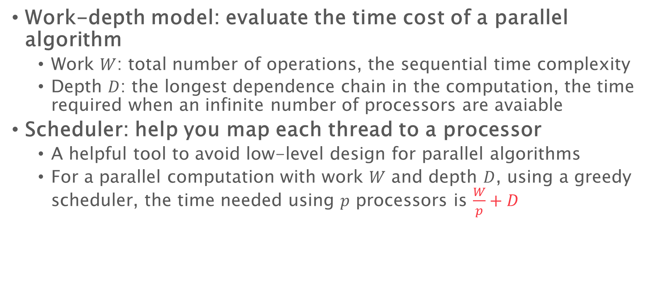
Last class
Work-depth model: evaluate the time cost of a parallel algorithm
Work $W$: total number of operations, the sequential time complexity
Depth $D$: the longest dependence chain in the computation, the time required when an infinite number of processors are avaiable
Scheduler: help you map each thread to a processor
A helpful tool to avoid low-level design for parallel algorithms
For a parallel computation with work $W$ and depth $D$, using a greedy scheduler, the time needed using $p$ processors is $\frac{W}{p}+D$

Slide 3
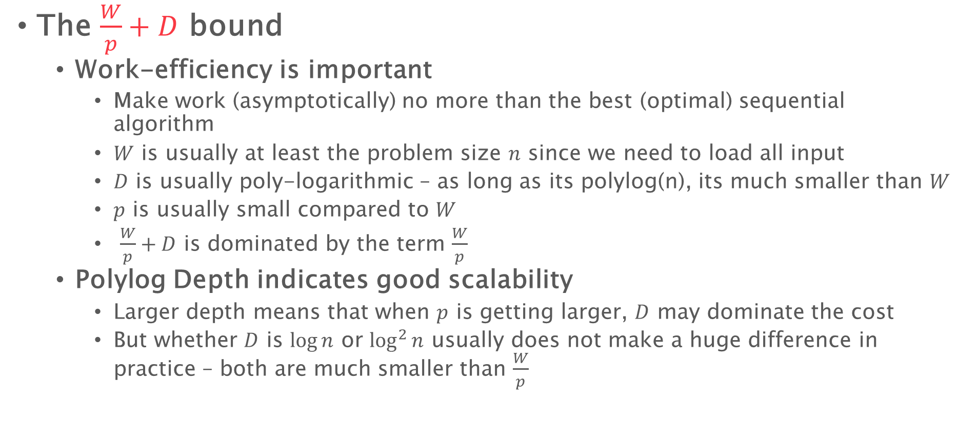
Last class
The $\frac{W}{p}+D$ bound
Work-efficiency is important
Make work (asymptotically) no more than the best (optimal) sequential algorithm
$W$ is usually at least the problem size $n$ since we need to load all input
$D$ is usually poly-logarithmic – as long as its polylog(n), its much smaller than $W$
$p$ is usually small compared to $W$
$\frac{W}{p}+D$ is dominated by the term $\frac{W}{p}$
Polylog Depth indicates good scalability
Larger depth means that when $p$ is getting larger, $D$ may dominate the cost
But whether $D$ is $\log{n}$ or $\log^{2}{n}$ usually does not make a huge difference in practice – both are much smaller than $\frac{W}{p}$

Slide 4
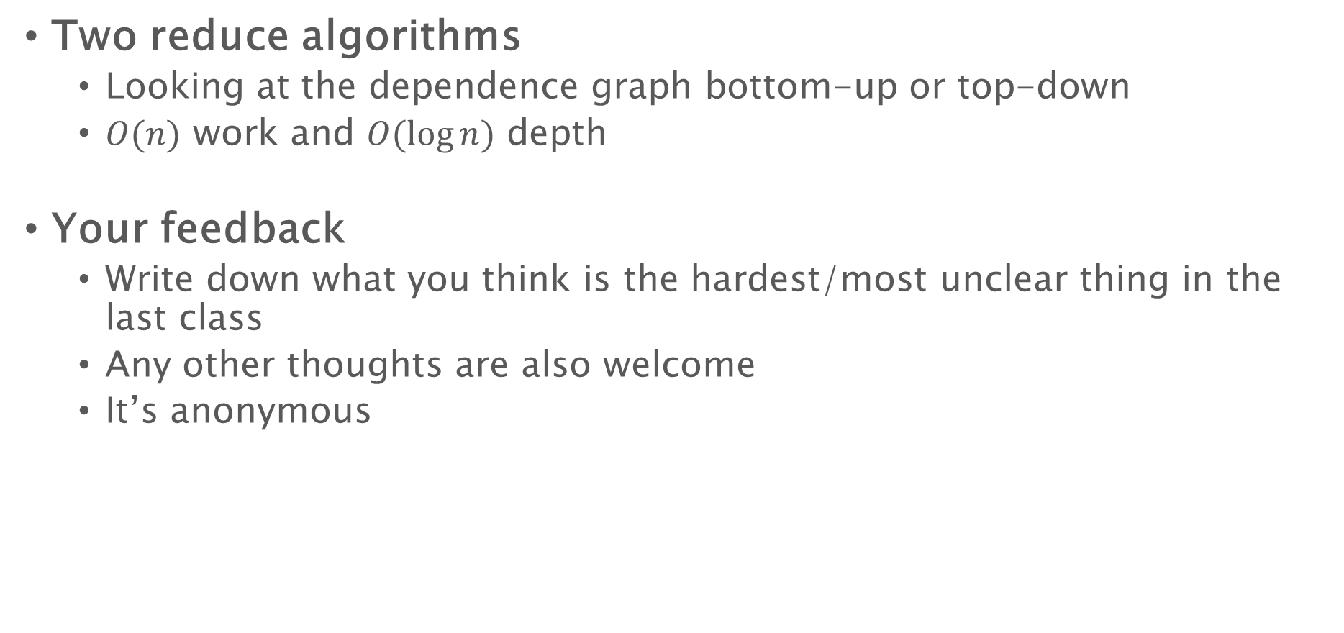
Last class
Two reduce algorithms
Looking at the dependence graph bottom-up or top-down
$O(n)$ work and $O(\log{n})$ depth
Your feedback
Write down what you think is the hardest/most unclear thing in the last class
Any other thoughts are also welcome
It’s anonymous

Slide 5
Prefix Sum (Scan)

Slide 6
Prefix sum
A = 1 2 3 4 5 6 7 8
B = 1 3 6 10 15 21 28 36
The most widely-used building block in parallel algorithm design
Similar idea applies to any associative binary operations

Slide 7
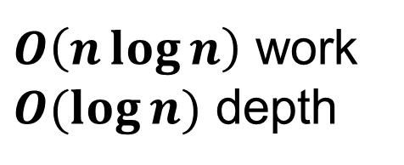
Prefix Sum
$O\left(n\log{n}\right)$ work
$O(\log{n})$ depth
1
2
3
4
5
6
7
8
+
+
+
+
3
+
7
11
+
15
10
26
+
36
1 | 2 | 3 | 4 | 5 | 6 | 7 | 8
3+3+4=10
10+5=15
10+5+6=21
10+11+7=28

Slide 8
Two algorithms to implement a reduce
reduce(A, n) {
if (n == 1) return A[0];
In parallel:
L = reduce(A, n/2);
R = reduce(A + n/2, n-n/2);
return L+R;
}
reduce(A, n) {
if (n == 1) return A[0];
if (n is odd) n=n+1;
parallel_for i=1 to n/2
B[i]=A[2i]+A[2i+1];
return reduce(B, n/2); }
Divide-and-conquer:
Dealing with the left and right halves recursively

Slide 9
Prefix sum: divide-and-conquer
Split the original problem into several parts with smaller sizes (e.g., evenly in two)
Solve the same problem on each part in parallel
Combine the results
1
2
3
4
5
6
7
8
+
+
+
+
3
+
7
11
+
15
10
26
+
36
Function scan_r(A, B, s, t, offset) {
If s=t-1 then {
B[s] = offset + A[s]; return; }
mid = (s+t)/2;
In Parallel:
scan_r(A, B, s, mid, offset);
scan_r(A, B, mid, t, offset+leftSum); }
1 2 3 4 5 6 7 8
Left prefix sum
Right prefix sum
1
3
6
10
5
11
18
26
+10
+10
+10
+10
Function scan(A, B) {
Call reduce(A, n) and save the reduce tree;
scan_r(A, B, 0, n, 0);}
1
3
6
10
15
21
28
36
What is 10?

Slide 10
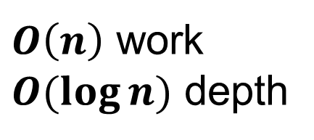
Prefix sum
$O\left(n\right)$ work
$O(\log{n})$ depth
Function scan_r(A, B, s, t, offset) {
If s=t then {
B[s] = offset + A[s]; return; }
mid = (s+t)/2;
In Parallel:
scan_r(A, B, s, mid, offset);
scan_r(A, B, mid+1, t, offset+leftSum); }
1
2
3
4
5
6
7
8
+
+
+
+
3
+
7
11
+
15
10
26
+
36
offset: 0
offset: 10
offset: 0
offset: 0+3=3
offset: 10
offset: 10+11=21
offset: 0
offset: 1
offset:
3
offset:
3+3=6
offset:
10
offset:
10+5=15
offset:
21
offset:
21+7=28
Result:
0+1=1
Result:
1+2=3
Result:
3+3=6
Result:
6+4=10
Result:
10+5=15
Result:
15+6=21
Result:
21+7=28
Result:
28+8=36
1 | 2 | 3 | 4 | 5 | 6 | 7 | 8

Slide 11
Two algorithms to implement a reduce
reduce(A, n) {
if (n == 1) return A[0];
In parallel:
L = reduce(A, n/2);
R = reduce(A + n/2, n-n/2);
return L+R;
}
reduce(A, n) {
if (n == 1) return A[0];
if (n is odd) n=n+1;
parallel_for i=1 to n/2
B[i]=A[2i]+A[2i+1];
return reduce(B, n/2); }
Reduce problem size:
Shrink the original size into a half

Slide 12
Prefix sum – another algorithm
Reduce the problem size into a smaller size (e.g., a half), possibly in parallel
Solve the same problem on the small input
Convert the result of the small problem to the final answer, possibly in parallel
1
2
3
4
5
6
7
8
+
+
+
+
3
+
7
11
+
15
10
26
+
36
A
1 2 3 4 5 6 7 8
Prefix sum of A
1
3
6
10
15
21
28
36
Prefix sum of A’
3
10
21
36
A’
3
7
11
15

Slide 13
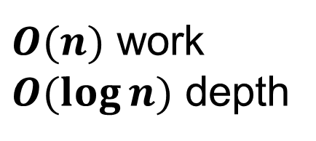
Prefix sum – another algorithm
1 2 3 4 5 6 7 8
1
3
6
10
15
21
28
36
1
2
3
4
5
6
7
8
+
+
+
+
3
7
11
15
3
+
7
11
+
15
3
10
21
36
10
26
+
10
26
36
Function PrefixSum(In, n, Out) {
if (n==1) Out[0] = In[0];
para_for (i=0 to n/2)
B[i] = In[2i]+In[2i+1]
PrefixSum(B, n/2, C);
Out[0] = In[0];
para_for (i=1 to n) {
if (i%2) Out[i] = C[(i-1)/2]+In[i];
else Out[i] = C[i/2];} }
10
36
36
36
$O(n)$ work
$O(\log{n})$ depth

Slide 14
How did we solve the prefix sum problem?
Divide-and-conquer
Split the problem in half, solve each of the same subproblems in parallel
i.e., solve the prefix sum of the left and the right halves of the array in parallel
Convert the results from the subproblems to the final answers
i.e., the right sum needs to add the “left sum” of the reduce algorithm
Reduce to smaller sizes
Convert the problem to a smaller size of the same problem
i.e., add every two elements to half the problem size
Convert the result of the smaller problem to the final answers
i.e., copy the results to the odd positions, and get the result at the even positions by adding the original input value

Slide 15
Computational Models

Slide 16
Cost model
Work-depth model
Evaluate the cost of an algorithm
Does not specify what operations can be used, how much do they cost, etc
How much does a parallel for cost?
How do processors synchronize?
What happens if two threads access the same memory location at the same time?
Sequentially, we have the Random Access Machine Model (RAM model)
Unbounded memory and you can access any location with its address
Every operation (computation, memory access, etc.) costs unit time
Simple and effective for analyzing sequential algorithms

Slide 17
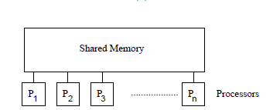
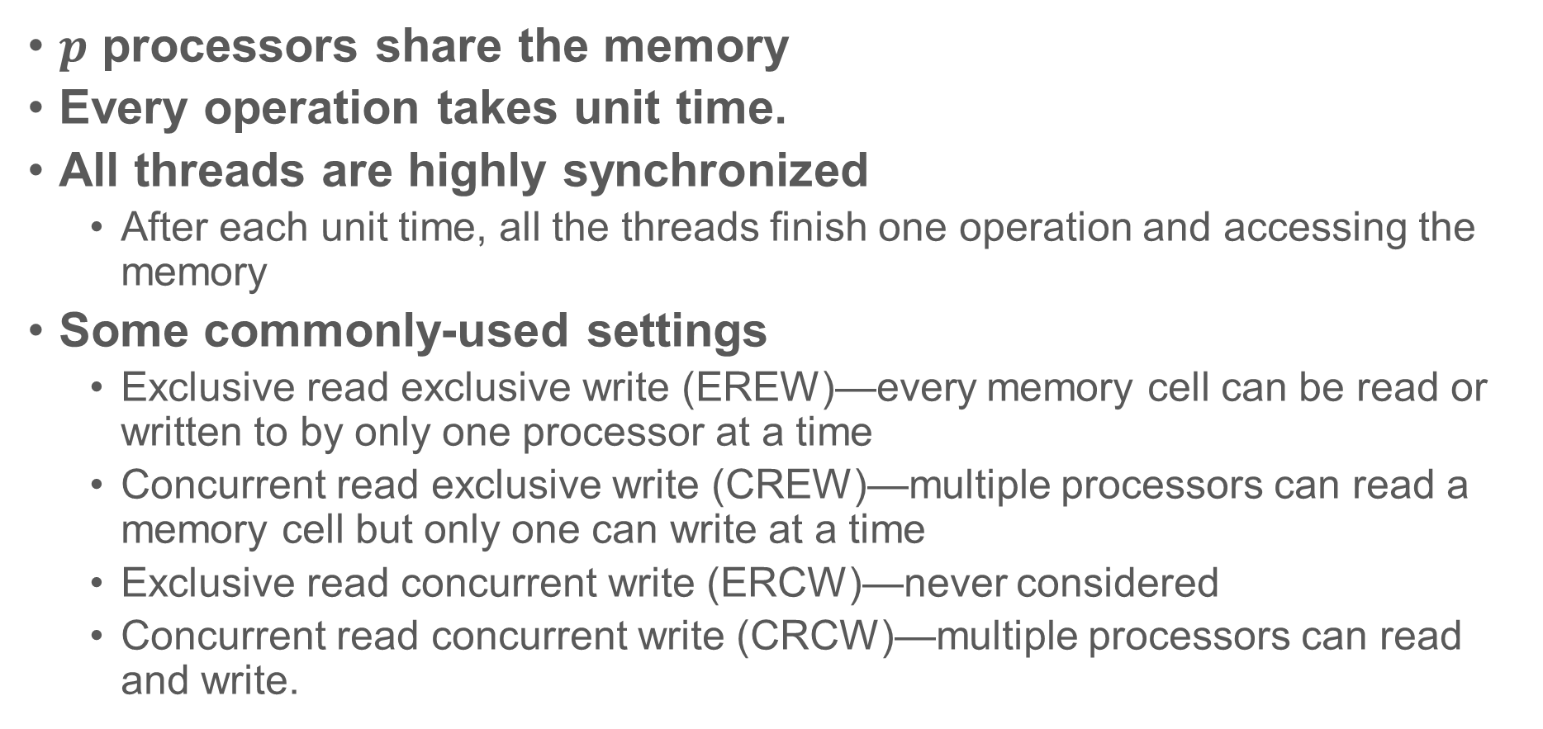
The PRAM (Parallel RAM) Model
$p$ processors share the memory
Every operation takes unit time.
All threads are highly synchronized
After each unit time, all the threads finish one operation and accessing the memory
Some commonly-used settings
Exclusive read exclusive write (EREW)—every memory cell can be read or written to by only one processor at a time
Concurrent read exclusive write (CREW)—multiple processors can read a memory cell but only one can write at a time
Exclusive read concurrent write (ERCW)—never considered
Concurrent read concurrent write (CRCW)—multiple processors can read and write.

Slide 18
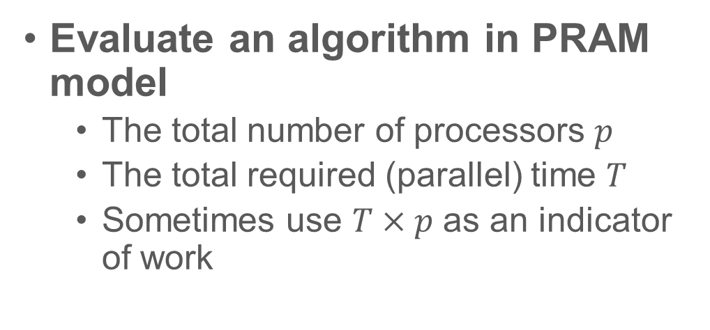
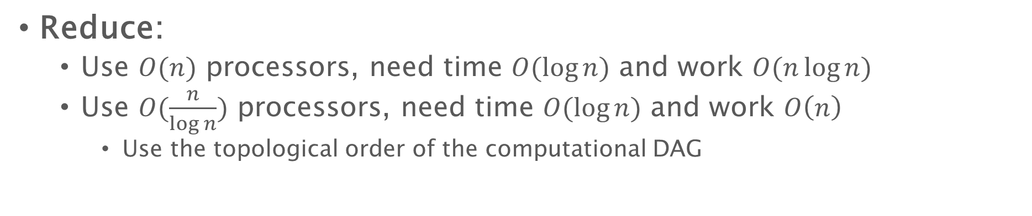
The PRAM (Parallel RAM) Model
Evaluate an algorithm in PRAM model
The total number of processors $p$
The total required (parallel) time $T$
Sometimes use $T×p$ as an indicator of work
1
2
3
4
5
6
7
8
+
+
+
+
3
+
7
11
+
15
10
26
+
36
Reduce:
Use $O(n)$ processors, need time $O(\log{n})$ and work $O(n\log{n})$
Use $O(\frac{n}{\log{n}})$ processors, need time $O(\log{n})$ and work $O\left(n\right)$
Use the topological order of the computational DAG

Slide 19
PRAM: pros and cons
Simple – we can get very good bound
But...
Do we know the number of processors ahead of time?
The number of available processors even varies during the execution
Your OS, some other applications may use some processors

Slide 20
PRAM: pros and cons
Simple – we can get very good bound
But...
Do we know the number of processors ahead of time?
Are processors really highly-synchronized?
Accessing memory is usually more expensive than computation
Synchronization is expensive
P1:
A = 5;
B = 3;
A = A+7;
P2:
C = 2;
A = 3;
B = B+C;
sync
sync
sync

Slide 21
PRAM: pros and cons
Simple, easy to analyze
But...
Do we know the number of processors ahead of time?
Are processors really highly-synchronized?
Accessing memory is usually more expensive than computation
Are concurrent writes ideal enough to take unit time?
Although we do not use PRAM in this course, many useful and good algorithms (and ideas) were proposed based on PRAM
Proposed in 1979, but parallelism moved into the mainstream of processor design from 2005

Slide 22
Fork-join parallelism

Slide 23
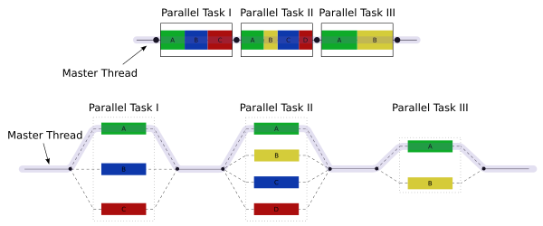

Fork-join Parallelism
The computation starts with one thread
A thread $T_{0}$ can fork $m$ threads to execute $m$ pieces of code. After they all finish, they join back and continue the rest computation in $T_{0}$
We can use work and depth to analyze the cost

Slide 24
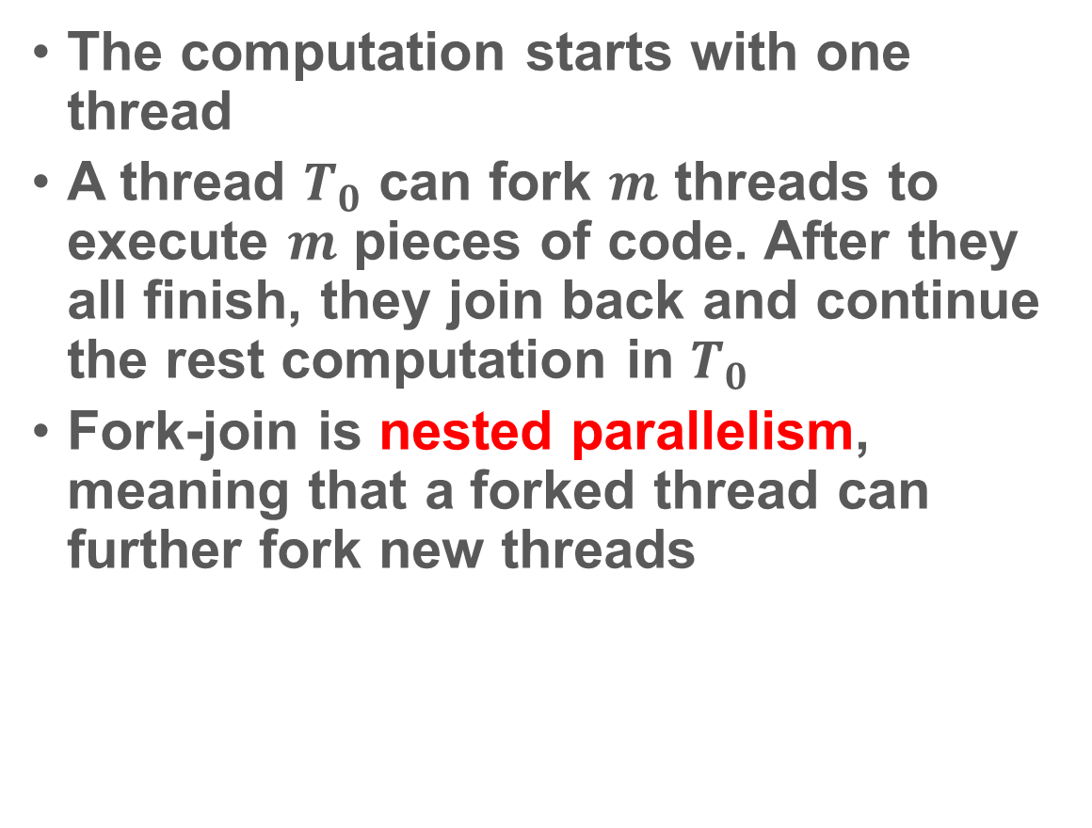
Fork-join Parallelism
The computation starts with one thread
A thread $T_{0}$ can fork $m$ threads to execute $m$ pieces of code. After they all finish, they join back and continue the rest computation in $T_{0}$
Fork-join is nested parallelism, meaning that a forked thread can further fork new threads

Slide 25
Fork-join Parallelism
The computation starts with one thread
A thread $T_{0}$ can fork $m$ threads to execute $m$ pieces of code. After they all finish, they join back and continue the rest computation in $T_{0}$
We can use work and depth to analyze the cost
Function Scan(A, B, s, t, ps)
If s=t then B[s] = ps + A[s]
In Parallel (Fork):
Scan(A, B, s, mid, ps)
Scan(A, B, mid+1, t, ps+leftSum)
Join

Slide 26
Fork-join parallelism
Function PrefixSum(In, n, Out) {
if (n==1) Out[0] = In[0];
para_for (i=0 to n/2) //Fork
B[i] = n[2i]+In[2i+1]
//Join
PrefixSum(B, n/2, C);
Out[0] = In[0];
para_for (i=1 to n) { //Fork
if (i%2) Out[i] = C[i/2];
else Out[i] = C[i/2-1] + In[i];
}
//Join
}

Slide 27
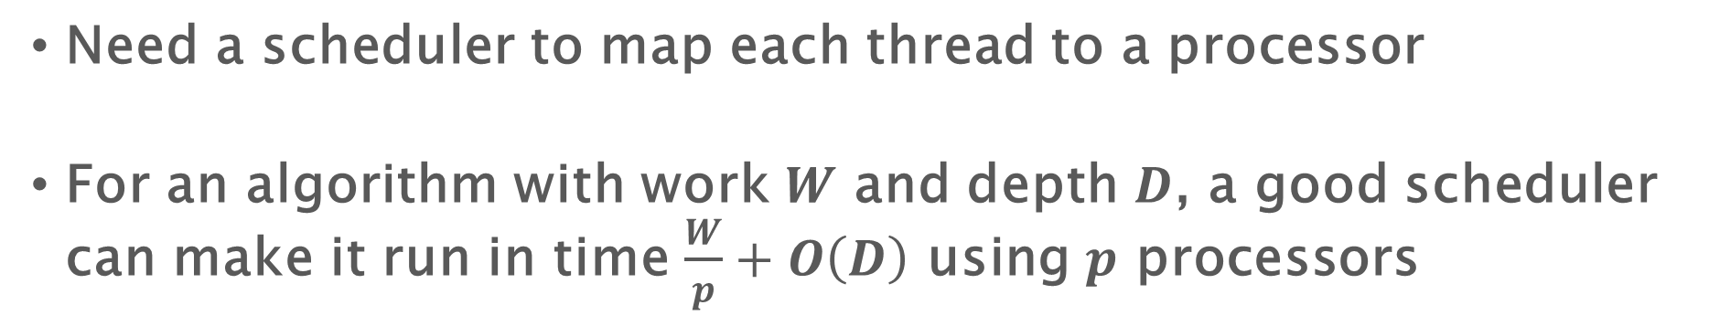
Execute a fork-join algorithm
Need a scheduler to map each thread to a processor
For an algorithm with work $W$ and depth $D$, a good scheduler can make it run in time $\frac{W}{p}+O\left(D\right)$ using $p$ processors

Slide 28
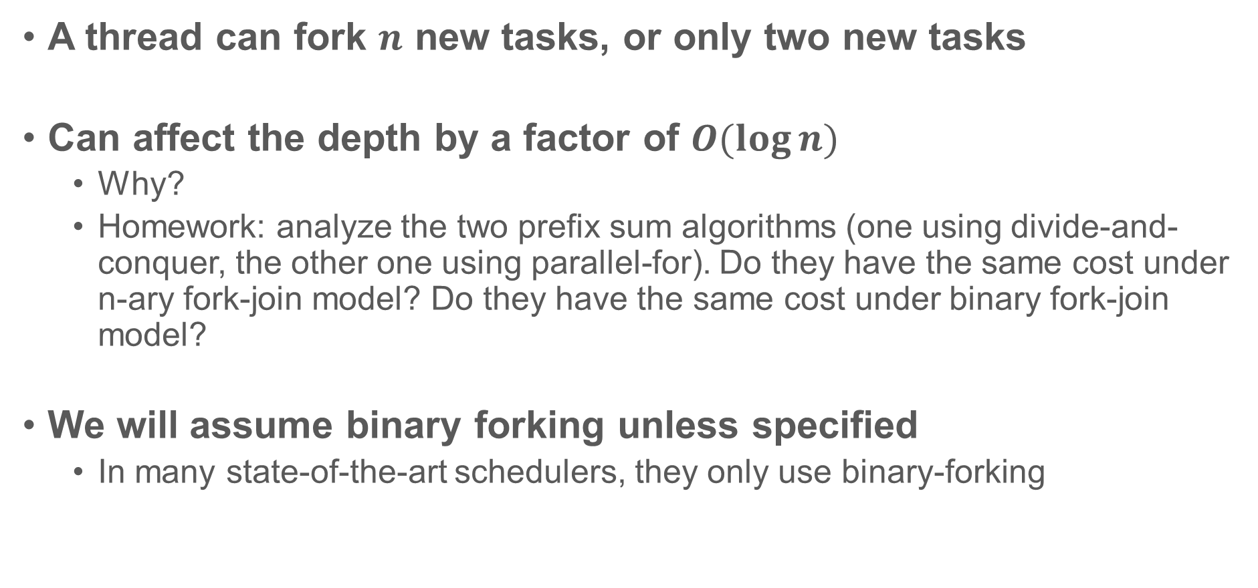
N-ary forking vs. binary forking
A thread can fork $n$ new tasks, or only two new tasks
Can affect the depth by a factor of $O(\log{n})$
Why?
Homework: analyze the two prefix sum algorithms (one using divide-and-conquer, the other one using parallel-for). Do they have the same cost under n-ary fork-join model? Do they have the same cost under binary fork-join model?
We will assume binary forking unless specified
In many state-of-the-art schedulers, they only use binary-forking

Slide 29
DAG for work-depth vs. fork-join
Start
Fork-join: a fork always corresponds to a join

Slide 30
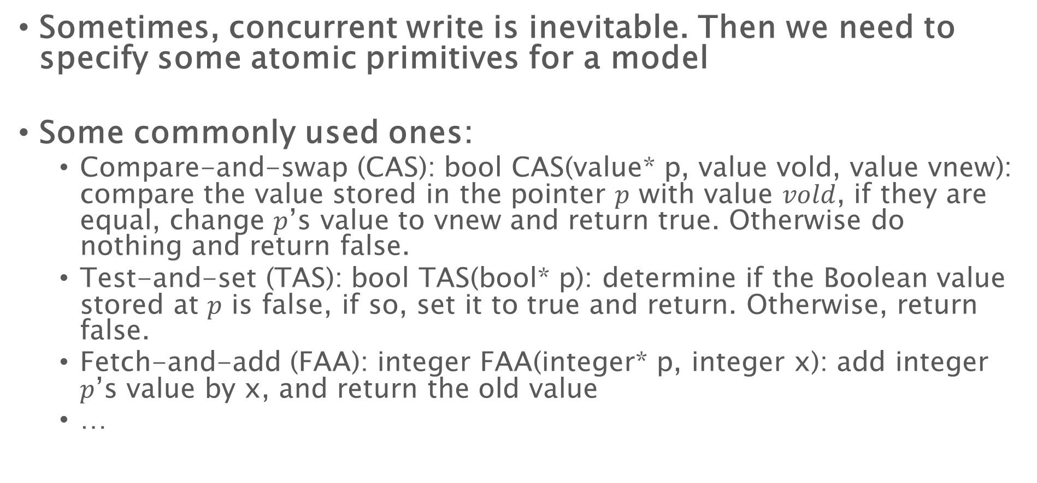
What else can we do
Sometimes, concurrent write is inevitable. Then we need to specify some atomic primitives for a model
Some commonly used ones:
Compare-and-swap (CAS): bool CAS(value* p, value vold, value vnew): compare the value stored in the pointer $p$ with value $vold$, if they are equal, change $p$’s value to vnew and return true. Otherwise do nothing and return false.
Test-and-set (TAS): bool TAS(bool* p): determine if the Boolean value stored at $p$ is false, if so, set it to true and return. Otherwise, return false.
Fetch-and-add (FAA): integer FAA(integer* p, integer x): add integer $p$’s value by x, and return the old value
…

Slide 31
Use Atomic Primitives
sum = 5
P1: add(3)
P2: add(4)
void Add(x) {
temp = sum;
sum = temp + x;
}
void Add(x) {
temp = sum;
sum = temp + x;
}
Fetch-and-add:
Multiple threads try to add values to a shared variable
Multiple threads want to get a global sequentialized order
5
5
8
9
Shared variable sum
void Add(x) {
FAA(&sum, x);
}
Shared variable sum
void Add(x) {
sum = sum + x;
}
sum = 8 (but should be 12)
Shared variable count
int get_id {
return FAA(&count, 1);
}

Slide 32
Use Atomic Primitives
Compare-and-swap:
Multiple threads wants to add to the head of a linked-list
struct node {
value_type value;
node* next; };
shared variable node* head;
void insert(node* x) {
node* old_head = head;
x->next = old_head;
while (!CAS(&head, old_head, x)) {
node* old_head = head;
x->next = old_head; }
}
X1
？
X2
？
head
head
X1
void insert(node* x) {
x->next = head;
head = x;
}
X2

Slide 33
Computational model
When talking about an algorithm or a bound:
Specify the model
Specify any parallel primitives you need
e.g, EREW PRAM, binary-forking with CAS, etc.
When talking about the execution time:
Also need to specify the scheduling algorithm
Usually, the more or the stronger primitive you use, the better your bound looks, but the less interesting/practical the result is
E.g., assume constant time parallel reduce – we can get a constant time sorting algorithm

Slide 34
Fibonacci Numbers

Slide 35
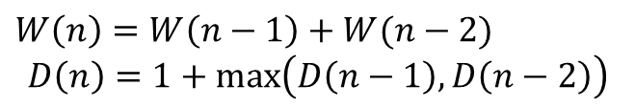

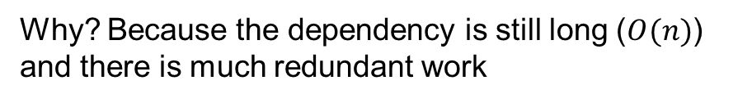
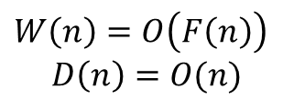
Fibonacci Numbers
0
The n-th Fibonacci number can be computed as:
$F\left(n\right)=F\left(n−1\right)+F(n−2)$
In the homework we’ll see a more efficient parallel algorithm
…
int F (int n) {
if (n <= 1) return n;
else {
In parallel:
int A = F(n-1);
int B = F(n-2);
return A+B;
}
$$W\left(n\right)=W\left(n−1\right)+W(n−2)$$
$$D\left(n\right)=1+\max\left(D\left(n−1\right),D\left(n−2\right)\right)$$
n-2
$$W\left(n\right)=O\left(F\left(n\right)\right)$$
$$D\left(n\right)=O(n)$$
n-1
Why? Because the dependency is still long ($O(n)$) and there is much redundant work
n

Slide 36
Parallel Programming Tools

Slide 37
Parallel Tools and Schedulers
In this course the following two schedulers are recommended for your homework and course project.
Cilk
PBBS
You can also use other languages/schedulers that you are more familiar with, e.g., OpenMP, Intel TBB, etc.

Slide 38
Cilk
#include <cilk/cilk.h>
#include <cilk/cilk_api.h>
Fork-join parallelism
cilk_spawn and cilk_sync
Parallel for: cilk_for
int reduce(int* A, int n) {
if (n == 1) return A[0];
int L, R;
L = cilk_spawn reduce(A, n/2);
R = reduce(A+n/2, n-n/2);
cilk_sync;
return L+R;
}
cilk_spawn S1;
S2;
cilk_sync;
cilk_for (int i = 0; i < n; i++)

Slide 39
Cilk
cilk_spawn means to create a new thread that is executed while the original thread proceed to the next instruction
Supported by gcc 5 to 7. Available on the course server.
LLVM: https://cilkplus.github.io/
int reduce(int* A, int n) {
if (n == 1) return A[0];
int L, R;
L = cilk_spawn reduce(A, n/2);
R = reduce(A+n/2, n-n/2);
cilk_sync;
return L+R; }

Slide 40
PBBS (Problem-based benchmark suite)
Code available at: https://github.com/cmuparlay/pbbslib
#include “pbbslib/utilities.h”
You can also use cilk or openmp to compile your code
void reduce(int* A, int n, int& ret) {
if (n == 1) ret = A[0]; else {
int L, R;
par_do([&] () {reduce(A, n/2, L);},
[&] () {reduce(A+n/2, n-n/2, R);});
ret = L+R;
}
}
lambda expression (must be function calls)
parallel_for (0, 100, [&] (int i) {A[i] = i;});

Slide 41
About homework
Sample code available using PBBS and Cilk in homework 1
You will implement your own version of a scan algorithm – add any optimizations that you think could help, and see if they really help
Use figures and tables to show the numbers you get
Analyze the numbers to explain any interesting/abnormal phenomenon
There is an entry of assignment in ilearn now, you can submit your code there

Slide 42
About homework
The goal of the programming part is to let you learn from practice some tricks and optimizations for implementing parallel algorithms – the process of learning matters
This is a graduate-level course, which means
As long as you finish all required tasks, everyone can pass
If you do a really good job, you get a good score
But if you cheat, you fail

Slide 43
About paper review
What problem is solved in the paper? What is the motivation?
Why is the problem challenging? How did previous work solve the problem and why they didn’t work?
What is the key technical ideas to solve the challenges?
What are the new theoretical results (if any)?
Why do they design experiments (if any) like that?
What do the experimental results (if any) tell us?
What do you think is the strength/novelty of the work?
What do you think is the weakness of the work? Do you have ideas to improve that?
What are the possible directions for future work?
Do you have any questions about the work?

Slide 44
About paper review
A useful document of some paper review tips: https://people.inf.ethz.ch/troscoe/pubs/review-writing.pdf
Your paper review is slightly different since you are reviewing papers that have already been published

