Slide 1
Parallel sorting algorithms

Slide 2
Last week
Matrix multiplication
Parallel reduce
8-way divide-and-conquer
Master theorem
Draw the recurrence tree
Three forms: compare the total cost at the root and the total cost at all leaves
Case 1: the leaves cost more, the cost at leaves dominates the final cost
Case 2: they are comparable (differ by a factor of polylog n), add another log n factor to the root cost as the final cost
Case 3: the root costs more (and the regularity condition): the cost at root dominates the final cost

Slide 3
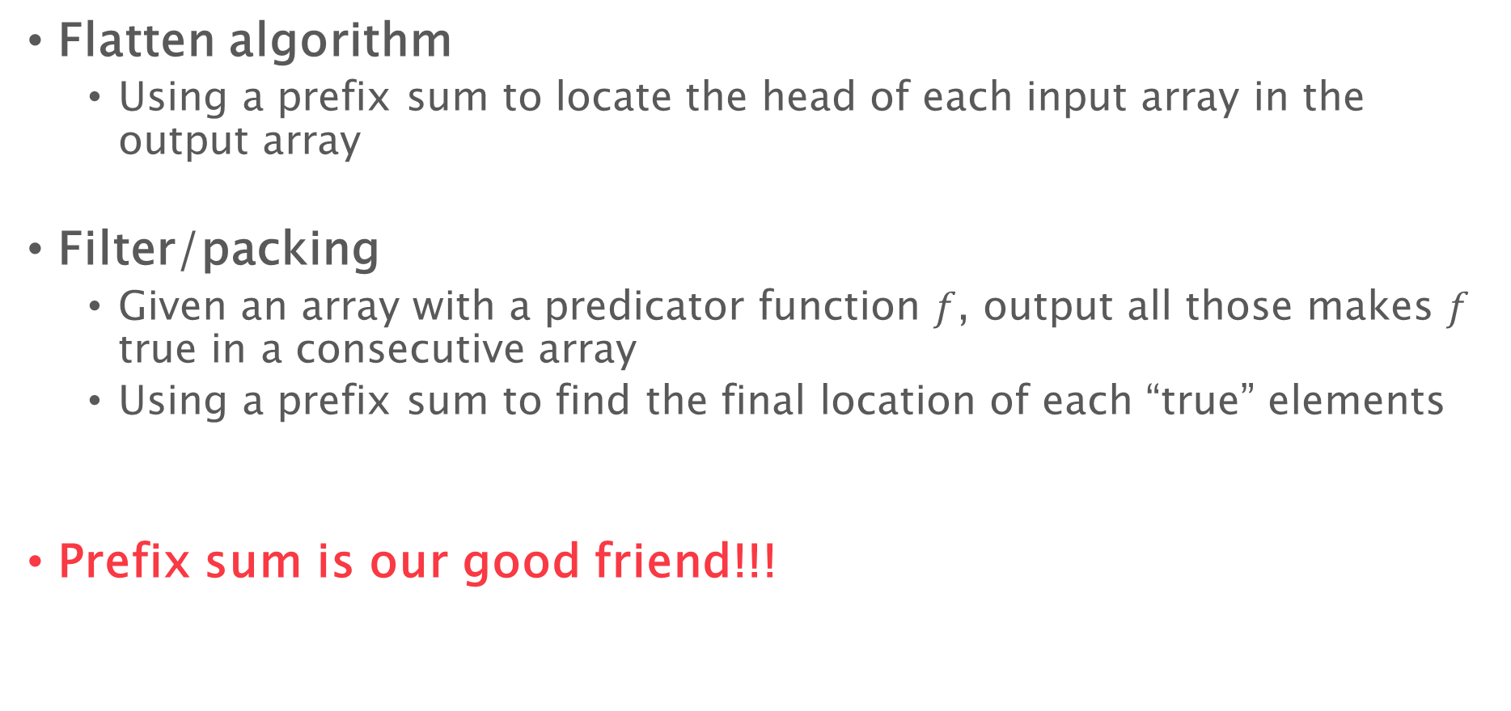
Last week
Flatten algorithm
Using a prefix sum to locate the head of each input array in the output array
Filter/packing
Given an array with a predicator function $f$, output all those makes $f$ true in a consecutive array
Using a prefix sum to find the final location of each “true” elements
Prefix sum is our good friend!!!

Slide 4
Last week
Constructing a tableau
Can be used to parallelize some dynamic programming algorithms
E.g., edit distance
Use 4-way, 9-way, … divide-and-conquer
The finer grained you get, the better depth bound, but the less cache efficiency
Divide-and-conquer is our good friend!!!
Submit your feedback during break time

Slide 5
Homework 1
Small corrections and clarifications
Problem 2c is now a bonus question

Slide 6
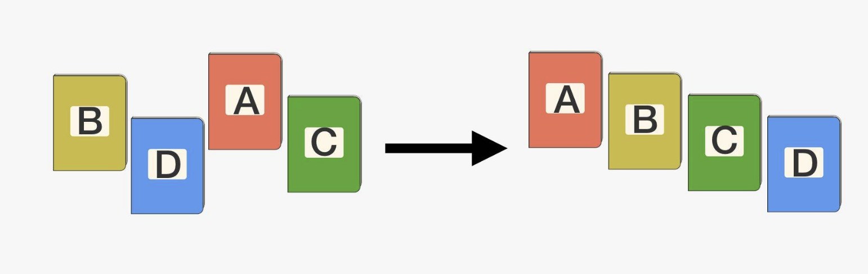

Sorting Algorithms
Given an array of elements $A$ with size $n$, and a total order defined, return an array $B$ of the same elements in $A$, with:
$B\left[0\right]≤B\left[1\right]≤B\left[2\right]≤…≤B[n−1]$
Sometimes in-place algorithms are preferred

Slide 7
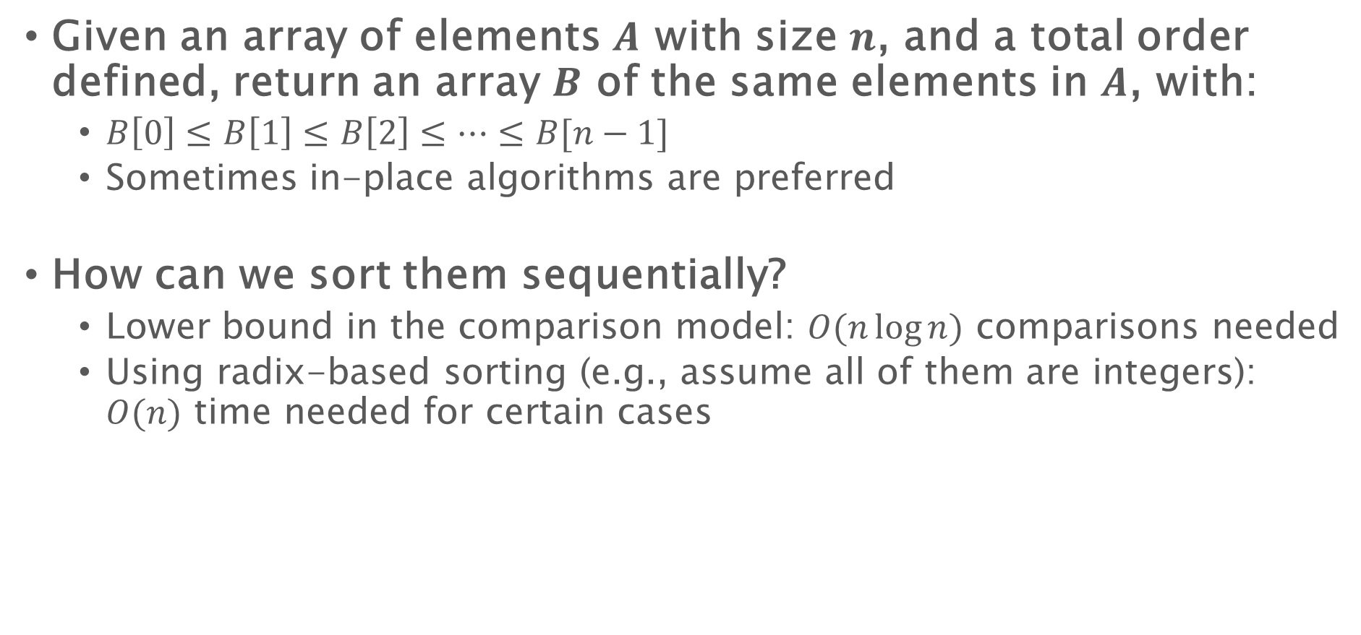
Sorting Algorithms
Given an array of elements $A$ with size $n$, and a total order defined, return an array $B$ of the same elements in $A$, with:
$B\left[0\right]≤B\left[1\right]≤B\left[2\right]≤…≤B[n−1]$
Sometimes in-place algorithms are preferred
How can we sort them sequentially?
Lower bound in the comparison model: $O(n\log{n})$ comparisons needed
Using radix-based sorting (e.g., assume all of them are integers): $O(n)$ time needed for certain cases

Slide 8
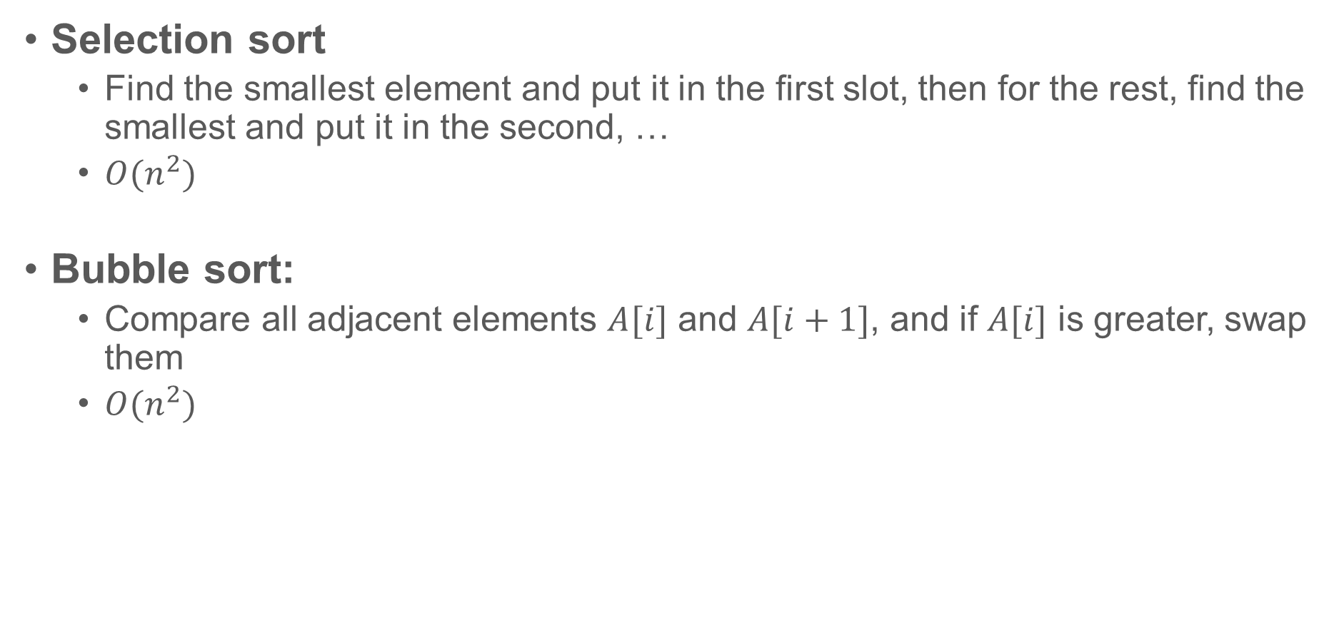
Sequential sorting algorithms: some simple ones
Selection sort
Find the smallest element and put it in the first slot, then for the rest, find the smallest and put it in the second, …
$O(n^{2})$
Bubble sort:
Compare all adjacent elements $A[i]$ and $A[i+1]$, and if $A[i]$ is greater, swap them
$O(n^{2})$

Slide 9
Sequential sorting algorithms: mergesort
5 12 7 9 26 10 2 16
Divide-and-conquer
5 12 7 9
26 10 2 16
Divide-and-conquer
5 12
7 9
10 26
2 16
Divide-and-conquer
Base cases
5
12
7
9
26
10
2
16
Merge
5 12
7 9
10 26
2 16
Merge
5 7 9 12
2 10 16 26
Merge
2 5 7 9 10 12 16 26
How to merge?
void mergesort(int *B, int *A, int n) {
if (n==1) B[0] = A[0]; else {
int C[n];
mergesort(C, A, n/2);
mergesort(C+n/2, A+n/2, n-n/2);
B = merge(C, n/2, C+n/2, n-n/2); }}

Slide 10

Sequential sorting algorithms: mergesort
Split the array evenly in two.
Sort each of them recursively
Merge them back – how?
merge(A, na, B, nb) {
p1 = 0; p2 = 0; p3 = 0;
while ((p1 < na) && (p2< nb)) {
if (A[p1]<B[p2]) {
C[p3] = A[p1]; p1++
} else {
C[p3] = B[p2]; p2++;
} }
//copy the rest of the unfinished array
return C;
}
0
4
7
8
1
2
3
5
6
9
0
1
2
3
4
5
6
7
8
9
Costs $O(n)$ time to merge two arrays of total size $n$

Slide 11
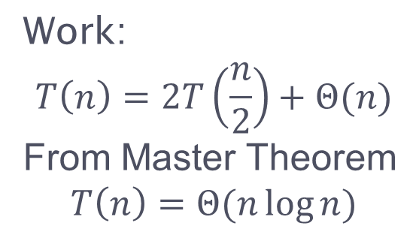
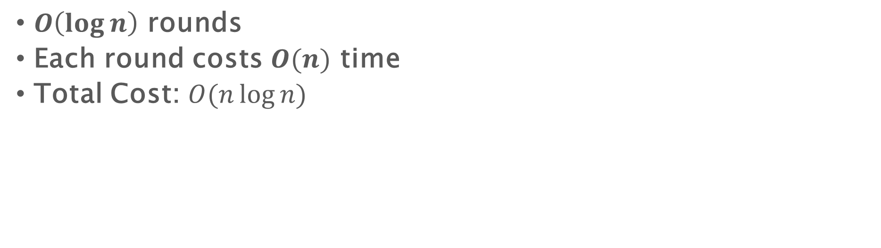
Sequential sorting algorithms: mergesort
$O\left(\log{n}\right)$ rounds
Each round costs $O(n)$ time
Total Cost: $O(n\log{n})$
Work:
$$T\left(n\right)=2T\left(\frac{n}{2}\right)+Θ(n)$$
From Master Theorem
$$T\left(n\right)=Θ(n\log{n})$$

Slide 12
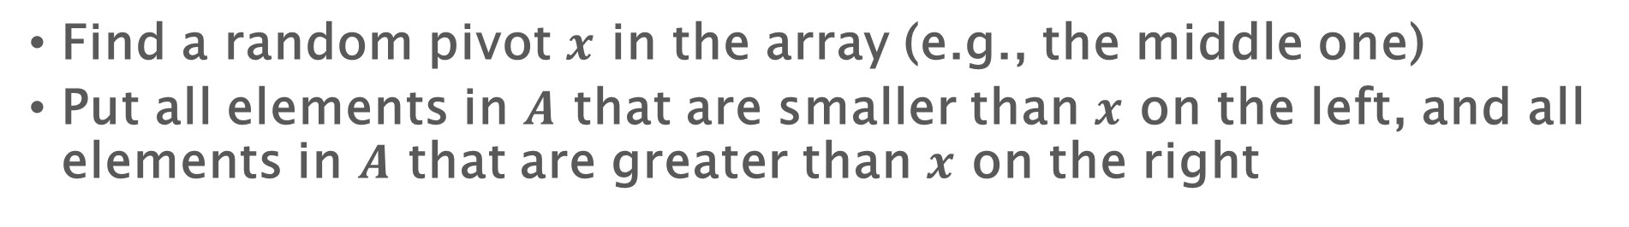
Sequential sorting algorithms: quicksort
Find a random pivot $x$ in the array (e.g., the middle one)
Put all elements in $A$ that are smaller than $x$ on the left, and all elements in $A$ that are greater than $x$ on the right
3
2
9
4
6
1
5
8
7
0
How to move elements around?
6
3
4
2
1
5
0
6
8
9
7
2
8
1
0
2
4
3
5
7
6
8
9
1
4
7
8
0
1
3
2
4
5
6
7
8
9
3
4
0
1
2
3
4
5
6
7
8
9

Slide 13
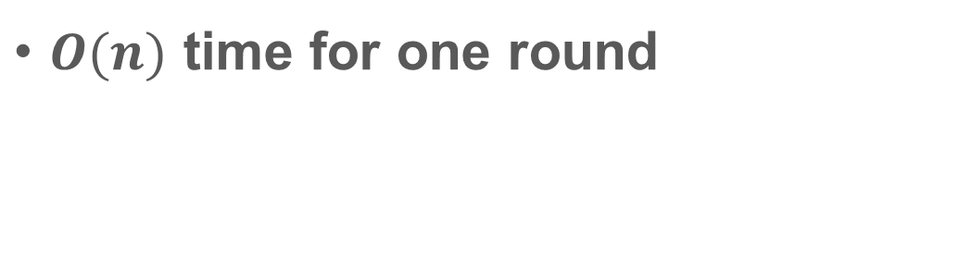
Sequential sorting algorithms: quicksort
How to move elements around? (using 6 as a pivot)
Partition(A, n, x) {
i = 0; j = n-1;
while (i < j) {
while (A[i] < x) i++;
while (A[j] > x) j++;
if (i < j) swap A[i] and A[j];
i++; j--;
}
}
6
2
9
4
1
3
5
8
7
0
0
2
9
4
1
3
5
8
7
6
0
2
9
4
1
3
5
8
7
6
$O(n)$ time for one round
0
2
5
4
1
3
9
8
7
6
0
2
5
4
1
3
9
8
7
6

Slide 14
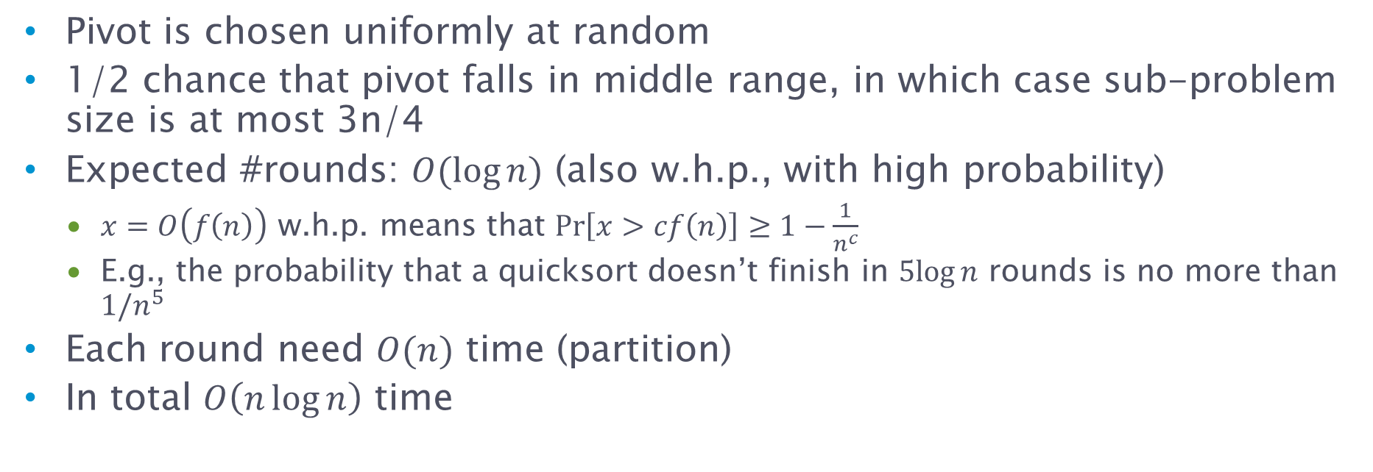
Quicksort cost analysis
Keys in order
n/4 keys
n/2 keys
n/4 keys
Pivot is chosen uniformly at random
1/2 chance that pivot falls in middle range, in which case sub-problem size is at most 3n/4
Expected #rounds: $O(\log{n})$ (also w.h.p., with high probability)
$x=O\left(f\left(n\right)\right)$ w.h.p. means that $Pr\left[x>cf\left(n\right)\right]≥1−\frac{1}{n^{c}}$
E.g., the probability that a quicksort doesn’t finish in $5log⁡n$ rounds is no more than $1/n^{5}$
Each round need $O(n)$ time (partition)
In total $O\left(n\log{n}\right)$ time

Slide 15
Sequential sorting algorithms
Quicksort is usually “quicker” than mergesort
Merge sort need additional space, and quicksort is in-place
Each recursive call in quicksort is dealing with a consecutive chunk in the input – better cache locality
What about in parallel?

Slide 16
Parallel Quicksort

Slide 17
Sequential quicksort
Parallel quicksort
Use a pivot and partition the array into two parts
Sort each of them recursively
Use a pivot and partition the array into two parts
Sort each of them recursively, in parallel

Slide 18
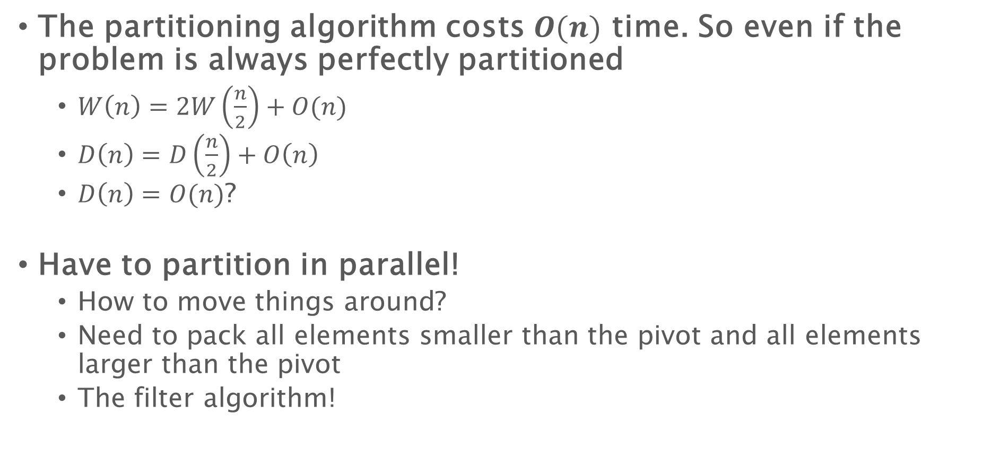
Parallel quick sort
The partitioning algorithm costs $O(n)$ time. So even if the problem is always perfectly partitioned
$W\left(n\right)=2W\left(\frac{n}{2}\right)+O(n)$
$D\left(n\right)=D\left(\frac{n}{2}\right)+O\left(n\right)$
$D\left(n\right)=O(n)$?
Have to partition in parallel!
How to move things around?
Need to pack all elements smaller than the pivot and all elements larger than the pivot
The filter algorithm!

Slide 19
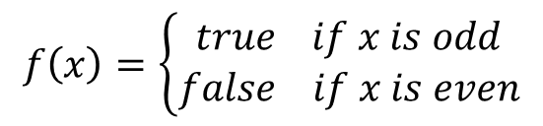



Parallel filtering / packing
Given an array $A$ of elements and a predicate function $f$, output an array $B$ with elements in $A$ that satisfy $f$
$$f\left(x\right)=\left\{\begin{aligned}true if x is odd \\ false if x is even\end{aligned}\right.$$
$$A=$$
4 | 2 | 9 | 3 | 6 | 5 | 7 | 11 | 10 | 8
$$B=$$
9 | 3 | 5 | 7 | 11

Slide 20
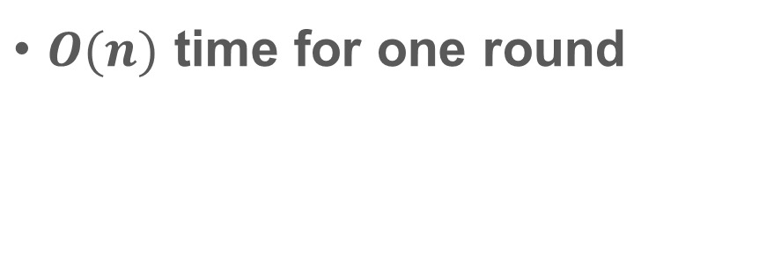
Using filter for partition
How to move elements around? The filter algorithm!
using 6 as a pivot
filter(A, flag, n) {
ps = scan(flag);
parallel_for(i=1 to n) {
if (ps[i]!=ps[i-1])
B[ps[i]] = A[i];
}
}
A
6
2
9
4
1
3
5
8
7
0
flag
0
1
0
1
1
1
1
0
0
1
A
X
2
X
4
1
3
5
X
X
0
flag
0
1
0
1
1
1
1
0
0
1
$O(n)$ time for one round
Prefix sum of flag
0
1
1
2
3
4
5
5
5
6
pack
2
4
1
3
5
0

Slide 21
Using filter to partition
To get all elements smaller than the pivot and all elements larger than the pivot
We can run two separate filters
Two rounds of I/O and global data movement
Parallel partition
After doing the first scan, we know the result of the second scan!

Slide 22
Using filter for partition
using 6 as a pivot
A
6
2
9
4
1
3
5
8
7
0
flag
0
1
0
1
1
1
1
0
0
1
scan1
0
1
1
2
3
4
5
5
5
6
scan1[]: the prefix sum of 1s
scan2[]: the prefix sum of 0s
=> scan1[i] + scan2[i] = i
=> scan2[i] = i - scan1[i]
pack
2
4
1
3
5
0
6
9
8
7
scan2
1
1
2
2
2
2
2
3
4
4

Slide 23

Parallel quicksort
Using the filter algorithm to do partition
Finishes in $O\left(\log{n}\right)$ rounds in expectation (also w.h.p.)
Each round need $O(n)$ work and $O(\log{n})$ depth
$O\left(n\log{n}\right)$ work and $O(\log^{2}{n})$ depth in total

Slide 24
Parallel Mergesort

Slide 25
Sequential mergesort
Parallel mergesort
Split the array evenly in two
Sort each of them recursively
Merge them back
Split the problem size evenly in two
Sort each of them recursively, in parallel
Merge them back

Slide 26

Parallel merge sort
The merging algorithm costs $O(n)$ time. So
$W\left(n\right)=2W\left(\frac{n}{2}\right)+O(n)$
$D\left(n\right)=D\left(\frac{n}{2}\right)+O\left(n\right)$
$D\left(n\right)=O(n)$?
Have to merge in parallel!

Slide 27
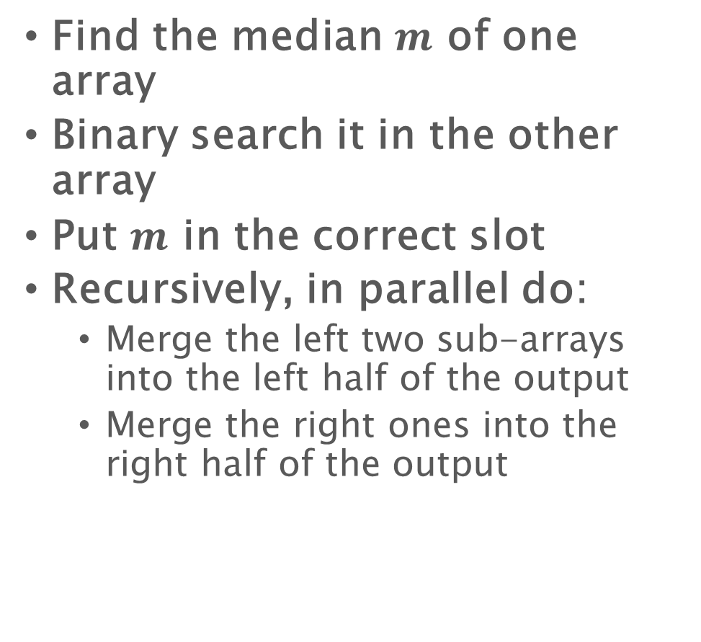
A parallel merge algorithm
2
3
4
6
9
Binary search
0
1
5
7
8
Find the median $m$ of one array
Binary search it in the other array
Put $m$ in the correct slot
Recursively, in parallel do:
Merge the left two sub-arrays into the left half of the output
Merge the right ones into the right half of the output
Subproblem 1:
Merge 2,3 with 0,1
Subproblem 2:
Merge 6,9 with 5,7,8
2
3
6
9
0
1
5
7
8
0
1
2
3
4
5
6
7
8
9

Slide 28
A parallel merge algorithm
2
3
4
6
9
Binary search
0
1
5
7
8
//merge array A of length n1 and array B of length n2 into array C.
Merge(A’, n1, B’, n2, C) {
if (A’ is empty or B’ is empty) base_case;
m = n1/2;
m2 = binary_search(B’, A’[m]);
C[m+m2+1] = A’[m];
in parallel:
merge(A’, m, B’, m2, C);
merge(A’+m+1, n1-m-1, B’+m2+1, n2-m2-1, C+m+m2);
return C;
}
Subproblem 1:
Merge 2,3 with 0,1
Subproblem 2:
Merge 6,9 with 5,7,8
2
3
6
9
0
1
5
7
8
0
1
2
3
4
5
6
7
8
9

Slide 29

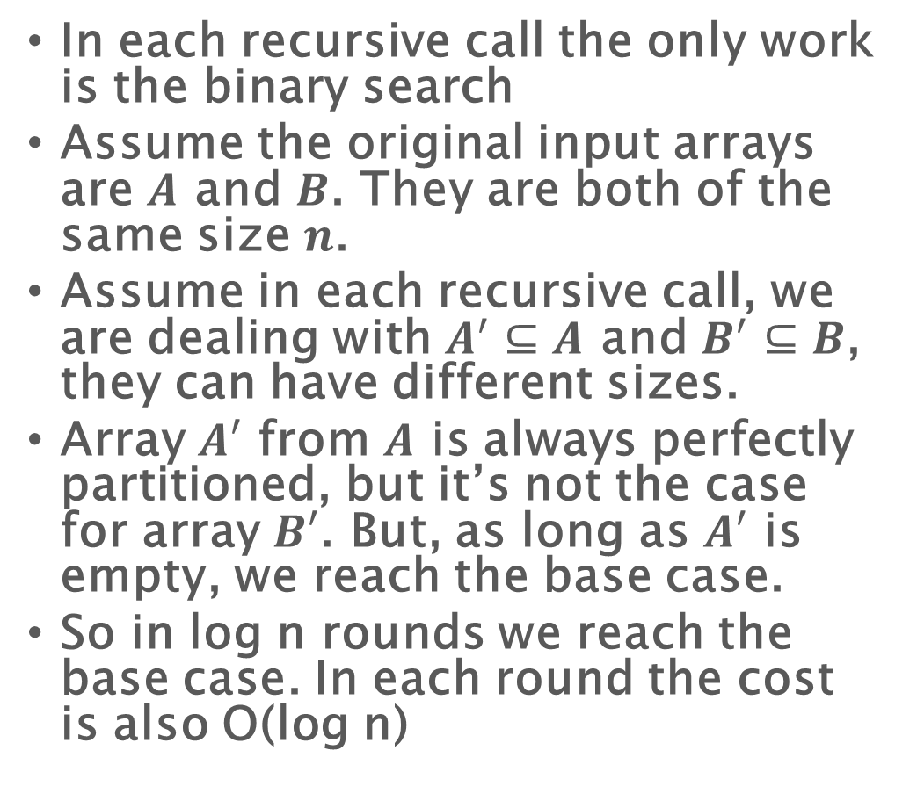
A parallel merge algorithm
2
3
4
6
9
Binary search
0
1
5
7
8
In each recursive call the only work is the binary search
Assume the original input arrays are $A$ and $B$. They are both of the same size $n$.
Assume in each recursive call, we are dealing with $A^{′}⊆A$ and $B^{′}⊆B$, they can have different sizes.
Array $A′$ from $A$ is always perfectly partitioned, but it’s not the case for array $B′$. But, as long as $A′$ is empty, we reach the base case.
So in log n rounds we reach the base case. In each round the cost is also O(log n)
Subproblem 1:
Merge 2,3 with 0,1
Subproblem 2:
Merge 6,9 with 5,7,8
2
3
6
9
0
1
5
7
8
0
1
2
3
4
5
6
7
8
9
$D\left(N\right)=O(\log^{2}{N})$

Slide 30
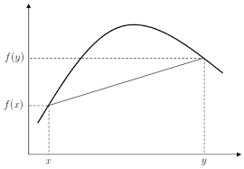
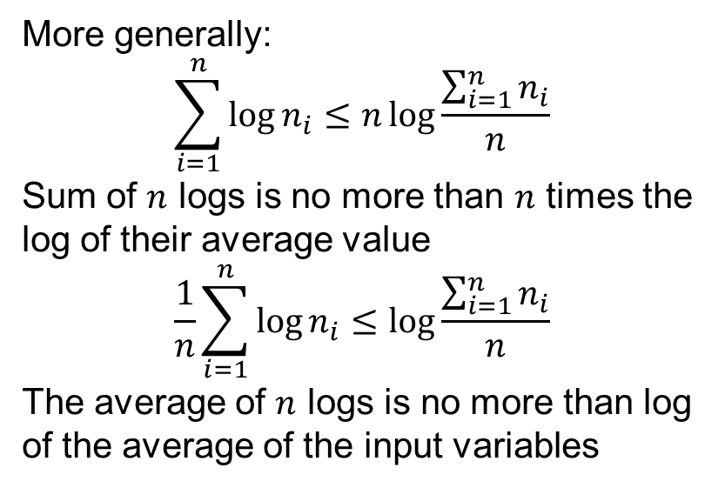
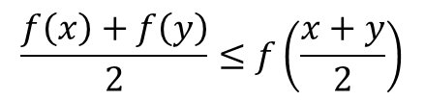
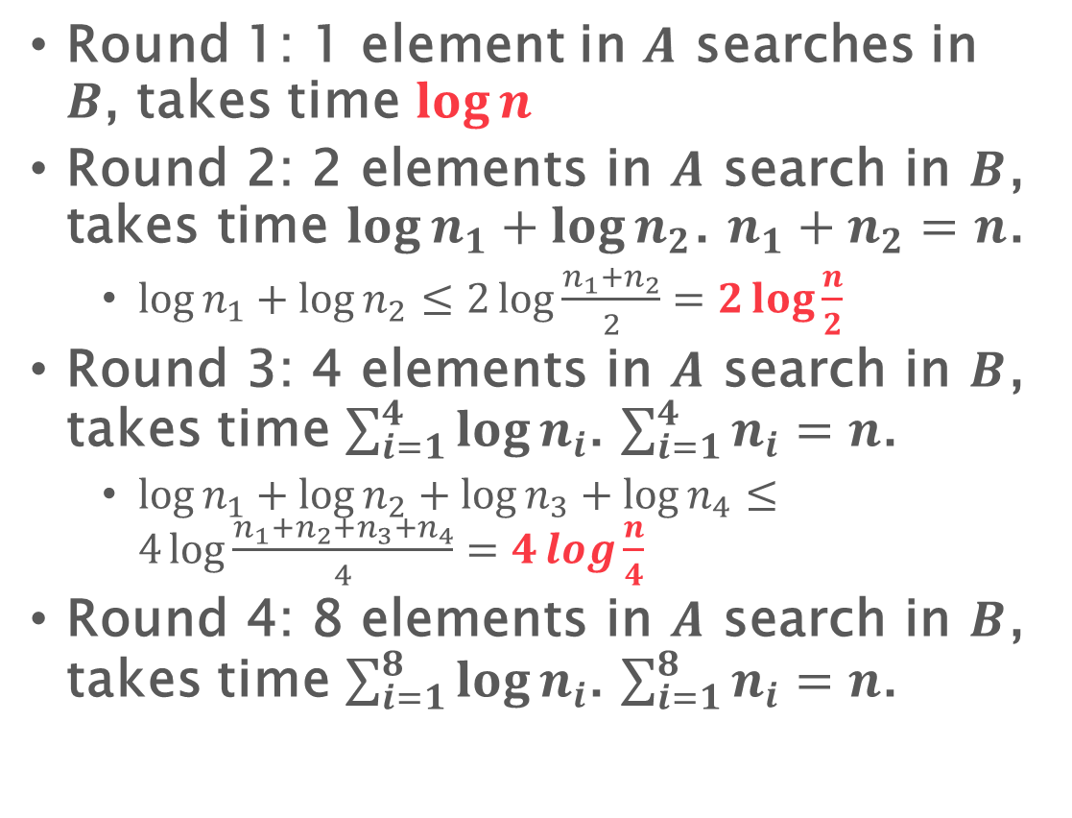
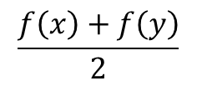

Parallel Merge: work
Concavity of log:
$$\frac{f\left(x\right)+f\left(y\right)}{2}≤f\left(\frac{x+y}{2}\right)$$
$$f\left(\frac{x+y}{2}\right)$$
$W\left(n\right)=W\left(n_{1}\right)+W(n−n_{1})+\log{n}$
Round 1: 1 element in $A$ searches in $B$, takes time $\log{n}$
Round 2: 2 elements in $A$ search in $B$, takes time $\log{n_{1}}+\log{n_{2}}$. $n_{1}+n_{2}=n$.
$\log{n_{1}}+\log{n_{2}}≤2\log{\frac{n_{1}+n_{2}}{2}}=2\log{\frac{n}{2}}$
Round 3: 4 elements in $A$ search in $B$, takes time $\sum_{i=1}^{4}{\log{n_{i}}}$. $\sum_{i=1}^{4}{n_{i}}=n$.
$\log{n_{1}}+\log{n_{2}}+\log{n_{3}}+\log{n_{4}}≤4\log{\frac{n_{1}+n_{2}+n_{3}+n_{4}}{4}}=4\log{\frac{n}{4}}$
Round 4: 8 elements in $A$ search in $B$, takes time $\sum_{i=1}^{8}{\log{n_{i}}}$. $\sum_{i=1}^{8}{n_{i}}=n$.
$$\frac{f\left(x\right)+f\left(y\right)}{2}$$
More generally:
$$\sum_{i=1}^{n}{\log{n_{i}}}≤n\log{\frac{\sum_{i=1}^{n}{n_{i}}}{n}}$$
Sum of $n$ logs is no more than $n$ times the log of their average value
$$\frac{1}{n}\sum_{i=1}^{n}{\log{n_{i}}}≤\log{\frac{\sum_{i=1}^{n}{n_{i}}}{n}}$$
The average of $n$ logs is no more than log of the average of the input variables

Slide 31
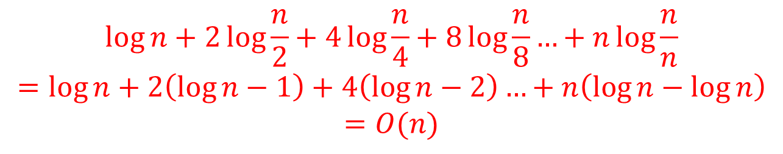
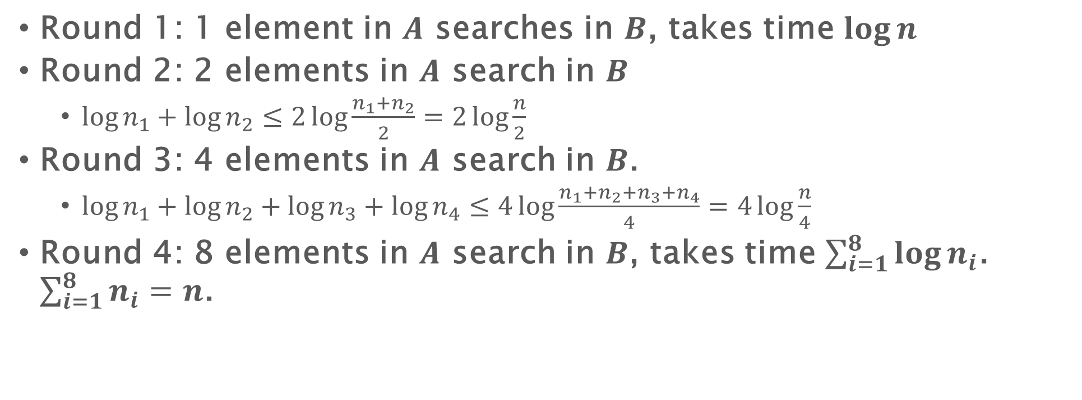
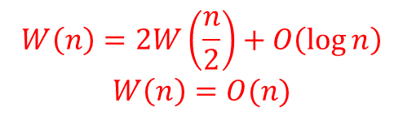
Parallel Merge: work
$W\left(n\right)=W\left(n_{1}\right)+W(n−n_{1})+\log{n}$
Round 1: 1 element in $A$ searches in $B$, takes time $\log{n}$
Round 2: 2 elements in $A$ search in $B$
$\log{n_{1}}+\log{n_{2}}≤2\log{\frac{n_{1}+n_{2}}{2}}=2\log{\frac{n}{2}}$
Round 3: 4 elements in $A$ search in $B$.
$\log{n_{1}}+\log{n_{2}}+\log{n_{3}}+\log{n_{4}}≤4\log{\frac{n_{1}+n_{2}+n_{3}+n_{4}}{4}}=4\log{\frac{n}{4}}$
Round 4: 8 elements in $A$ search in $B$, takes time $\sum_{i=1}^{8}{\log{n_{i}}}$. $\sum_{i=1}^{8}{n_{i}}=n$.
$$\log{n}+2\log{\frac{n}{2}}+4\log{\frac{n}{4}}+8\log{\frac{n}{8}}…+n\log{\frac{n}{n}}$$
$$=\log{n}+2\left(\log{n}−1\right)+4\left(\log{n}−2\right)…+n\left(\log{n}−\log{n}\right)$$
$$=O(n)$$
$$W\left(n\right)=2W\left(\frac{n}{2}\right)+O\left(\log{n}\right)$$
$$W\left(n\right)=O(n)$$
Use Master Theorem
This is leaf-dominated

Slide 32
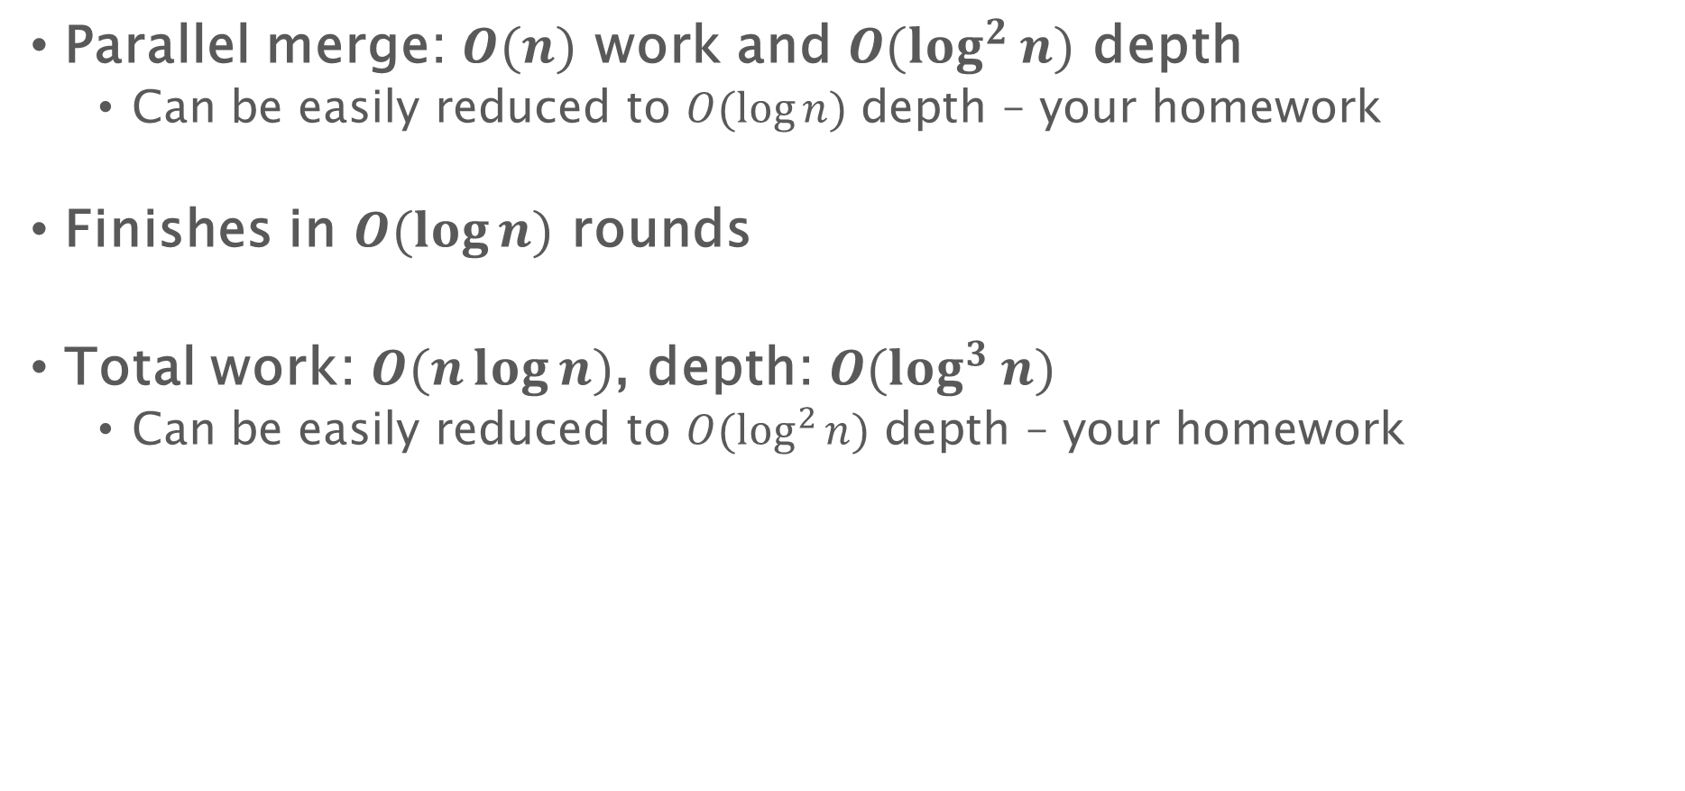
Parallel merge sort
Parallel merge: $O(n)$ work and $O(\log^{2}{n})$ depth
Can be easily reduced to $O(\log{n})$ depth – your homework
Finishes in $O(\log{n})$ rounds
Total work: $O(n\log{n})$, depth: $O(\log^{3}{n})$
Can be easily reduced to $O(\log^{2}{n})$ depth – your homework

Slide 33
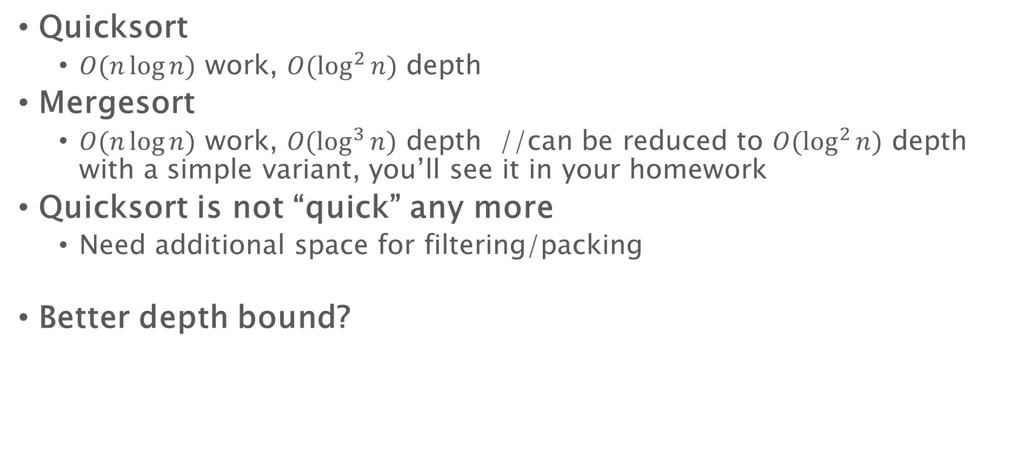
Parallel sorting algorithms
Quicksort
$O(n\log{n})$ work, $O(\log^{2}{n})$ depth
Mergesort
$O(n\log{n}) \text{work}\text{, }O(\log^{3}{n}) \text{depth}$ //can be reduced to $O(\log^{2}{n})$ depth with a simple variant, you’ll see it in your homework
Quicksort is not “quick” any more
Need additional space for filtering/packing
Better depth bound?

Slide 34
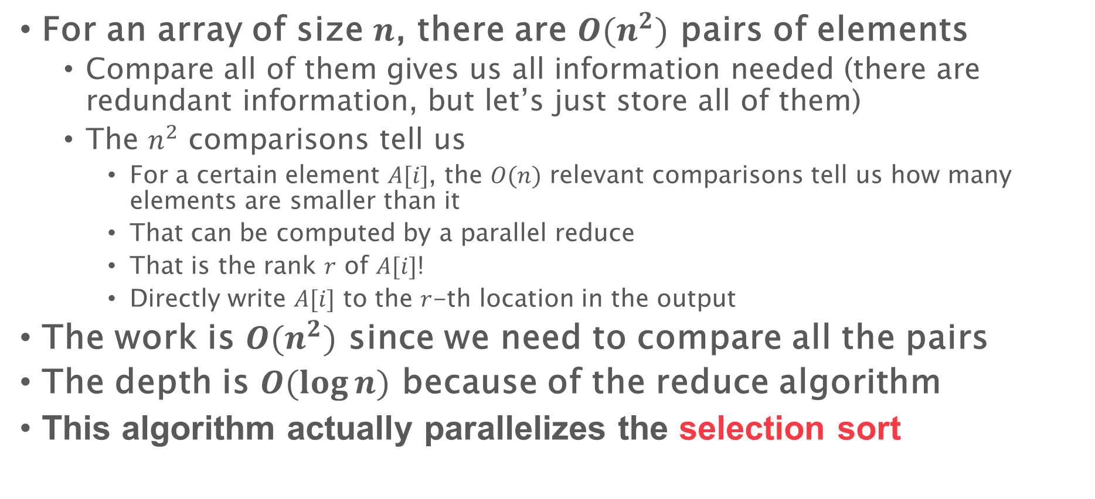
Parallel sorting - $O(n^{2})$ work and $O(\log{n})$ depth
For an array of size $n$, there are $O(n^{2})$ pairs of elements
Compare all of them gives us all information needed (there are redundant information, but let’s just store all of them)
The $n^{2}$ comparisons tell us
For a certain element $A[i]$, the $O(n)$ relevant comparisons tell us how many elements are smaller than it
That can be computed by a parallel reduce
That is the rank $r$ of $A[i]$!
Directly write $A[i]$ to the $r$-th location in the output
The work is $O(n^{2})$ since we need to compare all the pairs
The depth is $O(\log{n})$ because of the reduce algorithm
This algorithm actually parallelizes the selection sort

Slide 35
List Ranking

Slide 36
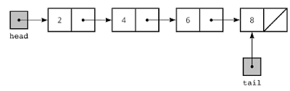
Linked Lists
Linked lists are simple and important data structures
Sometimes we have a tree of nodes with pointers indicating their parents
We want to know the rank of each node (e.g., the distance to the head/tail)

Slide 37
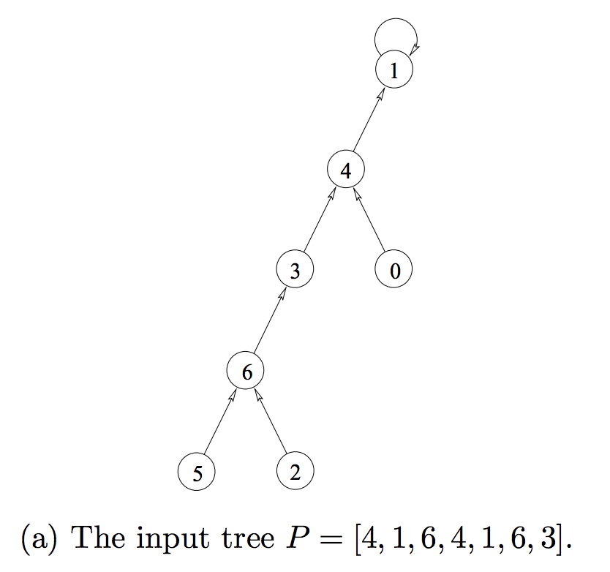
List Ranking
Input array P, P[i]=j means that the i-th element’s parent is the j-th element
In practice the input can be a linked list with next/parent pointers
Follow the pointers until reaching the root
Source: “Parallel Algorithms” by Guy E. Blelloch and Bruce M. Maggs

Slide 38
Work-Efficient List Ranking
Idea: reduce the problem size by a constant factor per round, and apply the algorithm recursively
ListRanking(list P)
If list has two or fewer nodes, then return //base case
Every node flips a fair coin
For each vertex u (except the last vertex), if u flipped Tails and P[u] flipped Heads then u will be paired with P[u]
rank(u) = rank(u)+rank(P[u])
P[u] = P[P[u]]
Recursively call ListRanking on smaller list
Insert contracted nodes v back into list with rank(v) = rank(v) + rank(P[v])
Remove an element if:
It is head
Its previous element is a tail
1
1
1
1
1
0
T
H
H
T
H
T
2
1
2
0
Source: MIT 6.886 by Julian Shun

Slide 39
Work-Efficient List Ranking
1
1
1
1
1
0
T
H
H
T
H
T
Contract + packing
2
1
2
0
Apply recursively
5
3
2
0
Expand
5
4
3
2
1
0
Source: MIT 6.886 by Julian Shun

Slide 40

Work-Depth Analysis
Remove an element if:
It is head
Its previous element is a tail
Number of pairs per round is reduced by (n-1)/4 in expectation
For all nodes u except for the last node, probability of u flipping Head and its previous element flipping Tails is 1/4
=> A node gets removed with probability 1/4
Each round takes linear work and O(log n) depth
Expected work: W(n) ≤ W(3n/4) + O(n)
Expected depth: D(n) ≤ D(3n/4) + O(log n)
W = O(n)
D = O(log² n)
$D=O(\log{n})$ in arbitrary-forking
Randomization is our good friend!!!
Source: MIT 6.886 by Julian Shun

Slide 41
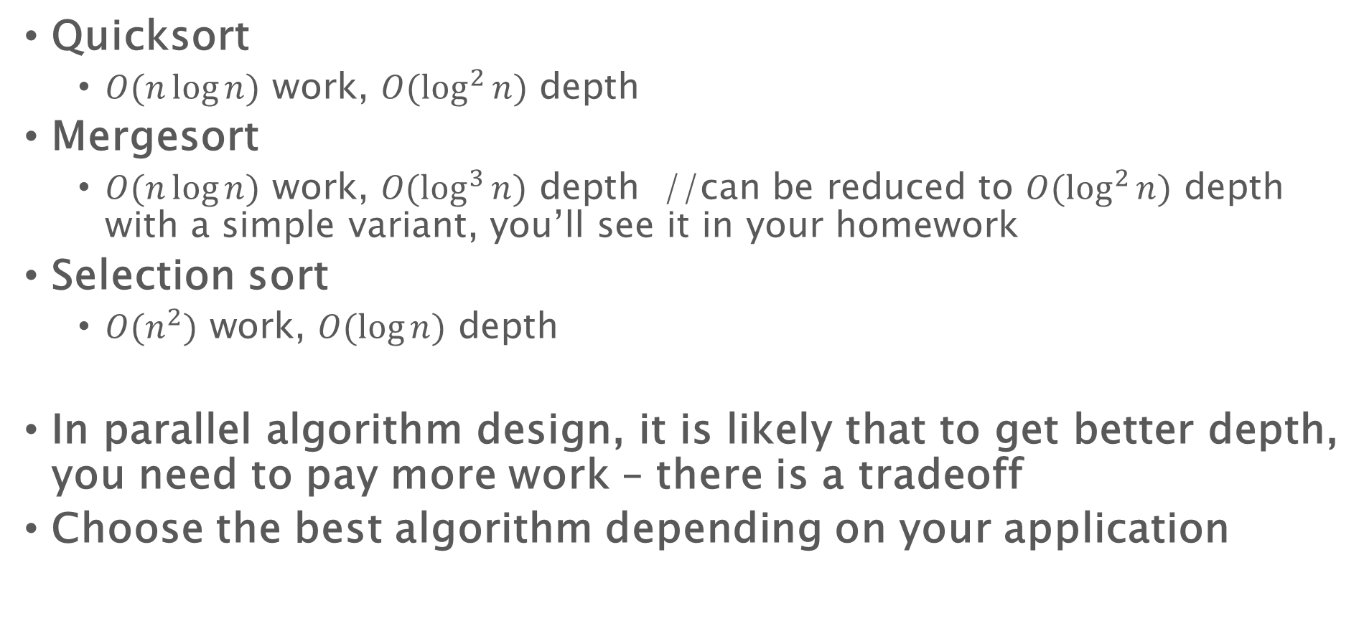
Parallel sorting algorithms
Quicksort
$O(n\log{n})$ work, $O(\log^{2}{n})$ depth
Mergesort
$O(n\log{n}) \text{work}\text{, }O(\log^{3}{n}) \text{depth}$ //can be reduced to $O(\log^{2}{n})$ depth with a simple variant, you’ll see it in your homework
Selection sort
$O(n^{2}) \text{work}\text{, }O(\log{n}) \text{depth}$
In parallel algorithm design, it is likely that to get better depth, you need to pay more work – there is a tradeoff
Choose the best algorithm depending on your application

Slide 42
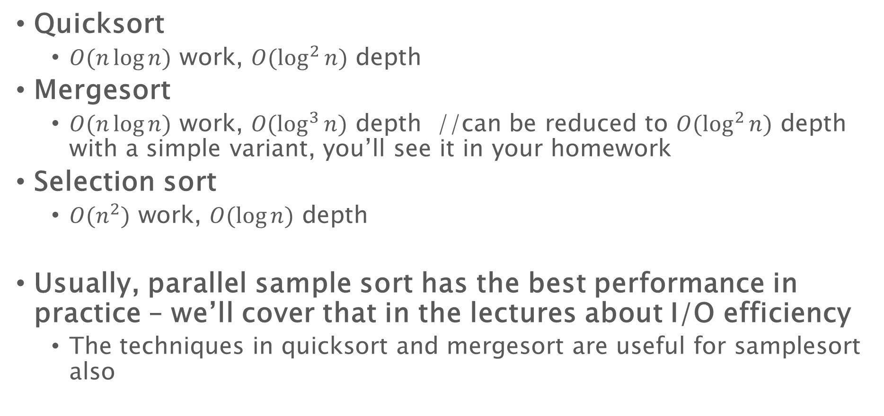
Parallel sorting algorithms
Quicksort
$O(n\log{n})$ work, $O(\log^{2}{n})$ depth
Mergesort
$O(n\log{n}) \text{work}\text{, }O(\log^{3}{n}) \text{depth}$ //can be reduced to $O(\log^{2}{n})$ depth with a simple variant, you’ll see it in your homework
Selection sort
$O(n^{2}) \text{work}\text{, }O(\log{n}) \text{depth}$
Usually, parallel sample sort has the best performance in practice – we’ll cover that in the lectures about I/O efficiency
The techniques in quicksort and mergesort are useful for samplesort also

