Slide 1
Parallel data structures

Slide 2





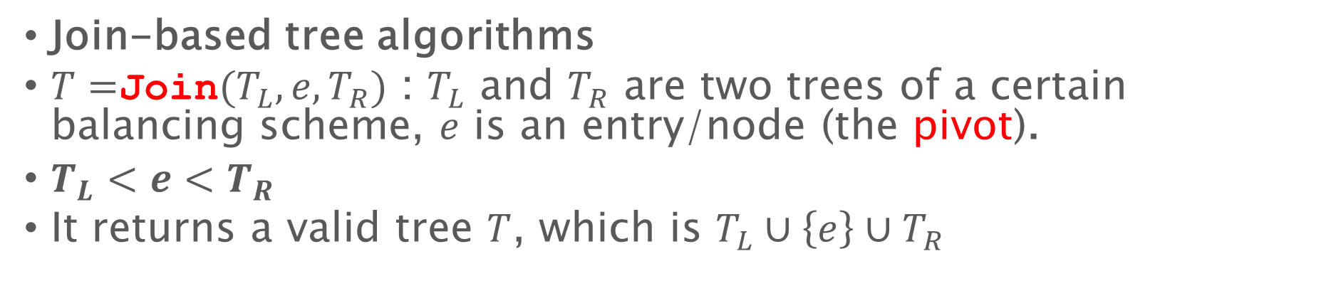





Last lecture: parallel trees
Join-based tree algorithms
$T=$Join$(T_{L},e,T_{R})$ : $T_{L}$ and $T_{R}$ are two trees of a certain balancing scheme, $e$ is an entry/node (the pivot).
$T_{L}<e<T_{R}$
It returns a valid tree $T$, which is $T_{L}∪\left\{e\right\}∪T_{R}$
$$T_{L}$$
$$T_{R2}$$
$$e$$
$$T=$$
4
2
10
$$T_{R}$$
$$e$$
$$T_{L}$$
(Rebalance if necessary)

Slide 3
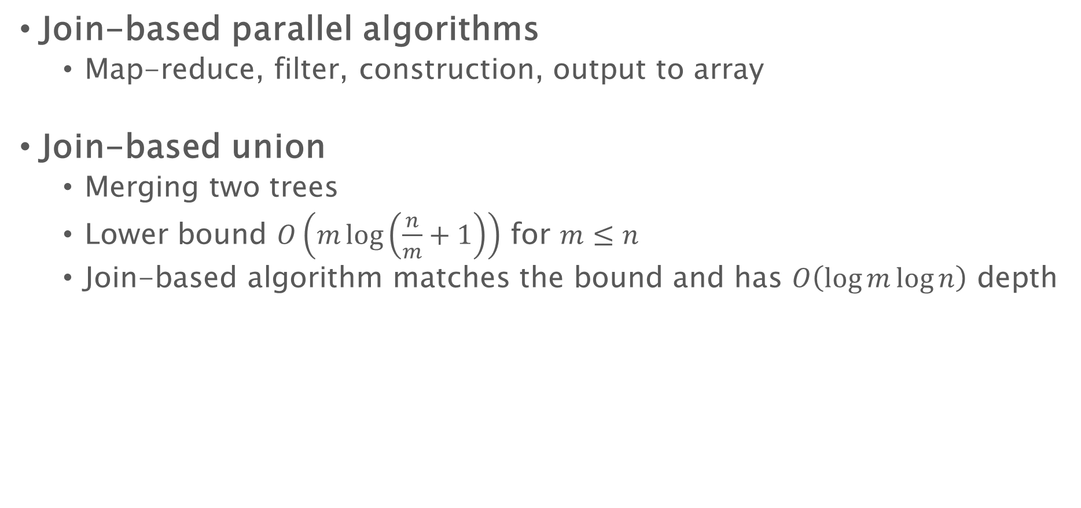
Parallel trees
Join-based parallel algorithms
Map-reduce, filter, construction, output to array
Join-based union
Merging two trees
Lower bound $O\left(m\log\left(\frac{n}{m}+1\right)\right)$ for $m≤n$
Join-based algorithm matches the bound and has $O\left(\log{m}\log{n}\right)$ depth

Slide 4


Persistence Using Join
Path-copying: copy the affected path on trees
Copying occur only in Join!
All the other parts in the algorithm remain unchanged
No extra cost in time asymptotically, small overhead in space
Safe for concurrency – multi-version concurrency control (MVCC)
$$T_{1}$$
$$T_{2}$$
5
5’
5’
3’
3
8
3’
1
4
9

Slide 5
Batching
Collect all concurrent writes can commit using a single writer once a while
Insert 15
delete 16
Insert 8
Delete 6
Insert 5
Insert 9
Delete 3
Batching layer
Union of [5,8,9,15]
Difference of [3,6,16]
Database

Slide 6


Garbage Collection
Each tree node records the number of other tree nodes/pointers refers to it
Node 8 and 1 in the example have reference counter 2
Collect a node if and only if its reference count is 1
$$T_{1}$$
$$T_{2}$$
5
5’
3
8
3’
1
4
9
Node | 1 | 3 | 5 | 8 | 9 | 5’ | 3’ | 4
Count | 2 | 1 | 1 | 2 | 1 | 1 | 1 | 1
1
1

Slide 7
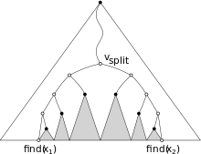
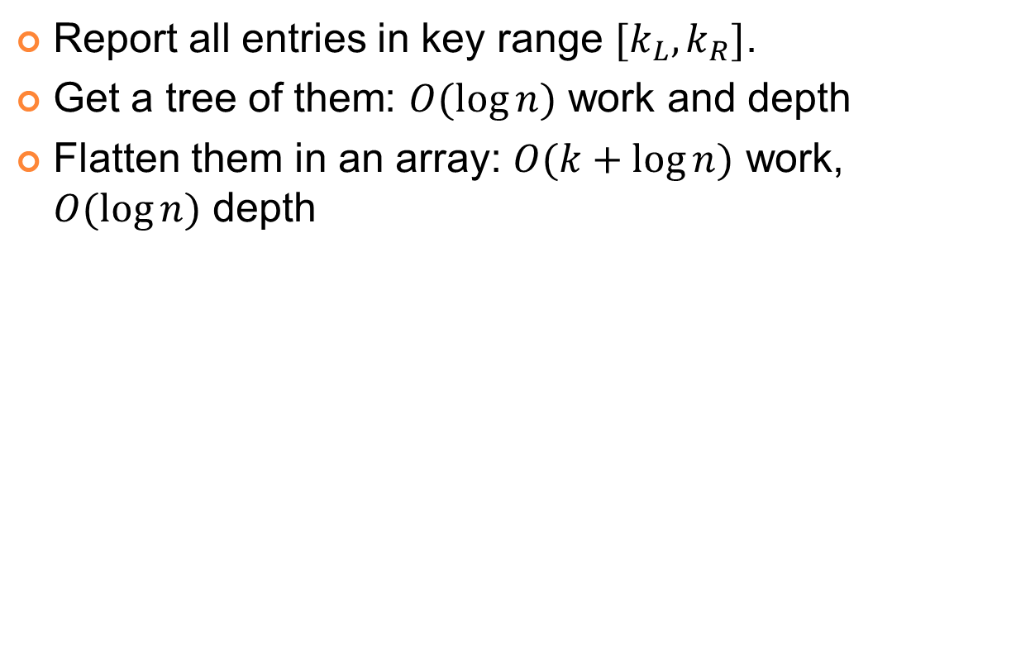



Range query (1D)
Report all entries in key range $[k_{L},k_{R}]$.
Get a tree of them: $O(\log{n})$ work and depth
Flatten them in an array: $O(k+\log{n})$ work, $O(\log{n})$ depth
Equivalent to using two split algorithms
$O(\log{n})$ related nodes / subtrees
$$k_{L}$$
$$k_{R}$$

Slide 8
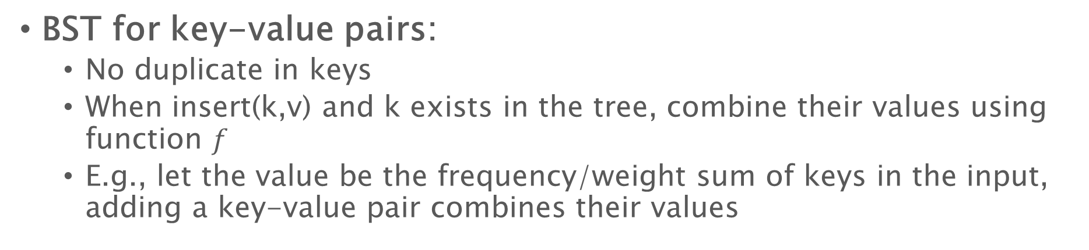
Extend union/insertion to support combine functions
BST for key-value pairs:
No duplicate in keys
When insert(k,v) and k exists in the tree, combine their values using function $f$
E.g., let the value be the frequency/weight sum of keys in the input, adding a key-value pair combines their values
insert
11, 1
5, 10
insert
4, 2
8, 9
2, 7
1, 13
4, 4
4, 6
11, 1

Slide 9
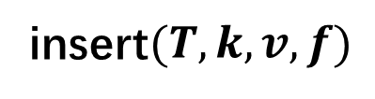
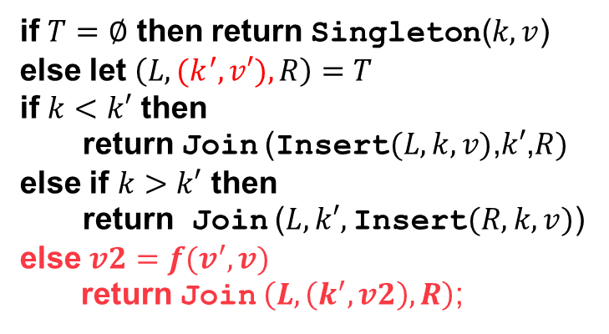
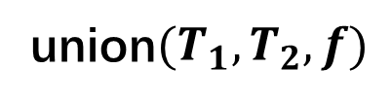
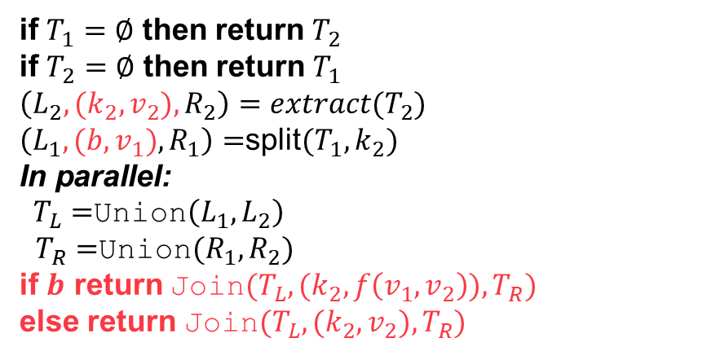
Extend union/insertion to support combine functions
union$(T_{1},T_{2},f)$
insert$(T,k,v,f)$
if $T_{1}=∅$ then return $T_{2}$
if $T_{2}=∅$ then return $T_{1}$
$\left(L_{2},(k_{2},v_{2}),R_{2}\right)=extract(T_{2})$
$\left(L_{1},(b,v_{1}),R_{1}\right)=$split$(T_{1},k_{2})$
In parallel:
$T_{L}=$Union$\left(L_{1},L_{2}\right)$
$T_{R}=$Union$(R_{1},R_{2})$
if $b$ return Join$(T_{L},(k_{2}, f\left(v_{1},v_{2}\right)), T_{R})$
else return Join$(T_{L},(k_{2},v_{2}),T_{R})$
if $T=∅$ then return Singleton($k,v$)
else let $\left(L,(k^{′},v′),R\right)=T$
if $k<k′$ then
return Join (Insert$(L,k,v)$,$k′$,$R)$
else if $k>k′$ then
return Join ($L, k′,$Insert$(R,k,v)$)
else $v2=f(v^{′},v)$
return Join $\left(L,\left(k^{′},v2\right),R\right)$;

Slide 10

Extend union/insertion to support combine functions
BST for key-value pairs:
Similarly for union/intersection/build
Build: first sort all keys, then duplicates will be contiguous
Combine their values using $f$, use the new value for the key
Construct the tree from the list with no duplicate keys

Slide 11
Augmenting trees

Slide 12

Augmented Trees for 1D Range Query
Each tree node store some extra information about the whole subtree rooted at it (E.g., partial sum)
key,value
4,11
54
$O(\log{n})$ related nodes / subtrees
Partial sum
sum of values in its subtree
2,7
6,10
13
30
1,4
3,2
5,17
7,3
$$k_{L}$$
$$k_{R}$$
4
2
17
3
Range sum query (sum of values in a key range):
$O(\log{n})$ time

Slide 14


Augmented Trees for 1D Range Query
Different functionalities are achieved by different augmentations
key,value
4,11
Partial “sum”
17
max of values in its subtree
2,7
6,10
Filter all values $≥10$
7
17
1,4
3,2
5,17
7,3
4
2
17
3
The maximum value in a certain key range
Filter all entries with value $≥v_{0}$

Slide 15

Augmentation – Formalization
4,11
We give a definition with respect to ordered key-value pairs and a map-reduce operation
Each tree node stores a key-value pair ($K×V$)
Each tree node also maintains some information about the whole subtree ($∈A$):
key,value
54
Partial “sum”
2,7
6,10
13
30
1,4
3,2
5,17
7,3
4
2
17
3
The augmented value

Slide 16
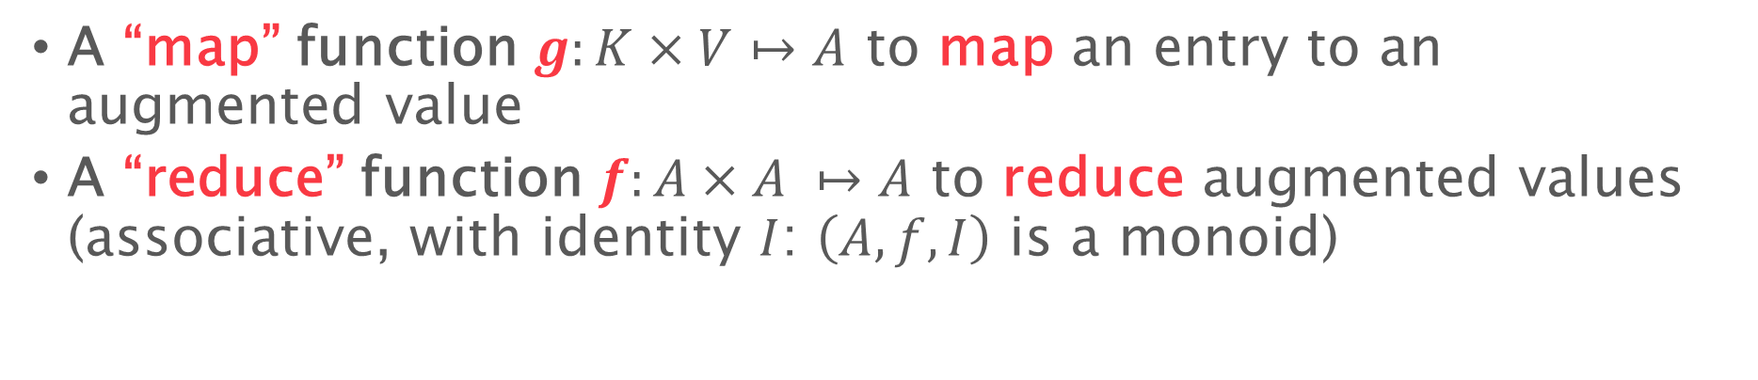
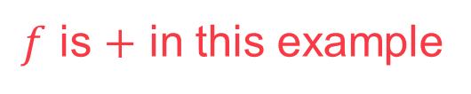

Augmentation – Formalization
key,value
4,11
11
Partial “sum”
54
= 4 + 7 + 2 + 11 + 17 + 10 + 3
2,7
7
6,10
10
13
= 4 + 7 + 2
30
= 17 + 10 + 3
1,4
4
3,2
2
5,17
17
7,3
3
4
= 4
2
= 2
17
= 17
3
= 3
The augmented value
Al“map” function $g:K×V↦A$ to map an entry to an augmented value
Al“reduce” function $f:A×A ↦A$ to reduce augmented values (associative, with identity $I$: $\left(A,f,I\right)$ is a monoid)
$g$ is $\left(k,v\right)↦v$ in this example
$f$ is $+$ in this example

Slide 17

Augmentation – Formalization
key,value
4,11
11
Partial “sum”
54
= 4 + 7 + 2 + 11 + 17 + 10 + 3
Al“map” function $g:K×V↦A$
Al“reduce” function $f:A×A ↦A$
$a\left(u\right)=f\left(f\left(a\left(lc\left(u\right)\right),g\left(entry\left(u\right)\right)\right),a\left(rc\left(u\right)\right)\right)$
2,7
7
6,10
10
13
= 4 + 7 + 2
30
= 17 + 10 + 3
1,4
4
3,2
2
5,17
17
7,3
3
4
= 4
2
= 2
17
= 17
3
= 3
The augmented value
$a(u)$: the augmented value of node $u$, $entry(u)$: the entry stored in node $u$
$lc(u)$ and $rc(u)$: the left/right child of node u.

Slide 18
Augmentation – Formalization
key,value
4,11
11
Partial “sum”
54
= (4 + 7 + 2) + g(4,11) + (17 + 10 + 3)
Al“map” function $g:K×V↦A$
Al“reduce” function $f:A×A ↦A$
$a\left(u\right)=f\left(f\left(a\left(lc\left(u\right)\right),g\left(entry\left(u\right)\right)\right),a\left(rc\left(u\right)\right)\right)$
2,7
7
6,10
10
13
= 4 + 7 + 2
30
= 17 + 10 + 3
1,4
4
3,2
2
5,17
17
7,3
3
4
= 4
2
= 2
17
= 17
3
= 3
The augmented value
$a(u)$: the augmented value of node $u$, $entry(u)$: the entry stored in node $u$
$lc(u)$ and $rc(u)$: the left/right child of node u.

Slide 19

Augmentation – Formalization
key,value
4,11
11
Partial “sum”
54
= 13 + 11 + 30
Al“map” function $g:K×V↦A$
Al“reduce” function $f:A×A ↦A$
$a\left(u\right)=f\left(f\left(a\left(lc\left(u\right)\right),g\left(entry\left(u\right)\right)\right),a\left(rc\left(u\right)\right)\right)$
Update the augmented value only in Join
Does not affect the asymptotical cost if $g$ and $f$ are simple
2,7
7
6,10
10
13
= 4 + 7 + 2
30
= 17 + 10 + 3
1,4
4
3,2
2
5,17
17
7,3
3
4
= 4
2
= 2
17
= 17
3
= 3
The augmented value

Slide 20
Augmented trees
Define keys and values
Define what is the augmented value
Define what is the map function
Define what is the reduce function (and identity)

Slide 21

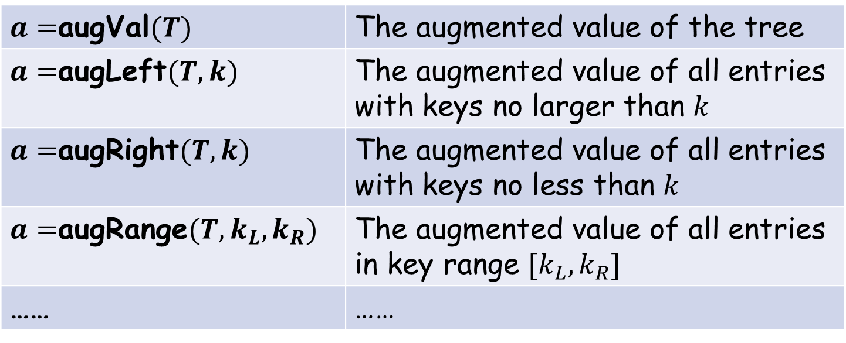
Useful interface for range queries
$a=$augVal$(T)$ | The augmented value of the tree
$a=$augLeft$(T,k)$ | The augmented value of all entries with keys no larger than $k$
$a=$augRight$(T,k)$ | The augmented value of all entries with keys no less than $k$
$a=$augRange$(T,k_{L}, k_{R})$ | The augmented value of all entries in key range $[k_{L},k_{R}]$
…… | ……
$$O(\log{n})$$

Slide 22
Case study: Interval trees

Slide 23



Interval Trees
A set of intervals on number line defined by end points (left, right) sorted by their left endpoints
Augment the tree with the maximum right endpoint in its subtree
Stabbing query: is point $p$ covered by any interval?
Stabbing query at $p=5$
1
2
3
4
5
6
7
8
9
(3,5)
(number line)
(2,6)
(1,7)
(4,5)
(5,6)
(6,7)
(7,9)
9
(4,5)
7
9
(2,6)
(6,7)
(left,right) | Max right
7
5
6
9
7
9
(1,7)
(3,5)
(5,6)
(7,9)
(key,val) | aug_val
Notes:
This is actually the example of augmented trees used in the book introduction to algorithms. The interval tree stores a set of intervals on the number line defined by their left and right end points. In the tree, intervals are sorted by their left endpoint. So these seven intervals are ordered by the left endpoints which are the red numbers one two three through seven. The other number in the pair is the right end point of the corresponding interval.
Each node is also augmented by the maximum right endpoint in its subtree, I will then show them in the empty cells here. In this subtree it is seven, here it is nine, for the root it is also nine.
This structure is often used to answer the stabbing query: whether a point p is covered by any interval or not.
Both the construction of the tree and the query can be done easily with the augmented map interface.
To do this First we need to define such an interval tree with an augmented map.

Slide 24

Interval Trees
Key: the left endpoint, value: the right endpoint.
Augmented value: maximum right endpoint
Map: $g\left(k,v\right)=v$ Reduce: $f\left(v_{1},v_{2}\right)=\max{(v_{1},v_{2})}$
Construct from a list of intervals $l$: $m_{I}=$ build$(l)$
1
2
3
4
5
6
7
8
9
(3,5)
(number line)
(2,6)
(1,7)
(4,5)
(5,6)
(6,7)
(7,9)
(4,5) | 9
(2,6) | 7
(6,7) | 9
(1,7) | 7
(3,5) | 5
(5,6) | 6
(7,9) | 9
(key,val) | aug_val
Notes:
The augmented map M_i defines such an interval tree. It is very similar to the sale receipts example with range max augmentation. it is defined to have keys to be the left endpoints, values to be the right end points, the augmented value is the maximum right endpoints. so K V and A are all the set of real numbers. The base function extracts the value, which is the right endpoint from the entry, the combine function is max.
Using the interface of augmented maps, constructing such an interval tree from a list of intervals is just to call the build function in the interface. As long as the augmented map is defined with proper base and combine functions, this build function will construct such an interval tree for you. So the construction is as easy as this one line of code.

Slide 25

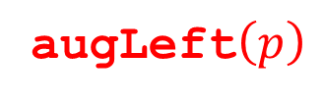

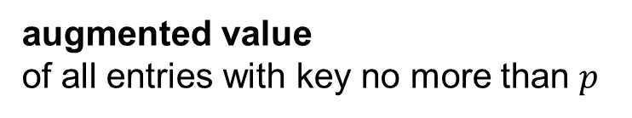
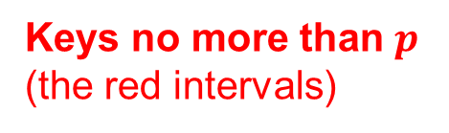


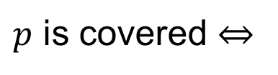
Interval Trees
Stabbing query on $p$:
$$≥p$$
1
2
3
4
5
6
7
8
9
(3,5)
(number line)
(2,6)
(1,7)
(4,5)
(5,6)
(6,7)
(7,9)
(4,5) | 9
(Example when $p=5$)
(2,6) | 7
(6,7) | 9
(1,7) | 7
(3,5) | 5
(5,6) | 6
(7,9) | 9
(key,val) | aug_val
Keys no more than $p$
(the red intervals)
$p$ is covered $⇔$
among all intervals starting before $p$, the maximum right end point $≥p$
augLeft$\left(p\right)$
augmented value
of all entries with key no more than $p$
augLeft$\left(p\right)$
(Calculated by max)
Notes:
Then the stabbing query. it asks whether p is covered by any interval, which is equivalent to the following condition: among all intervals starting before p, whether the maximum right point goes beyond p. So here’s an example when p is five. We first find all intervals starting before five, and find the maximum right end point of them, which is seven. Seven is larger than 5, so there must be at least one interval starts before five and ends after five. So the answer is yes, five is covered.
To answer the query we now need to figure out the left handside of this inequation. This actually can be calculated by the augleft function. Recall that augleft gives the augmented value of all entries with keys no more than p, which are exactly those intervals starting before p. So they are just the purple intervals here. The augmented value is calculated by the combine function, which is exactly max. So it is the maximum right endpoint. again, as long as the augmented map is properly defined, the query can be done with calling the augleft function in its interface and compare it with p. It is also just one line of code.
Actually

Slide 26
Case study: Range Tree

Slide 27
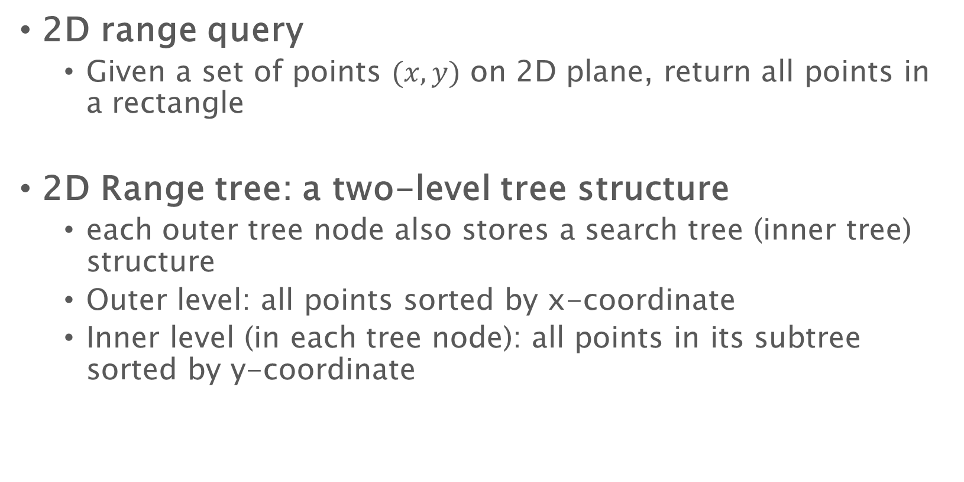
2D Range Tree
2D range query
Given a set of points $(x,y)$ on 2D plane, return all points in a rectangle
2D Range tree: a two-level tree structure
each outer tree node also stores a search tree (inner tree) structure
Outer level: all points sorted by x-coordinate
Inner level (in each tree node): all points in its subtree sorted by y-coordinate
Notes:
So what is the advantage of organizing points in this way? It is that for queries we can first search the range x l xr in the outer tree, finding order of log n related subtrees.
Then on each related inner tree we search the range y_l to y_r respectively, each costing order of log n. Then a 2d range query requires log n square time.
/*Note that the related trees are not subtrees in the outer tree, but are the inner trees associated at these tree nodes.*/

Slide 28
2D Range Tree
y
7
6
5
4
3
2
1
(1,7)
(4,5)
(2,6)
(6,4)
(5,1)
(3,3)
(7,2)
0
1 | 2 | 3 | 4 | 5 | 6 | 7
x
key (x,y) | inner tree
4,5
6,4
2,6
6,4
7,2
2,6
2,6
3,3
1,7
5,1
3,3
4,5
1,7
1,7
3,3
5,1
7,2
Notes:
Here’s an example. This is a range tree on the seven points. The first cell is the coordinate x comma y, the second cell is the weight, the last cell is the augmented value, which is the inner tree.in the outer tree points are sorted by the x-coordinate, so the order on x .
in each node, a secondary structure is maintained, with the exact points in its subtree, but are organized by y coordinate.
Here I write three of them as examples, and although I use lists, they are actually trees, and themselves augmented maps. For example, on the root, the associated inner tree contains the same the points in the outer tree but are organized by y. The order on y-coordinate is one two three upto seven.

Slide 29


















2D Range Tree
Query: $(x_{L},x_{R},y_{L},y_{R})$
$$x_{L},y_{L}$$
$$x_{R},y_{R}$$
A range query can be done by two nested range query on outer and inner level respectively
Report all points in the search range $O(\log^{2}{n}+k)$, where $k$ is the output size
Report the count in the search range: $O(\log^{2}{n})$
$$y_{L}$$
$$y_{R}$$
$$y_{L}$$
$$y_{R}$$
$$y_{L}$$
$$y_{R}$$
$$y_{L}$$
$$y_{R}$$
$$y_{L}$$
$$y_{R}$$
$$x_{L}$$
$$x_{R}$$
$$y_{L}$$
$$y_{R}$$
Notes:
So what is the advantage of organizing points in this way? It is that for queries we can first search the range x l xr in the outer tree, finding order of log n related subtrees.
Then on each related inner tree we search the range y_l to y_r respectively, each costing order of log n. Then a 2d range query requires log n square time.
/*Note that the related trees are not subtrees in the outer tree, but are the inner trees associated at these tree nodes.*/

Slide 30
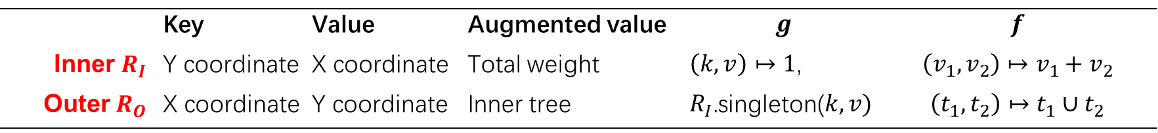


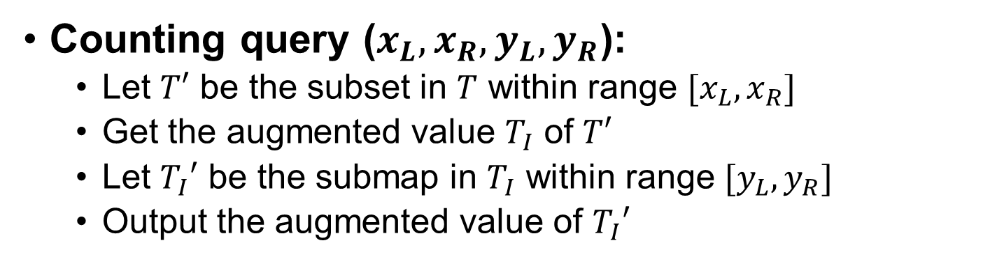
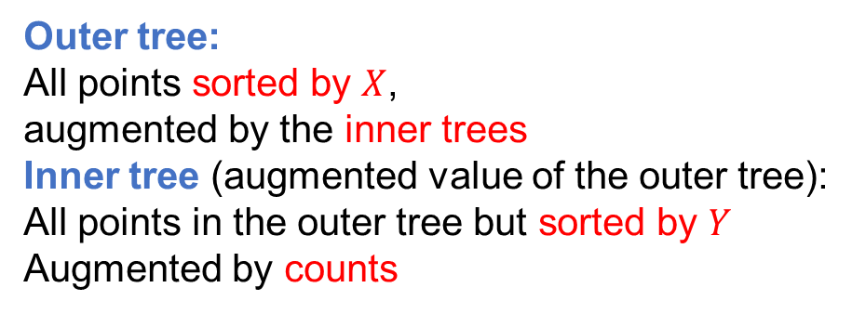
Model Range Query Using Augmented Trees
Outer tree:
All points sorted by $X$,
augmented by the inner trees
Inner tree (augmented value of the outer tree):
All points in the outer tree but sorted by $Y$
Augmented by counts
 | Key | Value | Augmented value | $$g$$ | $$f$$
Inner $R_{I}$ | Y coordinate | X coordinate | Total weight | $\left(k,v\right)↦1$, | $$\left(v_{1},v_{2}\right)↦v_{1}+v_{2}$$
Outer $R_{O}$ | X coordinate | Y coordinate | Inner tree | $R_{I}$.singleton($k,v)$ | $$\left(t_{1},t_{2}\right)↦t_{1}∪t_{2}$$
Counting query ($x_{L},x_{R},y_{L},y_{R}$):
Let $T′$ be the subset in $T$ within range $[x_{L},x_{R}]$
Get the augmented value $T_{I}$ of $T′$
Let $T_{I}′$ be the submap in $T_{I}$ within range $[y_{L},y_{R}]$
Output the augmented value of $T_{I}′$
$T_{I}$ = aug_range($T,x_{L},x_{R}$)
Output aug_range($T_{I},y_{L},y_{R}$)
Notes:
At this point let’s look at how this can help us solve the range queries. This is how we model the problem using a two-level nested augmented map. We store all the points in the outer map, sorted by x coordinates. The augmented value of the outer map, is an inner map, storing the same set of points, but sorted by y coordinates. The inner map is also augmented. The augmented value is the size of the map. So for the inner map, the base function always returns 1, and the combine function is addition.
For the outer map, because the augmented values are inner maps, the base functions is a singleton to construct an inner map, and the combine function is a union of two inner maps. For a counting query on such a map, we will need to first narrow the range down to the stripe in x_l to x_r, this is done on the outer map because the outer map is sorted by x. We find the augmented value of this sub map by using aug_range, it will be an inner map storing all the points in this stripe, but sorted by y coordinates. So we can further search the range y_l to y_r to narrow it down to the query window. We also use aug_range, it will output the number of query points. list all queries can be answered similarly.
So this is the high-level modelling for the problem. For concrete implementation, as I mentioned, we can use augmented tree structures for both levels.

Slide 31
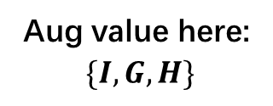
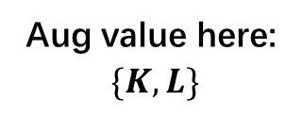

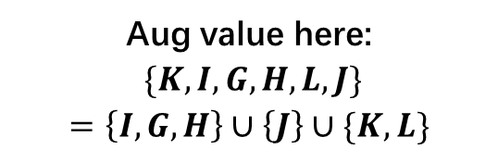
Range Query
Range Tree
The outer aug_range involves several inner trees
Call aug_range on each of them respectively
Aug value here:
$$\{K,I,G,H,L,J\}$$
$$=\left\{I,G,H\right\}∪\left\{J\right\}∪\{K,L\}$$
F
C
J
$$\{D,E\}$$
J
A
D
H
L
D
H
Aug value here:
$$\{I,G,H\}$$
Aug value here:
$$\{K,L\}$$
y
L
B
J
c
Counting query:
2 + 1 = 3
C
H
E
G
D
F
I
A
K
x
Notes:
Then we directly get a standard range tree structure. Here’s an example of the first three levels of the outer range tree. For example, the subtree at node H will store all points in the stripe here. The augmented value will be I, G and H in order. Similarly, at J the augmented value is K, I ,G, H,L,J in order.
For queries, one thing worth noting is that in PAM uses an optimization for nested aug_range queries on trees, very similar to the standard range tree query algorithm. So for example, for counting queries, we find all related inner trees and apply aug_range on them respectively, and then combine the result. You can find more details in the paper.

Slide 32

Augmented trees for 2D range tree
Construct the tree in $O(n\log{n})$ work and $O(\log^{3}{n})$ depth
Query of reporting the count of elements in $O(\log^{2}{n})$ work
Query of reporting all points in the rectangle in $O(\log^{2}{n}+k)$ work and $O(\log^{2}{n}+\log{k})$ depth
$k$ is the output size

Slide 33
Case study: Index searching

Slide 34
Document Searching
Inverted index
Searching queries:
Find corresponding document lists
Document 1:
Blue whales are the largest animals ever known to have lived on Earth.
Word | Document list
… | …
blue | 1, 4
whale | 1, 4
earth | 1
largest | 1, 2
calories | 3, 4
mammals | 2
head | 3
Eat | 4
half | 4
million | 4
mouthful | 4
Add a new document:
All updates need to be done atomically
Document 2:
Elephants are the largest land mammals.
Add document 4
Document 3:
Banging your head against a wall for one hour burns 150 calories.
Add “4” to the lists of {Blue, whales, eat, half, million, calories, mouthful}
Document 4:
Blue whales eat half a million calories in one mouthful.

Slide 35
Inverted Indexes
Stores each word in the outer tree with its document list as an inner tree
Queries: concurrent analytical queries are done on the current version
OR/AND query: union/intersection on the two document lists
Nested trees: represent the affiliation relation
Orange objects: words
Blue objects: documents
parallel
tree
join
D3
union
D2
algorithm
optimal
D5
D2
D1
D4

Slide 36
Inverted Indexes
Updates: take a Union with path-copying (update inner tree for duplicates)
Atomic: make multiple word-doc pairs visible at once
Non-destructive: old versions for ongoing queries
new version
current version
Orange objects: words
Blue objects: documents
parallel
parallel’
tree’
join
tree
D3
D3’
algorithm
optimal
D5’
union
D7:
parallel tree
D5
D2
D2’
D2
D7
D4’
D1
D4
D7
new_version = current_version.add({(parallel, D7), (tree, D7)}, f)
current_version = new_version
f(t1,t2)= union(t1,t2)

Slide 37
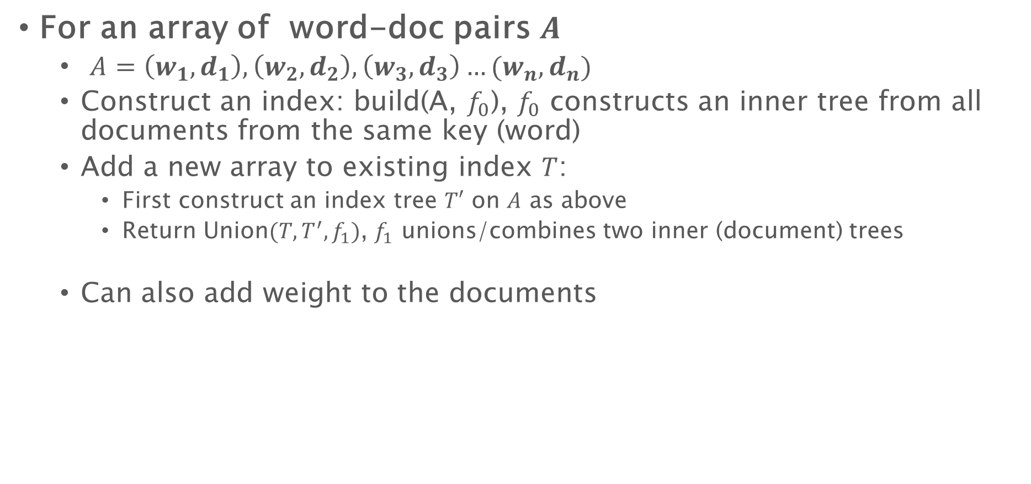
Inverted index
For an array of word-doc pairs $A$
$A=\left(w_{1},d_{1}\right),\left(w_{2},d_{2}\right),\left(w_{3},d_{3}\right)…(w_{n},d_{n})$
Construct an index: build(A, $f_{0}$), $f_{0}$ constructs an inner tree from all documents from the same key (word)
Add a new array to existing index $T$:
First construct an index tree $T′$ on $A$ as above
Return Union$(T,T^{′},f_{1})$, $f_{1}$ unions/combines two inner (document) trees
Can also add weight to the documents

Slide 38
Case study: Dynamic graphs

Slide 39
Application: Online Graph Processing
Stores each vertex in the outer tree with its edge list
Concurrent analytical queries see a snapshot on the current version
At the same time, new vertices can be added to the database atomically
new_version = current_version.add((6, 1), (1, 6), (4, 6), (6, 4))
current_version = new_version
3
1
3
4
6
2
2
2
5
4
1
5
5
1

Slide 40
Useful library
All join-based algorithms are implemented in library PAM
https://github.com/cmuparlay/PAM
Join-based trees for dynamic graph processing available in library ASPEN
https://github.com/ldhulipala/aspen
Also with compression

