Slide 1
Parallel Algorithms: Theory and Practice

Slide 2
Last Lecture
Two scan algorithms
Divide-and-conquer
Reduce the problem size
Computational models
PRAM
Fork-join: N-way vs. binary
Atomic primitives
Implement parallel algorithms using C++
I’ll ask for your feedback (about) every two lectures, you can be prepared for that

Slide 3
In this lecture
Matrix multiplication
Solve recurrences using Master Theorem
Some applications that can be solved in parallel

Slide 4
Matrix Multiplication

Slide 5
Matrix Multiplication
Consider standard iterative matrix-multiplication algorithm
Z
X
Y
:=
Where $X$, $Y$, and $Z$ are $N×N$ matrices
for i = 1 to N do
for j = 1 to N do
for k = 1 to N do
Z[i][j] += X[i][k] * Y[k][j]
$Θ(N3)$ computation in RAM model.

Slide 6
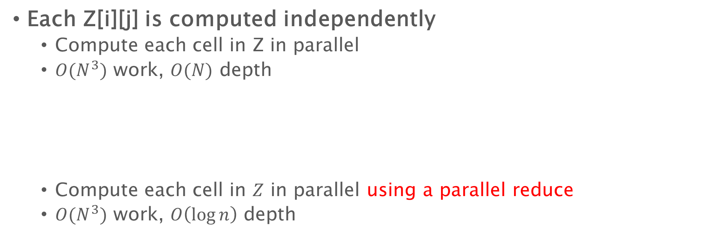
Matrix Multiplication
for i = 1 to N do
for j = 1 to N do
for k = 1 to N do
Z[i][j] += X[i][k] * Y[k][j]
Each Z[i][j] is computed independently
Compute each cell in Z in parallel
$O(N^{3})$ work, $O(N)$ depth
Compute each cell in $Z$ in parallel using a parallel reduce
$O(N^{3})$ work, $O\left(\log{n}\right)$ depth
par_for i = 1 to N do
par_for j = 1 to N do
for k = 1 to N do
Z[i][j] += X[i][k] * Y[k][j]
par_for i = 1 to N do
par_for j = 1 to N do
par_for k = 1 to N do
temp[k] = X[i][k] * Y[k][j];
Z[i][j] = parallel_reduce(temp, N);

Slide 7
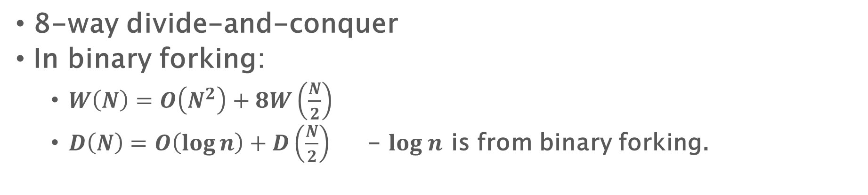
Recursive Matrix Multiplication
Compute 8 submatrix products recursively
Z₁₁ := X₁₁Y₁₁ + X₁₂Y₂₁
Z₁₂ := X₁₁Y₁₂ + X₁₂Y₂₂
Z₂₁ := X₂₁Y₁₁ + X₂₂Y₂₁
Z₂₂ := X₂₁Y₁₂ + X₂₂Y₂₁
Z₁₁
Z₁₂
X₁₁
X₁₂
Y₁₁
Y₁₂
:=
Z₂₁
Z₂₂
X₂₁
X₂₂
Y₂₁
Y₂₂
8-way divide-and-conquer
In binary forking:
$W\left(N\right)=O\left(N^{2}\right)+8W\left(\frac{N}{2}\right)$
$D\left(N\right)=O\left(\log{n}\right)+D\left(\frac{N}{2}\right)$ - $log n$ is from binary forking.
It is $O（1）$ for arbitrary-way forking
Notes:
Implementation: remember the base case

Slide 8
Matrix Multiplication
$W\left(N\right)=O\left(N^{2}\right)+8W\left(\frac{N}{2}\right)$
Omit constant:
$W\left(N\right)=N^{2}+8W\left(\frac{N}{2}\right)$
$W\left(\frac{N}{2}\right)={\left(\frac{N}{2}\right)}^{2}+8W\left(\frac{N}{4}\right)$
$W\left(\frac{N}{4}\right)={\left(\frac{N}{4}\right)}^{2}+8W\left(\frac{N}{8}\right)$
……
$D\left(N\right)=O\left(\log{n}\right)+D\left(\frac{N}{2}\right)$
$D\left(N\right)=O(\log^{2}{n})$
$W\left(N\right)=N^{2}+8W\left(\frac{N}{2}\right)$
$=N^{2}+8\left({\left(\frac{N}{2}\right)}^{2}+8W\left(\frac{N}{4}\right)\right)$
$=N^{2}+8{\left(\frac{N}{2}\right)}^{2}+64\left({\left(\frac{N}{4}\right)}^{2}+8W\left(\frac{N}{8}\right) \right)$
$=…$ ($\log_{2}{n}$ rounds)
$=N^{2}+2N^{2}+4N^{2}+…+8^{\log_{2}{n}}{\left(\frac{N}{2^{\log_{2}{n}}}\right)}^{2}$
$=O(N^{3})$

Slide 9
How to solve a recurrence in general?

Slide 10

Solving recurrences – Master Theorem
The Master Method for solving divide-and-conquer recurrences applies to the recurrences in the form:
$$T\left(n\right)=aT\left(\frac{n}{b}\right)+f\left(n\right)$$
Where $a≥1, b≥1$, and $f$ is asymptotically positive.
$f\left(c\right)$ is a constant when $c$ is a constant

Slide 11

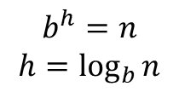


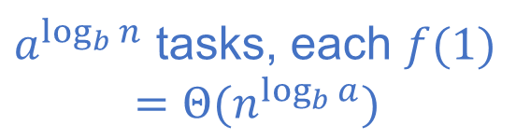



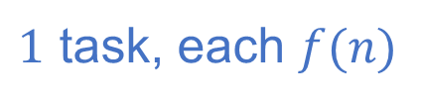
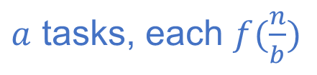

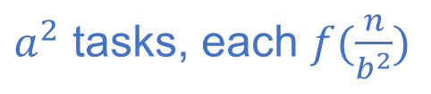
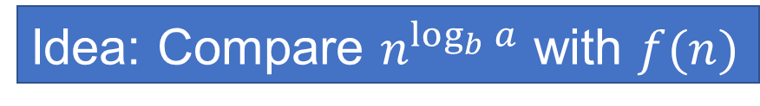
Recursion Tree: $T\left(n\right)=aT\left(\frac{n}{b}\right)+f(n)$
$$f(n)$$
$1$ task, each $f(n)$
$$a$$
$$f(n/b)$$
$$f(n/b)$$
$$f(n/b)$$
$$a$$
…
$a$ tasks, each $f(\frac{n}{b})$
$$b^{h}=n$$
$$h=\log_{b}{n}$$
$$f(n/b^{2})$$
$$f(n/b^{2})$$
$$f(n/b^{2})$$
…
$a^{2}$ tasks, each $f(\frac{n}{b^{2}})$
…
…
Idea: Compare $n^{\log_{b}{a}}$ with $f(n)$
$$f(O(1))$$
$a^{\log_{b}{n}}$ tasks, each $f(1)$
$$=Θ(n^{\log_{b}{a}})$$

Slide 12
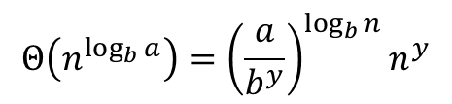
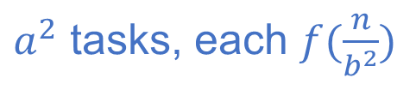
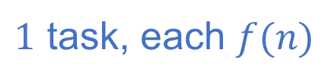


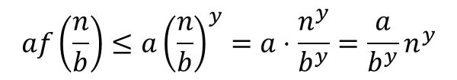
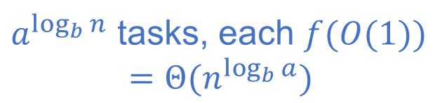
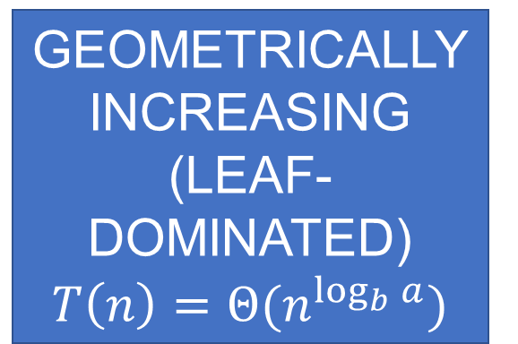

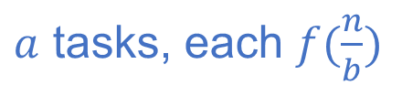
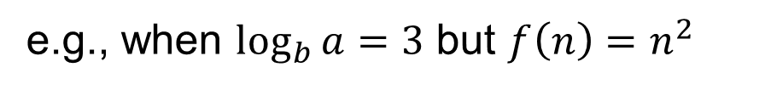
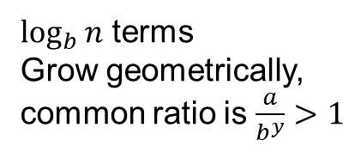
Recursion Tree: $T\left(n\right)=aT\left(\frac{n}{b}\right)+f(n)$
$$n^{\log_{b}{a}}>f(n)$$
Case 1, $f\left(n\right)=O(n^{y})$, where $y<\log_{b}{a}$
e.g., when $\log_{b}{a}=3$ but $f\left(n\right)=n^{2}$
GEOMETRICALLY INCREASING
(LEAF-DOMINATED)
$$T\left(n\right)=Θ(n^{\log_{b}{a}})$$
$1$ task, each $f(n)$
$$f\left(n\right)≤n^{y}$$
$$af\left(\frac{n}{b}\right)≤a{\left(\frac{n}{b}\right)}^{y}=a⋅\frac{n^{y}}{b^{y}}=\frac{a}{b^{y}}n^{y}$$
$a$ tasks, each $f(\frac{n}{b})$
$$b^{h}=n$$
$$h=\log_{b}{n}$$
$$a^{2}f\left(\frac{n}{b^{2}}\right)≤a^{2}{\left(\frac{n}{b^{2}}\right)}^{y}={\left(\frac{a}{b^{y}}\right)}^{2}n^{y}$$
$a^{2}$ tasks, each $f(\frac{n}{b^{2}})$
…
$\log_{b}{n}$ terms
Grow geometrically,
common ratio is $\frac{a}{b^{y}}>1$
…
$a^{\log_{b}{n}}$ tasks, each $f(O(1))$
$$=Θ(n^{\log_{b}{a}})$$
$$Θ\left(n^{\log_{b}{a}}\right)={\left(\frac{a}{b^{y}}\right)}^{\log_{b}{n}}n^{y}$$

Slide 13
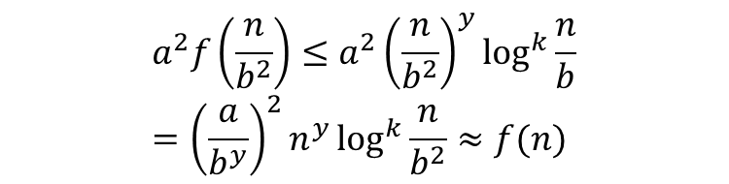

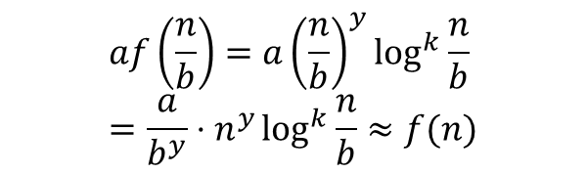
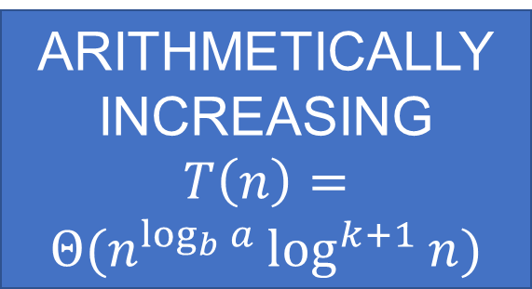

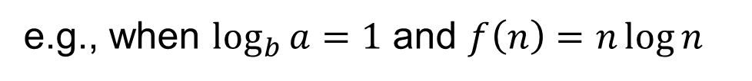
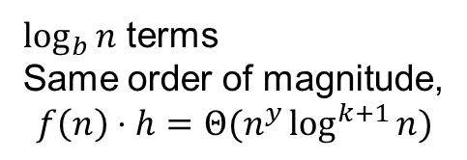
Recursion Tree: $T\left(n\right)=aT\left(\frac{n}{b}\right)+f(n)$
$$n^{\log_{b}{a}}≈f(n)$$
Case 2, $f\left(n\right)=Θ(n^{y}log^{k}{n})$, where $y=\log_{b}{a}$
e.g., when $\log_{b}{a}=1$ and $f\left(n\right)=n\log{n}$
ARITHMETICALLY
INCREASING $T\left(n\right)=Θ(n^{\log_{b}{a}}\log^{k+1}{n})$
$1$ task, each $f(n)$
$$f\left(n\right)=n^{y}\log^{k}{n}$$
$$af\left(\frac{n}{b}\right)=a{\left(\frac{n}{b}\right)}^{y}\log^{k}{\frac{n}{b}}=\frac{a}{b^{y}}⋅n^{y}\log^{k}{\frac{n}{b}}≈f(n)$$
$a$ tasks, each $f(\frac{n}{b})$
$$b^{h}=n$$
$$h=\log_{b}{n}$$
$$a^{2}f\left(\frac{n}{b^{2}}\right)≤a^{2}{\left(\frac{n}{b^{2}}\right)}^{y}\log^{k}{\frac{n}{b}}={\left(\frac{a}{b^{y}}\right)}^{2}n^{y}\log^{k}{\frac{n}{b^{2}}}≈f(n)$$
$a^{2}$ tasks, each $f(\frac{n}{b^{2}})$
…
$\log_{b}{n}$ terms
Same order of magnitude,
$$f\left(n\right)⋅h=Θ(n^{y}\log^{k+1}{n})$$
…
$a^{\log_{b}{n}}$ tasks, each $f(O(1))$
$$=Θ(n^{\log_{b}{a}})$$
$$Θ\left(n^{\log_{b}{a}}\right)={\left(\frac{a}{b^{y}}\right)}^{\log_{b}{n}}n^{y}$$

Slide 14

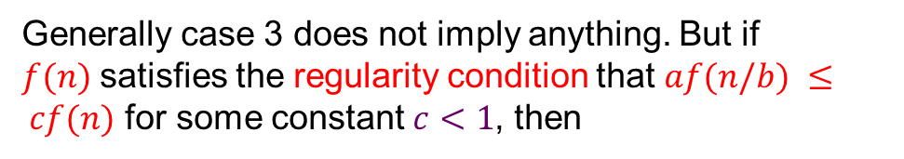
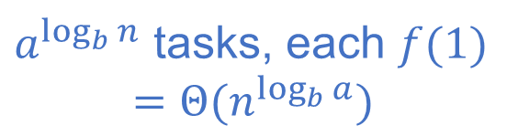
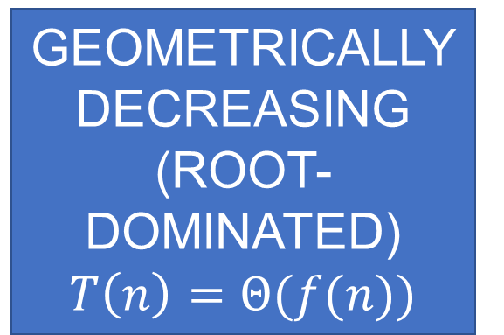
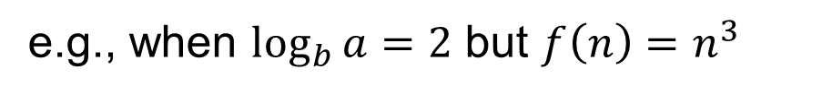
Recursion Tree: $T\left(n\right)=aT\left(\frac{n}{b}\right)+f(n)$
$$n^{\log_{b}{a}}<f(n)$$
Case 3, $f\left(n\right)=Ω(n^{y})$, where $y>\log_{b}{a}$
e.g., when $\log_{b}{a}=2$ but $f\left(n\right)=n^{3}$
$1$ task, each $f(n)$
Generally case 3 does not imply anything. But if $f(n)$satisfies the regularity condition that $af(n/b) ≤ cf(n)$ for some constant $c<1$, then
$a$ tasks, each $f(\frac{n}{b})$
GEOMETRICALLY DECREASING
(ROOT-DOMINATED)
$$T\left(n\right)=Θ(f(n))$$
$$b^{h}=n$$
$$h=\log_{b}{n}$$
$a^{2}$ tasks, each $f(\frac{n}{b^{2}})$
…
$a^{\log_{b}{n}}$ tasks, each $f(1)$
$$=Θ(n^{\log_{b}{a}})$$
E.g., when $f\left(n\right)=n^{y}$ where $y>\log_{b}{a}$. $T\left(n\right)=Θ(n^{y})$

Slide 15
Recursion Tree: $T\left(n\right)=aT\left(\frac{n}{b}\right)+f(n)$
$$f(n)$$
$1$ task, each $f(n)$
$$a$$
$$f(n/b)$$
$$f(n/b)$$
$$f(n/b)$$
$$a$$
…
$a$ tasks, each $f(\frac{n}{b})$
$$b^{h}=n$$
$$h=\log_{b}{n}$$
$$f(n/b^{2})$$
$$f(n/b^{2})$$
$$f(n/b^{2})$$
…
$a^{2}$ tasks, each $f(\frac{n}{b^{2}})$
…
…
You can always analyze a specific algorithm using the tree
$$f(O(1))$$
$a^{\log_{b}{n}}$ tasks, each $f(1)$
$$=Θ(n^{\log_{b}{a}})$$

Slide 16
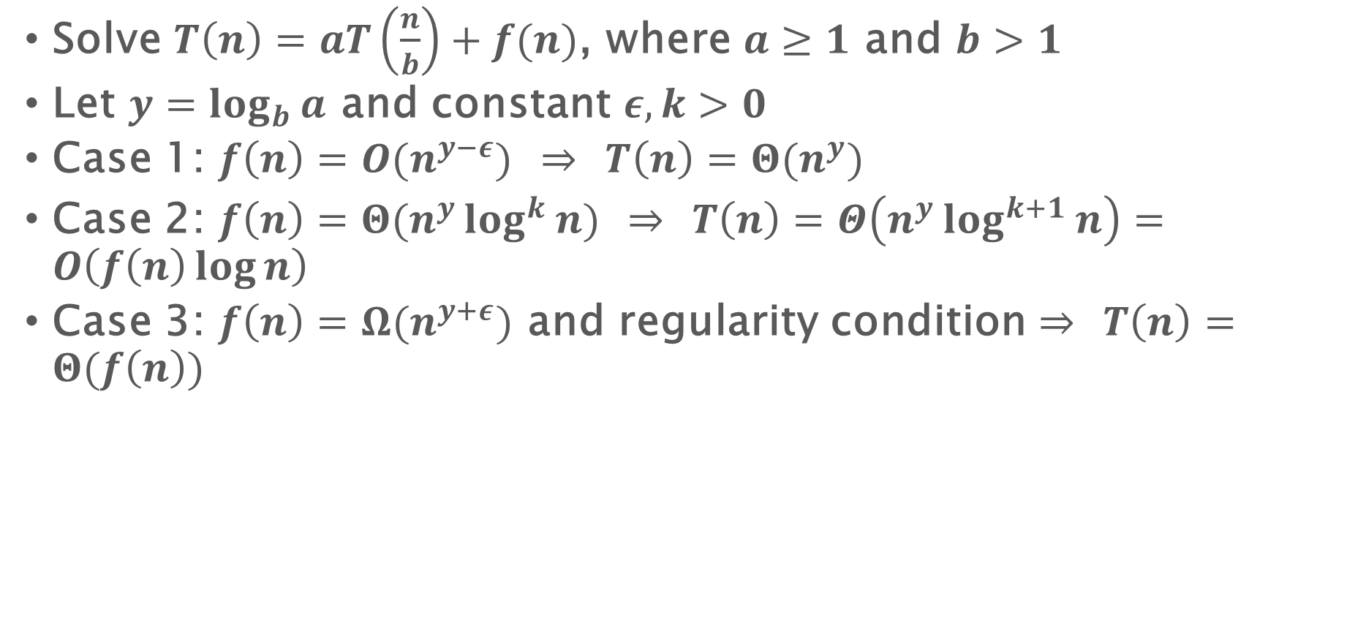
Master Theorem
Solve $T\left(n\right)=aT\left(\frac{n}{b}\right)+f(n)$, where $a≥1$ and $b>1$
Let $y=\log_{b}{a}$ and constant $ε,k>0$
Case 1: $f\left(n\right)=O(n^{y−ε})$ $⇒$ $T\left(n\right)=Θ(n^{y})$
Case 2: $f\left(n\right)=Θ(n^{y}log^{k}{n})$ $⇒$ $T\left(n\right)=Θ\left(n^{y}\log^{k+1}{n}\right)=O\left(f\left(n\right)\log{n}\right)$
Case 3: $f\left(n\right)=Ω(n^{y+ε})$ and regularity condition $⇒$ $T\left(n\right)=Θ(f\left(n\right))$

Slide 17

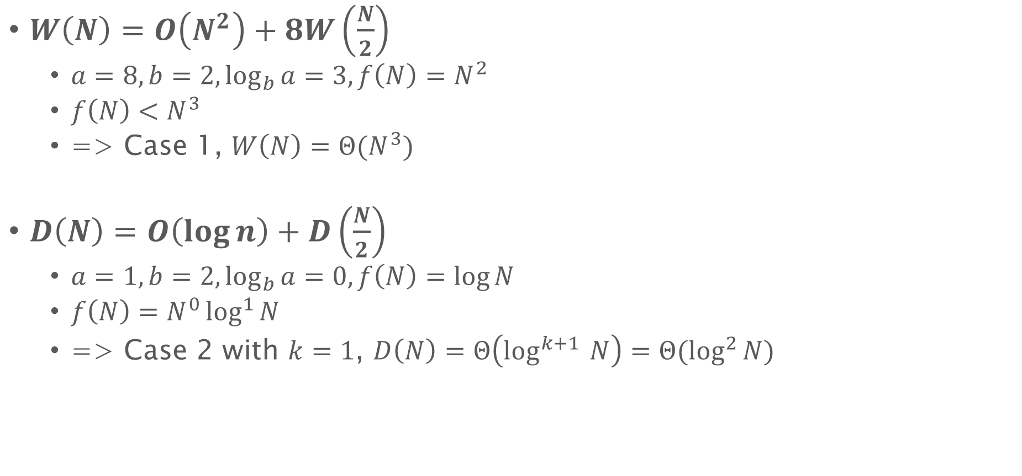
Matrix multiplication
Solve $T\left(n\right)=aT\left(\frac{n}{b}\right)+f(n)$, where $a≥1$ and $b>1$
Let $y=\log_{b}{a}$ and constant $ε,k>0$
Case 1: $f\left(n\right)=O(n^{y−ε})$
$⇒$ $T\left(n\right)=Θ(n^{y})$
Case 2: $f\left(n\right)=O(n^{y}log^{k}{n})$
$⇒$ $T\left(n\right)=Θ(n^{y}\log^{k+1}{n})$
Case 3: $f\left(n\right)=Ω(n^{y+ε})$ and regularity condition
$⇒$ $T\left(n\right)=Θ(f\left(n\right))$
$W\left(N\right)=O\left(N^{2}\right)+8W\left(\frac{N}{2}\right)$
$a=8,b=2,\log_{b}{a}=3,f\left(N\right)=N^{2}$
$f\left(N\right)<N^{3}$
=> Case 1, $W\left(N\right)=Θ(N^{3})$
$D\left(N\right)=O\left(\log{n}\right)+D\left(\frac{N}{2}\right)$
$a=1,b=2,\log_{b}{a}=0, f\left(N\right)=\log{N}$
$f\left(N\right)=N^{0}\log^{1}{N}$
=> Case 2 with $k=1$, $D\left(N\right)=Θ\left(\log^{k+1 }{N}\right)=Θ(\log^{2}{N})$

Slide 18
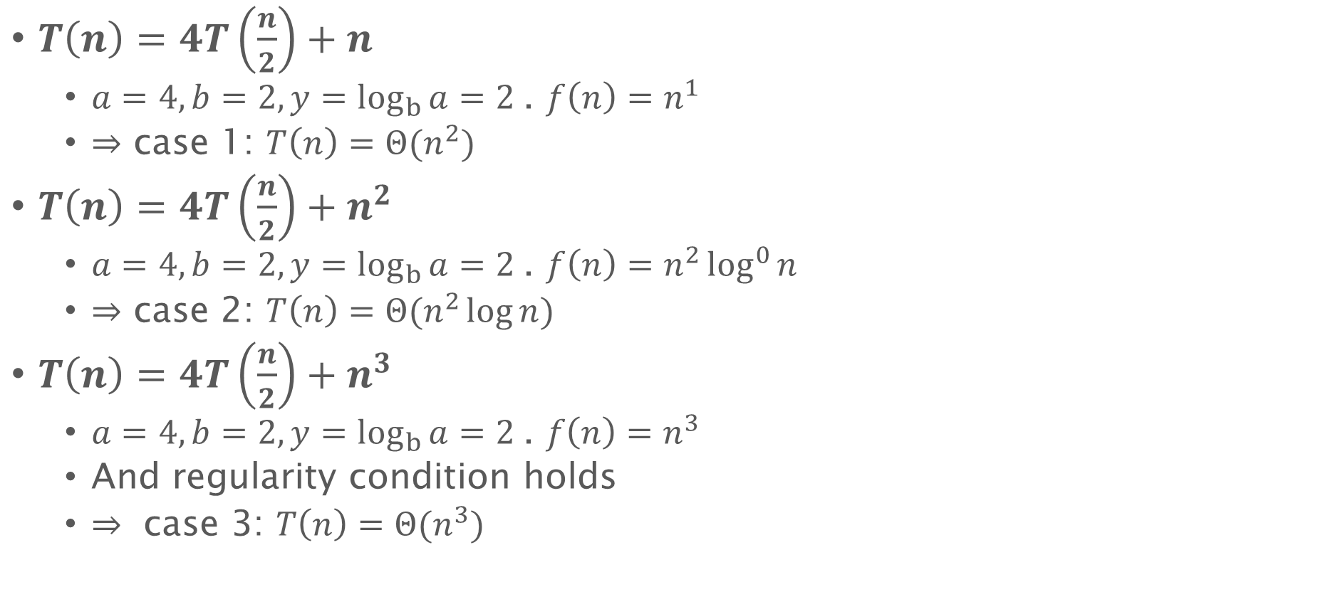
Master Theorem Quiz
Solve $T\left(n\right)=aT\left(\frac{n}{b}\right)+f(n)$, where $a≥1$ and $b>1$
Let $y=\log_{b}{a}$ and constant $ε,k>0$
Case 1: $f\left(n\right)=O(n^{y−ε})$
$⇒$ $T\left(n\right)=Θ(n^{y})$
Case 2: $f\left(n\right)=O(n^{y}log^{k}{n})$
$⇒$ $T\left(n\right)=Θ(n^{y}\log^{k+1}{n})$
Case 3: $f\left(n\right)=Ω(n^{y+ε})$ and regularity condition
$⇒$ $T\left(n\right)=Θ(f\left(n\right))$
$T\left(n\right)=4T\left(\frac{n}{2}\right)+n$
$a=4, b=2,y=\log_{b}{a}=2$. $f\left(n\right)=n^{1}$
$⇒$ case 1: $T\left(n\right)=Θ(n^{2})$
$T\left(n\right)=4T\left(\frac{n}{2}\right)+n^{2}$
$a=4, b=2,y=\log_{b}{a}=2$. $f\left(n\right)=n^{2}\log^{0}{n}$
$⇒$ case 2: $T\left(n\right)=Θ(n^{2}\log{n})$
$T\left(n\right)=4T\left(\frac{n}{2}\right)+n^{3}$
$a=4, b=2,y=\log_{b}{a}=2 \text{. }f\left(n\right)=n^{3}$
And regularity condition holds
$⇒ \text{case}\text{ 3: }T\left(n\right)=Θ(n^{3})$

Slide 19
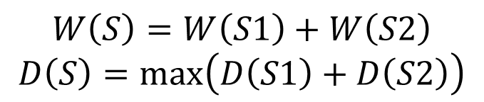
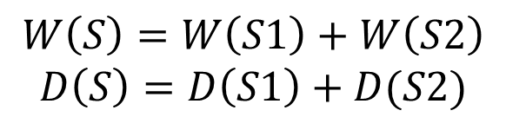
Use recurrence to compute work and depth
Case 1:
S = execute S2 after finishing S1
$$W\left(S\right)=W\left(S1\right)+W\left(S2\right)$$
$$D\left(S\right)=D\left(S1\right)+D(S2)$$
S1;
S2;
Case 2:
S = execute S2 and S1 in parallel
$$W\left(S\right)=W\left(S1\right)+W\left(S2\right)$$
$$D\left(S\right)=\max\left(D\left(S1\right)+D\left(S2\right)\right)$$
In parallel:
S1;
S2;

Slide 20
Flatten algorithm

Slide 21
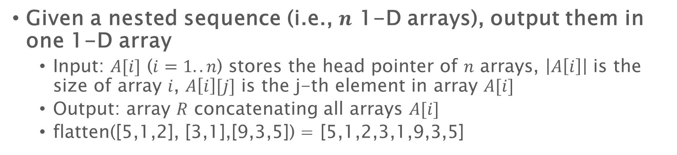
Flatten Algorithm
Given a nested sequence (i.e., $n$ 1-D arrays), output them in one 1-D array
Input: $A[i]$ ($i=1..n$) stores the head pointer of $n$ arrays, $\left|A\left[i\right]\right|$ is the size of array $i$, $A\left[i\right][j]$ is the j-th element in array $A[i]$
Output: array $R$ concatenating all arrays $A[i]$
flatten([5,1,2], [3,1],[9,3,5]) = [5,1,2,3,1,9,3,5]

Slide 22
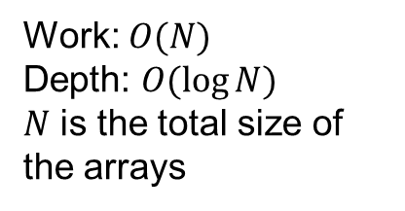
Flatten algorithm
Flatten(A, n) {
parallel_for (i = 0 to n) S[i] = |A[i]|;
offset = scan_exclusive(S, n);
parallel_for (i = 0 to n) {
off = offset[i];
parallel_for (j = 0 to S[i])
B[off+j]=A[i][j];
}
return B;}
Prefix sum
0
3
8
10
13
Array size
3
5
2
3
4
a0 | a1 | a2
b0 | b1 | b2 | b3 | b4
Element b2 is at location 3+2=5
c0 | c1
Element e1 is at location 13+1=14
d0 | d1 | d2
e0 | e1 | e2 | e3
Work: $O(N)$
Depth: $O(\log{N})$
$N$ is the total size of the arrays
0 | 1 | 2 | 3 | 4 | 5 | 6 | 7 | 8 | 9 | 10 | 11 | 12 | 13 | 14 | 15 | 16
a0 | a1 | a2 | b0 | b1 | b2 | b3 | b4 | c0 | c1 | d0 | d1 | d2 | e0 | e1 | e2 | e3

Slide 23
Constructing a Tableau

Slide 24
Edit Distance: Dynamic Programming
atcacac
b
acab
Given two strings A and B, the edit distance of A and B is the least number of edits (inserts and deletes) to modify A to B
S[i][j] is the edit distance of A[1..i] and B[1..j]
S[i][j] = min of
S[i-1][j-1] if A[i]==B[j]: convert A[1..i-1] to B[1..j-1] and keep A[i] since A[i]=B[j]
S[i-1][j]+1: convert A[1..i-1] to B[1..j] and delete A[i]
S[i][j-1]+1: convert A[1..i] to B[1..j-1] and insert B[j] at the end
A[1..i]=
atcacac
Case 1: just convert atcaca to aca (if A[i]==B[j])
S[i][j]=S[i-1][j-1]
B[1..j]=
acac
Take the minimum of them
A[1..i]=
atcacac
Case 2: convert atcaca to acac, and delete the last “c” in A
S[i][j]=S[i-1][j]+1
B[1..j]=
acac
A[1..i]=
atcacac
Case 3: convert atcacac to aca, and insert a “c” at the end of A
S[i][j]=S[i][j-1]+1
B[1..j]=
acac

Slide 25
Edit Distance: Dynamic Programming
S[i][j] = min of
S[i-1][j-1] if A[i]==B[j]
S[i-1][j]+1
S[i][j-1]+1
B
 |  | a | t | c | a | c | a | c
 | 0 | 1 | 2 | 3 | 4 | 5 | 6 | 7
t | 1 | 2 | 1 | 2 | 3 | 4 | 5 | 6
c | 2 | 3 | 2 | 1 | 2 | 3 | 4 | 5
a | 3 | 2 | 3 | 2 | 1 | 2 | 3 | 4
t | 4 | 3 | 2 | 3 | 2 | 3 | 4 | 5
Note: can be filled in any order as long as the cells to the left and above are filled.
Can follow path back through matrix to construct edits.
insert
delete
A
common

Slide 26
Edit Distance: Dynamic Programming
Sequential code:
for i = 1 to n
M[i,1] = i;
for j = 1 to m
M[1,j] = j;
for i = 2 to n
for j = 2 to m
if (A[i] == B[j])
M[i,j] = M[i-1,j-1];
else
M[i,j] = 1 + min(M[i-1,j],M[i,j-1]);

Slide 27
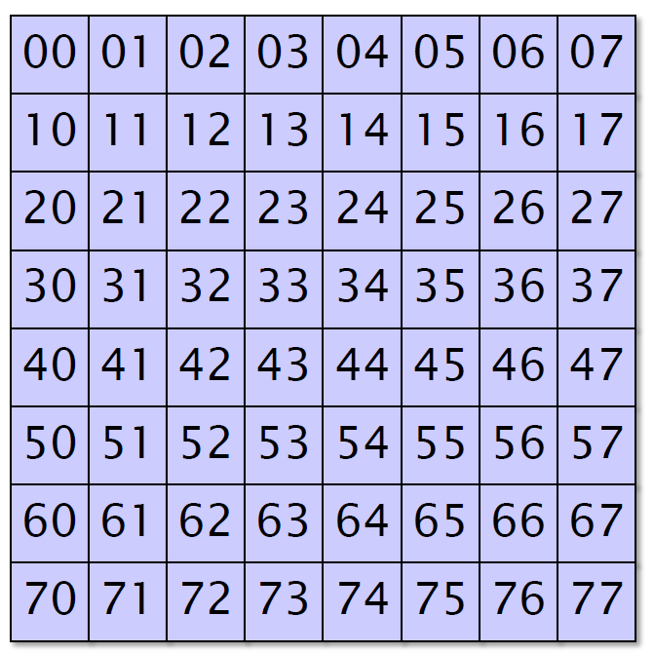
Constructing a Tableau
Fill in an $n×n$ tableau $A$, where
A[i][j]=f(A[i][j-1], A[i-1][j], A[i-1][j-1])
Dynamic Programming
Longest common subsequence
Edit distance
……

Slide 28
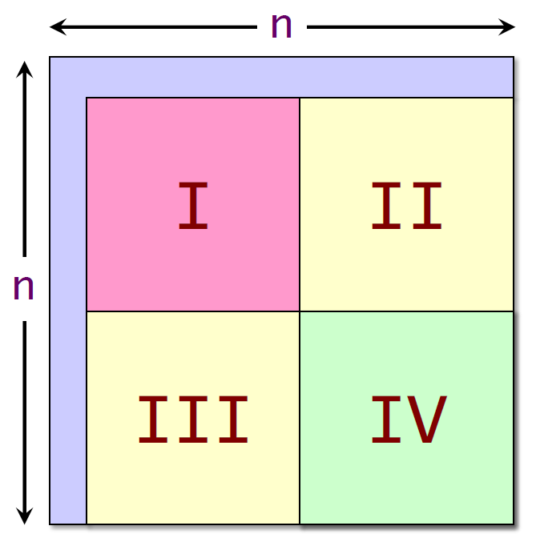
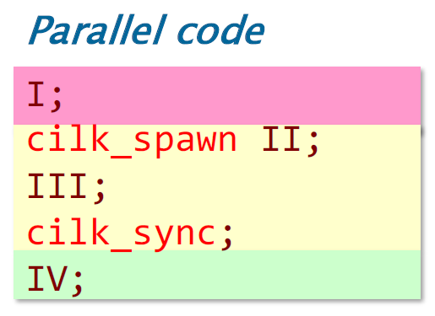
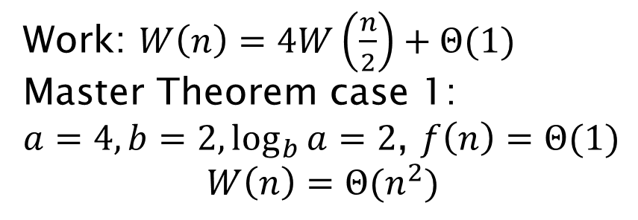
Constructing a Tableau
Work: $W\left(n\right)=4W\left(\frac{n}{2}\right)+Θ(1)$
Master Theorem case 1:
$a=4, b=2,\log_{b}{a}=2$, $f\left(n\right)=Θ(1)$
$$W\left(n\right)=Θ(n^{2})$$

Slide 29
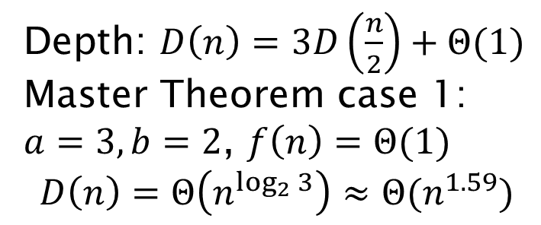
Constructing a Tableau
Depth: $D\left(n\right)=3D\left(\frac{n}{2}\right)+Θ(1)$
Master Theorem case 1:
$a=3, b=2$, $f\left(n\right)=Θ(1)$
$$D\left(n\right)=Θ\left(n^{\log_{2}{3}}\right)≈Θ(n^{1.59})$$

Slide 30

Constructing a Tableau: 4-way divide-and-conquer
Work: $W\left(n\right)=Θ(n^{2})$
Depth: $D\left(n\right)≈Θ(n^{1.59})$
Parallelism: $\frac{W\left(n\right)}{D\left(n\right)}=Ω(n^{0.41})$

Slide 31
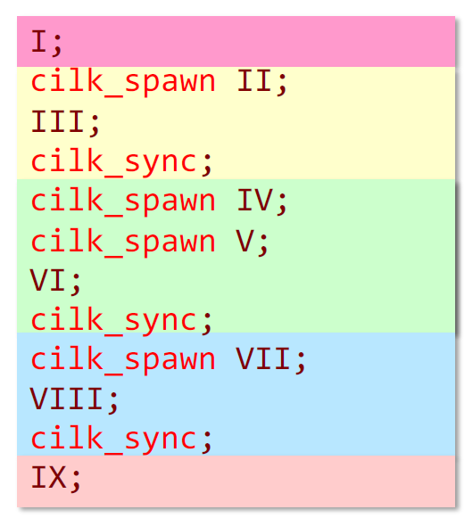
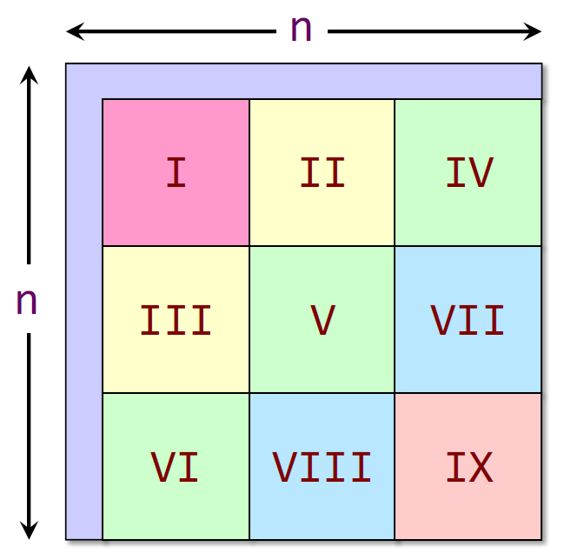
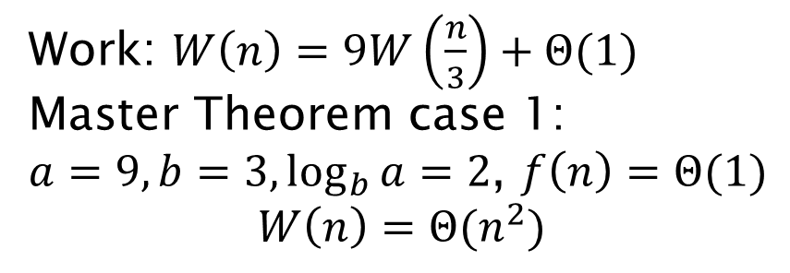
Constructing a Tableau
Work: $W\left(n\right)=9W\left(\frac{n}{3}\right)+Θ(1)$
Master Theorem case 1:
$a=9, b=3,\log_{b}{a}=2$, $f\left(n\right)=Θ(1)$
$$W\left(n\right)=Θ(n^{2})$$

Slide 32
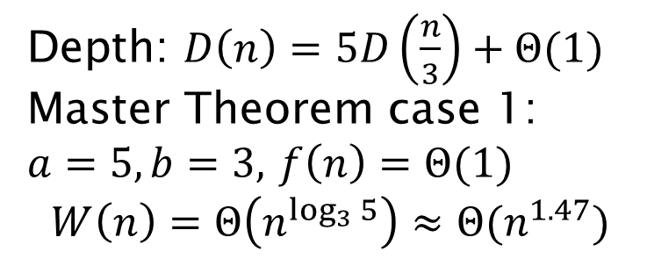
Constructing a Tableau
Depth: $D\left(n\right)=5D\left(\frac{n}{3}\right)+Θ(1)$
Master Theorem case 1:
$a=5, b=3,$ $f\left(n\right)=Θ(1)$
$$W\left(n\right)=Θ\left(n^{\log_{3}{5}}\right)≈Θ(n^{1.47})$$

Slide 33
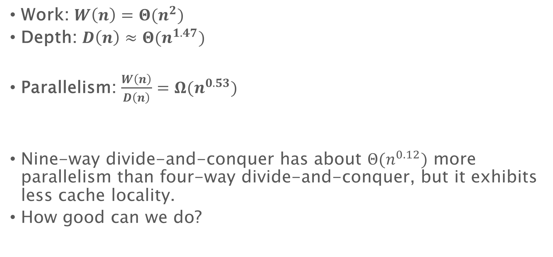
Constructing a Tableau: 9-way divide-and-conquer
Work: $W\left(n\right)=Θ(n^{2})$
Depth: $D\left(n\right)≈Θ(n^{1.47})$
Parallelism: $\frac{W\left(n\right)}{D\left(n\right)}=Ω(n^{0.53})$
Nine-way divide-and-conquer has about $Θ(n^{0.12})$ more parallelism than four-way divide-and-conquer, but it exhibits less cache locality.
How good can we do?

Slide 34
Filtering/packing

Slide 35
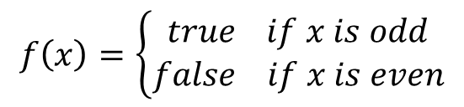



Parallel filtering / packing
Given an array $A$ of elements and a predicate function $f$, output an array $B$ with elements in $A$ that satisfy $f$
$$f\left(x\right)=\left\{\begin{aligned}true if x is odd \\ false if x is even\end{aligned}\right.$$
$$A=$$
4 | 2 | 9 | 3 | 6 | 5 | 7 | 11 | 10 | 8
$$B=$$
9 | 3 | 5 | 7 | 11

Slide 36

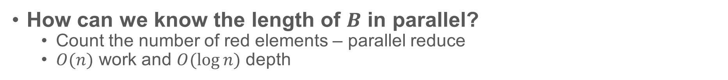
Parallel filtering / packing
How can we know the length of $B$ in parallel?
Count the number of red elements – parallel reduce
$O(n)$ work and $O(\log{n})$ depth
$$A=$$
4 | 2 | 9 | 3 | 6 | 5 | 7 | 11 | 10 | 8
0 | 0 | 1 | 1 | 0 | 1 | 1 | 1 | 0 | 0

