Slide 1
Parallel Graph Algorithms

Slide 2
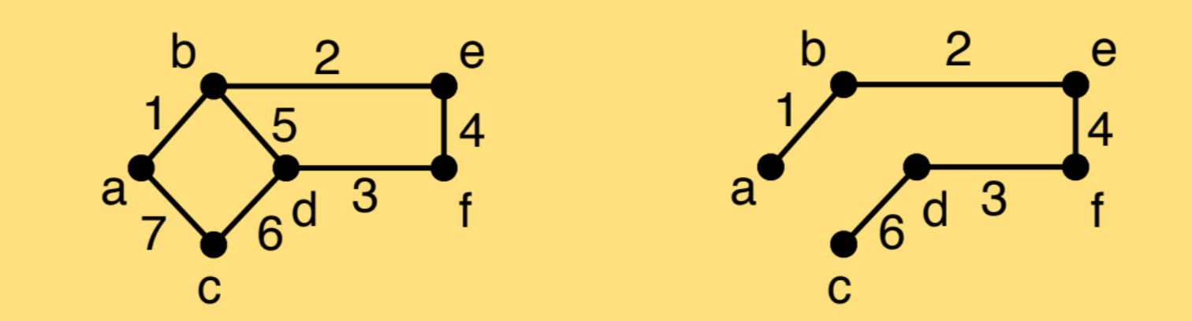
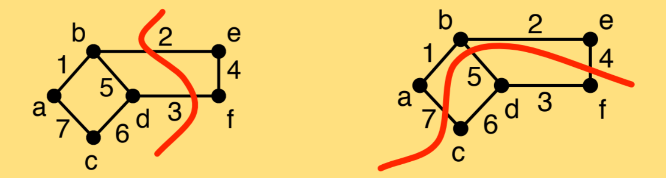
Last Lecture
Light-weight property for MST
If you partition the graph into two, the minimum edge between the two parts has to be in the MST.
Source: “Algorithms: Parallel and Sequential” book by Umut A. Acar and Guy E. Blelloch

Slide 3
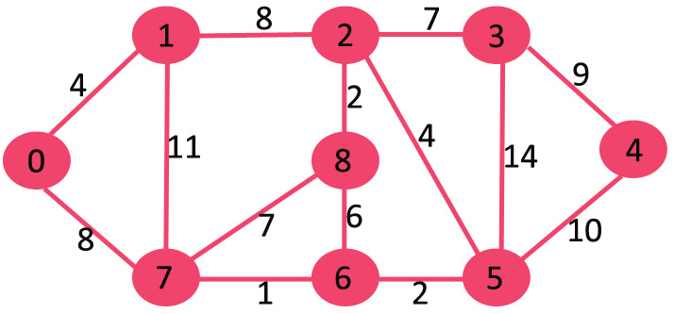
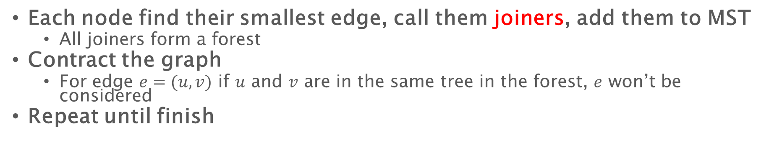
Boruvka’s algorithm
Each node find their smallest edge, call them joiners, add them to MST
All joiners form a forest
Contract the graph
For edge $e=(u,v)$ if $u$ and $v$ are in the same tree in the forest, $e$ won’t be considered
Repeat until finish
0, 1
8
11
8
2-8
Source: GeeksforGeeks https://www.geeksforgeeks.org/boruvkas-algorithm-greedy-algo-9/

Slide 4
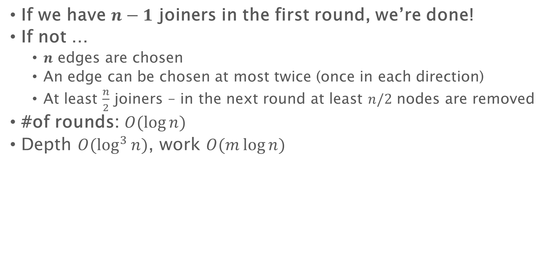
Boruvka’s algorithm
If we have $n−1$ joiners in the first round, we’re done!
If not …
$n$ edges are chosen
An edge can be chosen at most twice (once in each direction)
At least $\frac{n}{2}$ joiners – in the next round at least $n/2$ nodes are removed
#of rounds: $O(\log{n})$
Depth $O(\log^{3}{n})$, work $O(m\log{n})$

Slide 5


Parallel BFS – Radius stepping (undirected)
Use some shortcuts!
Shortcut each vertex to its $ρ$ nearest neighbors
Push the frontier further by one hop
$$ρ=4$$
4
3
2

Slide 6
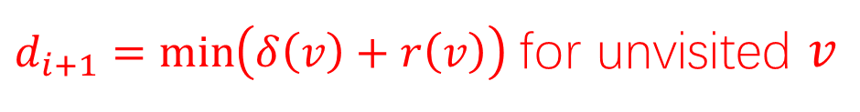
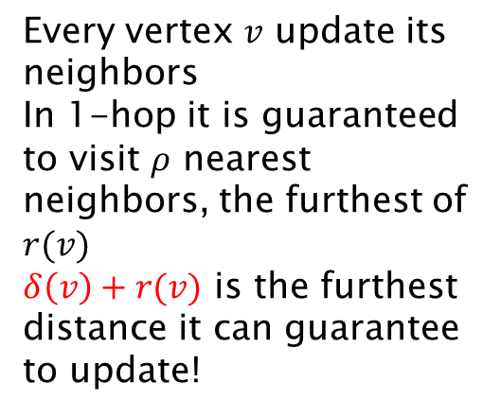







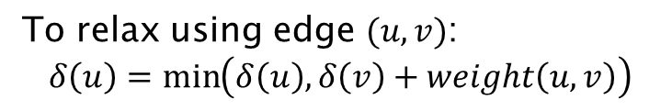




Push the frontier
To relax using edge $(u,v)$:
$$δ\left(u\right)=\min\left(δ\left(u\right),δ\left(v\right)+weight\left(u,v\right)\right)$$
Can update as far as $δ\left(v\right)+r(v)$
Because of the shortcuts, in each round we can push the frontier by more than 1
$$r(v_{1})$$
$$r(v_{2})$$
Every vertex $v$ update its neighbors
In 1-hop it is guaranteed to visit $ρ$ nearest neighbors, the furthest of $r(v)$
$δ\left(v\right)+r(v)$ is the furthest distance it can guarantee to update!
$$d_{i}$$
$$s$$
$$r(v_{3})$$
$δ(v)$: tentative distance
$r(v)$: radius of $v$, distance to its $ρ$-th nearest neighbor
$$r(v_{5})$$
$$r(v_{4})$$
$$d_{i+1}$$
$$r(v_{6})$$
tentative distance
$d_{i+1}=\min\left(δ\left(v\right)+r\left(v\right)\right)$ for unvisited $v$

Slide 7
Push the frontier
$$s$$
$$d_{i+1}$$
$d_{i+1}=\min\left(δ\left(v\right)+r\left(v\right)\right)$ for unvisited $v$

Slide 8
Push the frontier
$$s$$
$$d_{i+1}$$
$d_{i+1}=\min\left(δ\left(v\right)+r\left(v\right)\right)$ for unvisited $v$

Slide 9
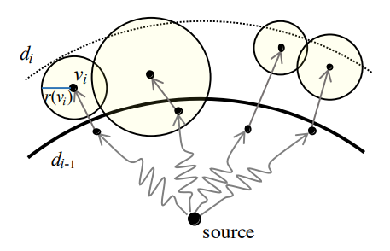
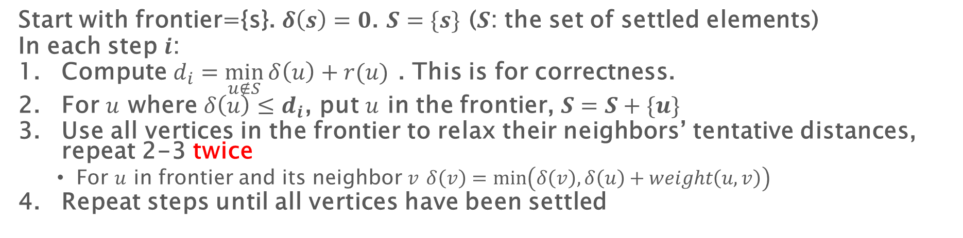
Parallel BFS: radius stepping
Start with frontier={s}. $δ\left(s\right)=0$. $S=\{s\}$ ($S$: the set of settled elements)
In each step $i$:
Compute $d_{i}=\min_{u∉S}{δ\left(u\right)+r(u)}$ . This is for correctness.
For $u$ where $δ\left(u\right)≤d_{i}$, put $u$ in the frontier, $S=S+\{u\}$
Use all vertices in the frontier to relax their neighbors’ tentative distances, repeat 2-3 twice
For $u$ in frontier and its neighbor $v$ $δ\left(v\right)=\min\left(δ\left(v\right),δ\left(u\right)+weight\left(u,v\right)\right)$
Repeat steps until all vertices have been settled
No guarantee to settle these vertices because #hops to processed nodes can be more than 2 (and unbounded)

Slide 10

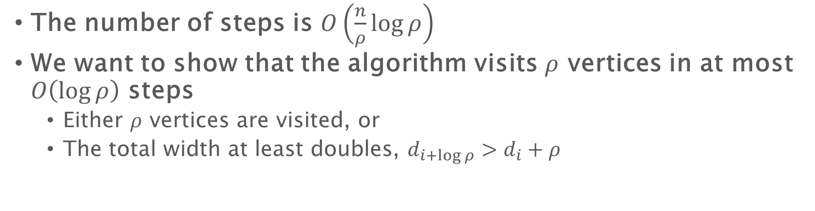






The number of steps
The number of steps is $O\left(\frac{n}{ρ}\log{ρ}\right)$
We want to show that the algorithm visits $ρ$ vertices in at most $O\left(\log{ρ}\right)$ steps
Either $ρ$ vertices are visited, or
The total width at least doubles, $d_{i+\log{ρ}}>d_{i}+ρ$
$$d_{i}$$
$$d_{i+1}$$
$$d_{i+2}$$
$$d_{i+3}$$
$$≥d_{i}+1$$
$$≥d_{i}+2$$
$$≥d_{i}+4$$

Slide 11
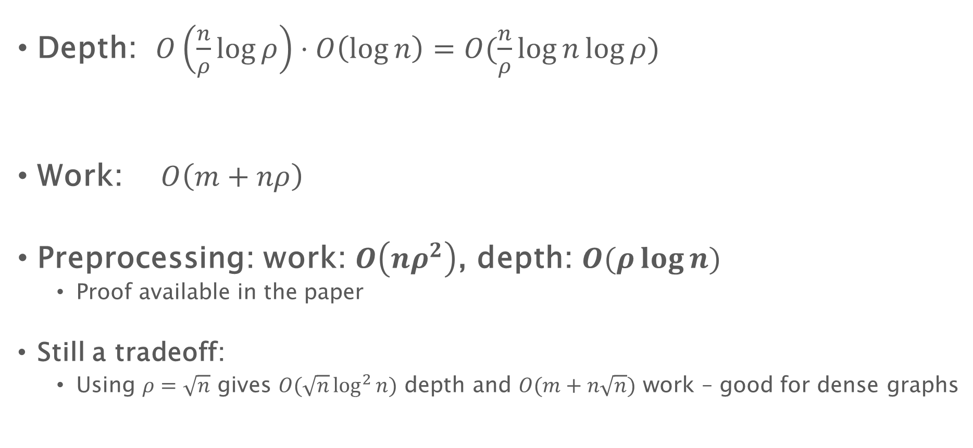
Work, depth of BFS using shortcuts (radius-stepping)
Depth: $O\left(\frac{n}{ρ}\log{ρ}\right)⋅O\left(\log{n}\right)=O(\frac{n}{ρ}\log{n}\log{ρ})$
Work: $O\left(m+nρ\right)$
Preprocessing: work: $O\left(nρ^{2}\right)$, depth: $O(ρ\log{n})$
Proof available in the paper
Still a tradeoff:
Using $ρ=\sqrt{n}$ gives $O(\sqrt{n}\log^{2}{n})$ depth and $O(m+n\sqrt{n})$ work – good for dense graphs
#steps
Update cost

Slide 12
Single Source Shortest Path

Slide 13
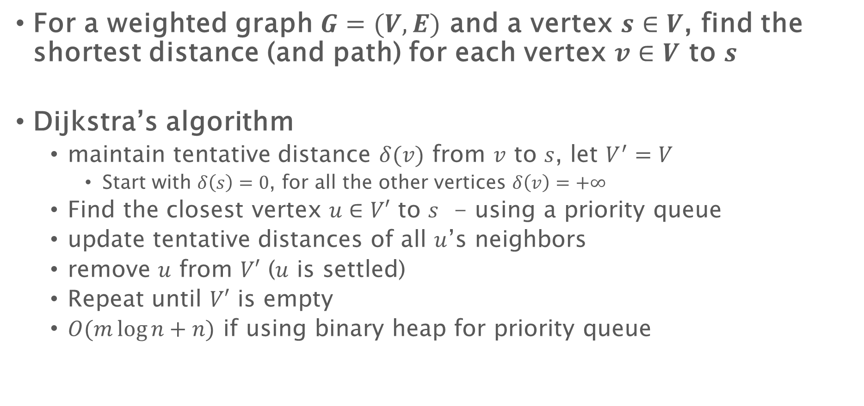
Single source shortest path
For a weighted graph $G=(V,E)$ and a vertex $s∈V$, find the shortest distance (and path) for each vertex $v∈V$ to $s$
Dijkstra’s algorithm
maintain tentative distance $δ(v)$ from $v$ to $s$, let $V^{′}=V$
Start with $δ\left(s\right)=0$, for all the other vertices $δ\left(v\right)=+∞$
Find the closest vertex $u∈V′$ to $s$ - using a priority queue
update tentative distances of all $u$’s neighbors
remove $u$ from $V′$ ($u$ is settled)
Repeat until $V′$ is empty
$O(m\log{n}+n)$ if using binary heap for priority queue
Parallelizable

Slide 14
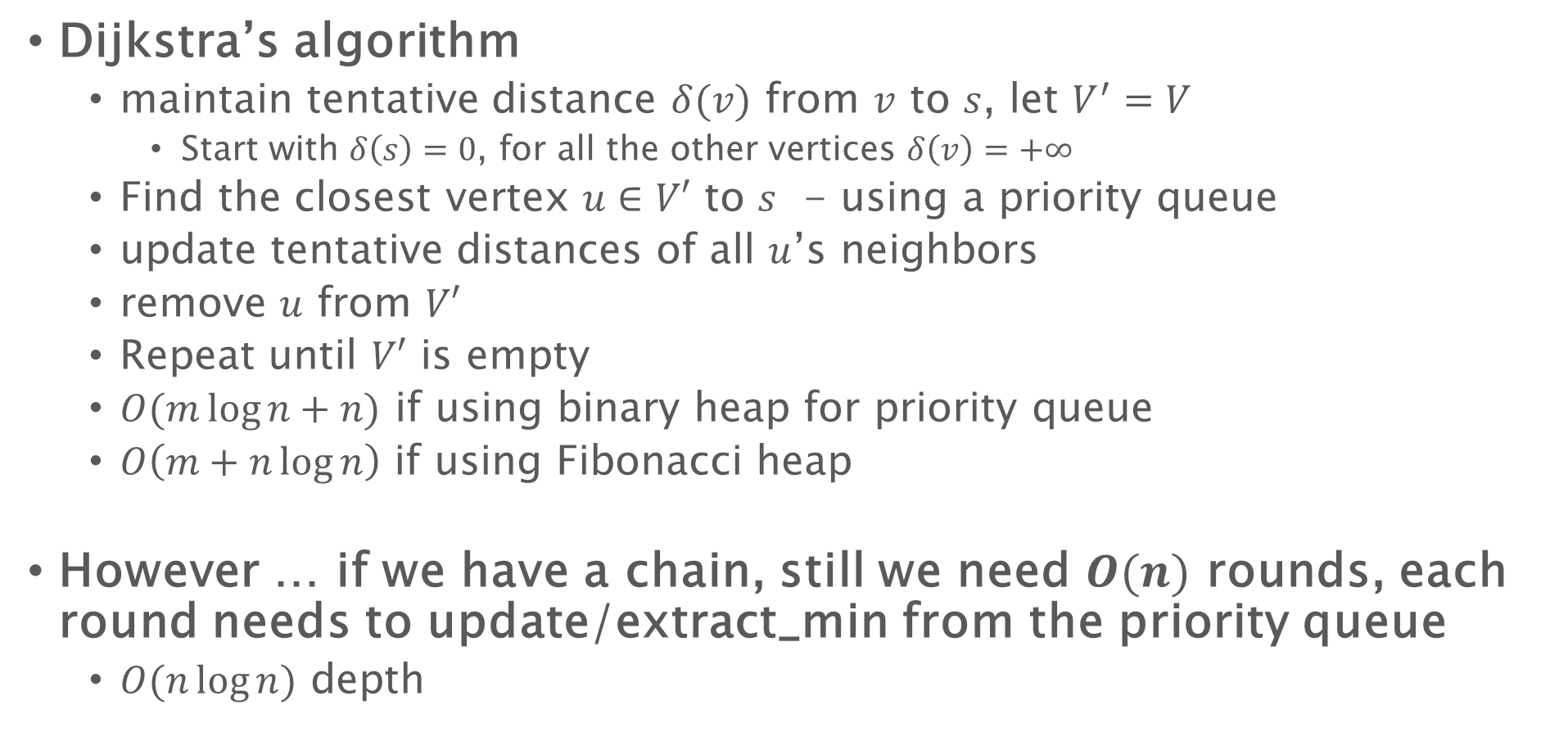
Single source shortest path
Dijkstra’s algorithm
maintain tentative distance $δ(v)$ from $v$ to $s$, let $V^{′}=V$
Start with $δ\left(s\right)=0$, for all the other vertices $δ\left(v\right)=+∞$
Find the closest vertex $u∈V′$ to $s$ - using a priority queue
update tentative distances of all $u$’s neighbors
remove $u$ from $V′$
Repeat until $V′$ is empty
$O(m\log{n}+n)$ if using binary heap for priority queue
$O\left(m+n\log{n}\right)$ if using Fibonacci heap
However … if we have a chain, still we need $O(n)$ rounds, each round needs to update/extract_min from the priority queue
$O(n\log{n})$ depth

Slide 15
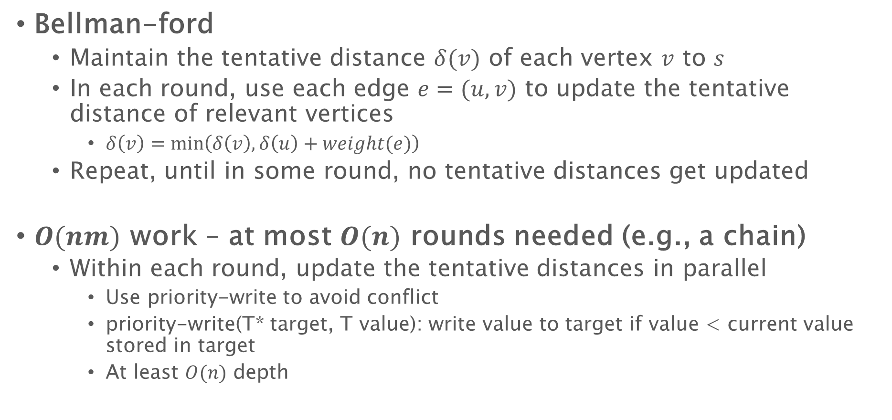
Single source shortest path
Bellman-ford
Maintain the tentative distance $δ(v)$ of each vertex $v$ to $s$
In each round, use each edge $e=(u,v)$ to update the tentative distance of relevant vertices
$δ\left(v\right)=\min\left(δ\left(v\right), δ\left(u\right)+weight(e)\right)$
Repeat, until in some round, no tentative distances get updated
$O(nm)$ work – at most $O(n)$ rounds needed (e.g., a chain)
Within each round, update the tentative distances in parallel
Use priority-write to avoid conflict
priority-write(T* target, T value): write value to target if value < current value stored in target
At least $O(n)$ depth

Slide 16

SSSP - notation
Tentative distance $δ(v)$: current distance of $v$ to the source
$weight(u,v)$: the edge weight between $u$ and $v$
We say a node $v$ has been settled if $δ(v)$ is the shortest distance from $v$ to $s$

Slide 17
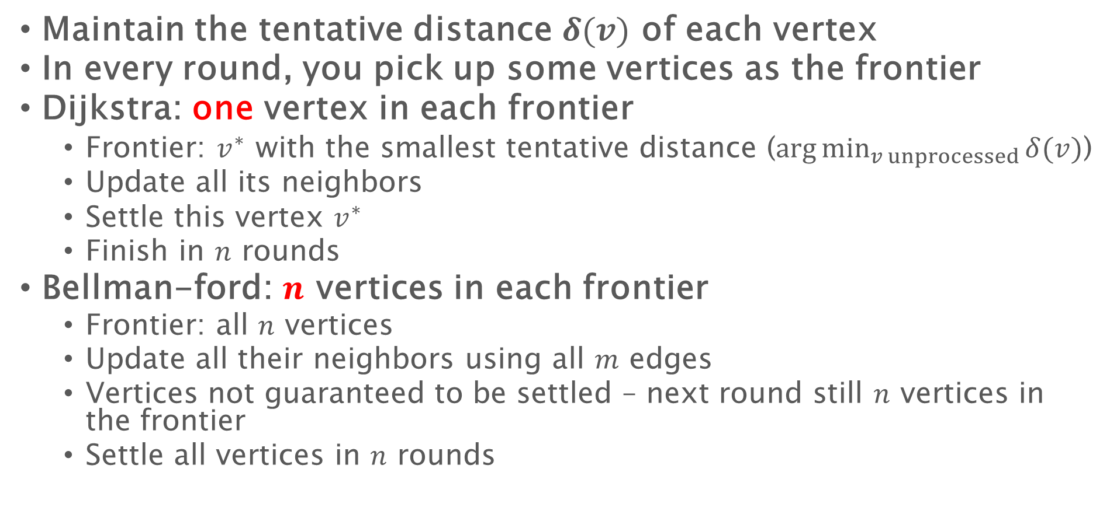
SSSP - What is the frontier and how to relax
Maintain the tentative distance $δ(v)$ of each vertex
In every round, you pick up some vertices as the frontier
Dijkstra: one vertex in each frontier
Frontier: $v^{∗}$ with the smallest tentative distance ($\arg{\min_{v unprocessed}{δ(v)}}$)
Update all its neighbors
Settle this vertex $v^{∗}$
Finish in $n$ rounds
Bellman-ford: $n$ vertices in each frontier
Frontier: all $n$ vertices
Update all their neighbors using all $m$ edges
Vertices not guaranteed to be settled – next round still $n$ vertices in the frontier
Settle all vertices in $n$ rounds

Slide 18
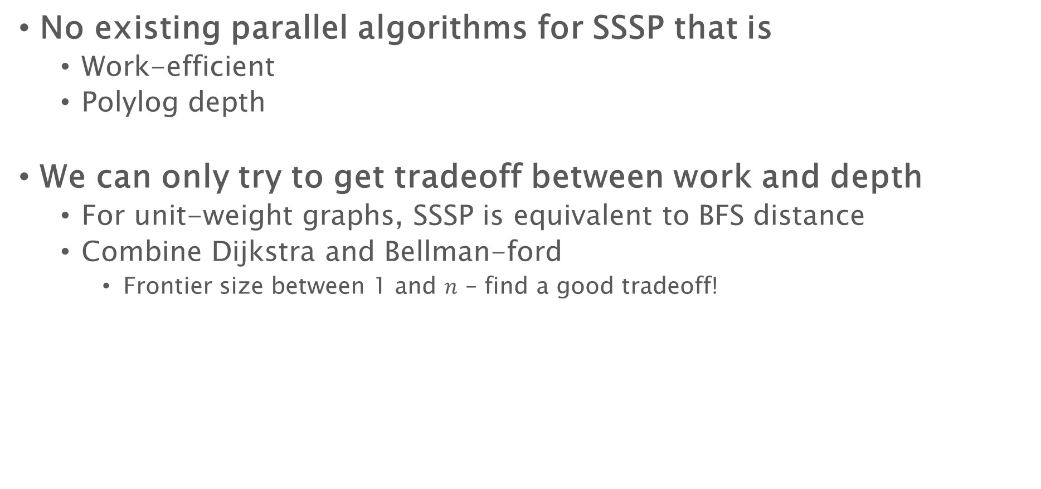
Single source shortest path
No existing parallel algorithms for SSSP that is
Work-efficient
Polylog depth
We can only try to get tradeoff between work and depth
For unit-weight graphs, SSSP is equivalent to BFS distance
Combine Dijkstra and Bellman-ford
Frontier size between 1 and $n$ – find a good tradeoff!

Slide 19

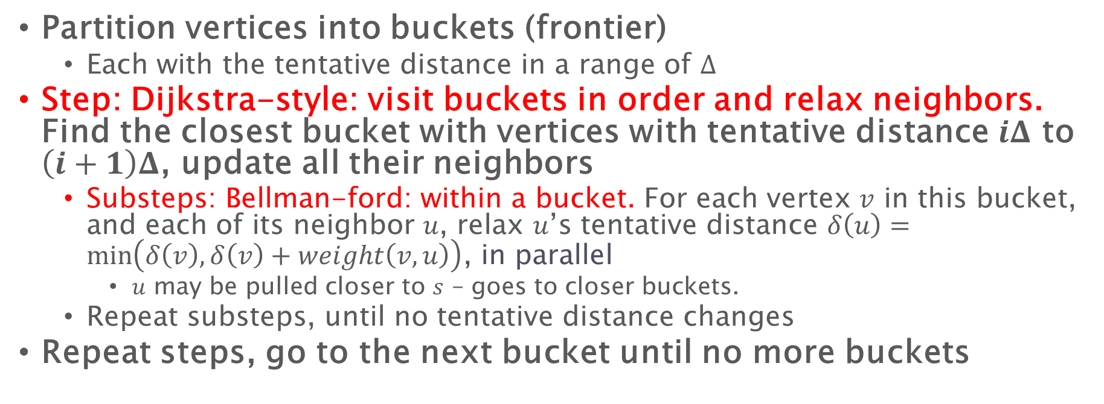




$Δ$-Stepping: Dijkstra + Bellman-Ford
Partition vertices into buckets (frontier)
Each with the tentative distance in a range of $Δ$
Step: Dijkstra-style: visit buckets in order and relax neighbors. Find the closest bucket with vertices with tentative distance $iΔ$ to $\left(i+1\right)Δ$, update all their neighbors
Substeps: Bellman-ford: within a bucket. For each vertex $v$ in this bucket, and each of its neighbor $u$, relax $u$’s tentative distance $δ\left(u\right)=\min\left(δ\left(v\right), δ\left(v\right)+weight\left(v,u\right)\right)$, in parallel
$u$ may be pulled closer to $s$ – goes to closer buckets.
Repeat substeps, until no tentative distance changes
Repeat steps, go to the next bucket until no more buckets
12
23
1
$$Δ=10$$
10
1
6
15
33
19
$$Δ$$
$$2Δ$$
$$3Δ$$
$$4Δ$$

Slide 20
$Δ$-Stepping: Dijkstra + Bellman-Ford
Partition vertices into buckets (frontier)
Each with the tentative distance in a range of $Δ$
Step: Dijkstra-style: visit buckets in order and relax neighbors. Find the closest bucket with vertices with tentative distance $iΔ$ to $\left(i+1\right)Δ$, update all their neighbors
Substeps: Bellman-ford: within a bucket. For each vertex $v$ in this bucket, and each of its neighbor $u$, relax $u$’s tentative distance $δ\left(u\right)=\min\left(δ\left(v\right), δ\left(v\right)+weight\left(v,u\right)\right)$, in parallel
$u$ may be pulled closer to $s$ – goes to closer buckets.
Repeat substeps, until no tentative distance changes
Repeat steps, go to the next bucket until no more buckets
12
23
1
$$Δ=10$$
10
1
6
15
33
19
$$Δ$$
$$2Δ$$
$$3Δ$$
$$4Δ$$

Slide 21

$Δ$-Stepping
Partition vertices into buckets (frontier)
Each with the tentative distance in a range of $Δ$
Step: Dijkstra-style: visit buckets in order and relax neighbors. Find the closest bucket with vertices with tentative distance $iΔ$ to $\left(i+1\right)Δ$, update all their neighbors
Substeps: Bellman-ford: within a bucket. For each vertex $v$ in this bucket, and each of its neighbor $u$, relax $u$’s tentative distance $δ\left(u\right)=\min\left(δ\left(v\right), δ\left(v\right)+weight\left(v,u\right)\right)$, in parallel
$u$ may be pulled closer to $s$ – goes to closer buckets.
Repeat substeps, until no tentative distance changes
Repeat steps, go to the next bucket until no more buckets
12
$$Δ=10$$
1
13
10
1
6
15
33
16
$$Δ$$
$$2Δ$$
$$3Δ$$
$$4Δ$$

Slide 22
$Δ$-Stepping
Partition vertices into buckets (frontier)
Each with the tentative distance in a range of $Δ$
Step: Dijkstra-style: visit buckets in order and relax neighbors. Find the closest bucket with vertices with tentative distance $iΔ$ to $\left(i+1\right)Δ$, update all their neighbors
Substeps: Bellman-ford: within a bucket. For each vertex $v$ in this bucket, and each of its neighbor $u$, relax $u$’s tentative distance $δ\left(u\right)=\min\left(δ\left(v\right), δ\left(v\right)+weight\left(v,u\right)\right)$, in parallel
$u$ may be pulled closer to $s$ – goes to closer buckets.
Repeat substeps, until no tentative distance changes
Repeat steps, go to the next bucket until no more buckets
12
$$Δ=10$$
1
13
10
1
6
15
31
14
$$Δ$$
$$2Δ$$
$$3Δ$$
$$4Δ$$

Slide 23
$Δ$-Stepping
Partition vertices into buckets (frontier)
Each with the tentative distance in a range of $Δ$
Step: Dijkstra-style: visit buckets in order and relax neighbors. Find the closest bucket with vertices with tentative distance $iΔ$ to $\left(i+1\right)Δ$, update all their neighbors
Substeps: Bellman-ford: within a bucket. For each vertex $v$ in this bucket, and each of its neighbor $u$, relax $u$’s tentative distance $δ\left(u\right)=\min\left(δ\left(v\right), δ\left(v\right)+weight\left(v,u\right)\right)$, in parallel
$u$ may be pulled closer to $s$ – goes to closer buckets.
Repeat substeps, until no tentative distance changes
Repeat steps, go to the next bucket until no more buckets
12
$$Δ=10$$
1
13
10
1
6
15
29
14
$$Δ$$
$$2Δ$$
$$3Δ$$
$$4Δ$$

Slide 24

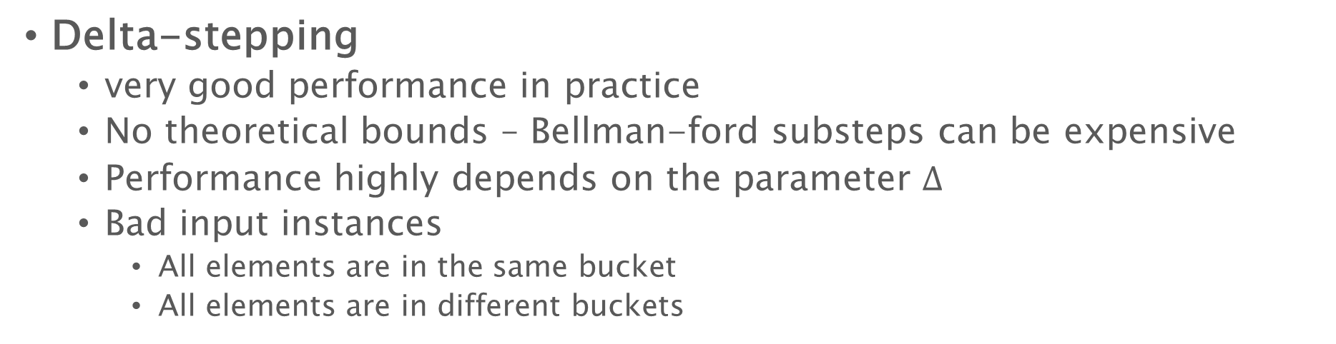
Single source shortest path
Delta-stepping
very good performance in practice
No theoretical bounds – Bellman-ford substeps can be expensive
Performance highly depends on the parameter $Δ$
Bad input instances
All elements are in the same bucket
All elements are in different buckets
1
2
4
8
16
32
64
128
256
$$s$$

Slide 25

Single source shortest path
Delta-stepping
very good performance in practice
No theoretical bounds – Bellman-ford substeps can be expensive
Performance highly depends on the parameter $Δ$
Bad input instances
All elements are in the same bucket
All elements are in different buckets
1
8
6
1003
1000
2
1022
1007
$$s$$
1030
1011
1020
1001
2

Slide 26
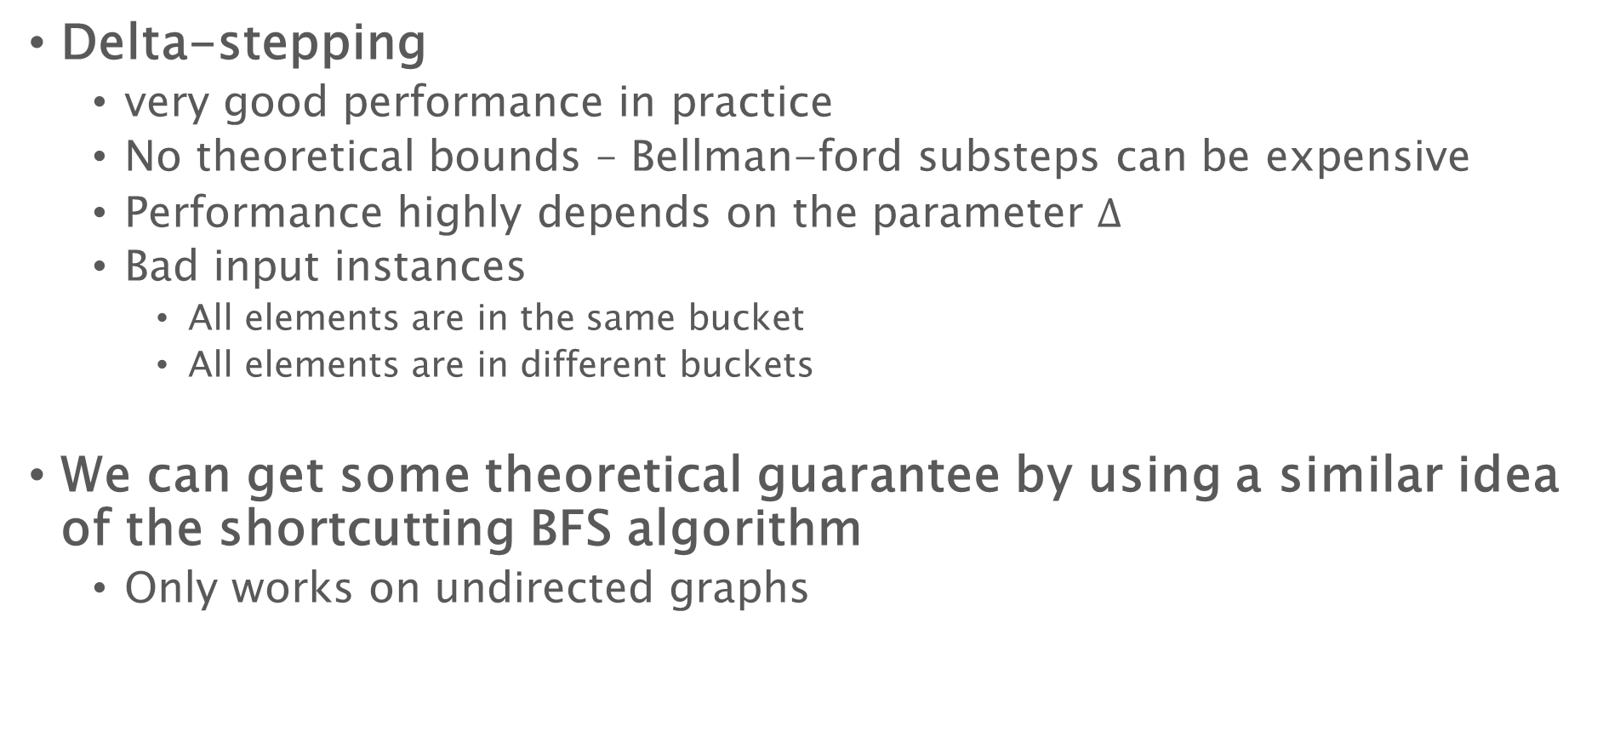
Single source shortest path
Delta-stepping
very good performance in practice
No theoretical bounds – Bellman-ford substeps can be expensive
Performance highly depends on the parameter $Δ$
Bad input instances
All elements are in the same bucket
All elements are in different buckets
We can get some theoretical guarantee by using a similar idea of the shortcutting BFS algorithm
Only works on undirected graphs

Slide 27
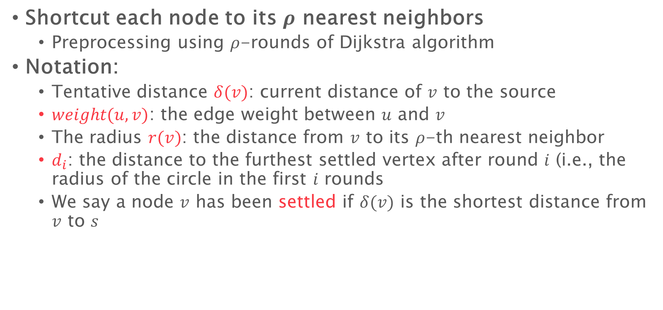
Radius-stepping
Shortcut each node to its $ρ$ nearest neighbors
Preprocessing using $ρ$-rounds of Dijkstra algorithm
Notation:
Tentative distance $δ(v)$: current distance of $v$ to the source
$weight(u,v)$: the edge weight between $u$ and $v$
The radius $r(v)$: the distance from $v$ to its $ρ$-th nearest neighbor
$d_{i}$: the distance to the furthest settled vertex after round $i$ (i.e., the radius of the circle in the first $i$ rounds
We say a node $v$ has been settled if $δ(v)$ is the shortest distance from $v$ to $s$

Slide 28



Definition of vertex radius
$ρ=4$
4
4
3
9
3
2
3
7
6
3
2
$$v$$
5
6
4
3
$$r\left(v\right)=5$$

Slide 29



Definition of vertex radius
$ρ=4$
4
4
3
$$v′$$
9
3
2
3
7
6
3
2
4
6
4
3
$$r\left(v′\right)=4$$

Slide 30




Push the frontier
To relax using edge $(u,v)$:
$$δ\left(u\right)=\min\left(δ\left(u\right),δ\left(v\right)+weight\left(u,v\right)\right)$$
Can update as far as $δ\left(v\right)+r(v)$
Because of the shortcuts, in each step we can push the frontier further
$$r(v_{1})$$
Every vertex $v$ update its neighbors
In 1-hop it is guaranteed to visit $ρ$ nearest neighbors, the furthest of $r(v)$
$δ\left(v\right)+r(v)$ is the furthest distance it can guarantee to update!
$$r(v_{2})$$
$$d_{i}$$
$$s$$
$$r(v_{3})$$
$$r(v_{5})$$
$$r(v_{4})$$
$$d_{i+1}$$
$$r(v_{6})$$
tentative distance
$d_{i+1}=\min\left(δ\left(v\right)+r\left(v\right)\right)$ for unvisited $v$ in the frontier

Slide 31
Push the frontier
$$s$$
$$d_{i+1}$$
$d_{i+1}=\min\left(δ\left(v\right)+r\left(v\right)\right)$ for unvisited $v$ in the frontier

Slide 32
Push the frontier
$$s$$
$$d_{i+1}$$
$d_{i+1}=\min\left(δ\left(v\right)+r\left(v\right)\right)$ for unvisited $v$ in the frontier

Slide 33
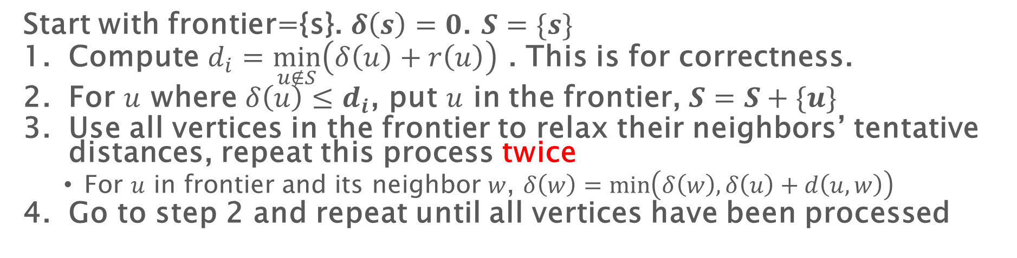
Parallel SSSP with shortcuts
Start with frontier={s}. $δ\left(s\right)=0$. $S=\{s\}$
Compute $d_{i}=\min_{u∉S}\left(δ\left(u\right)+r\left(u\right)\right)$ . This is for correctness.
For $u$ where $δ\left(u\right)≤d_{i}$, put $u$ in the frontier, $S=S+\{u\}$
Use all vertices in the frontier to relax their neighbors’ tentative distances, repeat this process twice
For $u$ in frontier and its neighbor $w$, $δ\left(w\right)=\min\left(δ\left(w\right),δ\left(u\right)+d\left(u,w\right)\right)$
Go to step 2 and repeat until all vertices have been processed
No guarantee to update this node because #hops to processed nodes can be more than 1

Slide 34

Radius stepping vs. $Δ$-stepping
Each round the frontier goes out by a dynamic value (decided by $\min\left(δ\left(v\right)+r\left(v\right)\right)$) instead of a fixed number $Δ$
Buckets (frontiers) are divided in a better way
Because of this, the number of substeps of Bellman-ford is only two
Can prove some depth bound

Slide 35

Parallel SSSP with shortcuts
The number of steps is $O\left(\frac{n}{ρ}\log{ρL}\right)$
𝐿: ratio of max / min edge weight
Work: $O((m+nρ)\log{n})$, depth: $O\left(\frac{n}{ρ}\log{n}\log{ρL}\right)$

Slide 36
Parallel SSSP with shortcuts
The number of steps is $O\left(\frac{n}{ρ}\log{ρL}\right)$
𝐿: ratio of max / min edge weight
Work: $O((m+nρ)\log{n})$, depth: $O\left(\frac{n}{ρ}\log{n}\log{ρL}\right)$

