Slide 1
Parallel data structures

Slide 2
Parallel Trees

Slide 3
Why we need trees? For organizing data.
Data are getting larger.
Luckily, memory size and the number of cores we can use is increasing, too.
Up to Terabytes of memory in multi-core machines.
100+ available threads
Parallelism, concurrency, theoretical efficiency and scalability in practice

Slide 4
Why we need trees? For organizing data.
Data are changing forever.
Luckily, trees are suitable for most of the dynamic use scenarios
Logarithmic time insertion/deletions
Persistence and multi-versioning on trees have been studied for years
Dynamicity, multi-versioning, concurrent updates and queries with correctness guarantee and time bounds

Slide 5
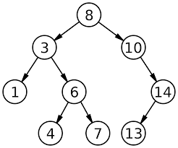
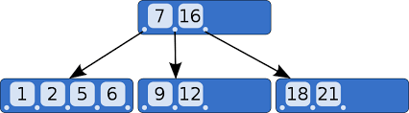
Why we need trees? For organizing ordered data.
Maintaining the ordering of a set of keys (key-values) by the tree structure
E.g., the in-order traversal
Usually numerically sorted keys lead to a search tree
A B-tree structure maintaining ordering on keys.
A binary search tree structure maintaining ordering on keys.

Slide 6
Why we need trees? Useful in many applications.
Building index for databases and data warehouses
Multi-dimensional range-based search
Computational geometry
Computer graphics
Database queries
Implementation for other abstract data types (ADTs)
Ordered sets/maps
Priority queues
Subroutines in other algorithms

Slide 7
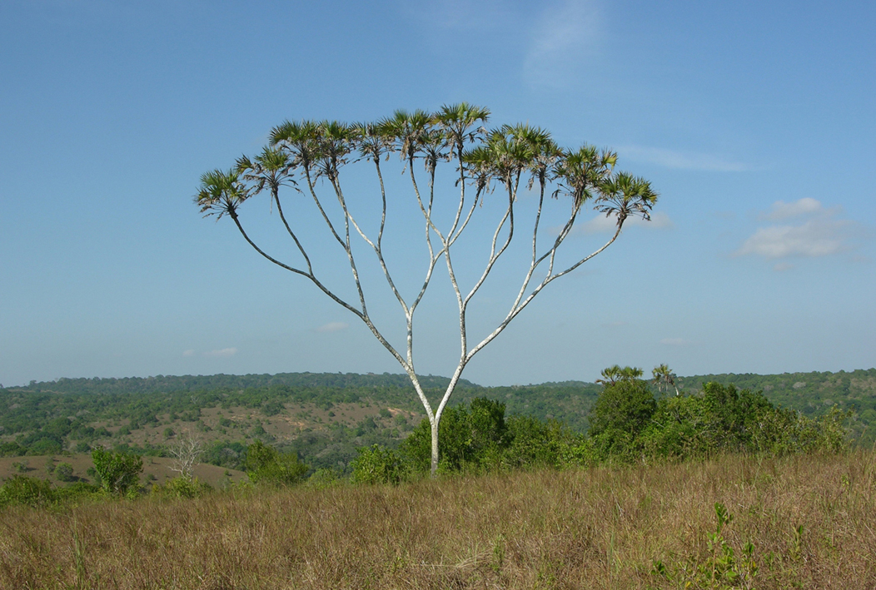
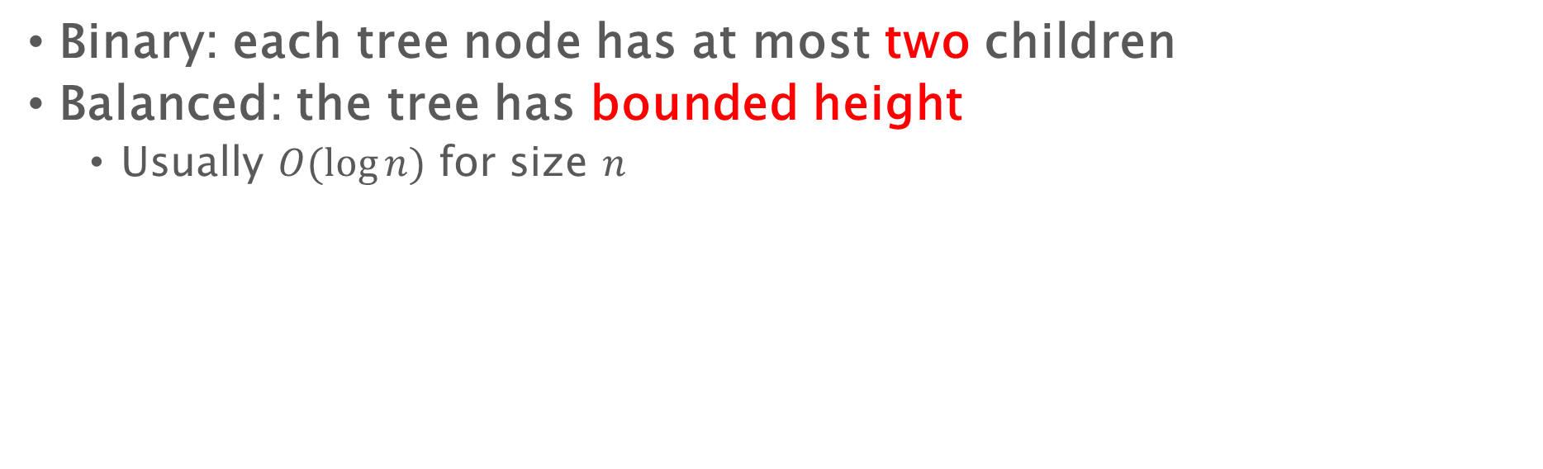
Balanced Binary Trees
Binary: each tree node has at most two children
Balanced: the tree has bounded height
Usually $O(\log{n})$ for size $n$
A wild balanced binary tree
hyphaene compressa

Slide 8

Balanced Binary Trees
Binary: each tree node has at most two children
Balanced: the tree has bounded height
Usually $O(\log{n})$ for size $n$
A wild balanced binary tree

Slide 9

Balanced Binary Trees
Binary: each tree node has at most two children
Balanced: the tree has bounded height
Usually $O(\log{n})$ for size $n$
An abstract balanced binary tree

Slide 10
Balanced Binary Trees
Balancing schemes: invariants to keep the tree balanced and to bound the tree height
We discuss four standard balancing schemes
Height balanced
Size balanced
Randomized balanced
AVL
Trees
Red-black Trees
Weight-balanced Trees
Treaps

Slide 11

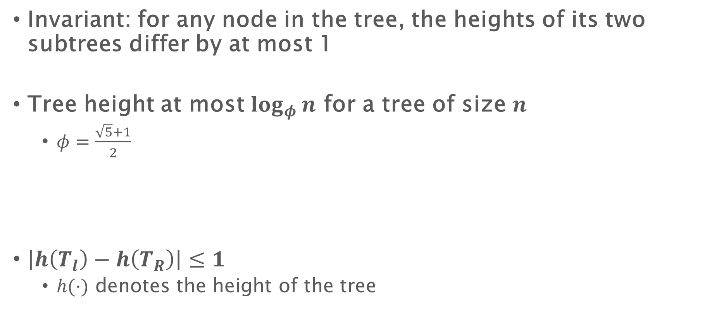

AVL trees
Invariant: for any node in the tree, the heights of its two subtrees differ by at most 1
Tree height at most $log_{φ}{n}$ for a tree of size $n$
$φ=\frac{\sqrt{5}+1}{2}$
$\left|h\left(T_{l}\right)−h\left(T_{R}\right)\right|≤1$
$h(⋅)$ denotes the height of the tree
$$T_{L}$$
$$T_{R}$$

Slide 12
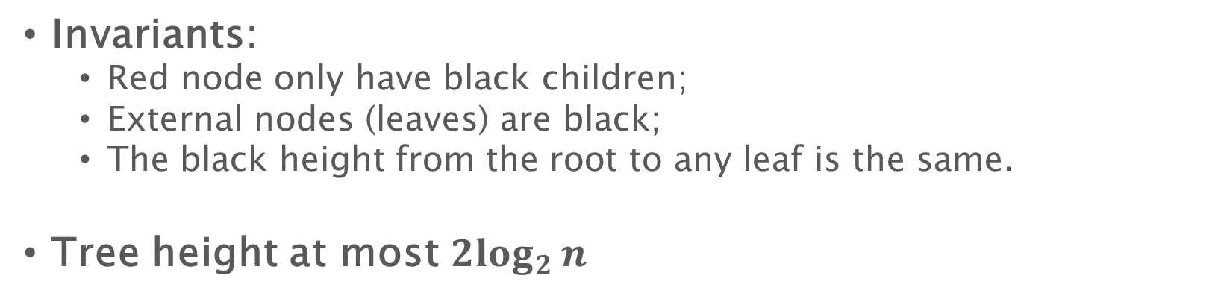
Red-black trees
Invariants:
Red node only have black children;
External nodes (leaves) are black;
The black height from the root to any leaf is the same.
Tree height at most $2\log_{2}{n}$
^
^
^
^
^
^
^
^

Slide 13
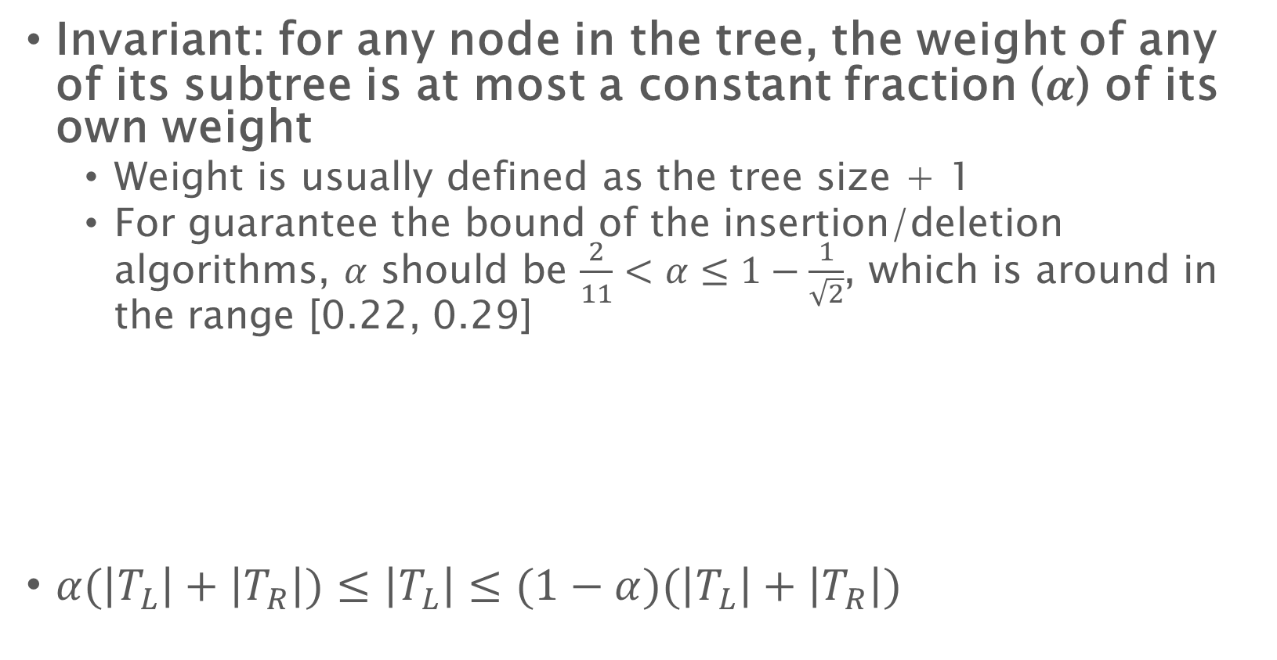
Weight-balanced trees
Invariant: for any node in the tree, the weight of any of its subtree is at most a constant fraction ($α$) of its own weight
Weight is usually defined as the tree size + 1
For guarantee the bound of the insertion/deletion algorithms, $α$ should be $\frac{2}{11}<α≤1−\frac{1}{\sqrt{2}}$, which is around in the range [0.22, 0.29]
$α(\left|T_{L}\right|+\left|T_{R}\right|)≤\left|T_{L}\right|≤(1−α)(\left|T_{L}\right|+\left|T_{R}\right|)$
$$T_{L}$$
$$T_{R}$$

Slide 14
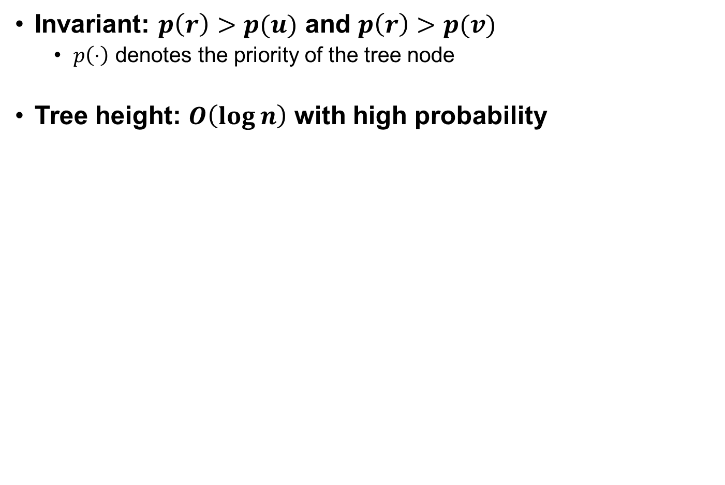



Treaps
Invariant: $p\left(r\right)>p(u)$ and $p\left(r\right)>p(v)$
$p\left(⋅\right)$ denotes the priority of the tree node
Tree height: $O\left(\log{n}\right)$ with high probability
$$r$$
$$v$$
$$u$$

Slide 15
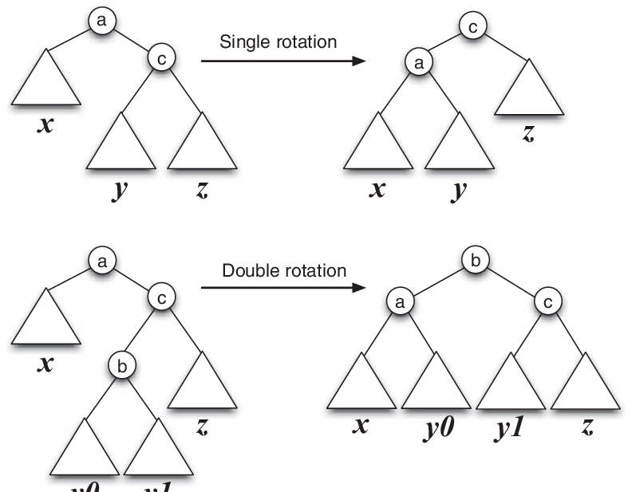
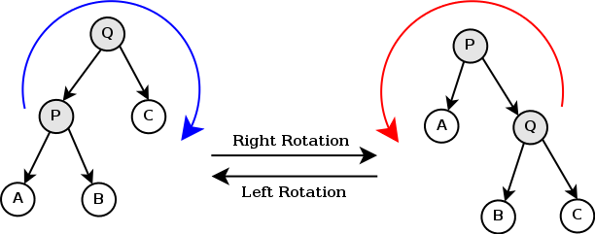
Tree rotation
Source: wikipedia
Source: https://www.researchgate.net/figure/A-single-left-rotation-and-a-double-left-rotation-a-b-and-c-are-elements-x-y-y0_fig4_220676747
Source: wikipedia

Slide 16

Applications Using Trees
Document Search Engine
Struct Doc { int l; pair<Word, Weight>* w; }; class doc_tree { void build(Doc* d); Doc_set search(Word w); Doc_set and_search(Word* w); Doc_set or_search(Word* w); void add_doc(Doc d); …… };
Find information about “balanced” and “binary”
Balanced AND Binary
1,234,567 results
Doc 1: Balanced binary tree
A binary tree is balanced if it keeps its height small …
Doc 2: AVL tree
AVL tree is a balanced binary search tree structure …
Fast & correct searching algorithm
Ongoing updates done atomically for each document
Updates and queries done concurrently

Slide 17


Applications Using Trees
Interval Searching
Determine if anyone is online for a certain time
Stabbing query at $6$
1
2
3
4
5
6
7
8
9
(timeline)
class interval_tree { void build(Interval* i); bool stabbing(Point p); Interval* all_cover(Point p); void insert(Interval i); interval_set filter(func f); Interval* output(); interval_tree combine(interval_tree tree); };

Slide 18
Applications using trees
Databases
Find all young CS students with good grade
Struct Student { id name, grade, age, major, … }; class database { void build(Doc* d); Student* search(int id); Student* fitler(function f); void add_student(Student s); …… };
select
name
from
students
where
age < 25
and major = ‘CS’
and grade >= ‘A’

Slide 19


Applications Using Trees
Geometric queries
(A 2D range query)
Find average temperature in Riverside
struct Point { X x; Y y; Weight w; }; class range_tree { void build(Point* p); Double ave_weight_search(X x1, X x2, Y y1, Y y2); int count_search(X x1, X x2, Y y1, Y y2); void insert(Point p); range_tree filter(func f); Point* output(); void update(X x, Y y, Weight w); };
Riverside

Slide 20
Applications Using Trees
Document Search Engine
Databases
Geometric queries
Find information about “balanced” and “binary”
Find all young CS students with good grade
(A 2D range query)
Find average temperature in Riverside area: 62 F
BalancedlANDlBinary
Elegance – Framework
Genericlfor balancing schemes
Genericifor applications
select
name
from
students
where
age < 25
and major = ‘CS’
and grade >= ‘A’
1,234,567 results
Doc 1: Balancedlbinary tree
A binary tree is balanced if it keeps its height small …
Doc 2: AVL tree
AVL tree is a balanced binary search tree structure …
Massive Data - Performance
Parallelism and concurrency
Efficiency both in theory and in practice
What we want
Riverside
Comprehensive Queries – Functionality
Range queries, bulk updates, …
Augmentation, …
Dynamicity, multi-versioning, …

Slide 21
What will do in this lecture?
Elegance
Framework
Genericlfor balancing schemes
Genericifor applications
Massive Data
Performance
Parallelism and concurrency
Efficiency both in theory and in practice
Functionality
Comprehensive Queries
Range queries, bulk updates, …
Augmentation, …
Dynamicity, multi-versioning, …
Join
(A primitive for trees)

Slide 22
Why do we need join
Traditional algorithms on trees are based on insertions or deletions – hard to be parallelized
On insertion/deletion involves in multiple nodes: e.g, all nodes that may be involved for rotations
If any of them changes during the insertion, the insertion may fail/be wrong
Can use locks/atomic primitives/…
High contention on root
search

Slide 23
Why do we need join
Traditional algorithms on trees are based on insertions/deletions – hard to be parallelized
On insertion/deletion involves in multiple nodes: e.g, all nodes that may be involved for rotations
If any of them changes during the insertion, the insertion may fail/be wrong
Can use locks/atomic primitives/…
High contention on root
Single-element at a time, hard for parallelism
We need new primitives!
search

Slide 24
What will do in this lecture?
Elegance
Framework
Genericlfor balancing schemes
Genericifor applications
Massive Data
Performance
Parallelism and concurrency
Efficiency both in theory and in practice
Functionality
Comprehensive Queries
Range queries, bulk updates, …
Augmentation, …
Dynamicity, multi-versioning, …
Join
(A primitive for trees)

Slide 25
1
Genericlfor balancing schemes
All algorithms except join are identical across balancing schemes
One algorithm for multiple balancing schemes!
2
Genericifor applications
Multiple applications based on the same tree structure
One tree for different problems!
A primitive for trees: Join

Slide 26




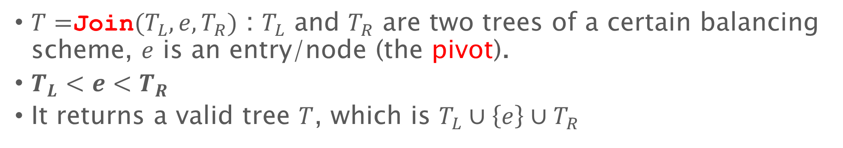






The Primitive Join
$T=$Join$(T_{L},e,T_{R})$ : $T_{L}$ and $T_{R}$ are two trees of a certain balancing scheme, $e$ is an entry/node (the pivot).
$T_{L}<e<T_{R}$
It returns a valid tree $T$, which is $T_{L}∪\left\{e\right\}∪T_{R}$
$$T_{L}$$
$$T_{R2}$$
$$e$$
$$T=$$
4
2
10
$$T_{R}$$
$$e$$
$$T_{L}$$
(Rebalance if necessary)

Slide 27



The Primitive Join
4
2
10
1
3
8
12
6
9
11
13
5
7
14
$$T_{L}$$
$$e$$
$$T_{R}$$

Slide 28

The Primitive Join
Connect at a balancing point
4
10
8
12
2
6
9
11
13
1
3
5
14
7
Balanced!

Slide 29
The Primitive Join
Connect at a balancing point
10
8
12
4
9
11
13
2
6
14
1
3
5
7

Slide 30
The Primitive Join
Connect at a balancing point
Rebalance (specific to balancing schemes)
Join algorithms for four balancing schemes and the cost bound [SPAA’16]
10
4
12
Cost analysis
(AVL)
2
8
11
13
3
4
1
6
9
14
5
7
2
10
Difference of height
1
3
11
8
In general it is still roughly proportional to the difference in height, but depending on the specific balancing scheme
6
9
12
5
7

Slide 31
Join-based insertion

Slide 32
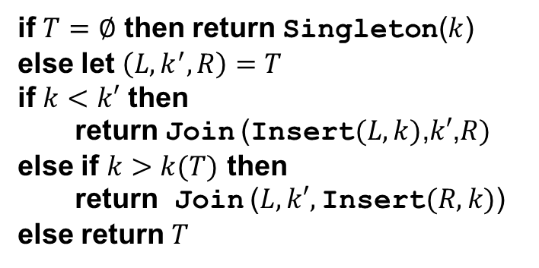
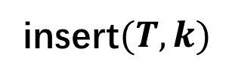
Join-based Algorithms Warm-up
insert$(T,k)$
Compare
Insert
if $T=∅$ then return Singleton($k$)
else let $\left(L,k^{′},R\right)=T$
if $k<k′$ then
return Join (Insert$(L,k)$,$k′$,$R)$
else if $k>k(T)$ then
return Join ($L, k′,$Insert$(R,k)$)
else return $T$
4
5
2
9
1
3

Slide 33
Join-based Algorithms Warm-up
insert$(T,k)$
Join results
(rebalanced may be required)
if $T=∅$ then return Singleton($k$)
else let $\left(L,k^{′},R\right)=T$
if $k<k′$ then
return Join (Insert$(L,k)$,$k′$,$R)$
else if $k>k(T)$ then
return Join ($L, k′,$Insert$(R,k)$)
else return $T$
5
2
9
1
3
4

Slide 34
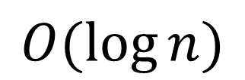
Join-based Algorithms Warm-up
insert$(T,k)$
Join results
(rebalanced may be required)
if $T=∅$ then return Singleton($k$)
else let $\left(L,k^{′},R\right)=T$
if $k<k′$ then
return Join (Insert$(L,k)$,$k′$,$R)$
else if $k>k(T)$ then
return Join ($L, k′,$Insert$(R,k)$)
else return $T$
3
Join will rebalance for Insert!
2
5
1
4
9
$$O(\log{n})$$

Slide 35
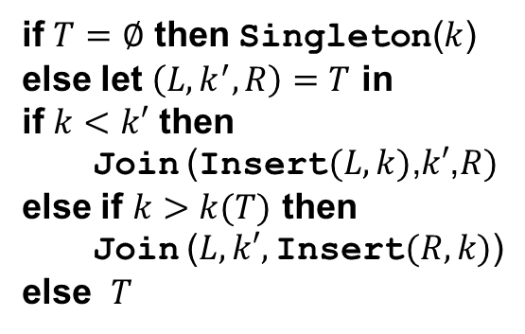
Join-based Algorithms Warm-up
insert$(T,k)$
Compare
Insert
if $T=∅$ then Singleton($k$)
else let $\left(L,k^{′},R\right)=T$ in
if $k<k′$ then
Join (Insert$(L,k)$,$k′$,$R)$
else if $k>k(T)$ then
Join ($L, k′,$Insert$(R,k)$)
else $T$
4
5
2
9
1
3

Slide 36
Join-based Algorithms Warm-up
insert$(T,k)$
Join results
(rebalanced may be required)
if $T=∅$ then Singleton($k$)
else let $\left(L,k^{′},R\right)=T$ in
if $k<k′$ then
Join (Insert$(L,k)$,$k′$,$R)$
else if $k>k(T)$ then
Join ($L, k′,$Insert$(R,k)$)
else $T$
5
2
9
1
3
4

Slide 37
Join-based Algorithms Warm-up
insert$(T,k)$
Join results
(rebalanced may be required)
if $T=∅$ then Singleton($k$)
else let $\left(L,k^{′},R\right)=T$ in
if $k<k′$ then
Join (Insert$(L,k)$,$k′$,$R)$
else if $k>k(T)$ then
Join ($L, k′,$Insert$(R,k)$)
else $T$
3
Join will rebalance for Insert!
2
5
1
4
9

Slide 38
Join-based split

Slide 39
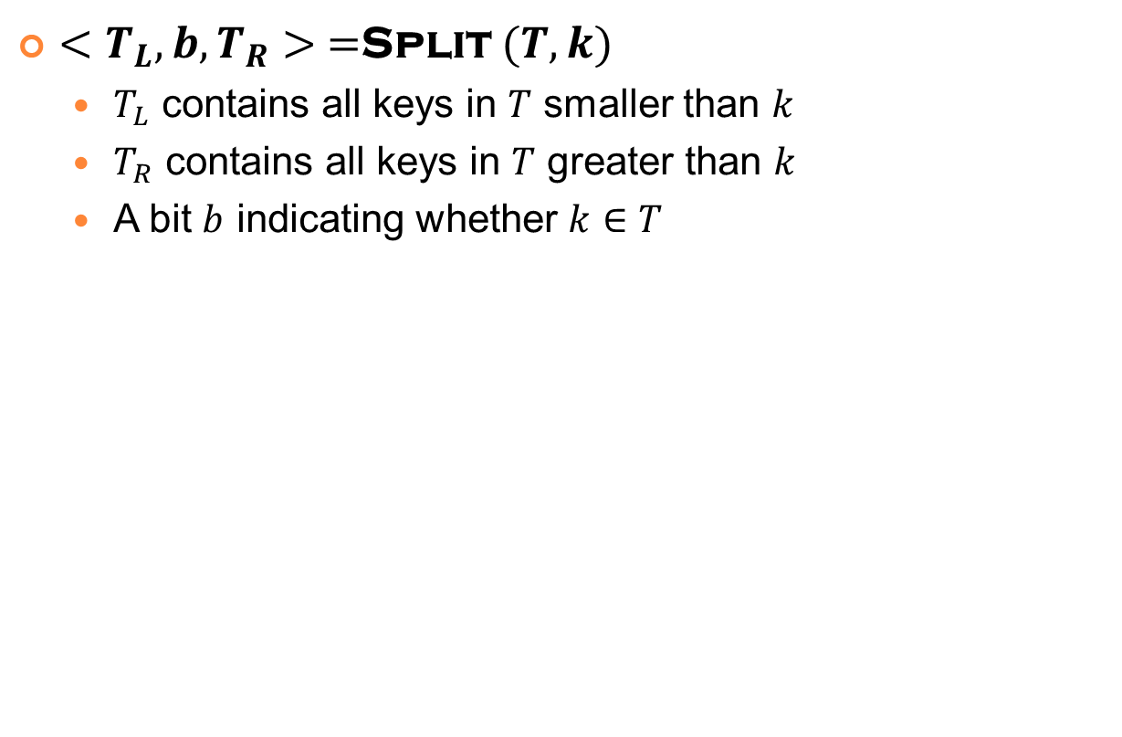

The Inverse of Join: Split
$<T_{L},b,T_{R}> =$Split $(T,k)$
$T_{L}$ contains all keys in $T$ smaller than $k$
$T_{R}$ contains all keys in $T$ greater than $k$
A bit $b$ indicating whether $k∈T$
42
: $b=1$
25
13
51
8
17
36
80
5
12
15
22
30
42
42
70
95
^
^
^
^
^
^
^
^
^
^
^
^
^
^
^
^

Slide 40


The Inverse of Join: Split
$<T_{L},b,T_{R}> =$Split $(T,k)$
$T_{L}$ contains all keys in $T$ smaller than $k$
$T_{R}$ contains all keys in $T$ greater than $k$
A bit $b$ indicating whether $k∈T$
42
: $b=1$
25
$$T_{R}=$$
13
51
8
17
36
80
5
12
15
22
30
70
95
^
^
^
^
^
^
^
^
^
^
^
^
^
^
^
^
Join

Slide 41


The Inverse of Join: Split
$<T_{L},b,T_{R}> =$Split $(T,k)$
$T_{L}$ contains all keys in $T$ smaller than $k$
$T_{R}$ contains all keys in $T$ greater than $k$
A bit $b$ indicating whether $k∈T$
42
: $b=1$
$$T_{L}=$$
25
$$T_{R}=$$
80
13
75
95
8
17
36
51
^
^
^
^
^
5
12
15
22
30
Magically rebalanced by Join!
^
^
^
^
^
^
^
^
^
^
^

Slide 42





The Inverse of Join: Split
$<T_{L},b,T_{R}> =Split(T,k)$
$$\left(h\left(T_{1}\right)−h\left(T_{2}\right)\right)+\left(h\left(T_{2}\right)−h\left(T_{3}\right)\right)+…$$
$$=O\left(h\left(T\right)\right)=O(\log{n})$$
42
: $b=1$
$$T_{L}=$$
25
$$T_{R}=$$
80
13
36
75
95
8
17
$$T_{3}$$
51
^
^
^
$$T_{1}$$
30
^
$$T_{2}$$
^
^
5
12
15
22
^
^
^
^
^
^
^
^
^
^

Slide 43



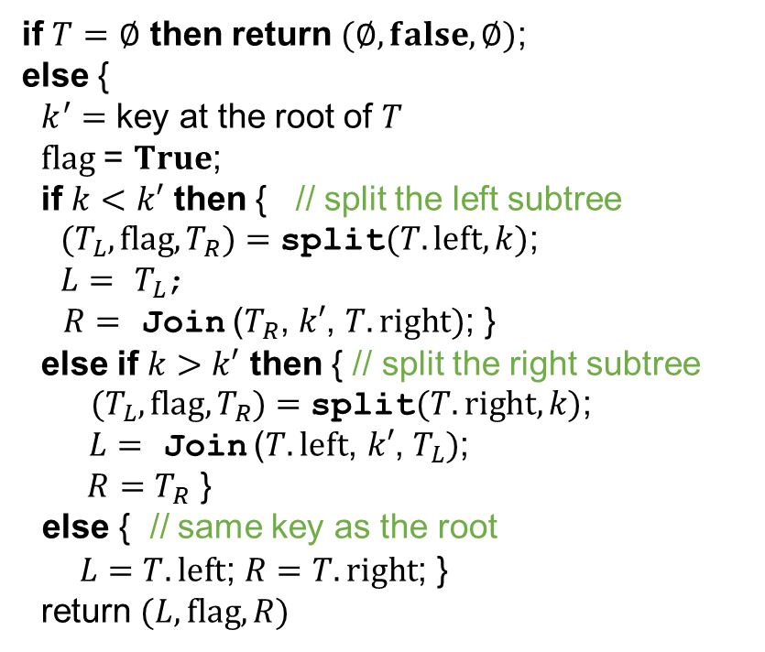



The Inverse of Join: Split
split$(T,k)$
$$k$$
$$k′$$
if $T=∅$ then return $(∅,false,∅)$;
else {
$k^{′}=$ key at the root of $T$
$flag$ = $True$;
if $k<k′$ then { // split the left subtree
$(T_{L},flag,T_{R})=$ split$(T.left,k)$;
$L=$ $T_{L}$;
$R=$ Join ($T_{R}$, $k′$, $T.right)$; }
else if $k>k′$ then { // split the right subtree
$(T_{L},flag,T_{R})=$ split$(T.right,k)$;
$L=$ Join ($T.left$, $k′$, $T_{L})$;
$R=T_{R}$ }
else { // same key as the root
$L=T.left$; $R=T.right$; }
return $(L,flag,R)$
$$T_{L}$$
$$T.right$$
$$T_{R}$$

Slide 44

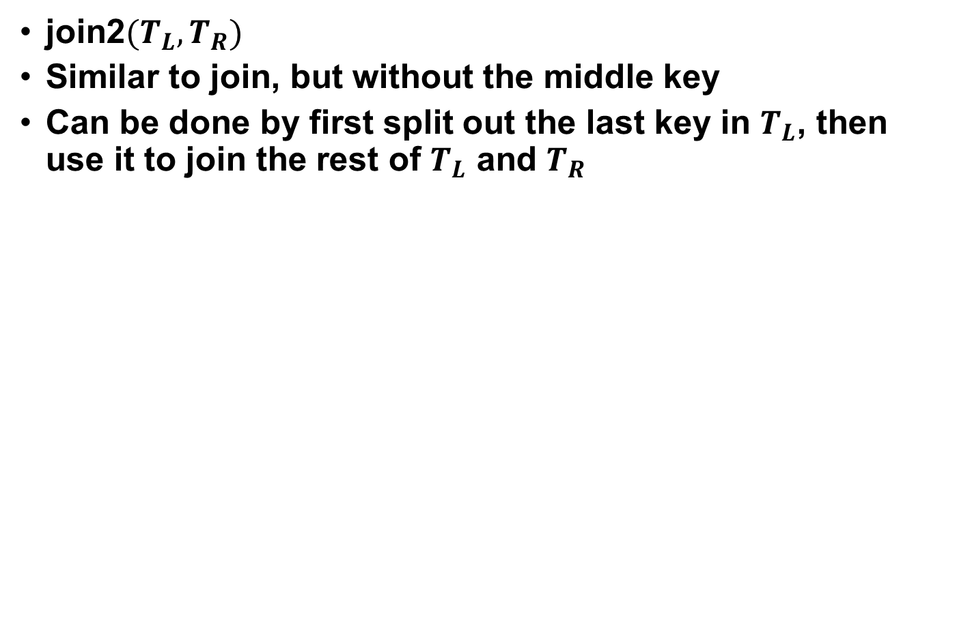
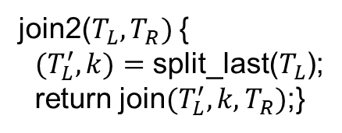

Another helper function: join2
join2$(T_{L},T_{R})$
Similar to join, but without the middle key
Can be done by first split out the last key in $T_{L}$, then use it to join the rest of $T_{L}$ and $T_{R}$
join2($T_{L},T_{R})$ {
$(T_{L}^{′},k)=$ split_last($T_{L}$);
return join$(T_{L}^{′},k,T_{R})$;}
u
v
$$T_{L}$$
$$T_{R}$$
k

Slide 45
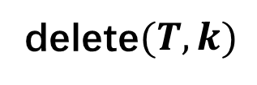

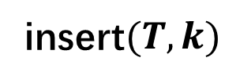
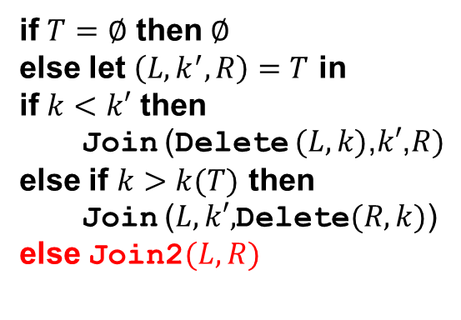
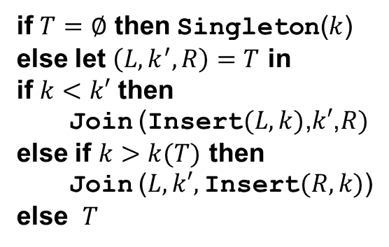

Join-based Algorithms - insertion and deletion
insert$(T,k)$
delete$(T,k)$
if $T=∅$ then Singleton($k$)
else let $\left(L,k^{′},R\right)=T$ in
if $k<k′$ then
Join (Insert$(L,k)$,$k′$,$R)$
else if $k>k(T)$ then
Join ($L, k′,$Insert$(R,k)$)
else $T$
if $T=∅$ then $∅$
else let $\left(L,k^{′},R\right)=T$ in
if $k<k′$ then
Join (Delete $(L,k)$,$k′$,$R)$
else if $k>k(T)$ then
Join ($L, k′,$Delete$(R,k)$)
else Join2$(L,R)$
$$O(\log{n})$$
$$O(\log{n})$$

Slide 46
Join-based parallel algorithms

Slide 47
Parallel Algorithms
Parallel algorithms on trees using divide-and-conquer scheme
Recursively deal with two subtrees in parallel (or split the tree into two pieces and handle them in parallel)
Combine results of recursive calls and the root (e.g., using join or join2)
Usually gives polylogarithmic bounds on depth
func(T, …) {
if (T is empty)
return base_case;
M = do_something(T.root);
in parallel:
L=func(T.left, …);
R=func(T.right, …);
return combine_results(L, R, M, …)
}

Slide 48

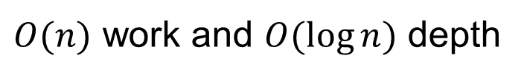
Get the maximum value
In each node we store a key and a value. The nodes are sorted by the keys.
get_max(Tree T) {
if (T is empty) return $−∞$;
in parallel:
L=get_max(T.left);
R=get_max(T.right);
return max(max(L, T.root.value), R);
$O(n)$ work and $O(\log{n})$ depth
Similar algorithm work on any map-reduce function

Slide 49
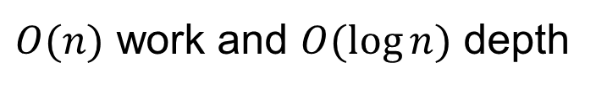
Map and reduce
Maps each entry on the tree to a certain value using function map, then reduce all the mapped values using reduce (with identity identity).
Assume map and reduce both have constant cost.
map_reduce(Tree T, function map, function reduce, value_type identity) {
if (T is empty) return identity;
M=map(t.root);
in parallel:
L=map_reduce(T.left, map, reduce, identity);
R=map_reduce(T.right, map, reduce, identity);
return reduce(reduce(L, M), R);
$O(n)$ work and $O(\log{n})$ depth

Slide 50
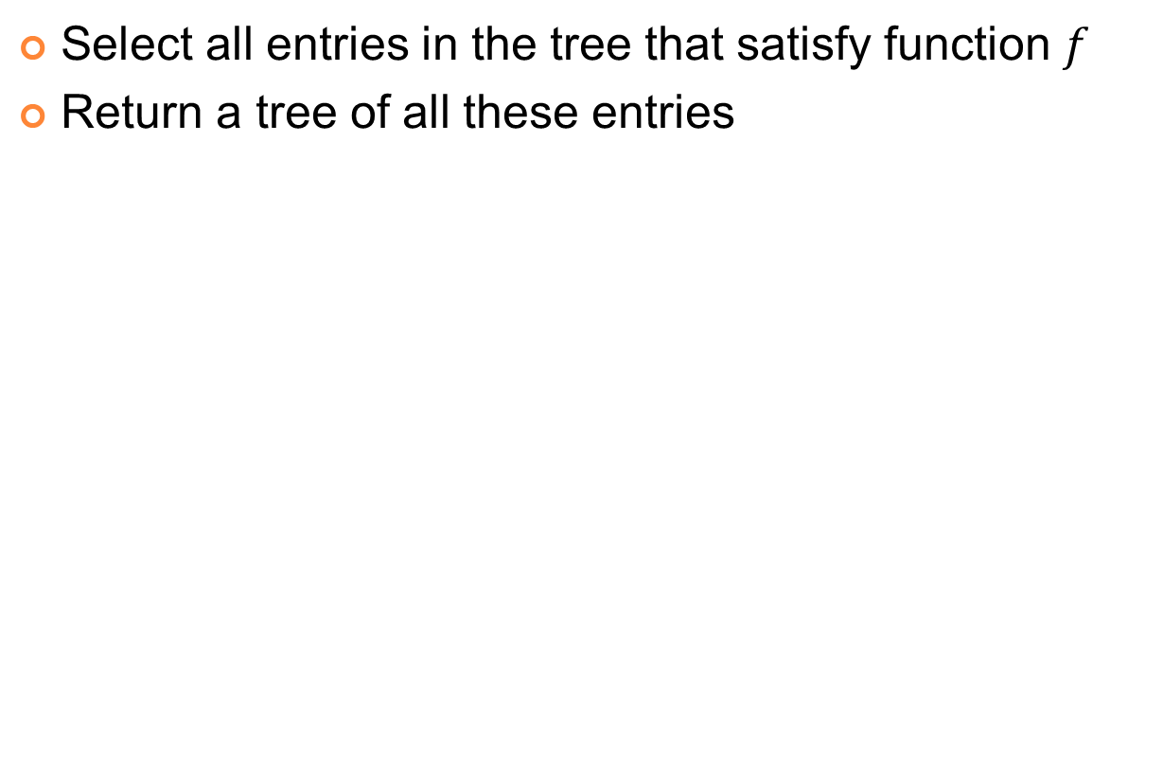
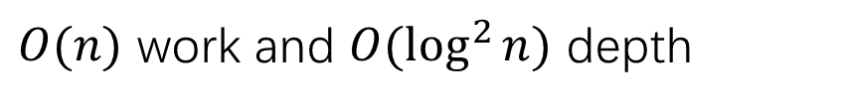
Filter
Select all entries in the tree that satisfy function $f$
Return a tree of all these entries
filter(Tree T, function f) {
if (T is empty) return an empty tree;
in parallel:
L=filter(T.left, f);
R=filter(T.right, f);
if (f(T.root)) return join(L, T.root, R);
else return join2(L, R); }
$O(n)$ work and $O(\log^{2}{n})$ depth

Slide 51

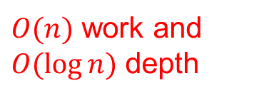
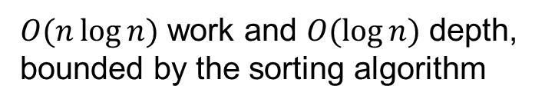
Construction
T=build(Array A, int size) {
$A′$=parallel_sort(A, size);
return build_sorted$(A^{′},s$);
}
T=build_sorted(Arrary A, int start, int end) {
if (start == end) return an empty tree;
if (start == end-1) return singleton(A[start]);
mid = (start+end)/2;
in parallel:
L = build_sorted(A, start, mid);
R = build_sorted(A, mid+1, end);
return join(L, A[mid], R);
$O(n)$ work and $O(\log{n})$ depth
$O(n\log{n})$ work and $O(\log{n})$ depth, bounded by the sorting algorithm

Slide 52
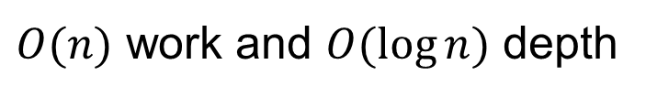
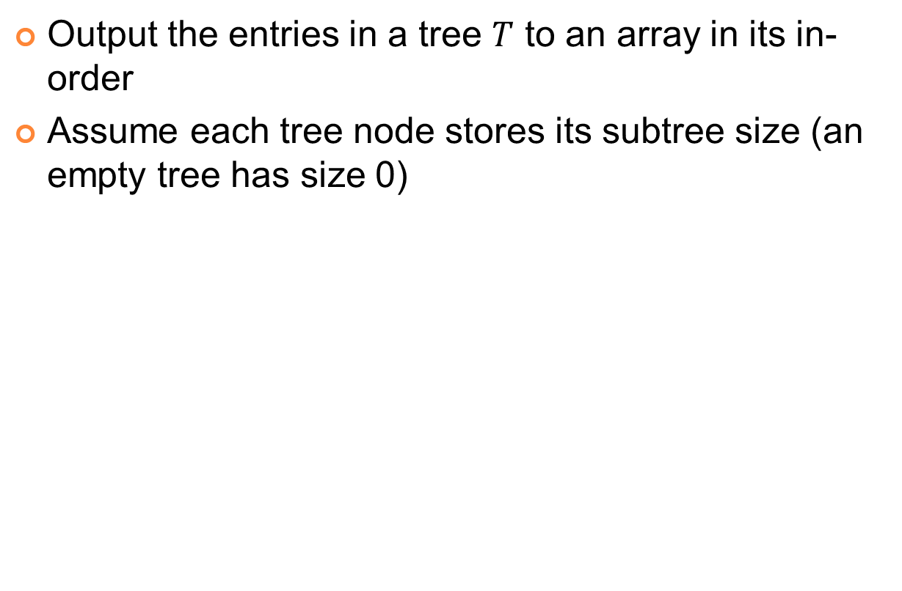




Output to array
Output the entries in a tree $T$ to an array in its in-order
Assume each tree node stores its subtree size (an empty tree has size 0)
$$e$$
to_array(Tree T, array A, int offset) {
if (T is empty) return;
A[offset+T.left.size] = get_entry(T.root);
in parallel:
to_array(T.left, A, offset);
to_array(T.right, A, offset+T.left.size()+1);
$$T.left$$
$$T.right$$
$$e$$
The size of the left subtree
$O(n)$ work and $O(\log{n})$ depth

Slide 53
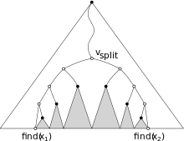
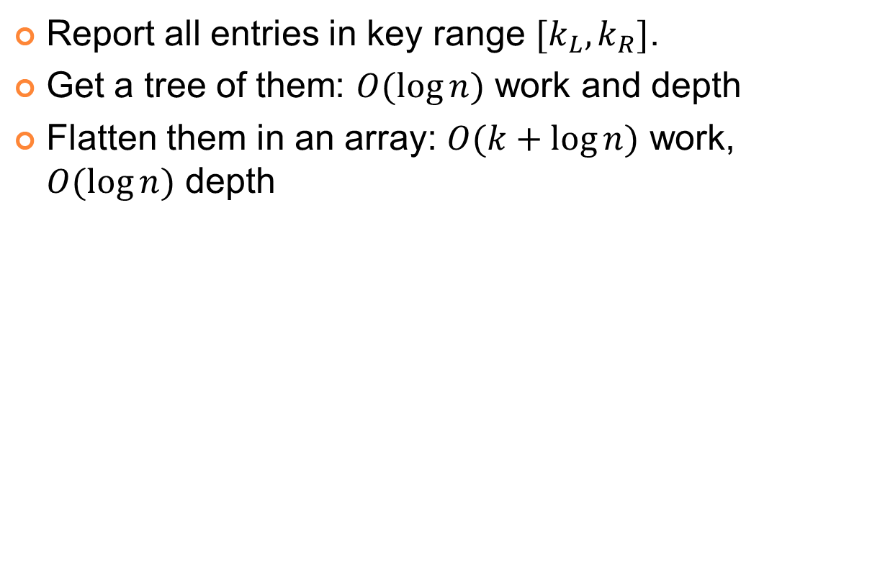



Range query (1D)
right(T, k) is just the right half of the split algorithm.
Can also use two split algorithms
Report all entries in key range $[k_{L},k_{R}]$.
Get a tree of them: $O(\log{n})$ work and depth
Flatten them in an array: $O(k+\log{n})$ work, $O(\log{n})$ depth
node* range (T, kl , kr ) {
node* cur = T;
key k = key at cur;
while ( kl > k or kr < k ) { // find v_split
if (kl > k ) cur = cur->right ;
if (kr < k) cur = cur->left;}
node* L = range_right ( cur->left, kl );
node* R = range_left ( cur->right, kr );
return join(L, cur, R); }
node * range_right (T, k ) { // left (t , k ) is symmetric
if ( t is null ) return T;
if (k > key(t)) return range_right (t->right, k);
return join(right (t->left, k), T, T->right ); }
$O(\log{n})$ related nodes / subtrees
$$k_{L}$$
$$k_{R}$$

