Slide 1
Parallel data structures

Slide 2
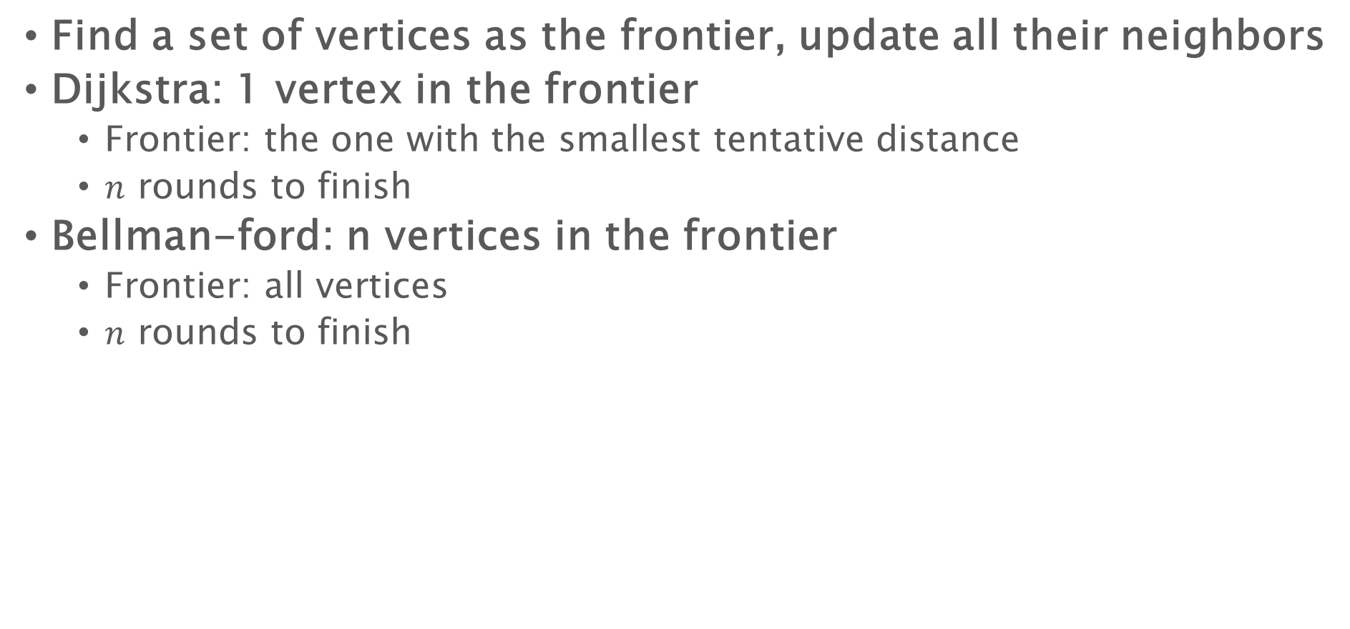
Last Lecture: SSSP
Find a set of vertices as the frontier, update all their neighbors
Dijkstra: 1 vertex in the frontier
Frontier: the one with the smallest tentative distance
$n$ rounds to finish
Bellman-ford: n vertices in the frontier
Frontier: all vertices
$n$ rounds to finish

Slide 3
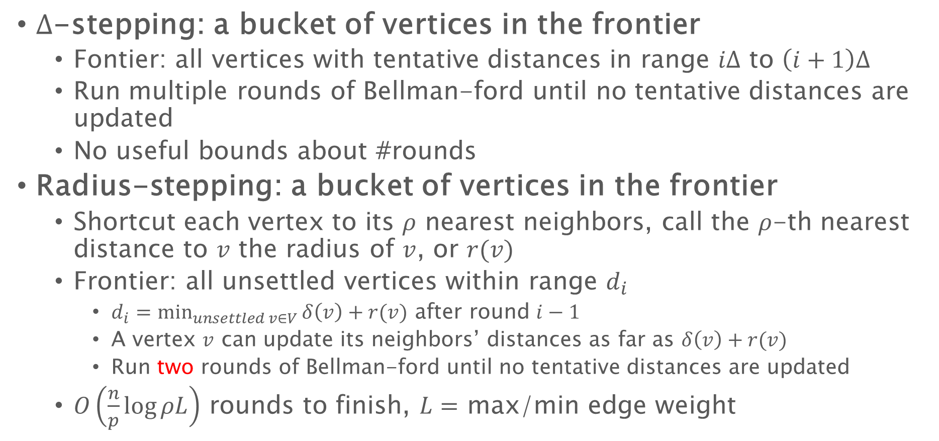
Last Lecture: SSSP
$Δ$-stepping: a bucket of vertices in the frontier
Fontier: all vertices with tentative distances in range $iΔ$ to $\left(i+1\right)Δ$
Run multiple rounds of Bellman-ford until no tentative distances are updated
No useful bounds about #rounds
Radius-stepping: a bucket of vertices in the frontier
Shortcut each vertex to its $ρ$ nearest neighbors, call the $ρ$-th nearest distance to $v$ the radius of $v$, or $r(v)$
Frontier: all unsettled vertices within range $d_{i}$
$d_{i}=\min_{unsettled v∈V}{δ\left(v\right)+r(v)}$ after round $i−1$
A vertex $v$ can update its neighbors’ distances as far as $δ\left(v\right)+r(v)$
Run two rounds of Bellman-ford until no tentative distances are updated
$O\left(\frac{n}{p}\log{ρL}\right)$ rounds to finish, $L=$ max/min edge weight

Slide 4
Useful tools
Almost all algorithms mentioned in the lectures about parallel algorithms are implemented in libraries:
Ligra/Ligra+ [Shun and Blelloch’13]
Frontier-based graph algorithms
https://github.com/jshun/ligra
Julienne [Dhulipala et al.’17]
Bucket-based graph algorithms
https://github.com/jshun/ligra/tree/master/apps/bucketing
GBBS [Dhulipala et al.’18]
Parallel graph algorithm library
https://github.com/ldhulipala/gbbs
ASPEN [Dhulipala et al.’18]
Dynamic graph processing library
https://github.com/ldhulipala/aspen

Slide 5





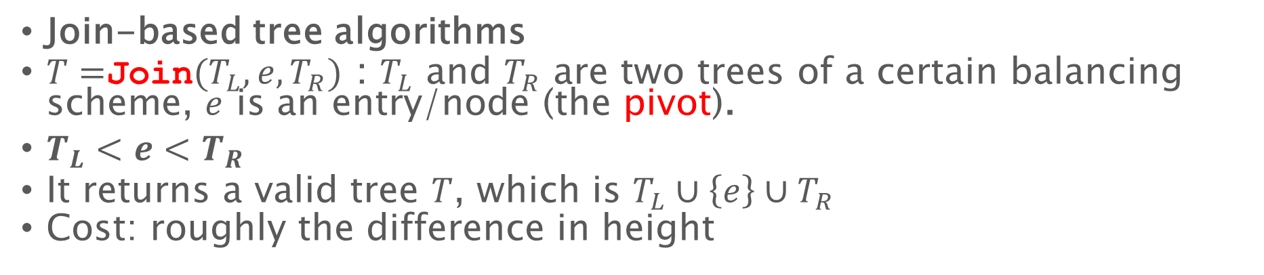





Last lecture: parallel trees
Join-based tree algorithms
$T=$Join$(T_{L},e,T_{R})$ : $T_{L}$ and $T_{R}$ are two trees of a certain balancing scheme, $e$ is an entry/node (the pivot).
$T_{L}<e<T_{R}$
It returns a valid tree $T$, which is $T_{L}∪\left\{e\right\}∪T_{R}$
Cost: roughly the difference in height
$$T_{L}$$
$$T_{R2}$$
$$e$$
$$T=$$
4
2
10
$$T_{R}$$
$$e$$
$$T_{L}$$
(Rebalance if necessary)

Slide 6
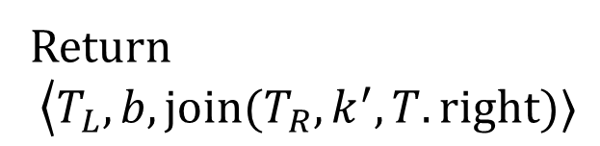


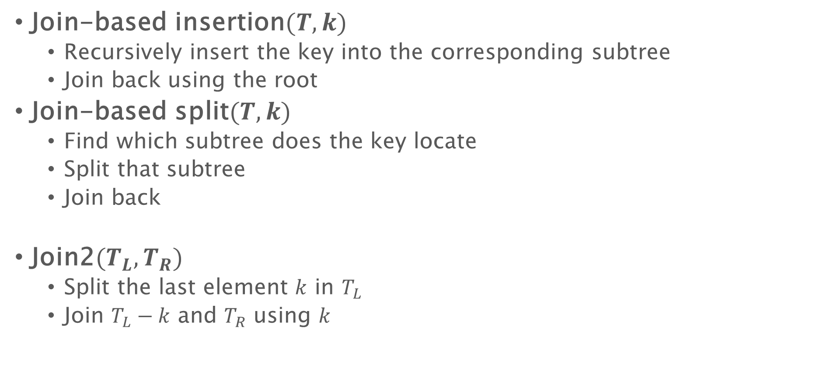




Parallel trees
Join-based insertion$(T,k)$
Recursively insert the key into the corresponding subtree
Join back using the root
Join-based split$(T,k)$
Find which subtree does the key locate
Split that subtree
Join back
Join2$(T_{L},T_{R})$
Split the last element $k$ in $T_{L}$
Join $T_{L}−k$ and $T_{R}$ using $k$
Return
$$\left\langle T_{L}\right.,b, join(T_{R},k^{′},T.right)⟩$$
$$k$$
$$k′$$
$$T_{L}$$
$$T.right$$
$$T_{R}$$
$$b$$

Slide 7
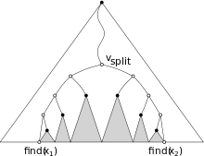
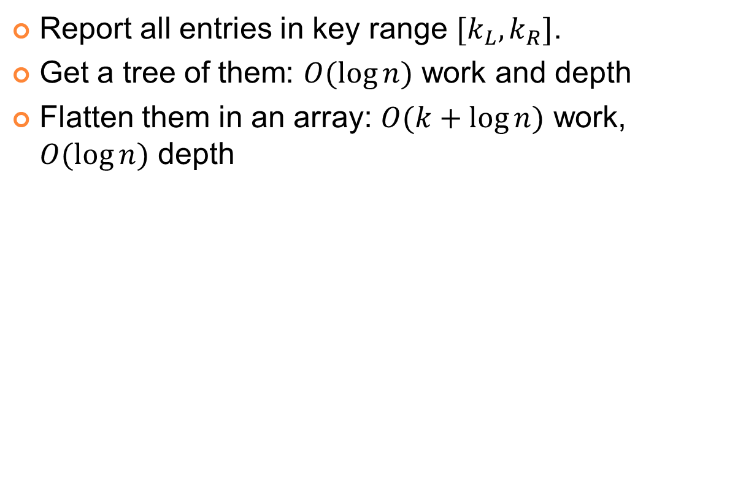



Range query (1D)
Report all entries in key range $[k_{L},k_{R}]$.
Get a tree of them: $O(\log{n})$ work and depth
Flatten them in an array: $O(k+\log{n})$ work, $O(\log{n})$ depth
Equivalent to using two split algorithms
$O(\log{n})$ related nodes / subtrees
$$k_{L}$$
$$k_{R}$$

Slide 8
node* range (T, kl , kr ) {
node* cur = T;
key k = key at cur;
while ( kl > k or kr < k ) { // find v_split
if (kl > k ) cur = cur->right ;
if (kr < k) cur = cur->left;}
node* L = range_right ( cur->left, kl );
node* R = range_left ( cur->right, kr );
return join(L, cur, R); }
node * range_right (T, k ) { // left (t , k ) is symmetric
if ( t is null ) return T;
if (k > key(t)) return range_right (t->right, k);
return join(right (t->left, k), T, T->right ); }

Slide 9
Join-based parallel algorithms

Slide 10
Parallel Algorithms
Parallel algorithms on trees using divide-and-conquer scheme
Recursively deal with two subtrees in parallel (or split the tree into two pieces and handle them in parallel)
Combine results of recursive calls and the root (e.g., using join or join2)
Usually gives polylogarithmic bounds on depth
func(T, …) {
if (T is empty)
return base_case;
M = do_something(T.root);
in parallel:
L=func(T.left, …);
R=func(T.right, …);
return combine_results(L, R, M, …)
}

Slide 11

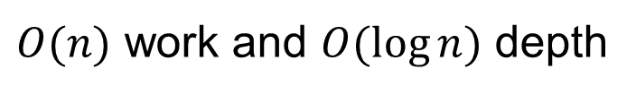
Get the maximum value
In each node we store a key and a value. The nodes are sorted by the keys.
get_max(Tree T) {
if (T is empty) return $−∞$;
in parallel:
L=get_max(T.left);
R=get_max(T.right);
return max(max(L, T.root.value), R);
$O(n)$ work and $O(\log{n})$ depth
Similar algorithm work on any map-reduce function

Slide 12
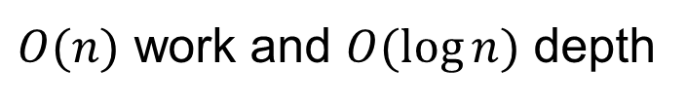
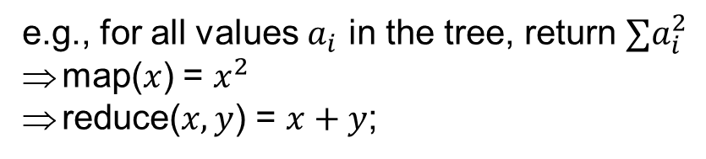
Map and reduce
Maps each entry on the tree to a certain value using function map, then reduce all the mapped values using reduce (with identity identity).
Reduce is associative
Assume map and reduce both have constant cost.
map_reduce(Tree T, function map, function reduce, value_type identity) {
if (T is empty) return identity;
M=map(t.root);
in parallel:
L=map_reduce(T.left, map, reduce, identity);
R=map_reduce(T.right, map, reduce, identity);
return reduce(reduce(L, M), R);
e.g., for all values $a_{i}$ in the tree, return $∑a_{i}^{2}$
map($x$) = $x^{2}$
reduce($x, y$) = $x+y$;
$O(n)$ work and $O(\log{n})$ depth
Notes:
This is useful, for example, if you run a database of a supermarket. All the sale receipts with dates are stored in a tree. At some point you want to know the total sales. Now you can map each entry to the sale number, and use the reduce function as addition, and the identity is zero. Similarly you can use a max function to know the maximum sale you’ve ever made.

Slide 13
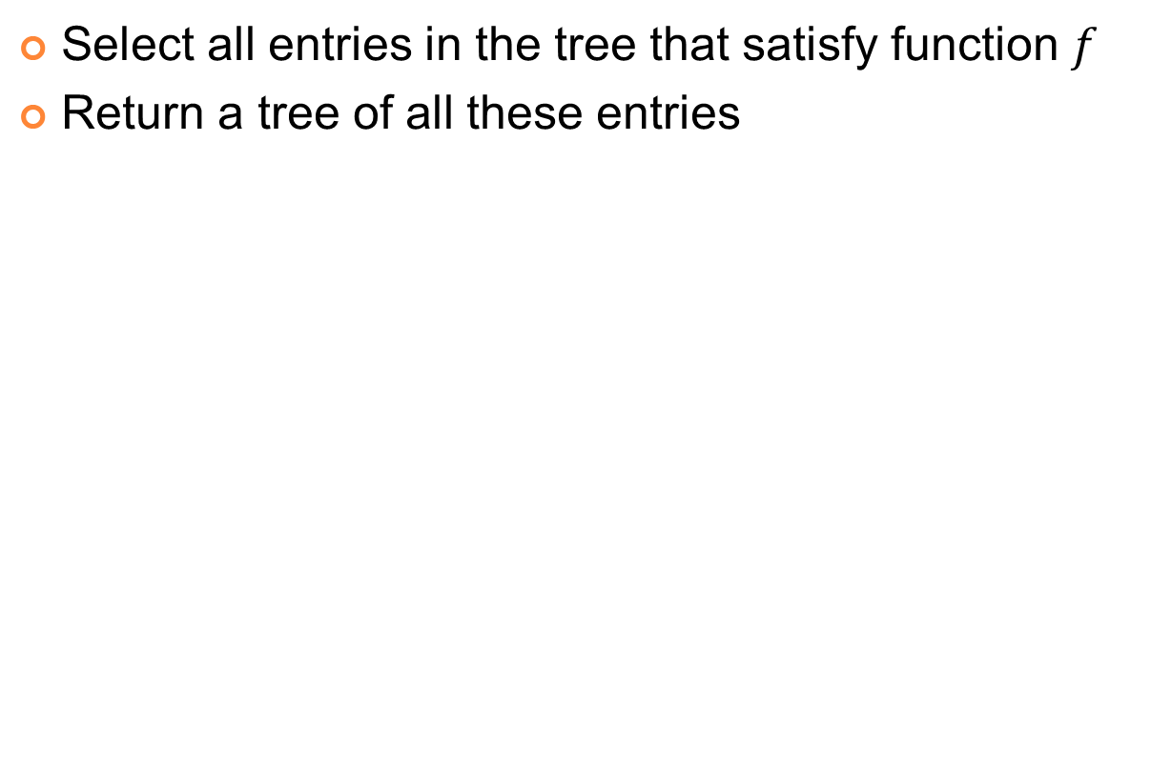
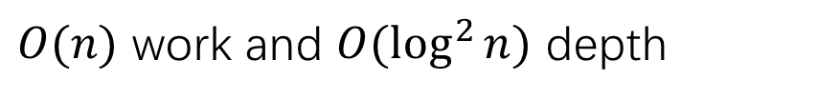
Filter
Select all entries in the tree that satisfy function $f$
Return a tree of all these entries
filter(Tree T, function f) {
if (T is empty) return an empty tree;
in parallel:
L=filter(T.left, f);
R=filter(T.right, f);
if (f(T.root)) return join(L, T.root, R);
else return join2(L, R); }
$O(n)$ work and $O(\log^{2}{n})$ depth
Notes:
For example, you want to select all keys that are even, or that are perfect squares.

Slide 14

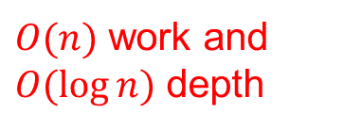
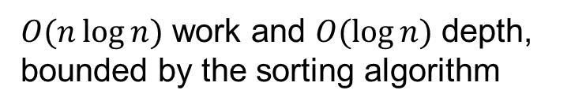
Construction
T=build(Array A, int size) {
$A′$=parallel_sort(A, size);
return build_sorted$(A^{′},s$);
}
T=build_sorted(Arrary A, int start, int end) {
if (start == end) return an empty tree;
if (start == end-1) return singleton(A[start]);
mid = (start+end)/2;
in parallel:
L = build_sorted(A, start, mid);
R = build_sorted(A, mid+1, end);
return join(L, A[mid], R);
$O(n)$ work and $O(\log{n})$ depth
$O(n\log{n})$ work and $O(\log{n})$ depth, bounded by the sorting algorithm

Slide 15
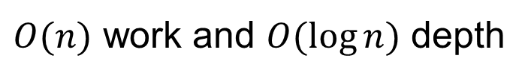
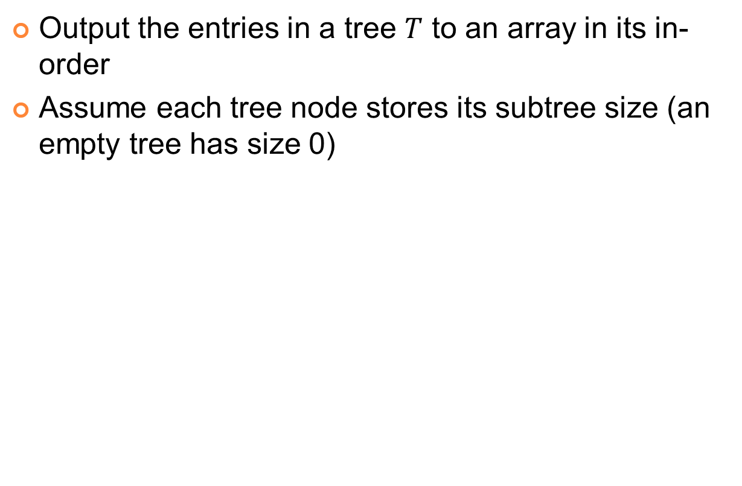




Output to array
Output the entries in a tree $T$ to an array in its in-order
Assume each tree node stores its subtree size (an empty tree has size 0)
$$e$$
to_array(Tree T, array A, int offset) {
if (T is empty) return;
A[offset+T.left.size] = get_entry(T.root);
in parallel:
to_array(T.left, A, offset);
to_array(T.right, A, offset+T.left.size()+1);
$$T.left$$
$$T.right$$
$$e$$
The size of the left subtree
$O(n)$ work and $O(\log{n})$ depth
Notes:
Next is the function to output a tree to an array. In the output we want to keep the in-order of the tree, such that the array is sorted. Sequentially we just recursively output its left subtree to an array, and then write the root to the next slot in the array, and then output the right subtree from the next slot. To use the same framework to do it in parallel, the only thing we need to take care of is how can we start dealing with the right subtree before finishing the left recursive call. The solution to this turns out to be very easy. We only need to store the subtree size in each tree node. Even though the subtree sizes are not stored at the beginning, we can use a parallel algorithm to compute the size of each subtree, in linear work and log n depth, using a very similar algorithm as the map and reduce algorithm. Then since we know the left subtree size, we immediately know at which slot the root entry will be written to. All the slots to the left of e are for the left subtree, all those on the right are for the right one. So these two recursive calls can run in parallel, not interfering with each other.
In the implementation, we introduce another parameter offset. This parameter denotes from which subscript of array A, the entries of the current tree T will be written to. When it comes to the left recursive call, the offset is the same as this one. For the right recursive call, we add the left tree size to the offset, and another one for the root.

Slide 16
Parallel algorithms for ordered sets

Slide 17





Ordered Sets
Ordered sets: sets with total ordering
Useful interface:
Find, previous, next, size, first, last, k-th, …
Filter, reduce, construction, …
Union, intersection, difference, symmetric difference, …
I am Mr. Big!
I am big!
4
<
6
<
10
>?
<?
<
93
11
<
26
<
<
15
A set of citizens in Zootopia (unordered)
A set of integers (ordered)
Notes:
First what is ordered set? An Ordered set is a collection of elements with total ordering. Such as a set of integers, strings or any types with defined total ordering.
To implement ordered sets often requires some special data structures such as arrays, linked lists or tree structures. In this talk we use balanced binary search trees as the data structure. I will talk about why and how later in the talk.

Slide 18
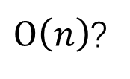
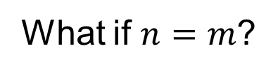
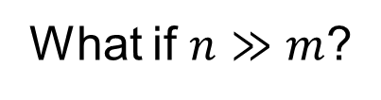
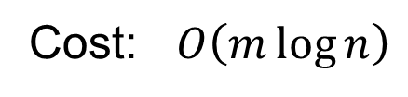
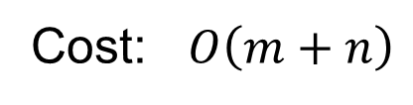
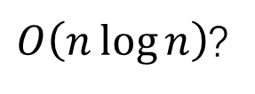
Merging Two Sets of Size n and m (n$≥$m)
Solution 1: flatten trees into arrays, merge with moving pointers:
Solution 2: insert the entries in the smaller tree into the larger tree
What is the minimum cost?
0
4
7
8
Cost: $O\left(m+n\right)$
1
2
3
5
6
9
What if $n≫m$?
$O\left(n\right)$?
0
1
2
3
4
5
6
7
8
9
5
Cost: $O\left(m\log{n}\right)$
7
2
9
6
What if $n=m$?
4
8
1
3
6
9
7
0
$O\left(n\log{n}\right)$?
0
4
7
8
18
Notes:
To combine two ordered lists into another ordered structure is not a new problem, We’ve met it in merge sort. Typically in merge sort, we store the two sets in arrays, and then merge them using two moving pointers. These two pointers start from the first element in each set, and the smaller element of the two will be written to the result array. Then that pointer move to the next position, and we repeat the process until all elements are visited.
After each comparison, one element will be written to the result, and the size of the result array is at most m plus n, so the cost of this algorithm is order of m+n. It is linear, but is not good enough. In merge sort we always have m equal to n, but in general, n can be much greater than m, and the work is still proportional to the larger size. Imagine, even if the smaller size is one, which means to insert one element in a sorted structure, we still need to pay the cost of n. So what’s wrong with this? Actually we have many parts such as this one two three in set two that are preserved from the input to the output. But we still need to read and write them one by one.
To avoid this, we can store the sets in balanced binary search trees and insert the elements of the smaller tree into the larger one. To keep the tree balanced, some rotations are necessary. each rotation costs order of log n. so this costs Order of m log n. It is mainly decided by the smaller size. However, when n equals to m, It is Order of n log n, but solution one will give us an algorithm of linear time. And the problem here, is that we don’t make good use of the ordered property of the first tree.
Now we’ve seen that efficient union algorithm is not an easy task, m plus n and m log n both are good in one case but terrible in the other.
So here, the question is, what is the optimal cost of the union function. And We give the answer under the comparison model

Slide 19
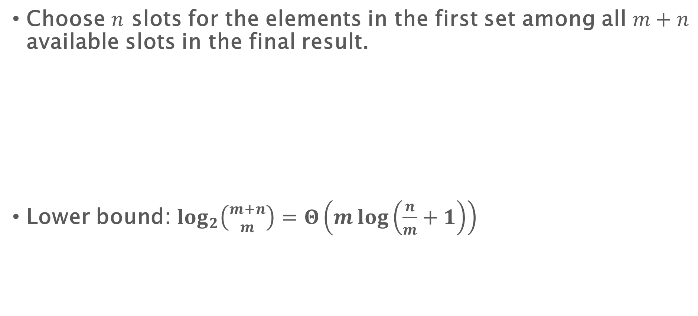
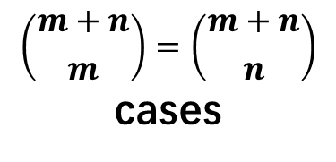


The Lower Bound of Merging Two Ordered Sets
Choose $n$ slots for the elements in the first set among all $m+n$ available slots in the final result.
Lower bound: $\log_{2}\left({m+n \atop m}\right)=Θ\left(m\log\left(\frac{n}{m}+1\right)\right)$
Set 1 (size $m$):
Set 2 (size $n≥m$):
0
4
7
8
1
2
3
5
6
9
$$\left({m+n \atop m}\right)=\left({m+n \atop n}\right)$$
cases
Result:
0
1
2
3
4
5
6
7
8
9
Notes:
The comparison model evaluates the number of comparisons in the algorithm.
Under this model, what union should do is : out of the all the m+n slots in the result array, choose m slots for the elements in set one. Or choose n slots for those in set two, which are equivalent. We need to use log based two of this many comparisons to distinguish them, If you do the math, it should be theta m log n over m plus one.

Slide 20
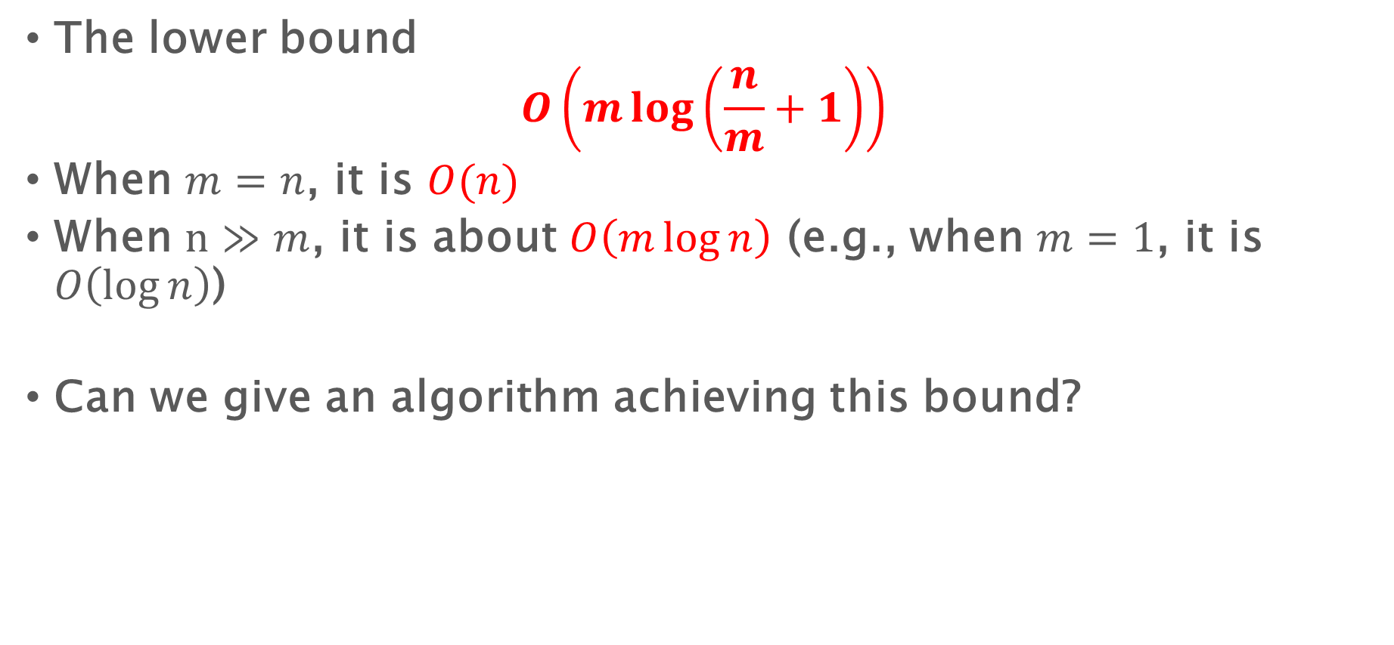
The Lower Bound of Merging Two Ordered Sets
The lower bound
$$O\left(m\log\left(\frac{n}{m}+1\right)\right)$$
When $m=n$, it is $O(n)$
When $n≫m$, it is about $O\left(m\log{n}\right)$ (e.g., when $m=1$, it is $O\left(\log{n}\right)$)
Can we give an algorithm achieving this bound?
Notes:
It has been shown that On a comparison-based model, the lower bound of union, intersection or difference for ordered sets is Order of m log n over m plus one. In case you are not familiar with this model I can briefly introduce it. This model is a common used computational model, which evaluates how many comparisons are required by an algorithm or a problem.
you may find this bound not very intuitive, I will *not* show the proof here, but I will show you that it is, actually, a very reasonable bound. For example, when m equals to n, it is order of n, and when n is much greater than m, this bound is about m log n. At least in these two extreme cases, this bound is quite good!

Slide 21
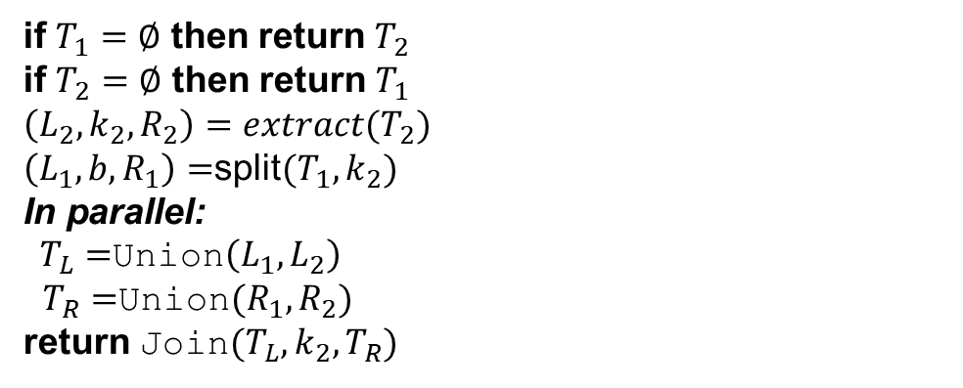
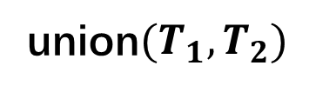
Join-based Algorithms: Union
union$(T_{1},T_{2})$
if $T_{1}=∅$ then return $T_{2}$
if $T_{2}=∅$ then return $T_{1}$
$\left(L_{2},k_{2},R_{2}\right)=extract(T_{2})$
$\left(L_{1},b,R_{1}\right)=$split$(T_{1},k_{2})$
In parallel:
$T_{L}=$Union$\left(L_{1},L_{2}\right)$
$T_{R}=$Union$(R_{1},R_{2})$
return Join$(T_{L},k_{2},T_{R})$
Base case
7
5
4
8
2
9
0
1
3
6
Notes:
Here is the pseudo code. Seems very easy, right? An initial version of this function was proposed by Adams in nineteen ninety-two, on weight-balanced trees. Now we make it work on all balancing schemes by plugging into the corresponding join function.
This function takes two trees T one and T two as input and return a tree containing the union of all elements.
The first two lines are base case. The main process looks like this: we first read the root of one tree, and use it to split the other tree.
(click)
Now T_1 is broken up into L one and R one by the key five, and T two naturally have left tree and right tree split by the root five.
(click)
So we recursively union the two parts smaller than five, and the two parts greater than five. These two unions can be done in parallel.
(click)
And finally, call join to join the three parts together.
(click)
Also we can implement intersection and difference in similar way.

Slide 22




Join-based Algorithms: Union
union$(T_{1},T_{2})$
if $T_{1}=∅$ then return $T_{2}$
if $T_{2}=∅$ then return $T_{1}$
$\left(L_{2},k_{2},R_{2}\right)=extract(T_{2})$
$\left(L_{1},b,R_{1}\right)=$split$(T_{1},k_{2})$
In parallel:
$T_{L}=$Union$\left(L_{1},L_{2}\right)$
$T_{R}=$Union$(R_{1},R_{2})$
return Join$(T_{L},k_{2},T_{R})$
5
4
7
2
9
0
8
1
3
6
$$L_{1}$$
$$R_{1}$$
$$L_{2}$$
$$R_{2}$$
Notes:
Here is the union function. Seems very easy, right? An initial version of this function was proposed by Adams in nineteen ninety-two, on weight-balanced trees. Now we make it work on all balancing schemes by plugging into the corresponding join function.
This function takes two trees T one and T two as input and return a tree containing the union of all elements in T one or T two.
The first two lines are base case. The main process in the next four lines: we first read the root of one tree, and use it to split the other tree.
(click)
Now T_1 is broken up into L one and R one by the key five, and T two naturally have left tree and right tree split by the root five.
(click)
So we recursively union the two parts smaller than five, and the two parts greater than five. These two unions can be done in parallel.
(click)
And finally, call join to join the three parts together.
(click)
Also we can implement intersection and difference in similar way.

Slide 23
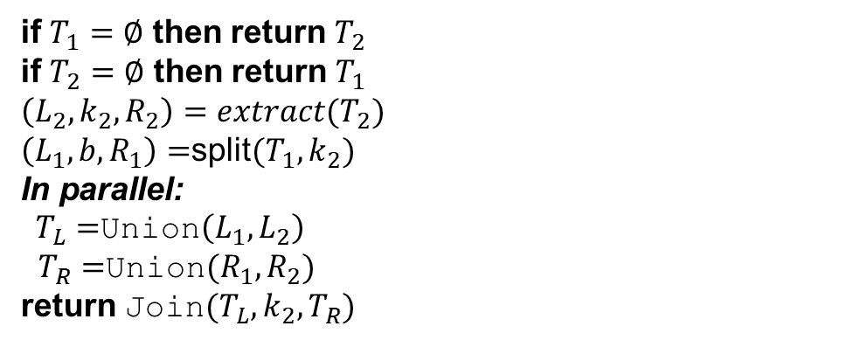
Join-based Algorithms: Union
union$(T_{1},T_{2})$
if $T_{1}=∅$ then return $T_{2}$
if $T_{2}=∅$ then return $T_{1}$
$\left(L_{2},k_{2},R_{2}\right)=extract(T_{2})$
$\left(L_{1},b,R_{1}\right)=$split$(T_{1},k_{2})$
In parallel:
$T_{L}=$Union$\left(L_{1},L_{2}\right)$
$T_{R}=$Union$(R_{1},R_{2})$
return Join$(T_{L},k_{2},T_{R})$
5
4
2
7
9
0
1
3
8
6
Union
Union
Notes:
Here is the union function. Seems very easy, right? An initial version of this function was proposed by Adams in nineteen ninety-two, on weight-balanced trees. Now we make it work on all balancing schemes by plugging into the corresponding join function.
This function takes two trees T one and T two as input and return a tree containing the union of all elements in T one or T two.
The first two lines are base case. The main process in the next four lines: we first read the root of one tree, and use it to split the other tree.
(click)
Now T_1 is broken up into L one and R one by the key five, and T two naturally have left tree and right tree split by the root five.
(click)
So we recursively union the two parts smaller than five, and the two parts greater than five. These two unions can be done in parallel.
(click)
And finally, call join to join the three parts together.
(click)
Also we can implement intersection and difference in similar way.

Slide 24


Join-based Algorithms: Union
union$(T_{1},T_{2})$
if $T_{1}=∅$ then return $T_{2}$
if $T_{2}=∅$ then return $T_{1}$
$\left(L_{2},k_{2},R_{2}\right)=extract(T_{2})$
$\left(L_{1},b,R_{1}\right)=$split$(T_{1},k_{2})$
In parallel:
$T_{L}=$Union$\left(L_{1},L_{2}\right)$
$T_{R}=$Union$(R_{1},R_{2})$
return Join$(T_{L},k_{2},T_{R})$
5
2
7
1
3
6
8
0
4
9
$$T_{L}$$
$$T_{R}$$
Notes:
Here is the union function. Seems very easy, right? An initial version of this function was proposed by Adams in nineteen ninety-two, on weight-balanced trees. Now we make it work on all balancing schemes by plugging into the corresponding join function.
This function takes two trees T one and T two as input and return a tree containing the union of all elements in T one or T two.
The first two lines are base case. The main process in the next four lines: we first read the root of one tree, and use it to split the other tree.
(click)
Now T_1 is broken up into L one and R one by the key five, and T two naturally have left tree and right tree split by the root five.
(click)
So we recursively union the two parts smaller than five, and the two parts greater than five. These two unions can be done in parallel.
(click)
And finally, call join to join the three parts together.
(click)
Also we can implement intersection and difference in similar way.

Slide 25
Join-based Algorithms: Union
union$(T_{1},T_{2})$
if $T_{1}=∅$ then return $T_{2}$
if $T_{2}=∅$ then return $T_{1}$
$\left(L_{2},k_{2},R_{2}\right)=extract(T_{2})$
$\left(L_{1},b,R_{1}\right)=$split$(T_{1},k_{2})$
In parallel:
$T_{L}=$Union$\left(L_{1},L_{2}\right)$
$T_{R}=$Union$(R_{1},R_{2})$
return Join$(T_{L},k_{2},T_{R})$
5
2
7
1
3
6
8
0
4
9
Similarly we can implement intersection and difference.
Notes:
Here is the union function. Seems very easy, right? An initial version of this function was proposed by Adams in nineteen ninety-two, on weight-balanced trees. Now we make it work on all balancing schemes by plugging into the corresponding join function.
This function takes two trees T one and T two as input and return a tree containing the union of all elements in T one or T two.
The first two lines are base case. The main process in the next four lines: we first read the root of one tree, and use it to split the other tree.
(click)
Now T_1 is broken up into L one and R one by the key five, and T two naturally have left tree and right tree split by the root five.
(click)
So we recursively union the two parts smaller than five, and the two parts greater than five. These two unions can be done in parallel.
(click)
And finally, call join to join the three parts together.
(click)
Also we can implement intersection and difference in similar way.

Slide 26
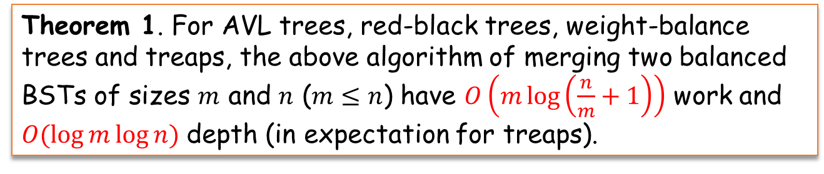
Join-based Algorithms: Union
Theorem 1. For AVL trees, red-black trees, weight-balance trees and treaps, the above algorithm of merging two balanced BSTs of sizes $m$ and $n$ ($m≤n$) have $O\left(m\log\left(\frac{n}{m}+1\right)\right)$ work and $O(\log{m}\log{n})$ depth (in expectation for treaps).
The bound also holds for intersection and difference

Slide 27

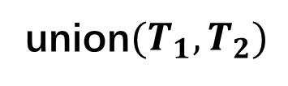
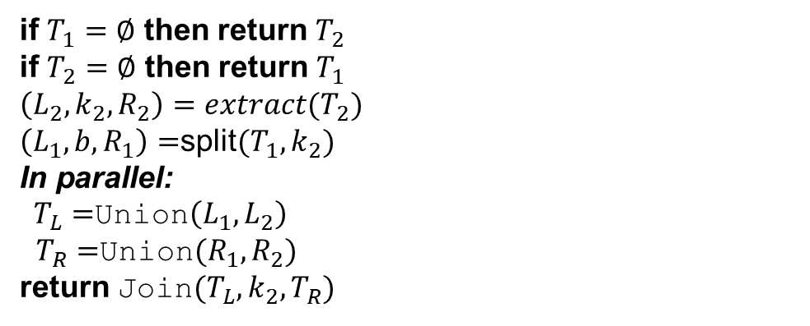
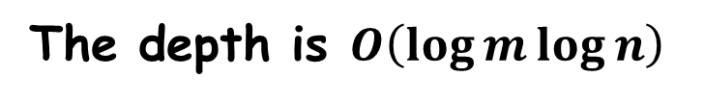
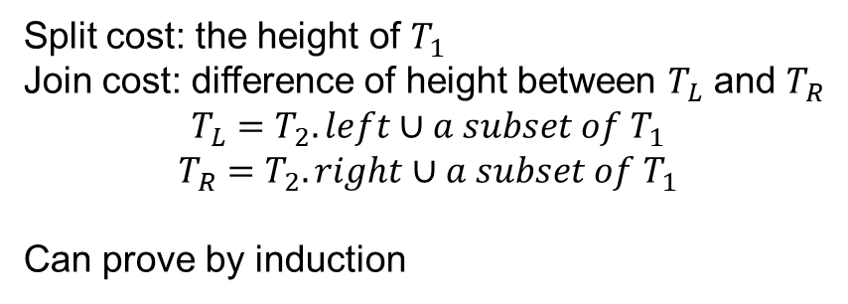
Cost analysis of union
Using AVL as an example
union$(T_{1},T_{2})$
Lemma 1. The Join work can be asymptotically bounded by its corresponding Split.
if $T_{1}=∅$ then return $T_{2}$
if $T_{2}=∅$ then return $T_{1}$
$\left(L_{2},k_{2},R_{2}\right)=extract(T_{2})$
$\left(L_{1},b,R_{1}\right)=$split$(T_{1},k_{2})$
In parallel:
$T_{L}=$Union$\left(L_{1},L_{2}\right)$
$T_{R}=$Union$(R_{1},R_{2})$
return Join$(T_{L},k_{2},T_{R})$
Split cost: the height of $T_{1}$
Join cost: difference of height between $T_{L}$ and $T_{R}$
$$T_{L}=T_{2}.left∪a subset of T_{1}$$
$$T_{R}=T_{2}.right∪a subset of T_{1}$$
Can prove by induction
The depth is $O\left(\log{m}\log{n}\right)$
$h_{2}$ steps to reach the base case, $O(h_{1})$ cost for each split

Slide 28
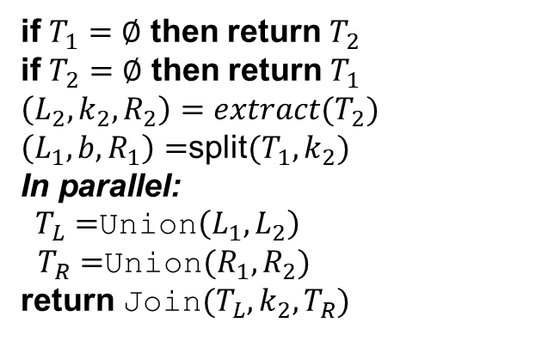
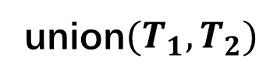


The Split Work
union$(T_{1},T_{2})$
if $T_{1}=∅$ then return $T_{2}$
if $T_{2}=∅$ then return $T_{1}$
$\left(L_{2},k_{2},R_{2}\right)=extract(T_{2})$
$\left(L_{1},b,R_{1}\right)=$split$(T_{1},k_{2})$
In parallel:
$T_{L}=$Union$\left(L_{1},L_{2}\right)$
$T_{R}=$Union$(R_{1},R_{2})$
return Join$(T_{L},k_{2},T_{R})$
Union
split
8
$$T_{1}$$
4
9
0
Union
5
Union
split
split
4
$$T_{2}$$
8
2
7
0
9
1
3
6
^
8
0
4
^
9
Union
Union
Union
Union
Notes:
Lets take a quick look of the split work. If we always choose the split pivot from T_2, then each node in T_2 will split one subset in T_1. For example, the very first step is that the root five split the whole T one into two parts,
then the two parts will be sent to its two children respectively,
and then two and seven split the two subsets respectively, and sent the result to *their* children, and so forth.
And the total work of split, can be summed up over layers. Remember that the split cost is order of log n, so first at the root, layer one, it is log n.

Slide 29
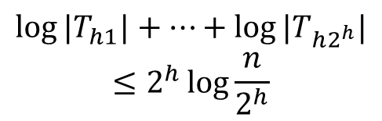



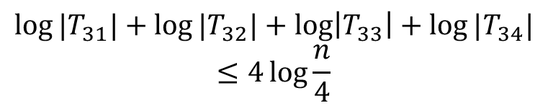



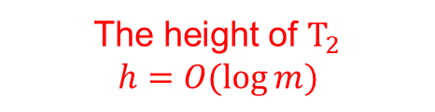
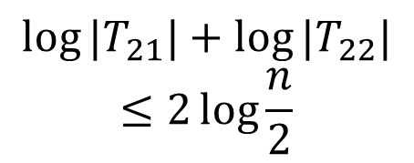





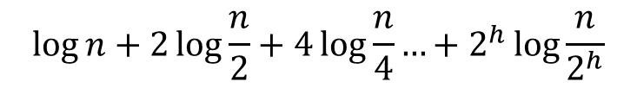

The Split Work
Concavity:
$$\log{\sum_{i=1}^{k}{a_{i}}}≤k\log{\frac{∑a_{i}}{k}}$$
split
8
$$T_{1}$$
4
9
$$\log{{|T}_{1}|}=\log{n}$$
0
$$T_{21}$$
5
$$T_{22}$$
($|T|$: the size of tree $T$)
split
$$\log{{|T}_{21}|}+\log{|T_{22}|}$$
$$≤2\log{\frac{n}{2}}$$
split
4
$$T_{2}$$
8
2
7
0
9
……
1
3
6
^
$$\log{{|T}_{31}|}+\log{{|T}_{32}|}+\log\left|T_{33}\right|+\log{{|T}_{34}|}$$
$$≤4\log{\frac{n}{4}}$$
8
$$\log{{|T}_{h1}|}+…+\log{|T_{h2^{h}}|}$$
$$≤2^{h}\log{\frac{n}{2^{h}}}$$
$$T_{31}$$
0
$$T_{32}$$
4
$$T_{33}$$
^
$$T_{34}$$
9
$$\log{n}+2\log{\frac{n}{2}}+4\log{\frac{n}{4}}…+2^{h}\log{\frac{n}{2^{h}}}$$
c
$$=O\left(m \log\left(\frac{n}{m}+1\right)\right)$$
The height of $T_{2}$
$$h=O(\log{m})$$
c
(If $T_{2}$ is perfectly balanced)
$\log_{2}{m}$ terms
Notes:
(click)and on layer two it is the sum of the log of the size of the two small trees, and from the concavity of log function we know it is no more than two log n over 2. (click)And so forth, until the bottom of T_2, we have two to the h terms. (click) Sum over all the layers is the split cost.
(click)Intuitively, if T_2 is perfectly balanced, which means that h is exactly log m, there will be log m terms in this expression, and the result is m log n over m plus one, which is optimal. However, for any of the four balancing schemes, the tree cannot be balanced with such strict condition.
If we add a constant c here, it will appear in the result here, the power of m, which is very terrible. So what’s wrong with this? The problem here is that even at the very bottom of the tree, there can be at most m nodes. If we use two to the c log m to estimate the number of nodes, it would be m to the c, which is too loose.
So here comes our fact three. With this fact tree, we can re-organize the expression in the other direction, which is …
and with some simplify work it would be the optimal bound. This is not a strict proof, only this is intuitively what role does fact three s in the proof. I cannot explain the details here.
OK, that’s all about the theory part. Next I will show you some experimental results.

Slide 30

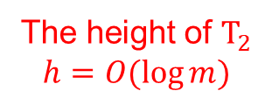


The Split Work
Concavity:
$$\sum_{i=1}^{k}{a_{i}}≤k\log{\frac{∑a_{i}}{k}}$$
split
8
$$T_{1}$$
4
9
$$\log{{|T}_{1}|}=\log{n}$$
0
$$T_{21}$$
5
$$T_{22}$$
($|T|$: the size of tree $T$)
split
$$\log{{|T}_{21}|}+\log{|T_{22}|}$$
$$≤2\log{\frac{n}{2}}$$
split
4
$$T_{2}$$
8
2
7
0
9
……
$$\log{{|T}_{31}|}+\log{{|T}_{32}|}+\log\left|T_{33}\right|+\log{{|T}_{34}|}$$
$$≤4\log{\frac{n}{4}}$$
1
3
6
^
8
$$\log{{|T}_{h1}|}+…+\log{|T_{h2^{h}}|}$$
$$≤2^{h}\log{\frac{n}{2^{h}}}$$
$$T_{31}$$
0
$$T_{32}$$
4
$$T_{33}$$
^
$$T_{34}$$
9
$$\log{n}+2\log{\frac{n}{2}}+4\log{\frac{n}{4}}…+2^{h}\log{\frac{n}{2^{h}}}$$
c
$$=O\left(m \log\left(\frac{n}{m}+1\right)\right)$$
The height of $T_{2}$
$$h=O(\log{m})$$
c
(If $T_{2}$ is perfectly balanced)
$\log_{2}{m}$ terms
Notes:
(click)and on layer two it is the sum of the log of the size of the two small trees, and from the concavity of log function we know it is no more than two log n over 2. (click)And so forth, until the bottom of T_2, we have two to the h terms. (click) Sum over all the layers is the split cost.
(click)Intuitively, if T_2 is perfectly balanced, which means that h is exactly log m, there will be log m terms in this expression, and the result is m log n over m plus one, which is optimal. However, for any of the four balancing schemes, the tree cannot be balanced with such strict condition.
If we add a constant c here, it will appear in the result here, the power of m, which is very terrible. So what’s wrong with this? The problem here is that even at the very bottom of the tree, there can be at most m nodes. If we use two to the c log m to estimate the number of nodes, it would be m to the c, which is too loose.
So here comes our fact three. With this fact tree, we can re-organize the expression in the other direction, which is …
and with some simplify work it would be the optimal bound. This is not a strict proof, only this is intuitively what role does fact three s in the proof. I cannot explain the details here.
OK, that’s all about the theory part. Next I will show you some experimental results.

Slide 31


How can we enumerate the splitters?
Height $O\left(\log{n}\right)$
For the $i$-th layer, there are at most $2^{i−1}$ nodes
For $c\log{n}$ layers, are there $2^{c\log{n}}=n^{c}$ nodes?
1
2
4
8
16?
32?
AVL tree, $N=23$

Slide 32

How can we enumerate the splitters?
Idea: group all nodes bottom up
Example: AVL tree: group all nodes with height $2i−1$ and $2i$ into level $−i$: no more than $\frac{N}{2^{i−1}}$ of them
AVL tree, $N=23$

Slide 33





How can we enumerate the splitters?
Idea: group all nodes bottom up
Example: AVL tree: group all nodes with height $2i−1$ and $2i$ into level $−i$: no more than $\frac{N}{2^{i−1}}$ of them
Height 6, 1 of them
$$≤\frac{N}{4}$$
Height 5, 1 of them
Lemma 3. In an AVL tree of size $N$, there are at most $\frac{N}{2^{i−1}}$ nodes in level $−i$.
Height 4, 2 of them
$$≤\frac{N}{2}$$
Height 3, 4 of them
Similar idea is applicable to other balancing schemes
Height 2, 6 of them
$$≤N$$
Height 1,
9 of them
AVL tree, $N=23$

Slide 34




Proof sketch
Let $n_{i}$ be the number of nodes with height $i$
Every node with height 3 has at least 2 leaf descendants, so $n_{3}≤\frac{n_{1}}{2}$
AVL invariant
Remove all leaf nodes, it is still an AVL tree, so $n_{4}≤\frac{n_{2}}{2}$
Obviously $n_{1}+n_{2}≤N$
So $n_{3}+n_{4}≤\frac{N}{2}$
Lemma 3. In an AVL tree of size $N$, there are at most $\frac{N}{2^{i−1}}$ nodes in level $−i$.
AVL tree, $n=23$

Slide 35

The Split Work
split
8
$$T_{1}$$
4
9
0
$$T_{21}$$
5
$$T_{22}$$
split
split
4
$$T_{2}$$
8
2
7
0
9
1
3
6
^
$$O\left(m\log{\frac{n}{m}}+\frac{m}{2}\log{\frac{n}{m/2}}+\frac{m}{4}\log{\frac{n}{m/4}}+…\right)=O\left(m\log\left(\frac{n}{m}+1\right)\right)$$
8
$$T_{31}$$
0
$$T_{32}$$
4
$$T_{33}$$
^
$$T_{34}$$
9
$$\log{n}+2\log{\frac{n}{2}}+4\log{\frac{n}{4}}…+2^{h}\log{\frac{n}{2^{h}}}$$
c
$$=O\left(m \log\left(\frac{n}{m}+1\right)\right)$$
c
(If $T_{2}$ is perfectly balanced)
$\log_{2}{m}$ terms
Notes:
(click)and on layer two it is the sum of the log of the size of the two small trees, and from the concavity of log function we know it is no more than two log n over 2. (click)And so forth, until the bottom of T_2, we have two to the h terms. (click) Sum over all the layers is the split cost.
(click)Intuitively, if T_2 is perfectly balanced, which means that h is exactly log m, there will be log m terms in this expression, and the result is m log n over m plus one, which is optimal. However, for any of the four balancing schemes, the tree cannot be balanced with such strict condition.
If we add a constant c here, it will appear in the result here, the power of m, which is very terrible. So what’s wrong with this? The problem here is that even at the very bottom of the tree, there can be at most m nodes. If we use two to the c log m to estimate the number of nodes, it would be m to the c, which is too loose.
So here comes our fact three. With this fact tree, we can re-organize the expression in the other direction, which is …
and with some simplify work it would be the optimal bound. This is not a strict proof, only this is intuitively what role does fact three s in the proof. I cannot explain the details here.
OK, that’s all about the theory part. Next I will show you some experimental results.

Slide 36
Join-based Algorithms: Union
Theorem 1. For AVL trees, red-black trees, weight-balance trees and treaps, the above algorithm of merging two balanced BSTs of sizes $m$ and $n$ ($m≤n$) have $O\left(m\log\left(\frac{n}{m}+1\right)\right)$ work and $O(\log{m}\log{n})$ depth (in expectation for treaps).
The bound also holds for intersection and difference

Slide 37
Persistent parallel trees for MVCC

Slide 38
What Are Persistence and MVCC?
Persistence [DSST’86]: for data structures
Preserves the previous version of itself
Always yields a new version when being updated
Multi-version Concurrency Control (MVCC): for databases
Let write transactions create new versions
Let ongoing queries work on old versions
To guarantee concurrent updates and queries to work correctly and efficiently
Queries work on a consistent version
Writers/readers do not block each other
Why Persistence and MVCC?

Slide 39

Why Persistence and MVCC?
An example of a document search engine.
Whales OR dog
Riverside
Calories
room AND magic
Document 4:
The University of California, Riverside is a public research university in Riverside, California.
Document 1:
Blue whales eat half a million calories in one mouthful.
Document 2:
My dog probably thinks I’m magical because rooms light up when I enter them.
Document 3:
Banging your head against a wall for one hour burns 150 calories.
A Document Database
For end-user experience:
Queries shouldn't be delayed by updates
Queries must be done on a consistent version of database
Generally useful for any database systems with concurrent updates and queries.
Hybrid Transactional and Analytical Processing (HTAP) Database System

Slide 40

Persistence Using Join
Path-copying: copy the affected path on trees
Copying occur only in Join!
$$T_{1}$$
insert
4
5
3
8
1
9

Slide 41

Persistence Using Join
Path-copying: copy the affected path on trees
Copying occur only in Join!
$$T_{1}$$
insert
5
4
3
8
1
9

Slide 42

Persistence Using Join
Path-copying: copy the affected path on trees
Copying occur only in Join!
Always copy the middle node
All the other parts in the algorithm remain unchanged
No extra cost in time asymptotically, small overhead in space
Safe for concurrency – multi-version concurrency control (MVCC)
$$T_{1}$$
$$T_{2}$$
5
5’
5’
3’
3
8
3’
1
4
9

Slide 43






Persistence for MVCC
Each operate on a snapshot – safe for concurrency
Multiple updates can be visible atomically – lock-free
Current version $T$
$$T_{1}$$
$$T_{3}$$
$P_{1}: T_{1}=T$.insert(4)
$P_{2}: T_{2}=T$.delete(9)
$P_{3}: T_{3}=T$.insert(6)
$$T_{2}$$
5’
commit($T_{1}$)
5’’’
5’
5’’’
5
5’’
5’’
3’
8’’
3
8
8’
3’
8’
8’’
6’
1
4
9

Slide 44




Transactions using Multi-version Concurrency Control (MVCC)
Lock-free atomic updates ☺
A series of operations
A bulk of operations (e.g., union)
Easy roll-back ☺
Do not affect other concurrent operations ☺
Any operation works on as if a single-versioned tree with no extra (asymptotical) cost ☺
Bank: find all with balance>10
Bank: add the total balance
Insurance agent: check Bob’s balance
Frank: check my balance
current
Carol
$2
Wendy
${ v}_{1}$
Wendy +$2
${ v}_{temp}$
Carol -$2
${ v}_{2}$
Carol
17
Carol’
17
Carol”
15
Worst-case
$O(\log{n})$ for a lookup
$O(\log{n})$ for an insertion
Bob
20
Frank
7
Frank’
7
Alice
17
David
13
Wendy
4
Wendy’
6

Slide 45

Persistence for Multi-version Concurrency Control (MVCC)
Lock-free atomic updates ☺
A series of operations
A bulk of operations (e.g., union)
Easy roll-back ☺
Do not affect other concurrent operations ☺
Any operation works on as if a single-versioned tree with no extra (asymptotical) cost ☺
Bank: find all with balance>10
Bank: add the total balance
Insurance agent: check Bob’s balance
current
Carol
$2
Wendy
${ v}_{1}$
Wendy +$2
${ v}_{temp}$
Carol -$2
${ v}_{2}$
Carol
17
Carol’
17
Carol”
15
New Insight
Path-copying for parallel bulk functions using join
Bob
20
Frank
7
Frank’
7
Alice
17
David
13
Wendy
4
Wendy’
6

Slide 46
Transactions using Multi-version Concurrency Control (MVCC)
Lock-free atomic updates ☺
A series of operations
A bulk of operations (e.g., union)
Easy roll-back ☺
Do not affect other concurrent operations ☺
Any operation works on as if a single-versioned tree with no extra (asymptotical) cost ☺
Concurrent writes? ☹
Concurrent transactions work on snapshots
They don’t come into effect on the same tree?
Useless old nodes? ☹
Out-of-date nodes should be collected in time
Bank: find all with balance>10
Bank: add the total balance
Insurance agent: check Bob’s balance
current
Carol
$2
Wendy
${ v}_{1}$
Wendy +$2
${ v}_{temp}$
Carol -$2
${ v}_{2}$
Carol
17
Carol’
17
Carol”
15
Bob
20
Frank
7
Frank’
7
Alice
17
David
13
Wendy
4
Wendy’
6

Slide 47
Persistence for Multi-version Concurrency Control (MVCC)
Lock-free atomic updates ☺
Easy roll-back ☺
Fine-grained garbage collection ☺
Strongly immutable – concurrency is safe ☺
Any operation works on as if a single-versioned tree with no extra (asymptotical) cost ☺
Concurrent writes? ☹
Concurrent transactions work on snapshots of the current version
Without other techniques, serializability is not guaranteed
Useless old nodes? ☹
Out-of-date nodes should be detected and collected in time
Notes:
There are many benefits, but there are also some issues that we need to take care of when using path-copying. The first one is concurrent writes. In our case, concurrent transactions work on snapshots of the current version. Therefore serializability is not guaranteed without other techniques. Also for multiversioned system, we want to collect out of date versions in time. These issues matter both in theory and in practice. So the next question is, can we combine our join-based path copying with other techniques to solve these issues, while still have good theoretical guarantee and practical performance?

Slide 48
Batching
Collect all concurrent writes can commit using a single writer once a while
Insert 15
delete 16
Insert 8
Delete 6
Insert 5
Insert 9
Delete 3
Database

Slide 49
Batching
Collect all concurrent writes can commit using a single writer once a while
Insert 15
delete 16
Insert 8
Delete 6
Insert 5
Insert 9
Delete 3
Batching layer
Union of [5,8,9,15]
Difference of [3,6,16]
Database

Slide 50


Garbage Collection
Reference Counter Garbage Collector
Each tree node records the number of other tree nodes/pointers refers to it
Node 8 and 1 in the example have reference counter 2
$$T_{1}$$
$$T_{2}$$
Reference count:
5
5’
Node | 1 | 3 | 5 | 8 | 9 | 5’ | 3’ | 4
Count | 2 | 1 | 1 | 2 | 1 | 1 | 1 | 1
3
8
3’
1
4
9

Slide 51
Garbage Collection
Each tree node records the number of other tree nodes/pointers refers to it
Node 8 and 1 in the example have reference counter 2
Collect a node if and only if its reference count is 1
$$T_{1}$$
$$T_{2}$$
collect(node* t) {
if (!t) return;
if (t->ref_cnt == 1) {
node* lc = t->lc, *rc = t->rc;
free(t);
in parallel:
collect(lc);
collect(rc);
} else dec(t->ref_cnt);
}
5
5’
3
8
3’
1
4
9
Node | 1 | 3 | 5 | 8 | 9 | 5’ | 3’ | 4
Count | 2 | 1 | 1 | 2 | 1 | 1 | 1 | 1
1
1

Slide 52
Version chains
An alternative way is to use version chains
Stores all versions in one (tree) skeleton
Readers need to check the visibility of versions
Less space used, but readers can be slow
36
5
Time stamp | 9 | 11 | 20 | 21 | 34 | 55 | 60
Value | 4 | 5 | 2 | 7 | 2 | 5 | 9
3
8
A reader starting at time 36 would check the version chain and return the value 2 at time stamp 34
1
9
Notes:
So let’s recall the main techniques in our single-writer concurrency. First, it is based on multi-versioning. Why? This is because readers can work on old versions, and are not delayed by ongoing updates.
For multiversioing, we use path-copying. Why? An alternative way is to use the so-called version chains. For example, in trees, all history of a tree node will be stored in it, and all versions are in one tree skeleton. Here is an example, the values of the key eight, varies over time, and if a reader comes at time thirty six, it will check the version chain and find the corresponding value is 2 at time stamp thirty four. The main drawback of this is that readers can be slow because of traversing the version chain. This is not good for scenarios that especially requires fast response to queries. Using path-copying, each version is kind of isolated, and readers, as well as writers, work on as if it is a single versioned tree.

