Slide 1
Parallel Graph Algorithms

Slide 2
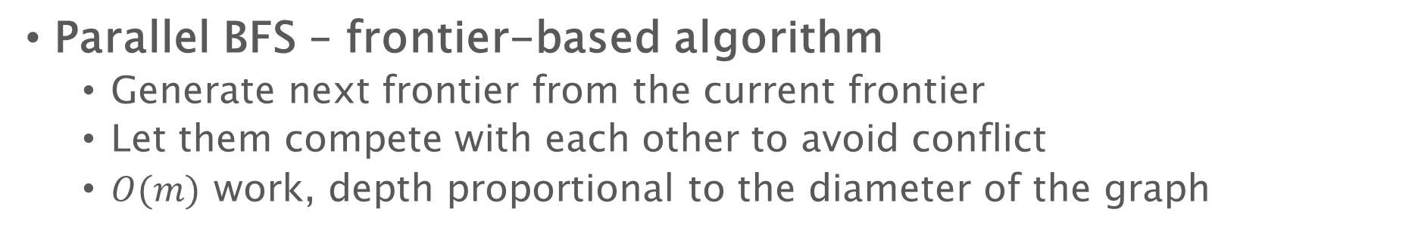
Last Lecture
Parallel BFS – frontier-based algorithm
Generate next frontier from the current frontier
Let them compete with each other to avoid conflict
$O(m)$ work, depth proportional to the diameter of the graph
Frontier
1
2
2
1
s
0
2
1
2

Slide 3
Last Lecture
Useful subroutines:
Test-and-set: when two vertices have the same neighbor to be added to the next frontier
Filter: each vertex pack their effective neighbors
Flatten: all the lists of effective neighbors are concatenated together as the next frontier
Frontier
1
2
2
1
s
0
2
1
2

Slide 4
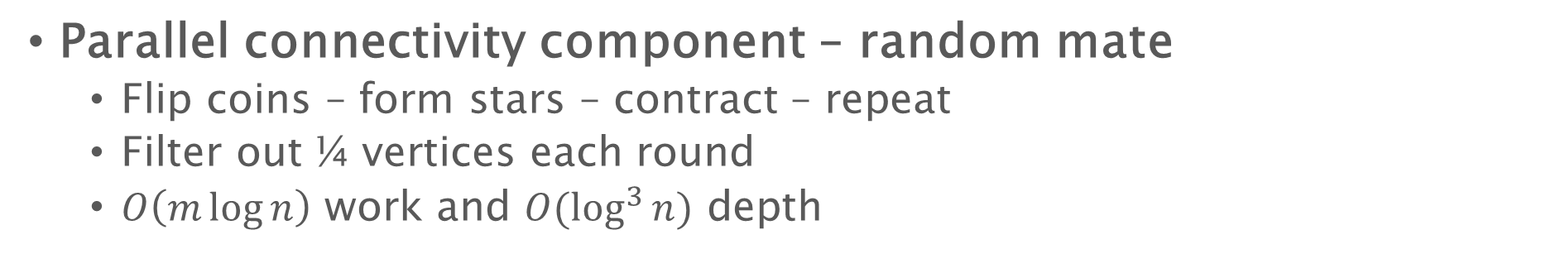
Last Lecture
Parallel connectivity component – random mate
Flip coins – form stars – contract – repeat
Filter out ¼ vertices each round
$O\left(m\log{n}\right)$ work and $O(\log^{3}{n})$ depth
1
2
9
12
4
3
7
8
11
5
6
10
1
2
9
12
4
3
7
8
11
2
12
5
6
3
8
10
6
10

Slide 5





Last Lecture
Parallel SCC
Split the graph into four subgraphs based on reachability queries
Divide-and-conquer: no theoretical guarantee
Multiple reachability queries in parallel
Delete edges across subgraphs
$$S_{1}−S_{2}$$
$$v$$
$$S_{1}∩S_{2}$$
$$S_{2}−S_{1}$$
$$G−S_{1}−S_{2}$$

Slide 6






Last Lecture
If an edge connects two edges in two subgraphs, remove it
$$v$$
$$u$$
Reachable from $v$
Reachable to $v$
Reachable from $u$
Reachable to $u$

Slide 7
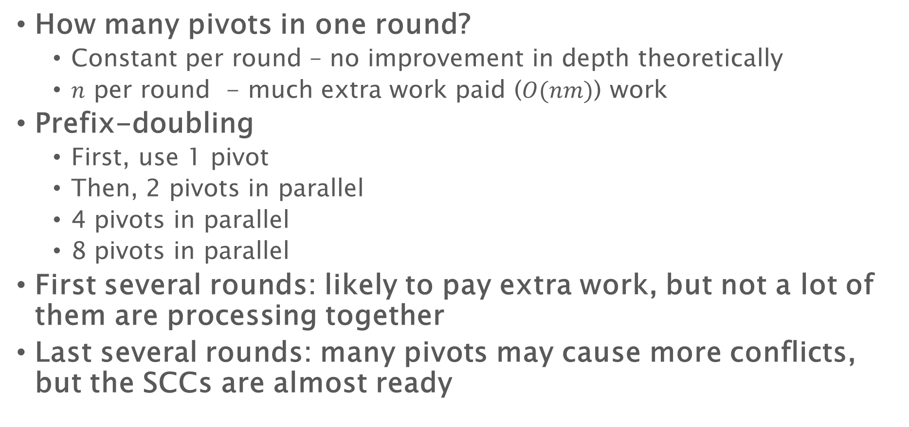
Last Lecture
How many pivots in one round?
Constant per round – no improvement in depth theoretically
$n$ per round - much extra work paid ($O(nm)$) work
Prefix-doubling
First, use 1 pivot
Then, 2 pivots in parallel
4 pivots in parallel
8 pivots in parallel
First several rounds: likely to pay extra work, but not a lot of them are processing together
Last several rounds: many pivots may cause more conflicts, but the SCCs are almost ready

Slide 8

Last Lecture
Process all vertices in a random order
$O(m\log{n})$ work and $O(diam\left(G\right)\log{n})$ depth if using BFS for reachability query
Bound depends on the reachability query algorithm

Slide 9
Minimum Spanning Tree

Slide 10
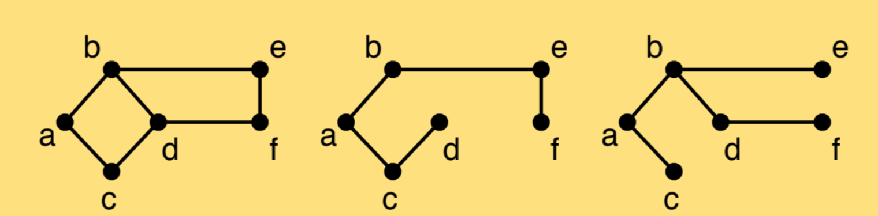
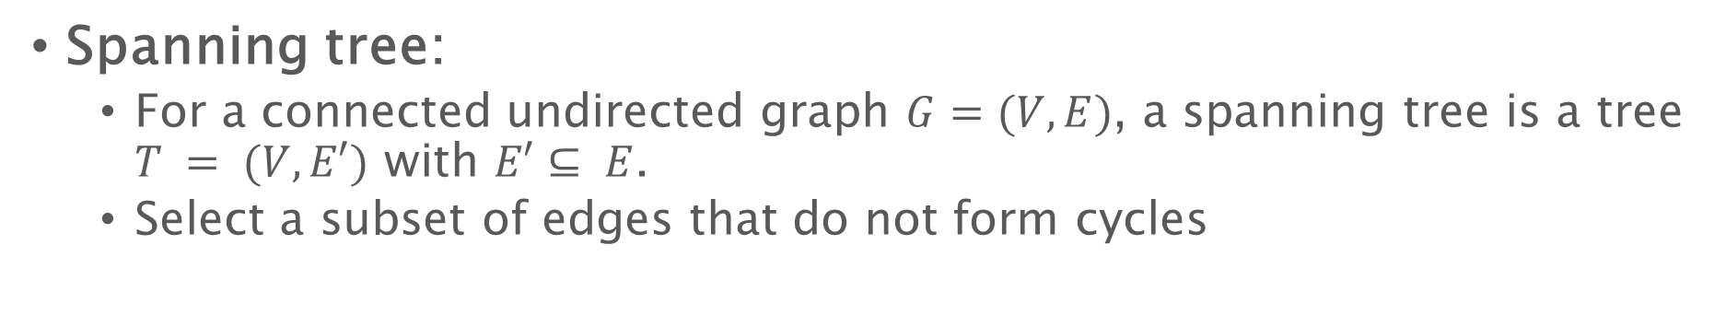
Minimum spanning tree
Spanning tree:
For a connected undirected graph $G=(V, E)$, a spanning tree is a tree $T = (V, E′)$ with $E′⊆ E$.
Select a subset of edges that do not form cycles
Source: “Algorithms: Parallel and Sequential” book by Umut A. Acar and Guy E. Blelloch

Slide 11
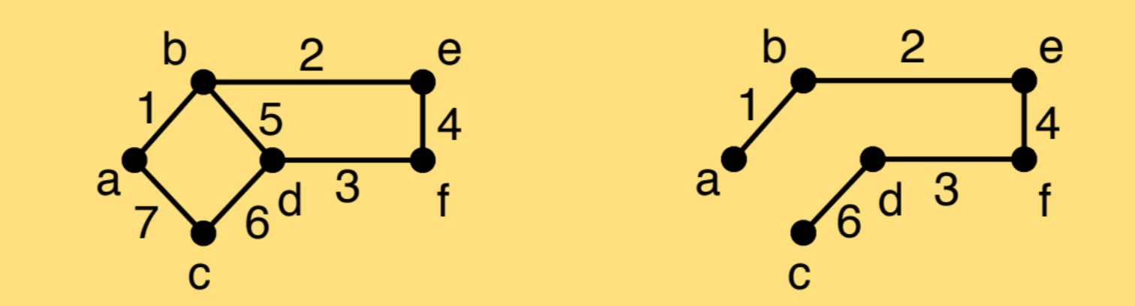
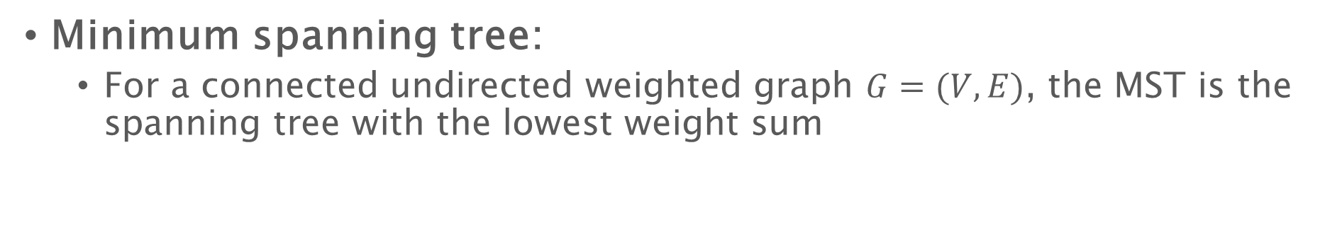
Minimum spanning tree
Minimum spanning tree:
For a connected undirected weighted graph $G=(V, E)$, the MST is the spanning tree with the lowest weight sum
Source: “Algorithms: Parallel and Sequential” book by Umut A. Acar and Guy E. Blelloch

Slide 12
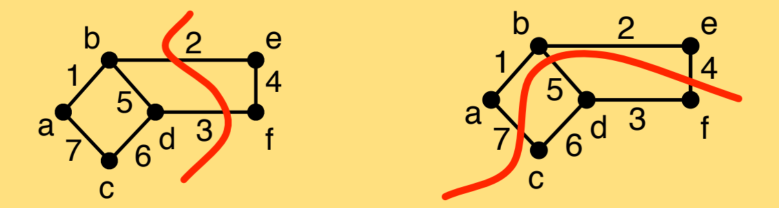
Light-edge property for MST
If you partition the graph into two, the minimum edge between the two parts has to be in the MST.
Source: “Algorithms: Parallel and Sequential” book by Umut A. Acar and Guy E. Blelloch

Slide 13
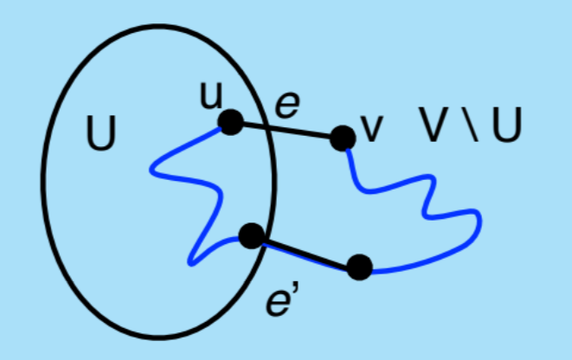
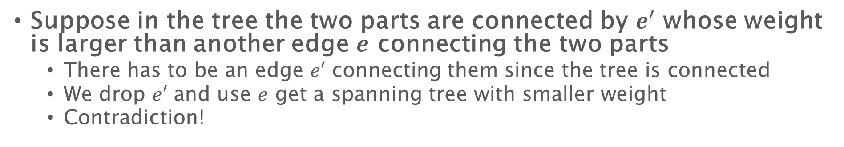
Light-edge property for MST - Proof (sketch)
Suppose in the tree the two parts are connected by $e′$ whose weight is larger than another edge $e$ connecting the two parts
There has to be an edge $e′$ connecting them since the tree is connected
We drop $e′$ and use $e$ get a spanning tree with smaller weight
Contradiction!
Source: “Algorithms: Parallel and Sequential” book by Umut A. Acar and Guy E. Blelloch

Slide 14
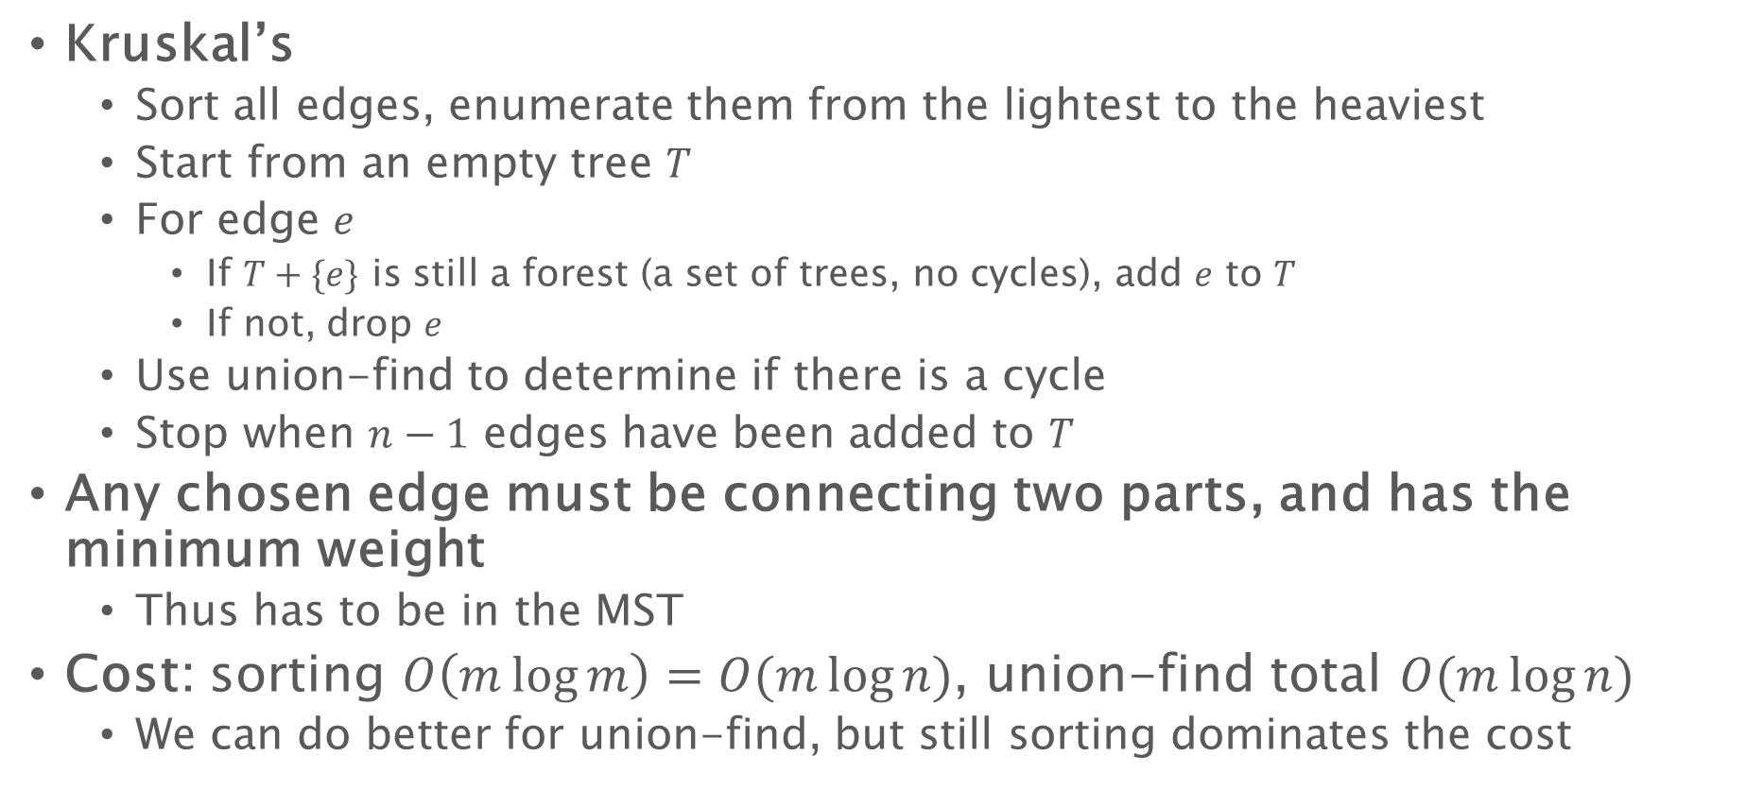
MST algorithms
Kruskal’s
Sort all edges, enumerate them from the lightest to the heaviest
Start from an empty tree $T$
For edge $e$
If $T+\{e\}$ is still a forest (a set of trees, no cycles), add $e$ to $T$
If not, drop $e$
Use union-find to determine if there is a cycle
Stop when $n−1$ edges have been added to $T$
Any chosen edge must be connecting two parts, and has the minimum weight
Thus has to be in the MST
Cost: sorting $O\left(m\log{m}\right)=O(m\log{n})$, union-find total $O(m\log{n})$
We can do better for union-find, but still sorting dominates the cost

Slide 15
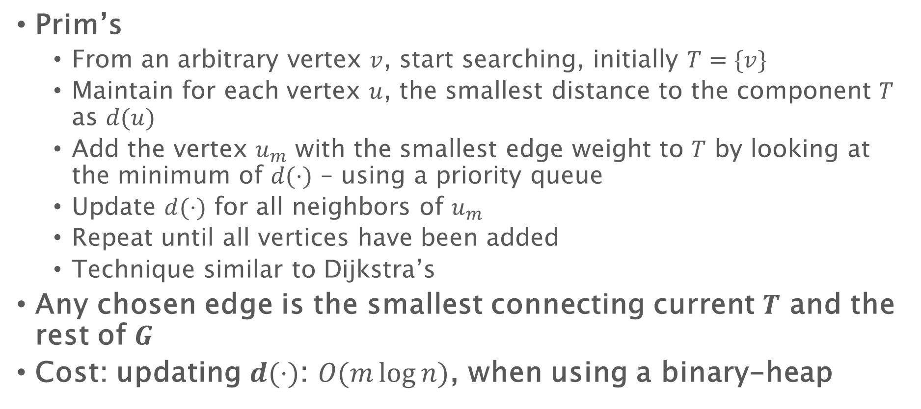
MST algorithms
Prim’s
From an arbitrary vertex $v$, start searching, initially $T=\{v\}$
Maintain for each vertex $u$, the smallest distance to the component $T$ as $d(u)$
Add the vertex $u_{m}$ with the smallest edge weight to $T$ by looking at the minimum of $d(⋅)$ – using a priority queue
Update $d(⋅)$ for all neighbors of $u_{m}$
Repeat until all vertices have been added
Technique similar to Dijkstra’s
Any chosen edge is the smallest connecting current $T$ and the rest of $G$
Cost: updating $d(⋅)$: $O(m\log{n})$, when using a binary-heap

Slide 16
MST algorithms
Both Kruskal’s and Prim’s are essentially sequential
When we think in parallel, they are not the best candidate to parallelize
Other MST algorithms?
Boruvka’s algorithm (1926)

Slide 17
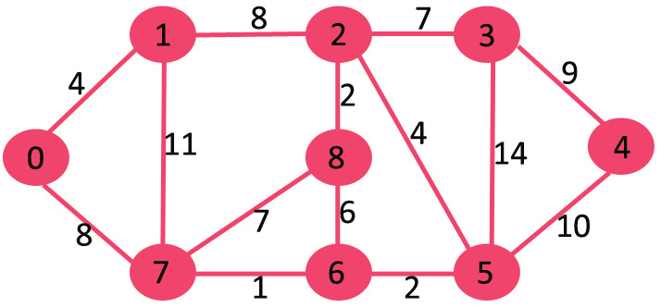

Boruvka’s algorithm
For two parts: $v$ and $V\backslash \{v\}$, based on the light-edge property, the smallest edge incident $v$ must be chosen in the MST
Let each vertex find their smallest edge
Add them to the MST
Source: GeeksforGeeks https://www.geeksforgeeks.org/boruvkas-algorithm-greedy-algo-9/

Slide 18

Boruvka’s algorithm
For two parts: $v$ and $V\backslash \{v\}$, based on the light-edge property, the smallest edge incident $v$ must be chosen in the MST
Let each node find their smallest edge
Add them to the MST
Source: GeeksforGeeks https://www.geeksforgeeks.org/boruvkas-algorithm-greedy-algo-9/

Slide 19
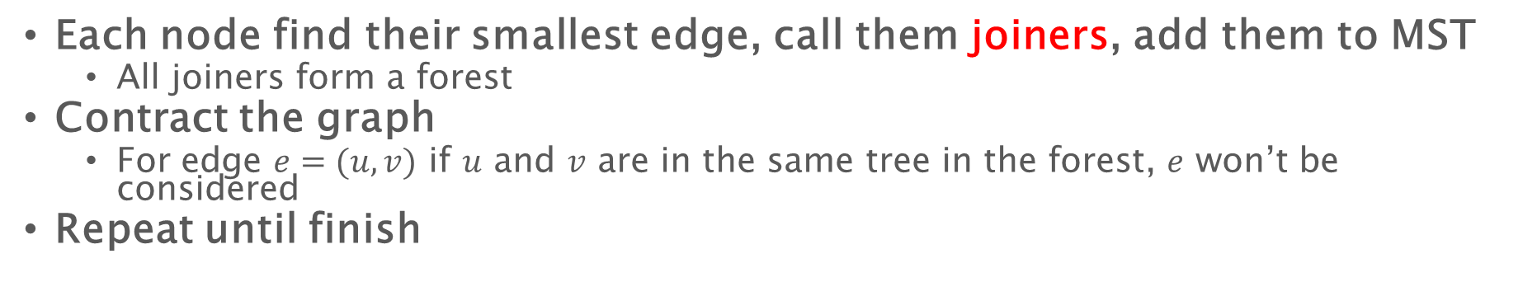
Boruvka’s algorithm
Each node find their smallest edge, call them joiners, add them to MST
All joiners form a forest
Contract the graph
For edge $e=(u,v)$ if $u$ and $v$ are in the same tree in the forest, $e$ won’t be considered
Repeat until finish
0, 1
8
11
8
2-8
Source: GeeksforGeeks https://www.geeksforgeeks.org/boruvkas-algorithm-greedy-algo-9/

Slide 20
Boruvka’s algorithm
We will get a forest
Some “tree” structures
Only two of them points to each other – contract them as the root
Then each component is a rooted tree
Source: GeeksforGeeks https://www.geeksforgeeks.org/boruvkas-algorithm-greedy-algo-9/

Slide 21
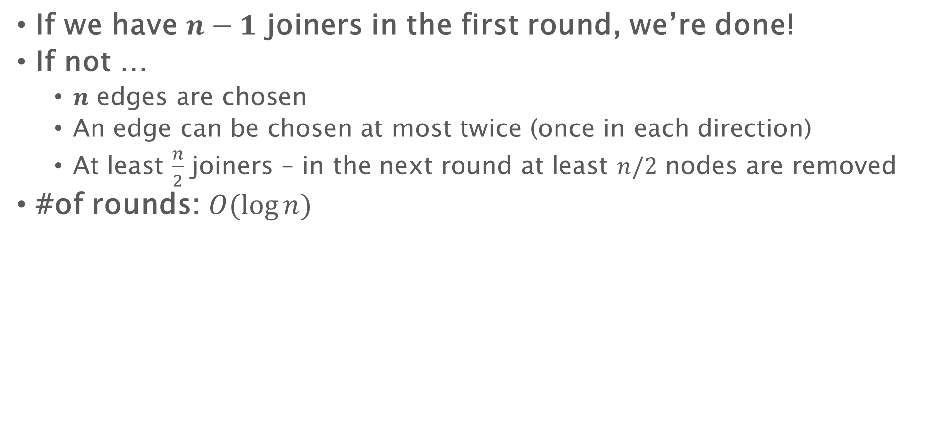
Boruvka’s algorithm
If we have $n−1$ joiners in the first round, we’re done!
If not …
$n$ edges are chosen
An edge can be chosen at most twice (once in each direction)
At least $\frac{n}{2}$ joiners – in the next round at least $n/2$ nodes are removed
#of rounds: $O(\log{n})$

Slide 22
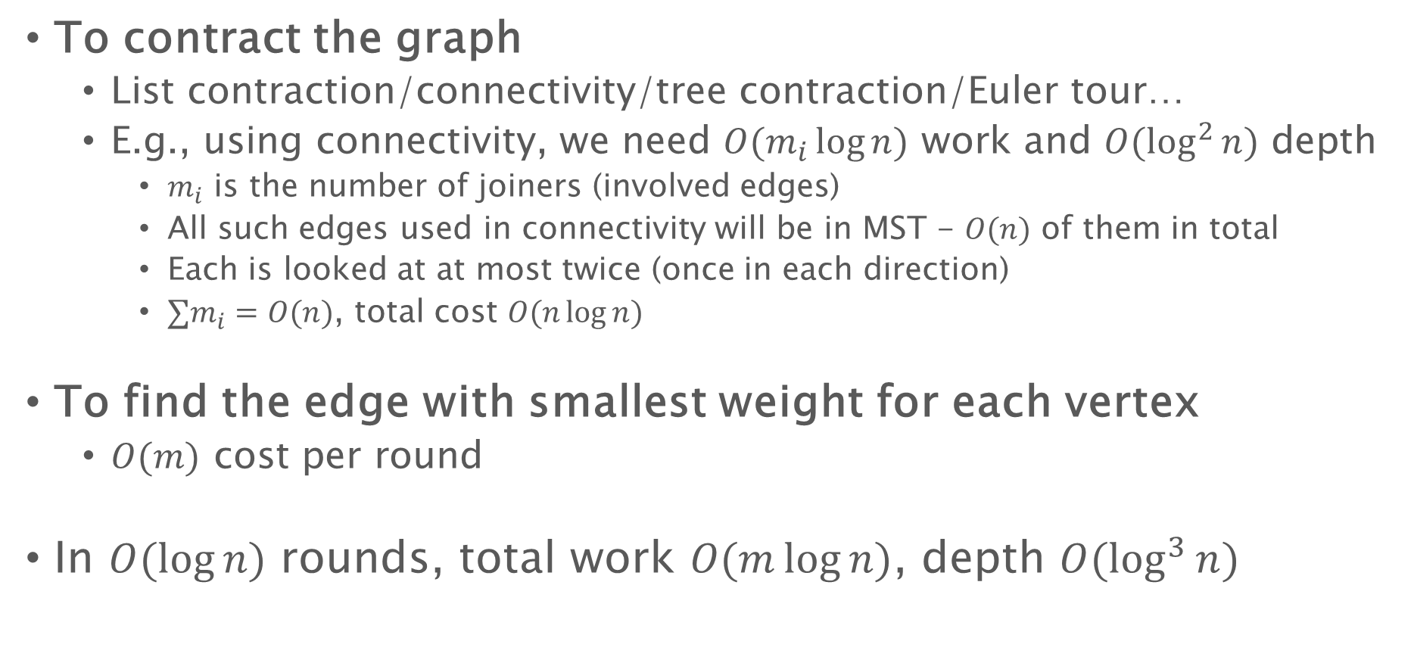
Boruvka’s algorithm
To contract the graph
List contraction/connectivity/tree contraction/Euler tour…
E.g., using connectivity, we need $O(m_{i}\log{n})$ work and $O(\log^{2}{n})$ depth
$m_{i}$ is the number of joiners (involved edges)
All such edges used in connectivity will be in MST - $O(n)$ of them in total
Each is looked at at most twice (once in each direction)
$∑m_{i}=O(n)$, total cost $O(n\log{n})$
To find the edge with smallest weight for each vertex
$O(m)$ cost per round
In $O(\log{n})$ rounds, total work $O(m\log{n})$, depth $O(\log^{3}{n})$

Slide 23
BFS with Better Depth Bound

Slide 24
Parallel BFS
Depth proportional to the diameter of the input graph
To do BFS through the chain, using the frontier-based algorithm, in each round we can one push the frontier out by one
Can we jump further than that?

Slide 25


Parallel BFS – Radius stepping (undirected)
Diam(G) can be large
If G is a chain, can we do better?
Let’s use some shortcuts!
Shortcut each vertex to its $ρ$ nearest neighbors
$$ρ=4$$
4
3
2

Slide 26

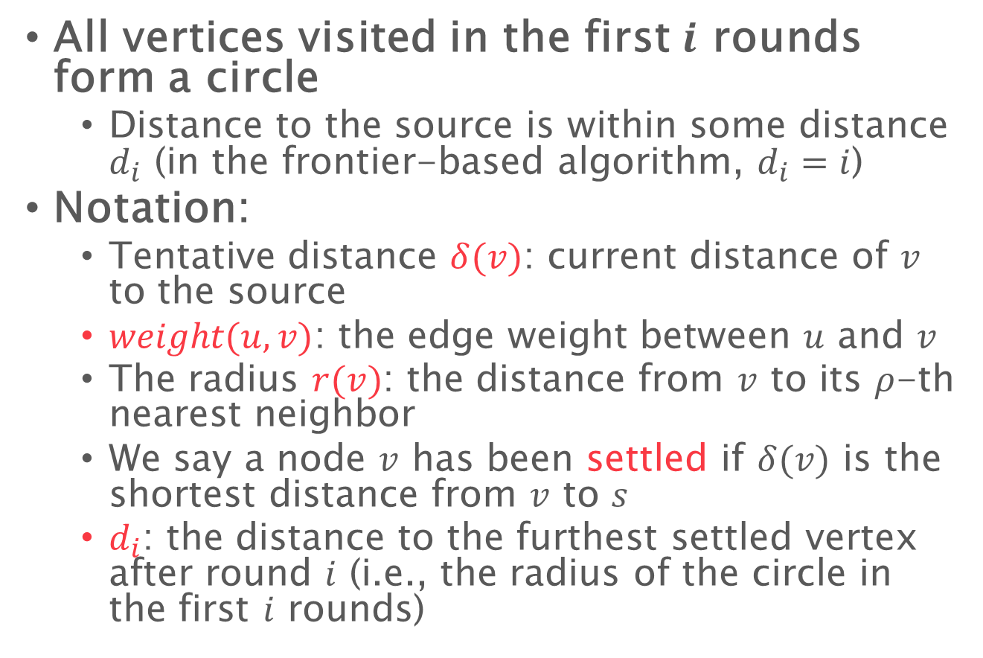
Growing radius
All vertices visited in the first $i$ rounds form a circle
Distance to the source is within some distance $d_{i}$ (in the frontier-based algorithm, $d_{i}=i$)
Notation:
Tentative distance $δ(v)$: current distance of $v$ to the source
$weight(u,v)$: the edge weight between $u$ and $v$
The radius $r(v)$: the distance from $v$ to its $ρ$-th nearest neighbor
We say a node $v$ has been settled if $δ(v)$ is the shortest distance from $v$ to $s$
$d_{i}$: the distance to the furthest settled vertex after round $i$ (i.e., the radius of the circle in the first $i$ rounds)
s
$$d_{i}$$
Generally, in a BFS algorithm, all nodes in the frontier are settled

Slide 27



Definition of vertex radius
$ρ=5$
2
$$v$$
$$r\left(v\right)=2$$
Notes:
Here let’s define the vertex radius r(v) to be the distance to v’s rho-th nearest vertex
This rho is a parameter of the algorithm.
For example in this case, let’s consider vertex v, and this is its 5 nearest vertices including itself.
So r(v) is 5 in this case, corresponding to the length of this blue path.

Slide 28


Definition of vertex radius
$ρ=5$
3
2
2
$$v$$
3
$$r\left(v\right)=3$$
Notes:
Here let’s define the vertex radius r(v) to be the distance to v’s rho-th nearest vertex
This rho is a parameter of the algorithm.
For example in this case, let’s consider vertex v, and this is its 5 nearest vertices including itself.
So r(v) is 5 in this case, corresponding to the length of this blue path.

Slide 29
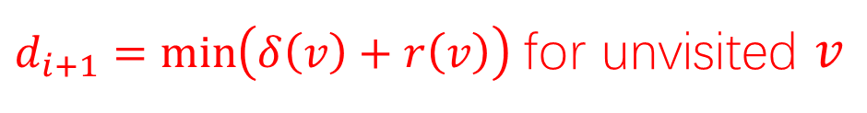










Push the frontier
Every vertex $v$ update its neighbors
In 1-hop it is guaranteed to visit $ρ$ nearest neighbors, the furthest of $r(v)$
$δ\left(v\right)+r(v)$ is the furthest distance it can guarantee to update!
Because of the shortcuts, in each round we can push the frontier by more than 1
$$r(v_{1})$$
$$r(v_{2})$$
$$d_{i}$$
$$s$$
$$r(v_{3})$$
$$r(v_{5})$$
$$r(v_{4})$$
$$d_{i+1}$$
$$r(v_{6})$$
tentative distance
$d_{i+1}=\min\left(δ\left(v\right)+r\left(v\right)\right)$ for unvisited $v$
Notes:
Which is the only extra step in radius stepping and it is at the beginning of one step.
The orange points are settled vertices while (click) the blue vertices form the frontier.
(click, click, click) The new round distance d_i+1 is computed to be the minimum value of delta(v)+r(v) for each v in the frontier.
Here delta(v) is….
Then apply standard Bellman-Ford within the annulus

Slide 30
Push the frontier
$$s$$
$$d_{i+1}$$
$d_{i+1}=\min\left(δ\left(v\right)+r\left(v\right)\right)$ for unvisited $v$
Notes:
Then apply standard Bellman-Ford within the annulus

Slide 31
Push the frontier
$$s$$
$$d_{i+1}$$
$d_{i+1}=\min\left(δ\left(v\right)+r\left(v\right)\right)$ for unvisited $v$
Notes:
Then apply standard Bellman-Ford within the annulus
After that, all vertices within the annulus are settled, and we have the same situation at the beginning of this animation.
We then move to the next step and repeat this process.
That’s all for the running process of radius stepping.
Comparing to Delta-stepping, we dynamically pick the round distances, or the width of the annulus
(And this help us to limit the number of steps)

Slide 32
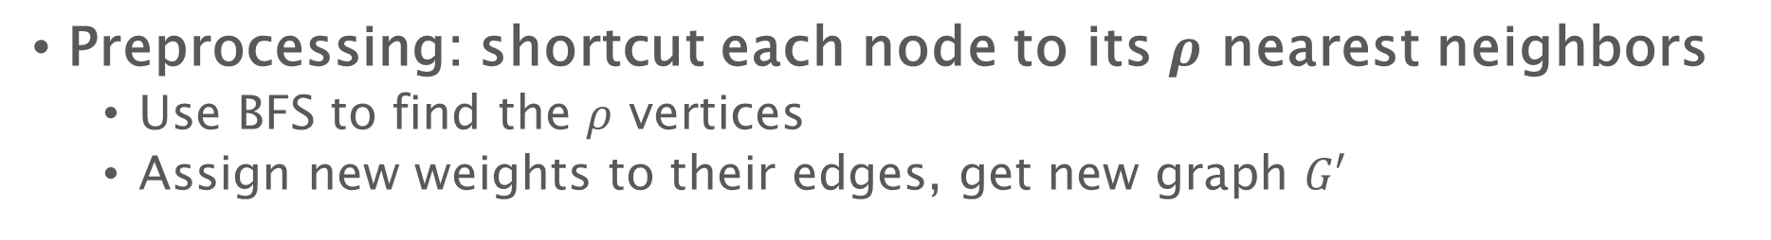
Parallel BFS with shortcuts
Preprocessing: shortcut each node to its $ρ$ nearest neighbors
Use BFS to find the $ρ$ vertices
Assign new weights to their edges, get new graph $G′$

Slide 33
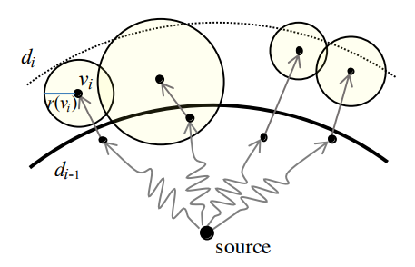
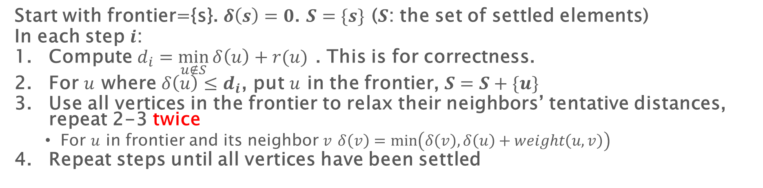
Parallel BFS: radius stepping
Start with frontier={s}. $δ\left(s\right)=0$. $S=\{s\}$ ($S$: the set of settled elements)
In each step $i$:
Compute $d_{i}=\min_{u∉S}{δ\left(u\right)+r(u)}$ . This is for correctness.
For $u$ where $δ\left(u\right)≤d_{i}$, put $u$ in the frontier, $S=S+\{u\}$
Use all vertices in the frontier to relax their neighbors’ tentative distances, repeat 2-3 twice
For $u$ in frontier and its neighbor $v$ $δ\left(v\right)=\min\left(δ\left(v\right),δ\left(u\right)+weight\left(u,v\right)\right)$
Repeat steps until all vertices have been settled
No guarantee to settle these vertices because #hops to processed nodes can be more than 2 (and unbounded)

Slide 34



The number of steps
The number of steps is $O\left(\frac{n}{ρ}\log{ρ}\right)$
We want to show that the algorithm visits $ρ$ vertices in at most $O\left(\log{ρ}\right)$ steps
$$d_{i}$$
$$d_{i+1}$$
Notes:
Here the vertex radius is the distance to its rho-th nearest vertex, then the number of steps is O(n/p * log rho L) where (click) L is the longest edge in the graph
This is because the algorithm will visit at least $ρ$ elements in at most $O\left(\log{ρL}\right)$ steps
Let’s say we pick this vertex to get the new round distance, and its rho-nearest neighbor ball does not touch the boundary in the i-th step.
Then we can settle all vertices within this ball in this step, which contains rho vertices already. And it’s done in 1 step.

Slide 35


The number of steps
The number of steps is $O\left(\frac{n}{ρ}\log{ρ}\right)$
We want to show that the algorithm visits $ρ$ vertices in at most $O\left(\log{ρ}\right)$ steps
$$d_{i}$$
$$d_{i+1}$$
Notes:
Otherwise, let’s say the ball touches the boundary, and we visited less than rho elements in this step.

Slide 36

The number of steps
The number of steps is $O\left(\frac{n}{ρ}\log{ρ}\right)$
We want to show that the algorithm visits $ρ$ vertices in at most $O\left(\log{ρ}\right)$ steps
$$d_{i}$$
$$d_{i+1}$$
$$d_{i+2}$$
Notes:
We will look at the next step.
Again the ball must touch d_i, otherwise we’ve visited rho vertices in these two steps.

Slide 37

The number of steps
The number of steps is $O\left(\frac{n}{ρ}\log{ρ}\right)$
We want to show that the algorithm visits $ρ$ vertices in at most $O\left(\log{ρ}\right)$ steps
$$d_{i}$$
$$d_{i+1}$$
$$d_{i+2}$$
$$d_{i+3}$$
Notes:
This can happen for multiple times.

Slide 38

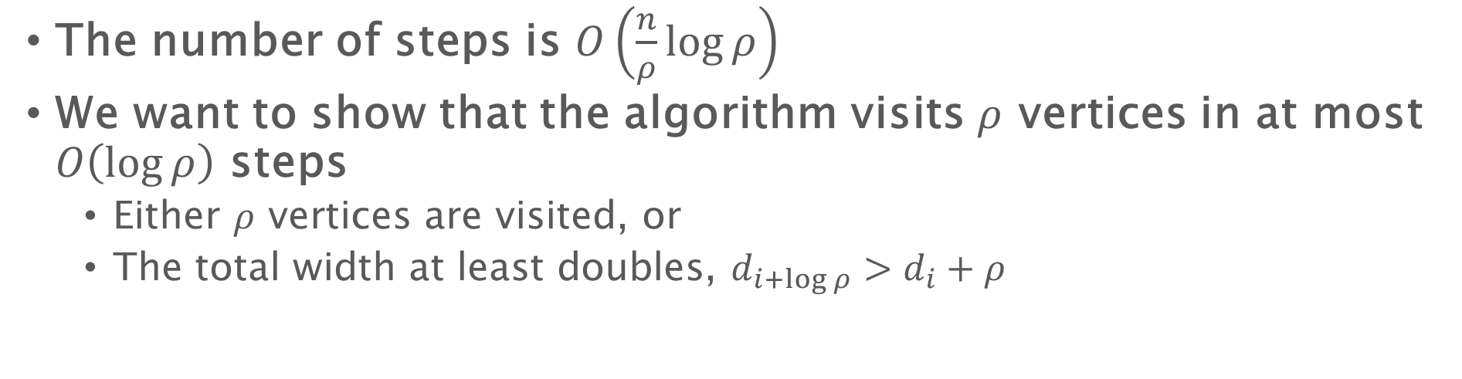






The number of steps
The number of steps is $O\left(\frac{n}{ρ}\log{ρ}\right)$
We want to show that the algorithm visits $ρ$ vertices in at most $O\left(\log{ρ}\right)$ steps
Either $ρ$ vertices are visited, or
The total width at least doubles, $d_{i+\log{ρ}}>d_{i}+ρ$
$$d_{i}$$
$$d_{i+1}$$
$$d_{i+2}$$
$$d_{i+3}$$
$$≥d_{i}+1$$
$$≥d_{i}+2$$
$$≥d_{i}+4$$
Notes:
So in each step, we either have already visited rho vertices, or (click) the total width of the annuli doubles in each step because the ball has to touch d_i.
For the second case, since a path with distance $ρL$ will contain at least $ρ$ elements, and the width of annulus double in each step, it can only happens for $O\left(\log{ρL}\right)$ steps, and this proves the claim.

Slide 39
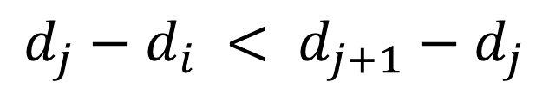



The number of steps
The number of steps is $O\left(\frac{n}{ρ}\log{ρ}\right)$
We want to show that the algorithm visits $ρ$ vertices in at most $O\left(\log{ρ}\right)$ steps
Either $ρ$ vertices are visited, or
The total width at least doubles, $d_{i+\log{ρ}}>d_{i}+ρ$
$$d_{i}$$
$$d_{j}$$
$$d_{j+1}$$
$$d_{j}−d_{i} < d_{j+1}−d_{j}$$
Notes:
So in each step, we either have already visited rho vertices, or (click) the total width of the annuli doubles in each step because the ball has to touch d_i.
For the second case, since a path with distance $ρL$ will contain at least $ρ$ elements, and the width of annulus double in each step, it can only happens for $O\left(\log{ρL}\right)$ steps, and this proves the claim.

Slide 40
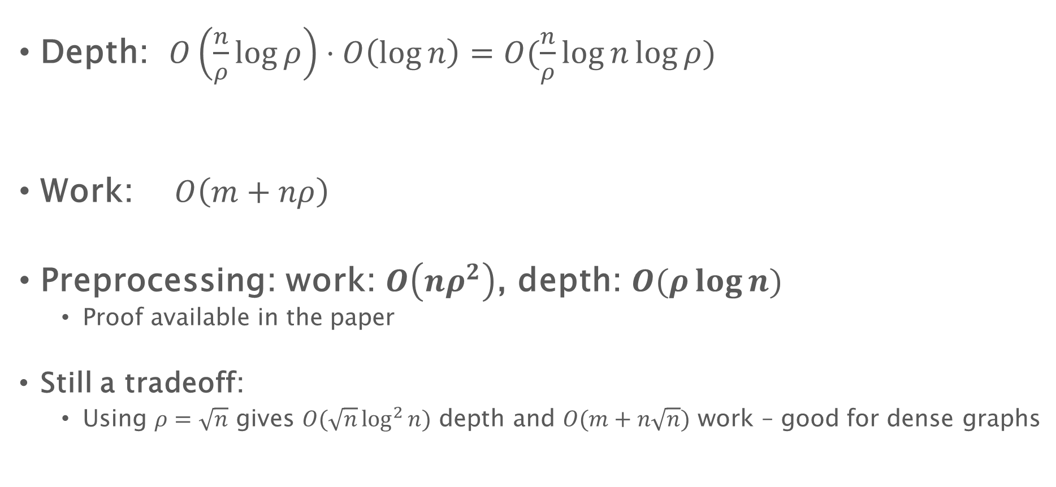
Work, depth of BFS using shortcuts (radius-stepping)
Depth: $O\left(\frac{n}{ρ}\log{ρ}\right)⋅O\left(\log{n}\right)=O(\frac{n}{ρ}\log{n}\log{ρ})$
Work: $O\left(m+nρ\right)$
Preprocessing: work: $O\left(nρ^{2}\right)$, depth: $O(ρ\log{n})$
Proof available in the paper
Still a tradeoff:
Using $ρ=\sqrt{n}$ gives $O(\sqrt{n}\log^{2}{n})$ depth and $O(m+n\sqrt{n})$ work – good for dense graphs
#steps
Update cost
Notes:
Now let’s look at the work and depth for radius-stepping
Assume the longest path within each annulus in $k$, then the number of Bellman-Ford rounds in each step is $k+2$
(click) Theoretically we can use parallel BSTs to maintain distance updates and the priority queue to compute the round distances
(click) Then we have this work and depth bounds for the algorithm.
The computation is pretty trivial and we refer you to our paper for more details.
(As you may notice, we have this k here, which is annoying since it can be large. (click) So we will preprocess the graph to add some shortcut edges to let k be a constant.)

Slide 41
Single Source Shortest Path

Slide 42
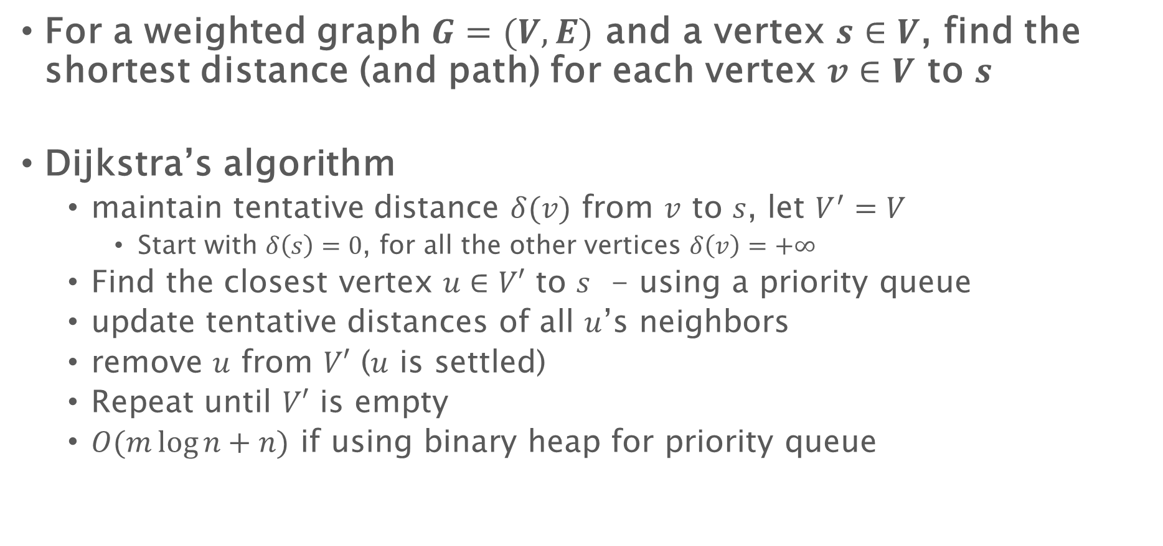
Single source shortest path
For a weighted graph $G=(V,E)$ and a vertex $s∈V$, find the shortest distance (and path) for each vertex $v∈V$ to $s$
Dijkstra’s algorithm
maintain tentative distance $δ(v)$ from $v$ to $s$, let $V^{′}=V$
Start with $δ\left(s\right)=0$, for all the other vertices $δ\left(v\right)=+∞$
Find the closest vertex $u∈V′$ to $s$ - using a priority queue
update tentative distances of all $u$’s neighbors
remove $u$ from $V′$ ($u$ is settled)
Repeat until $V′$ is empty
$O(m\log{n}+n)$ if using binary heap for priority queue
Parallelizable

Slide 43
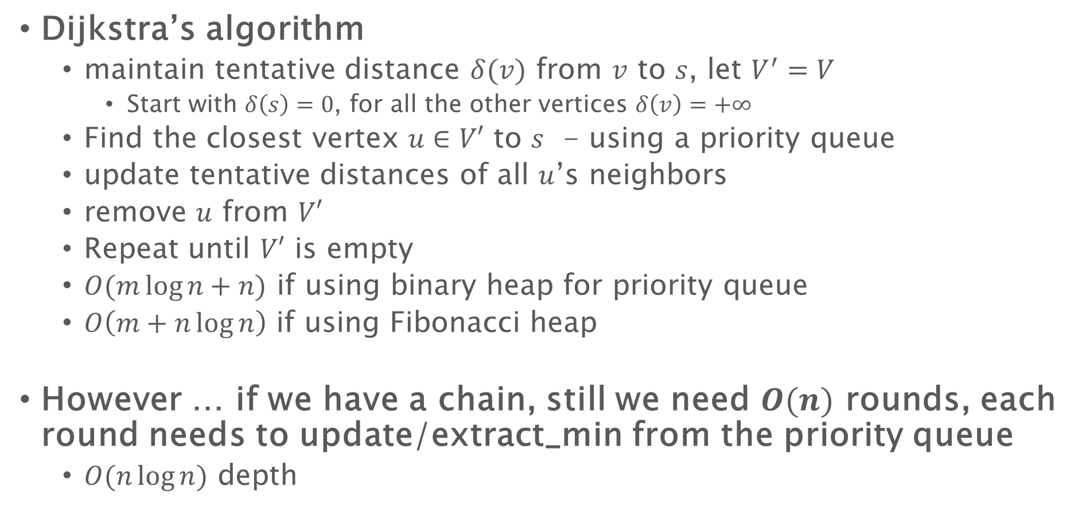
Single source shortest path
Dijkstra’s algorithm
maintain tentative distance $δ(v)$ from $v$ to $s$, let $V^{′}=V$
Start with $δ\left(s\right)=0$, for all the other vertices $δ\left(v\right)=+∞$
Find the closest vertex $u∈V′$ to $s$ - using a priority queue
update tentative distances of all $u$’s neighbors
remove $u$ from $V′$
Repeat until $V′$ is empty
$O(m\log{n}+n)$ if using binary heap for priority queue
$O\left(m+n\log{n}\right)$ if using Fibonacci heap
However … if we have a chain, still we need $O(n)$ rounds, each round needs to update/extract_min from the priority queue
$O(n\log{n})$ depth

Slide 44
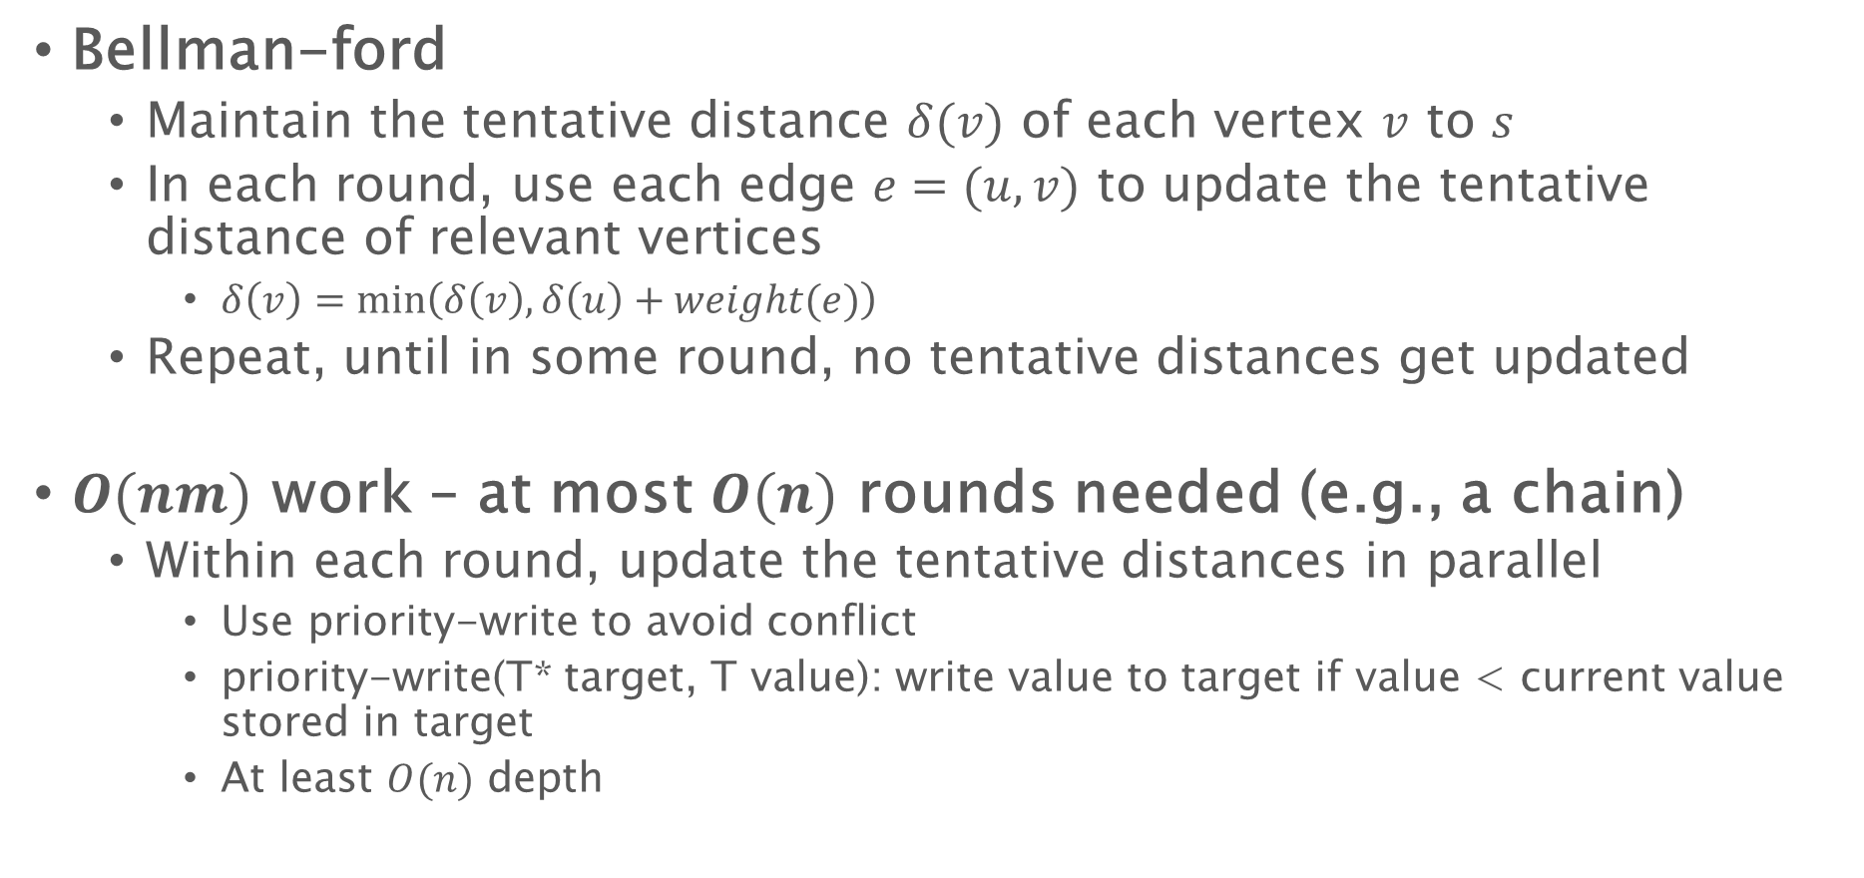
Single source shortest path
Bellman-ford
Maintain the tentative distance $δ(v)$ of each vertex $v$ to $s$
In each round, use each edge $e=(u,v)$ to update the tentative distance of relevant vertices
$δ\left(v\right)=\min\left(δ\left(v\right), δ\left(u\right)+weight(e)\right)$
Repeat, until in some round, no tentative distances get updated
$O(nm)$ work – at most $O(n)$ rounds needed (e.g., a chain)
Within each round, update the tentative distances in parallel
Use priority-write to avoid conflict
priority-write(T* target, T value): write value to target if value < current value stored in target
At least $O(n)$ depth

Slide 45

SSSP - notation
Tentative distance $δ(v)$: current distance of $v$ to the source
$weight(u,v)$: the edge weight between $u$ and $v$
We say a node $v$ has been settled if $δ(v)$ is the shortest distance from $v$ to $s$

Slide 46
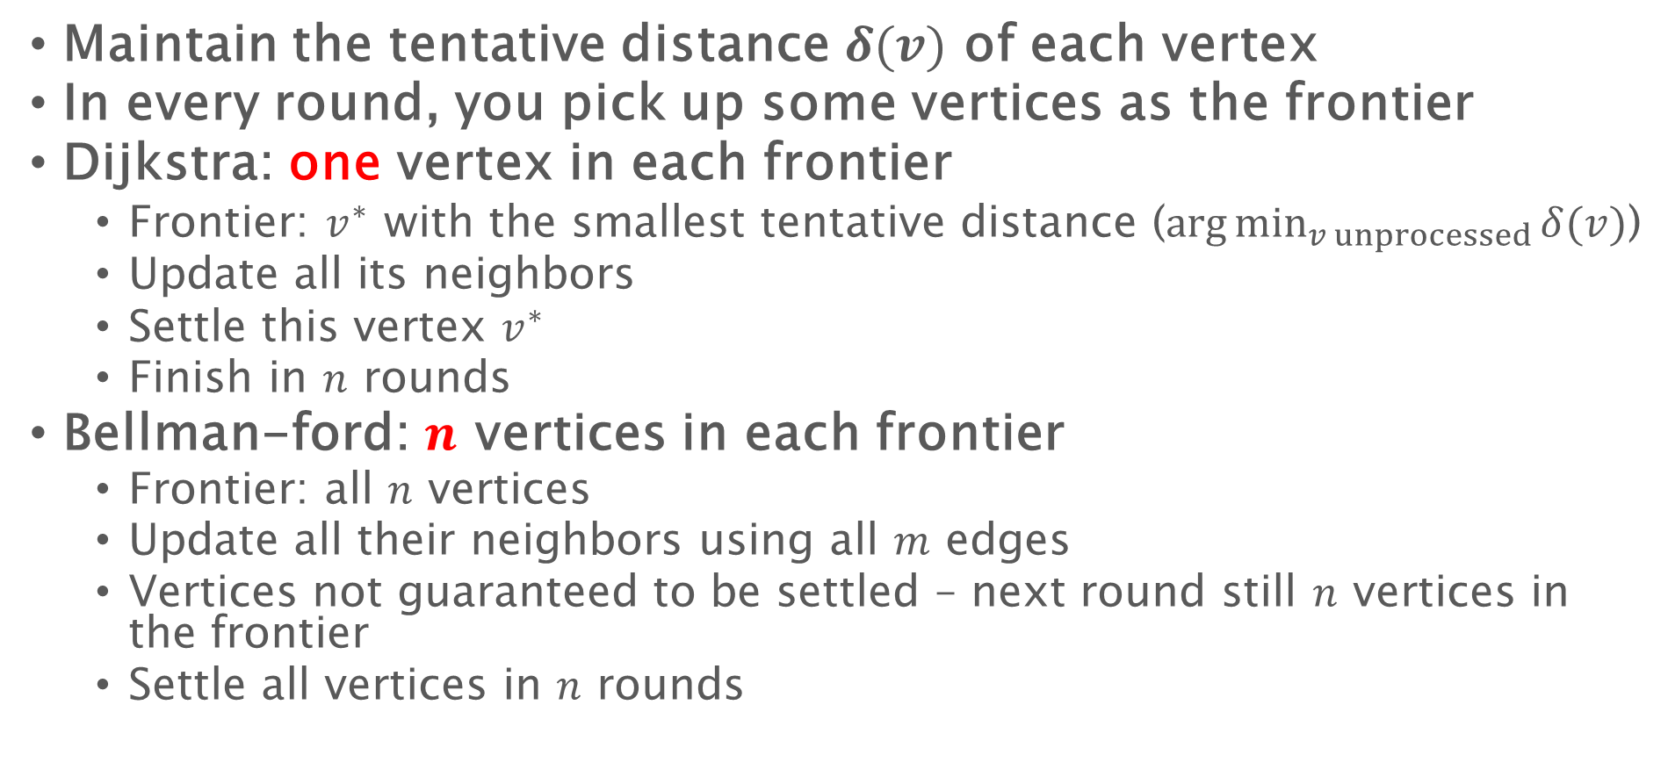
SSSP - What is the frontier and how to relax
Maintain the tentative distance $δ(v)$ of each vertex
In every round, you pick up some vertices as the frontier
Dijkstra: one vertex in each frontier
Frontier: $v^{∗}$ with the smallest tentative distance ($\arg{\min_{v unprocessed}{δ(v)}}$)
Update all its neighbors
Settle this vertex $v^{∗}$
Finish in $n$ rounds
Bellman-ford: $n$ vertices in each frontier
Frontier: all $n$ vertices
Update all their neighbors using all $m$ edges
Vertices not guaranteed to be settled – next round still $n$ vertices in the frontier
Settle all vertices in $n$ rounds

Slide 47
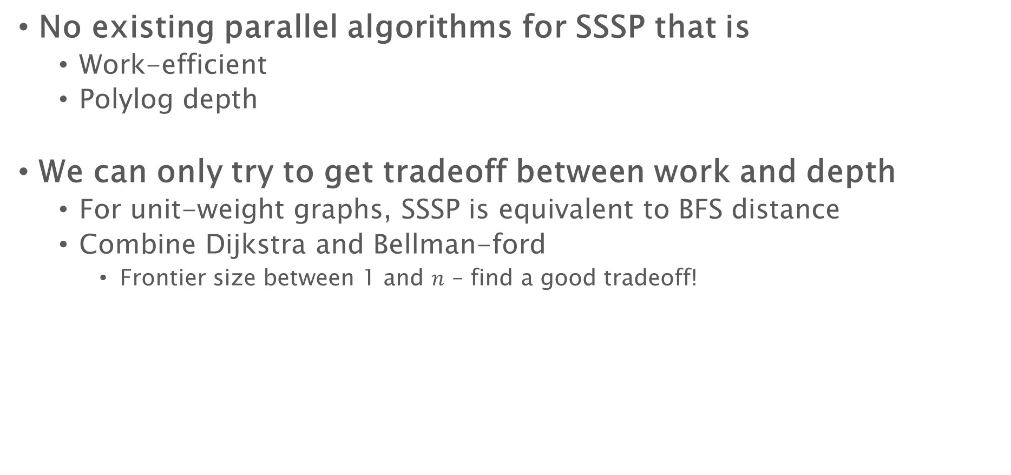
Single source shortest path
No existing parallel algorithms for SSSP that is
Work-efficient
Polylog depth
We can only try to get tradeoff between work and depth
For unit-weight graphs, SSSP is equivalent to BFS distance
Combine Dijkstra and Bellman-ford
Frontier size between 1 and $n$ – find a good tradeoff!

Slide 48

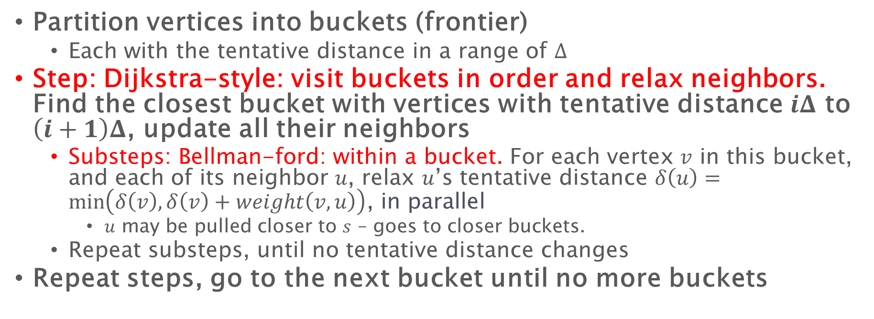




$Δ$-Stepping: Dijkstra + Bellman-Ford
Partition vertices into buckets (frontier)
Each with the tentative distance in a range of $Δ$
Step: Dijkstra-style: visit buckets in order and relax neighbors. Find the closest bucket with vertices with tentative distance $iΔ$ to $\left(i+1\right)Δ$, update all their neighbors
Substeps: Bellman-ford: within a bucket. For each vertex $v$ in this bucket, and each of its neighbor $u$, relax $u$’s tentative distance $δ\left(u\right)=\min\left(δ\left(v\right), δ\left(v\right)+weight\left(v,u\right)\right)$, in parallel
$u$ may be pulled closer to $s$ – goes to closer buckets.
Repeat substeps, until no tentative distance changes
Repeat steps, go to the next bucket until no more buckets
12
1
23
$$Δ=10$$
10
1
6
15
33
19
$$Δ$$
$$2Δ$$
$$3Δ$$
$$4Δ$$
Notes:
The priority queue in Delta-stepping is implemented using a set of bucket, each represents a range with size Delta.
At any time, the frontier is stored in a number of buckets.
The algorithm is very simple, and that’s why it’s practical.
We start with the first bucket and try to relax all neighbors of the vertices in that bucket.
(The values are updated and the vertices are moved to the corresponding buckets.)

Slide 49

$Δ$-Stepping
Partition vertices into buckets (frontier)
Each with the tentative distance in a range of $Δ$
Step: Dijkstra-style: visit buckets in order and relax neighbors. Find the closest bucket with vertices with tentative distance $iΔ$ to $\left(i+1\right)Δ$, update all their neighbors
Substeps: Bellman-ford: within a bucket. For each vertex $v$ in this bucket, and each of its neighbor $u$, relax $u$’s tentative distance $δ\left(u\right)=\min\left(δ\left(v\right), δ\left(v\right)+weight\left(v,u\right)\right)$, in parallel
$u$ may be pulled closer to $s$ – goes to closer buckets.
Repeat substeps, until no tentative distance changes
Repeat steps, go to the next bucket until no more buckets
12
$$Δ=10$$
1
13
10
1
6
15
33
16
$$Δ$$
$$2Δ$$
$$3Δ$$
$$4Δ$$
Notes:
The values are updated and the vertices are moved to the corresponding buckets.
While there remain potential unsettled vertices
We do it again for all neighbors.

Slide 50
$Δ$-Stepping
Partition vertices into buckets (frontier)
Each with the tentative distance in a range of $Δ$
Step: Dijkstra-style: visit buckets in order and relax neighbors. Find the closest bucket with vertices with tentative distance $iΔ$ to $\left(i+1\right)Δ$, update all their neighbors
Substeps: Bellman-ford: within a bucket. For each vertex $v$ in this bucket, and each of its neighbor $u$, relax $u$’s tentative distance $δ\left(u\right)=\min\left(δ\left(v\right), δ\left(v\right)+weight\left(v,u\right)\right)$, in parallel
$u$ may be pulled closer to $s$ – goes to closer buckets.
Repeat substeps, until no tentative distance changes
Repeat steps, go to the next bucket until no more buckets
12
$$Δ=10$$
1
13
10
1
6
15
33
14
$$Δ$$
$$2Δ$$
$$3Δ$$
$$4Δ$$
Notes:
We need an extra round here

Slide 51
$Δ$-Stepping
Partition vertices into buckets (frontier)
Each with the tentative distance in a range of $Δ$
Step: Dijkstra-style: visit buckets in order and relax neighbors. Find the closest bucket with vertices with tentative distance $iΔ$ to $\left(i+1\right)Δ$, update all their neighbors
Substeps: Bellman-ford: within a bucket. For each vertex $v$ in this bucket, and each of its neighbor $u$, relax $u$’s tentative distance $δ\left(u\right)=\min\left(δ\left(v\right), δ\left(v\right)+weight\left(v,u\right)\right)$, in parallel
$u$ may be pulled closer to $s$ – goes to closer buckets.
Repeat substeps, until no tentative distance changes
Repeat steps, go to the next bucket until no more buckets
12
$$Δ=10$$
1
13
10
1
6
15
29
14
$$Δ$$
$$2Δ$$
$$3Δ$$
$$4Δ$$
Notes:
Until everything is settled, we move to the next bucket.
That’s the whole algorithm. Pretty simple?
We name the outerloop as steps, so each bucket corresponds to a step.
The innerloop corresponds to substeps, the number of Bellman-Ford rounds.
(If you look at this algorithm)

Slide 52

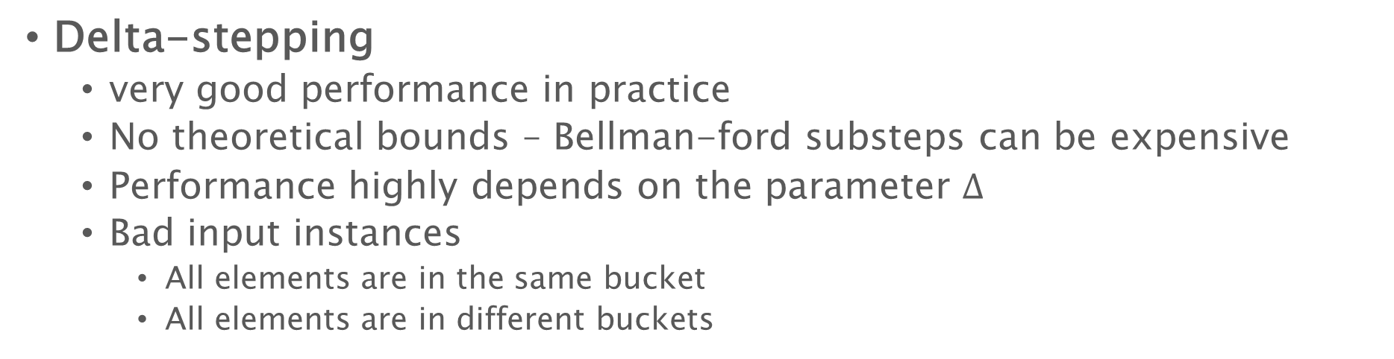
Single source shortest path
Delta-stepping
very good performance in practice
No theoretical bounds – Bellman-ford substeps can be expensive
Performance highly depends on the parameter $Δ$
Bad input instances
All elements are in the same bucket
All elements are in different buckets
1
2
4
8
16
32
64
128
256
$$s$$

Slide 53

Single source shortest path
Delta-stepping
very good performance in practice
No theoretical bounds – Bellman-ford substeps can be expensive
Performance highly depends on the parameter $Δ$
Bad input instances
All elements are in the same bucket
All elements are in different buckets
1
8
6
1003
1000
2
1022
1007
$$s$$
1030
1011
1020
1001
2

Slide 54
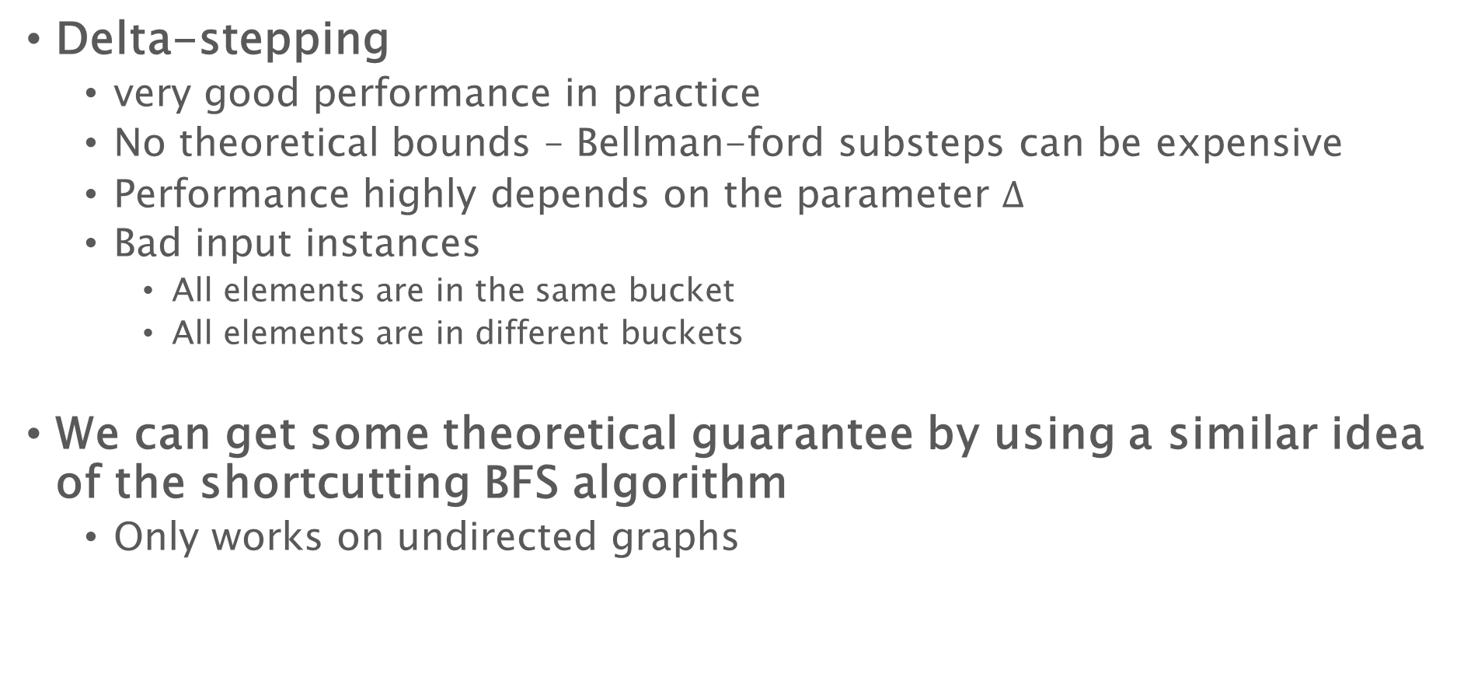
Single source shortest path
Delta-stepping
very good performance in practice
No theoretical bounds – Bellman-ford substeps can be expensive
Performance highly depends on the parameter $Δ$
Bad input instances
All elements are in the same bucket
All elements are in different buckets
We can get some theoretical guarantee by using a similar idea of the shortcutting BFS algorithm
Only works on undirected graphs

Slide 55
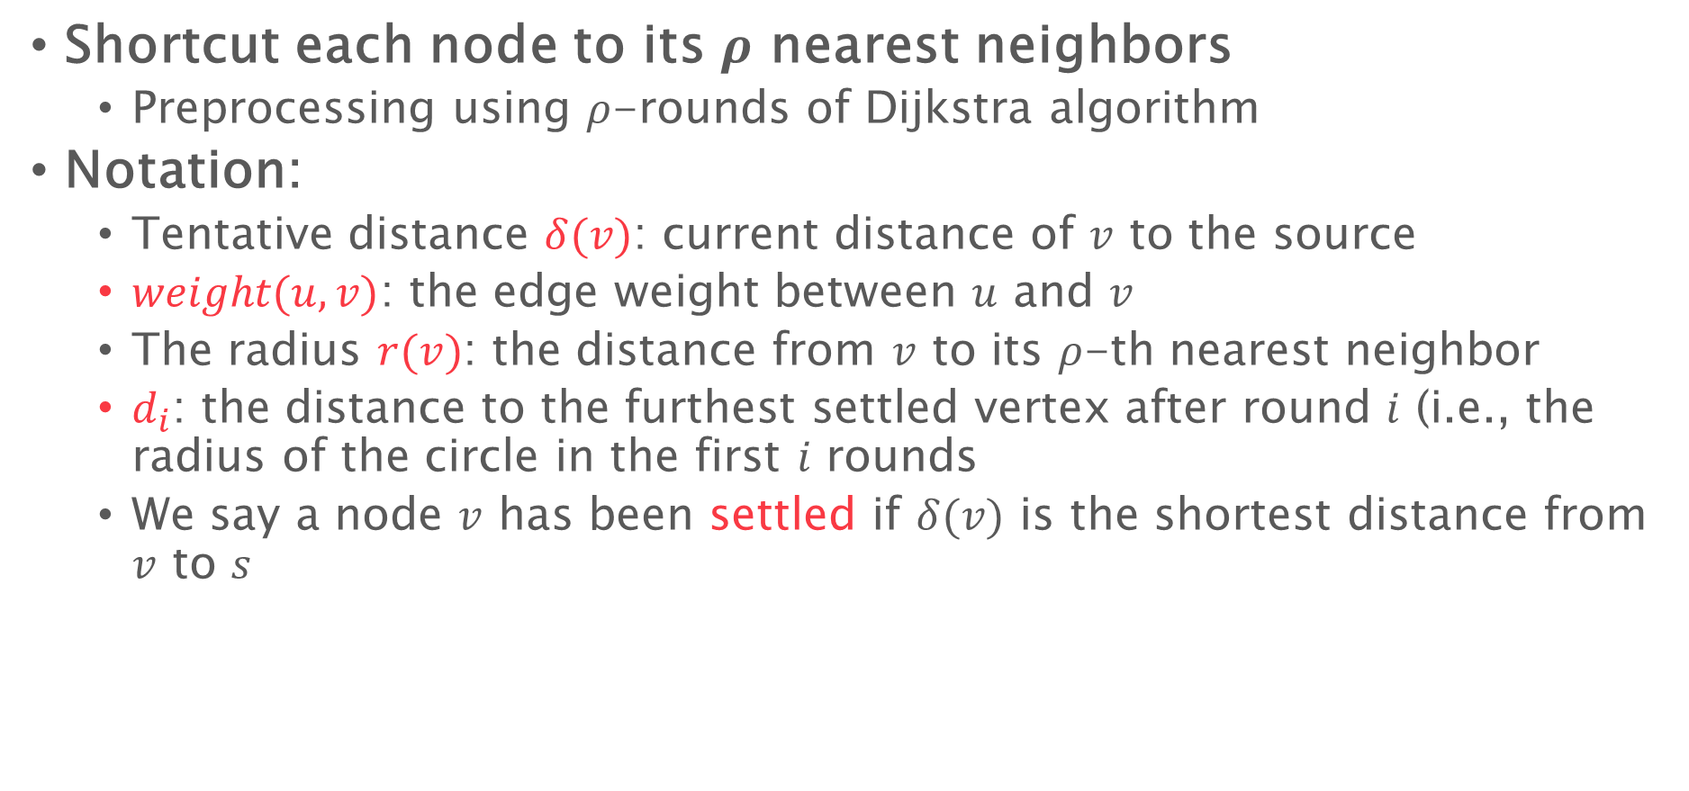
Radius-stepping
Shortcut each node to its $ρ$ nearest neighbors
Preprocessing using $ρ$-rounds of Dijkstra algorithm
Notation:
Tentative distance $δ(v)$: current distance of $v$ to the source
$weight(u,v)$: the edge weight between $u$ and $v$
The radius $r(v)$: the distance from $v$ to its $ρ$-th nearest neighbor
$d_{i}$: the distance to the furthest settled vertex after round $i$ (i.e., the radius of the circle in the first $i$ rounds
We say a node $v$ has been settled if $δ(v)$ is the shortest distance from $v$ to $s$

Slide 56



Definition of vertex radius
$ρ=4$
4
4
3
9
3
2
3
7
6
3
2
$$v$$
5
6
4
3
$$r\left(v\right)=5$$
Notes:
Here let’s define the vertex radius r(v) to be the distance to v’s rho-th nearest vertex
This rho is a parameter of the algorithm.
For example in this case, let’s consider vertex v, and this is its 5 nearest vertices including itself.
So r(v) is 5 in this case, corresponding to the length of this blue path.

Slide 57



Definition of vertex radius
$ρ=4$
4
4
3
$$v′$$
9
3
2
3
7
6
3
2
4
6
4
3
$$r\left(v′\right)=4$$
Notes:
We can have this r(v) for all vertices in this graph, and we will later introduce how we compute this.
(And this is the vertex radius)

Slide 58




Push the frontier
All vertices in the ring are guaranteed to be updated in this round
Because of the shortcuts, in each step we can push the frontier further
$$r(v_{1})$$
$$r(v_{2})$$
$$d_{i}$$
$$s$$
$$r(v_{3})$$
$$r(v_{5})$$
$$r(v_{4})$$
$$d_{i+1}$$
$$r(v_{6})$$
tentative distance
$d_{i+1}=\min\left(δ\left(v\right)+r\left(v\right)\right)$ for unvisited $v$ in the frontier
Notes:
Which is the only extra step in radius stepping and it is at the beginning of one step.
The orange points are settled vertices while (click) the blue vertices form the frontier.
(click, click, click) The new round distance d_i+1 is computed to be the minimum value of delta(v)+r(v) for each v in the frontier.
Here delta(v) is….
Then apply standard Bellman-Ford within the annulus

Slide 59
Push the frontier
$$s$$
$$d_{i+1}$$
$d_{i+1}=\min\left(δ\left(v\right)+r\left(v\right)\right)$ for unvisited $v$ in the frontier
Notes:
Then apply standard Bellman-Ford within the annulus

Slide 60
Push the frontier
$$s$$
$$d_{i+1}$$
$d_{i+1}=\min\left(δ\left(v\right)+r\left(v\right)\right)$ for unvisited $v$ in the frontier
Notes:
Then apply standard Bellman-Ford within the annulus
After that, all vertices within the annulus are settled, and we have the same situation at the beginning of this animation.
We then move to the next step and repeat this process.
That’s all for the running process of radius stepping.
Comparing to Delta-stepping, we dynamically pick the round distances, or the width of the annulus
(And this help us to limit the number of steps)

Slide 61
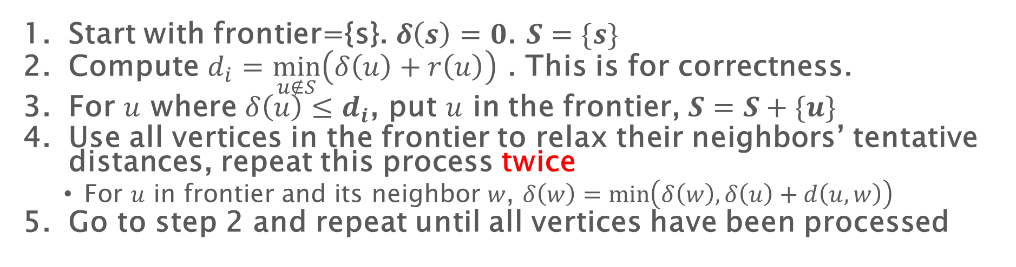
Parallel SSSP with shortcuts
Because of this, #of substeps can be bounded in 2
Start with frontier={s}. $δ\left(s\right)=0$. $S=\{s\}$
Compute $d_{i}=\min_{u∉S}\left(δ\left(u\right)+r\left(u\right)\right)$ . This is for correctness.
For $u$ where $δ\left(u\right)≤d_{i}$, put $u$ in the frontier, $S=S+\{u\}$
Use all vertices in the frontier to relax their neighbors’ tentative distances, repeat this process twice
For $u$ in frontier and its neighbor $w$, $δ\left(w\right)=\min\left(δ\left(w\right),δ\left(u\right)+d\left(u,w\right)\right)$
Go to step 2 and repeat until all vertices have been processed
No guarantee to update this node because #hops to processed nodes can be more than 1

Slide 62

Parallel SSSP with shortcuts
The number of steps is $O\left(\frac{n}{ρ}\log{ρL}\right)$
𝐿: ratio of max / min edge weight
Work: $O((m+nρ)\log{n})$, depth: $O\left(\frac{n}{ρ}\log{n}\log{ρL}\right)$

Slide 63

Homework 1 grading
Almost finished
Get your grading after class or during office hours
If you have any questions about the grading and solutions, come to talk to me
In total 80 points, with some possible bonus points
Median & average: both around 67~68
Fibonacci numbers: compute $F_{1},F_{2}…F_{n}$, instead of just $F_{n}$!

Slide 64
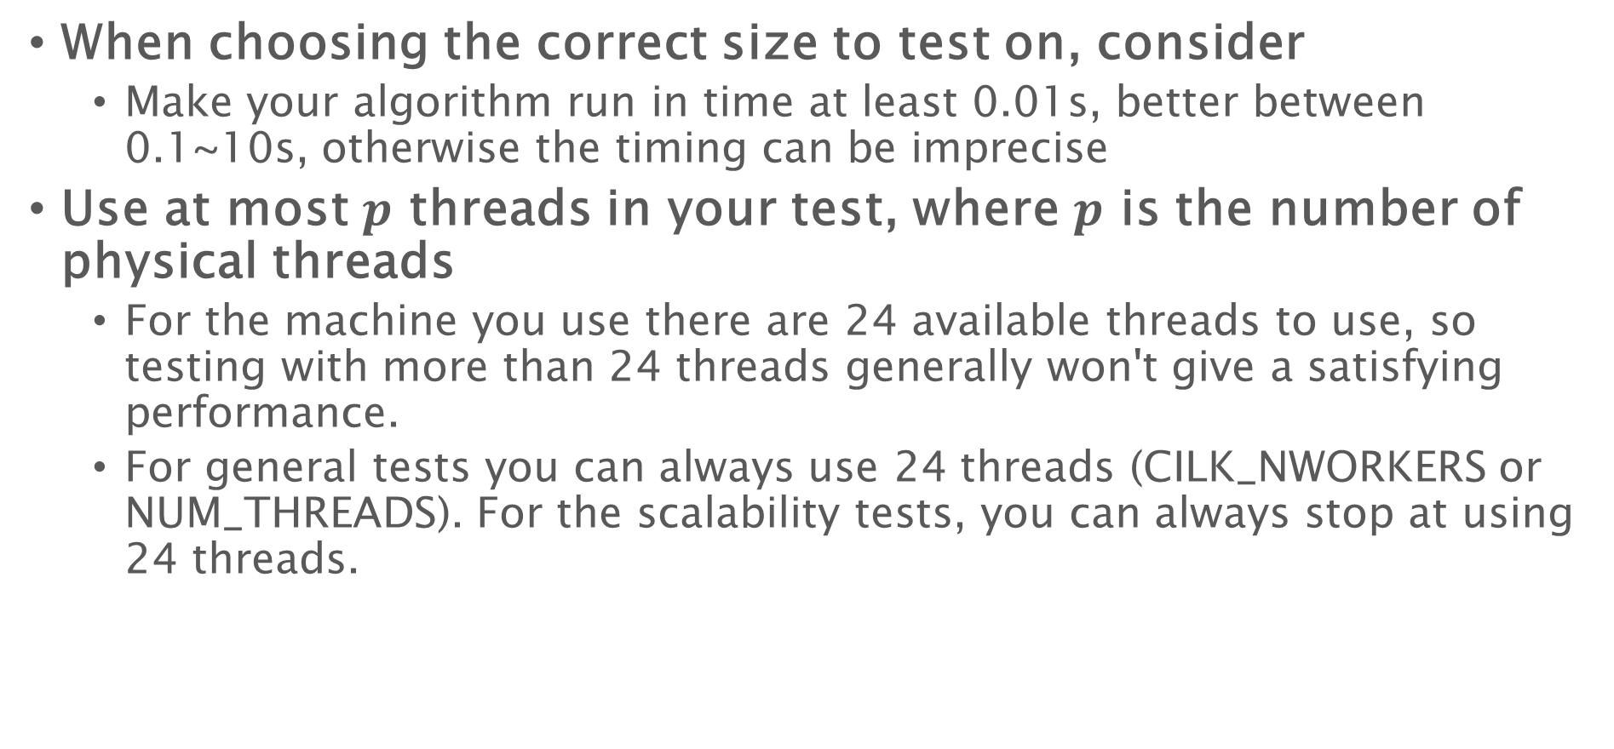
More suggestions about the programming part
When choosing the correct size to test on, consider
Make your algorithm run in time at least 0.01s, better between 0.1~10s, otherwise the timing can be imprecise
Use at most $p$ threads in your test, where $p$ is the number of physical threads
For the machine you use there are 24 available threads to use, so testing with more than 24 threads generally won't give a satisfying performance.
For general tests you can always use 24 threads (CILK_NWORKERS or NUM_THREADS). For the scalability tests, you can always stop at using 24 threads.

