Slide 1

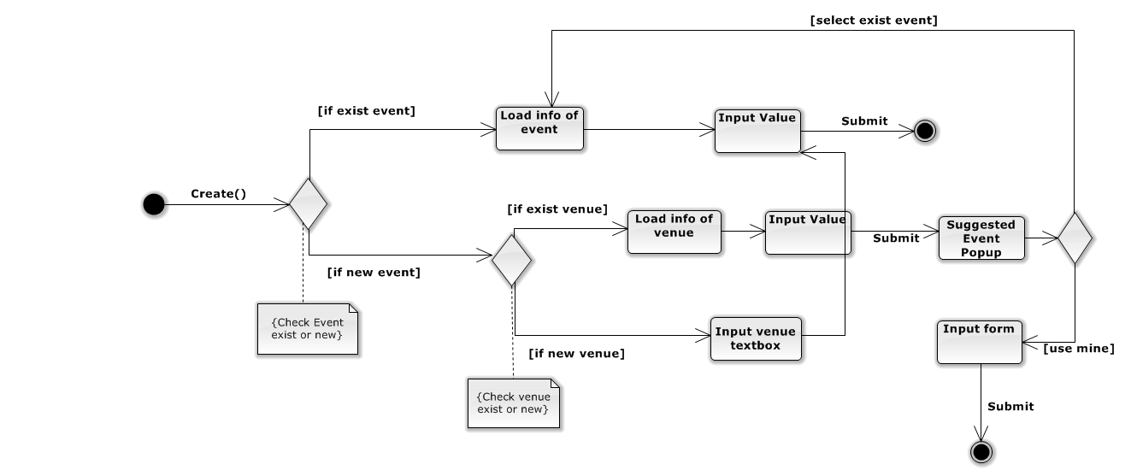
DropIt Project
Tran Type

Slide 2
Group 8 - Drop It
DropIt Project
Instant Payment
Hold Payment
5 days
Tran Type
Seller will receive money after buyer checkout successfully
Seller will receive money after 5 days when buyer got ticket on hand
Advantage for seller
Insecure transaction
Advantage for buyer
Secure transaction

Slide 3
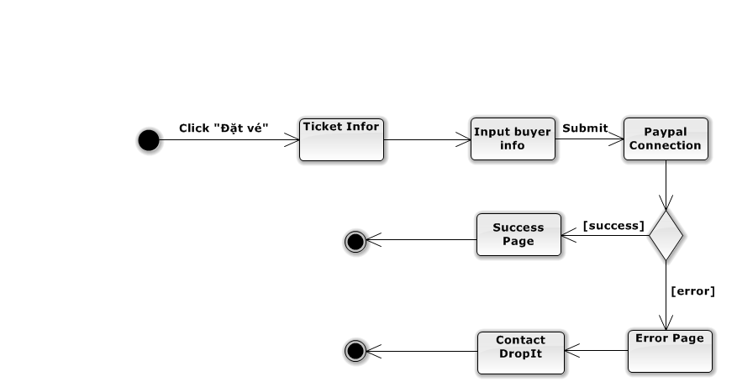
DropIt Project
Tran Type

