Slide 1

Develop C2C Buyer Platform Which Matching Buyer and Service Provider
Group 8 - Drop It
Supervisor:
Lâm Hữu Khánh Phương

Slide 2
Group 8 - Drop It
Lê Khôi Phong
Project Leader
Technical Leader
Developer
Tester
Công Minh Hiếu
Business analysis
Developer
Tester
Introduction
The People
Ticket.St
Problem
Đào Như Tùng
Business analysis
Developer
Tester
Nguyễn Thanh Tùng
Quality Assurance
Developer
Tester
Our Proposal
Đặng Quốc Duy
Quality Assurance
Developer
Tester

Slide 3
Group 8 - Drop It
Introduction
Drop It Project
Technologies & Tools
Demo
Disadvantages & Future
Q&A
Contents

Slide 4
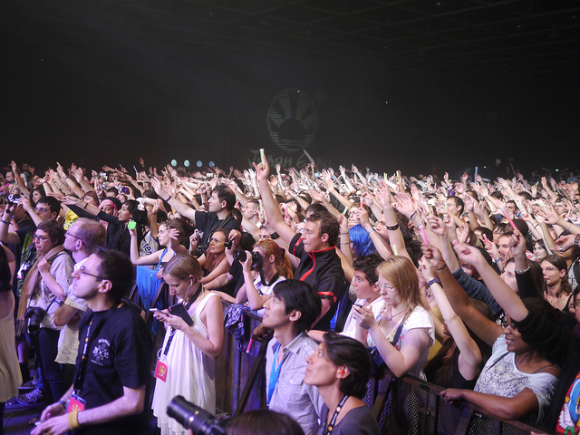
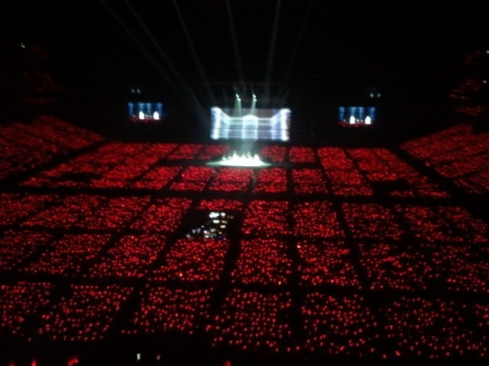
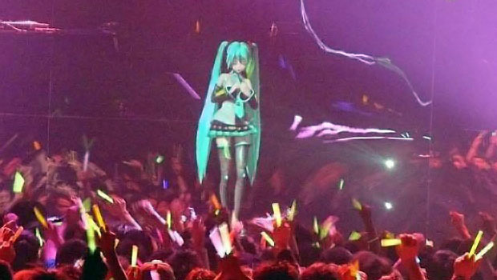
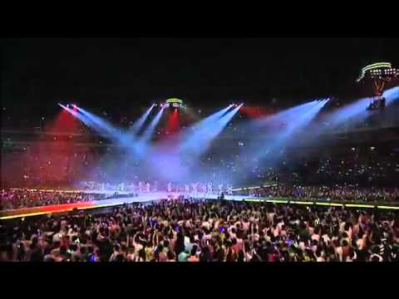
Group 8 - Drop It
In Japan, There are hundred of events everyday
Introduction
The People
Ticket.St
Problem
Our Proposal

Slide 5
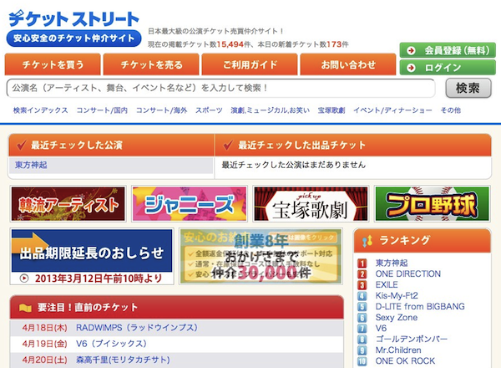
Group 8 - Drop It
C2C marketplace
Focused on buying/selling of show tickets
Monthly transaction $700,000
Over 100,000 members
More 5,000 kinds of tickets at all times
Introduction
The People
Ticket.St
Problem
Our Proposal

Slide 6
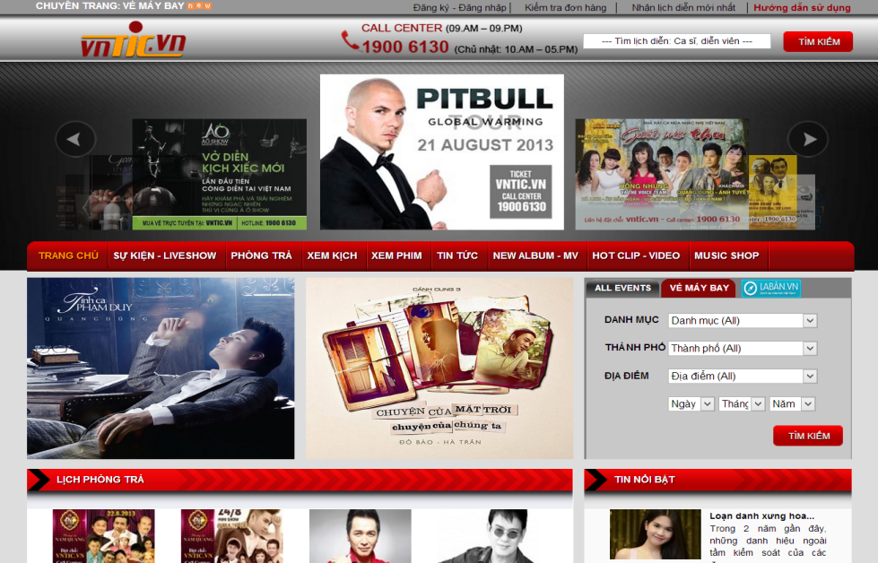
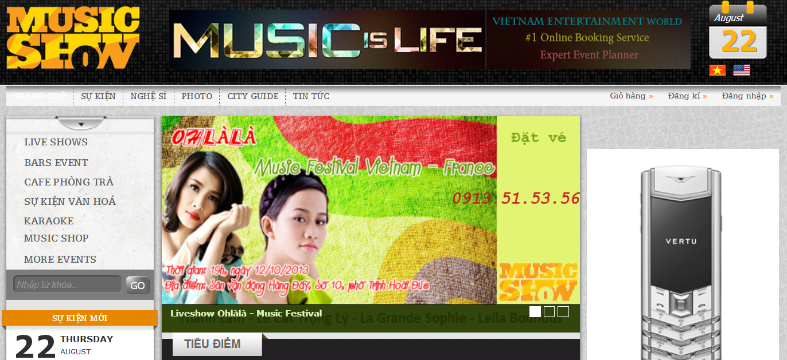
Group 8 - Drop It
All B2C model
Mostly Introduce show, event
Online payment not
quite good
Introduction
The People
Ticket.St
Problem
Our Proposal

Slide 7

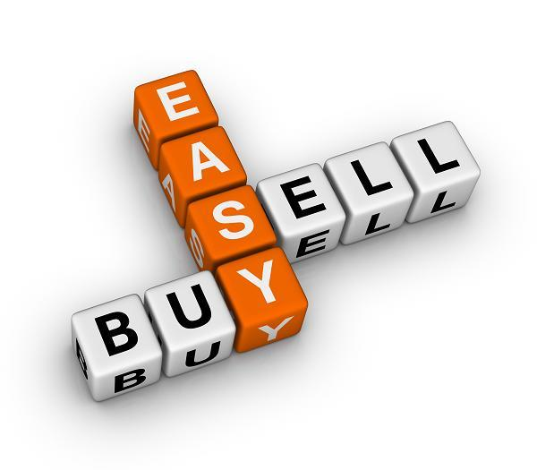

Group 8 - Drop It
Focus on second hand ticket market
More people know your ticket by trading online
Request ticket of event easily
Provide customers prefer a sense of security when buying
Online payment
Introduction
The People
Ticket.St
Problem
Our Proposal

Slide 8
Group 8 - Drop It
Overall Features
Main Features
Drop It Project

Slide 9

Group 8 - Drop It
DropIt Project
Overall design
User
Main features
Sort Event
Sell Ticket
View History
Sort Ticket
Buy Ticket
View Other Profile
View Event Detail
Request Ticket
Follow Event
Search
Respond
Receive Notification

Slide 10

Group 8 - Drop It
Require Sellable
Main Features
Login or Registry
Post Ticket page
Select Event
Sell Ticket
Buy Ticket
Request
Notification
Waiting for buyer
Post ticket
Input info & price
Transaction
Success
Deliver Ticket
Receive Money

Slide 11
Group 8 - Drop It
Require Login
Main Features
Select ticket
Click “Đặt vé”
Input info
Sell Ticket
Buy Ticket
Request
Wait for shipping
PayPal
Checkout
Notification
Receive Ticket

Slide 12
Group 8 - Drop It
Main Features
Login or Register
Request page
Sell Ticket
Buy Ticket
Request
Notification
Input info
Select Event
Post Request
Waiting for respond

Slide 13



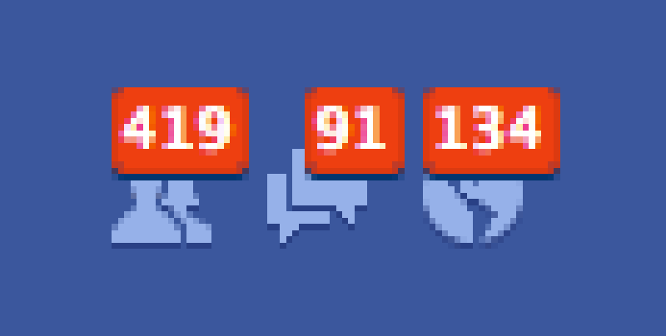
Group 8 - Drop It
Main Features
Follow Event
Sell Ticket
Buy Ticket
Customer A
Request
Notification
Post Ticket
Request Ticket
Customer B
Receive Notification
Customer A

Slide 14
Group 8 - Drop It
Technologies
Tools
Technologies & Tools

Slide 15








Group 8 - Drop It
Technologies

Slide 16





Group 8 - Drop It
Tools

Slide 17
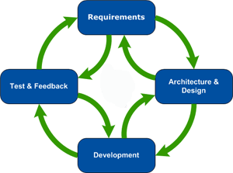
Development
Model
Agile Development Model

Slide 18
Demo
Demo

Slide 19
Group 8 - Drop It
Disadvantages
Customer can only buy 1 ticket per transaction
Customer have to check out through PayPal
There’s only one Admin manages the system
Services only in HCM City
Disadvantages

Slide 20
Group 8 - Drop It
Future Development
Allows user buy & sell many tickets
Provide more payment methods
Implement more roles for administration
Provide shipping nationwide
Future Plan

Slide 21

Group 8 - Drop It
Thanks for Listening

