Slide 1

Develop C2C Buyer Platform Which Matching Buyer and Service Provider
Group 8 - Drop It
Super Visor:
Lâm Hữu Khánh Phương
Student:
Lê Khôi Phong
Đào Như Tùng
Công Minh Hiếu
Nguyễn Thanh Tùng
Đặng Quốc Duy

Slide 2
Group 8 - Drop It
Introduction
Drop It Project
Technologies & Tools
Future Plan
Demo and Q&A
Contents

Slide 3
Group 8 - Drop It
The People
Story in Japan - Ticket.St
Problem
Our Proposal
Introduction

Slide 4
Group 8 - Drop It
Lê Khôi Phong
Project Leader
Technical Leader
Developer
Tester
Công Minh Hiếu
Business analysis
Developer
Tester
Introduction
The People
Ticket.St
Problem
Đào Như Tùng
Business analysis
Developer
Tester
Nguyễn Thanh Tùng
Quality Assurance
Developer
Tester
Our Proposal
Đặng Quốc Duy
Quality Assurance
Developer
Tester

Slide 5
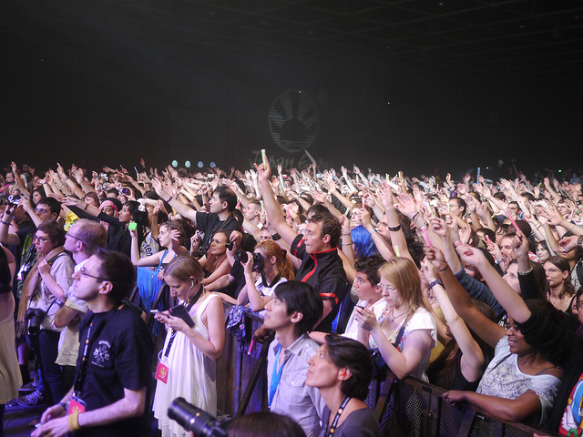
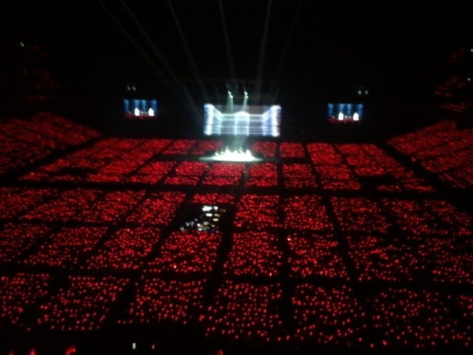
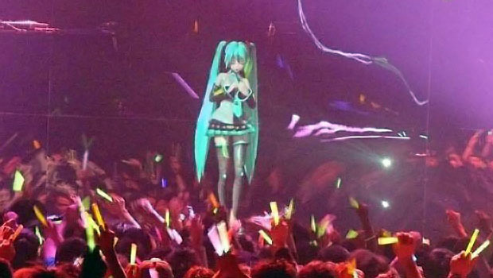
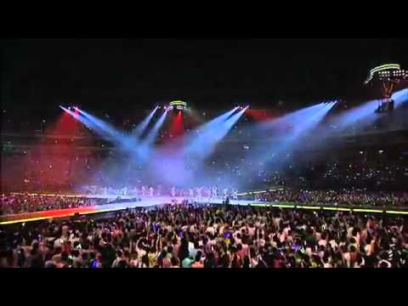
Group 8 - Drop It
In Japan, There are hundred of events everyday
Introduction
The People
Ticket.St
Problem
Our Proposal

Slide 6
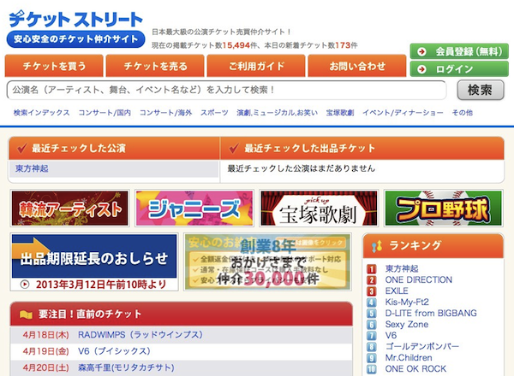
Group 8 - Drop It
C2C marketplace
Focused on buying/selling of show tickets.
Monthly transaction $700,000
Over 100,000 members
More 5,000 kinds of tickets at all times
Introduction
The People
Ticket.St
Problem
Our Proposal

Slide 7
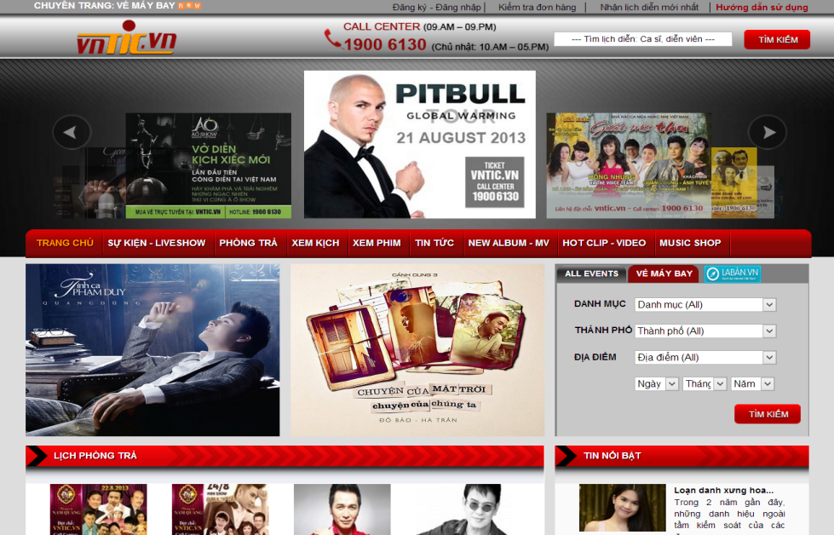
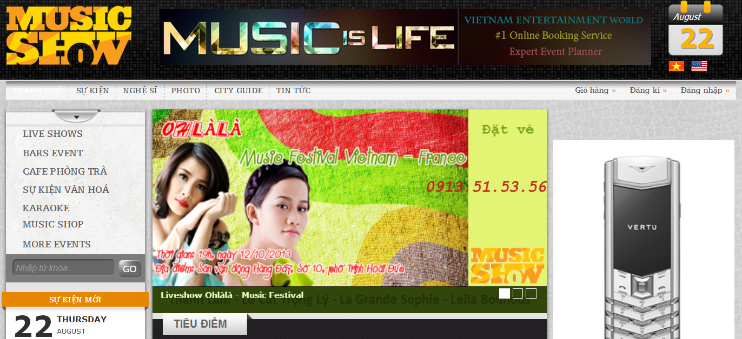
Group 8 - Drop It
All B2C model
Mostly Introduce show, event
Weak online payment
Introduction
The People
Ticket.St
Problem
Our Proposal

Slide 8

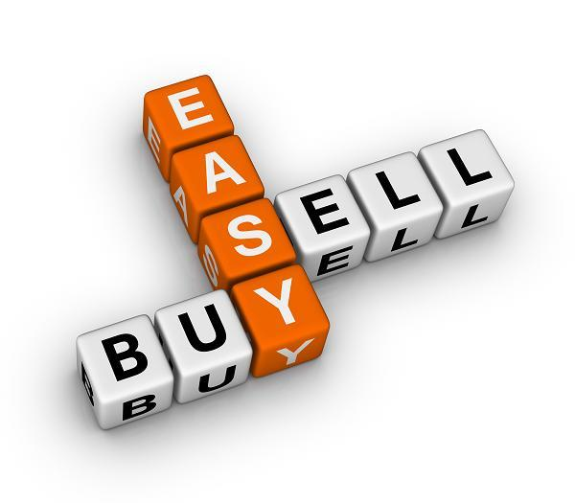

Group 8 - Drop It
Focus on 2nd ticket market
More people know your ticket by trading online.
Request ticket of event easily.
Provide customers prefer a sense of security when buying.
Online payment.
Introduction
The People
Ticket.St
Problem
Our Proposal

Slide 9
Group 8 - Drop It
Overall design
Main Features
Drop It Project

Slide 10
Group 8 - Drop It
DropIt Project
Overall design
Main features

Slide 11

Group 8 - Drop It
Main Features
Login or Registry
Post Ticket page
Sell Ticket
Buy Ticket
Notification
Request
Input info & price
Select Event
Post ticket

Slide 12
Group 8 - Drop It
Require Login
Main Features
Select ticket
Click “Đặt vé”
Input info
Sell Ticket
Buy Ticket
Notification
Request
Wait for shipping
Paypal
Checkout

Slide 13



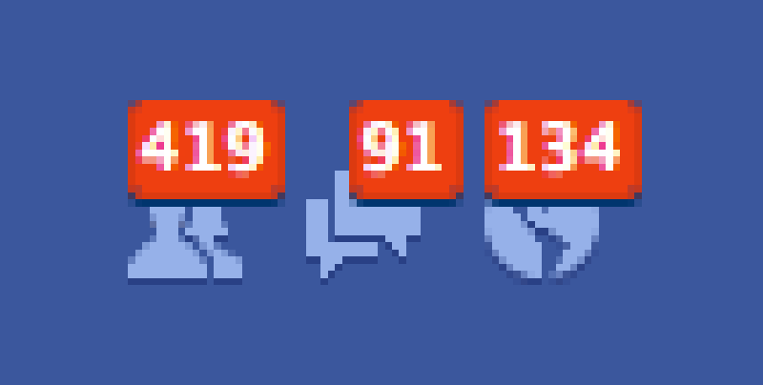
Group 8 - Drop It
Main Features
Follow Event
Sell Ticket
Buy Ticket
Customer A
Notification
Request
Post Ticket
Request Ticket
Customer B
Receive Notification
Customer A

Slide 14
Group 8 - Drop It
Main Features
Sell Ticket
Buy Ticket
Notification
Request

Slide 15
Group 8 - Drop It
Technologies
Tools
Technologies & Tools

Slide 16








Group 8 - Drop It
Technologies

Slide 17





Group 8 - Drop It
Tools

Slide 18
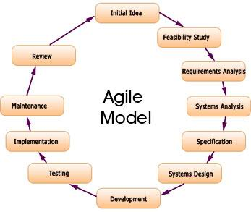
Agile Development Model

Slide 19
Group 8 - Drop It
Disadvantage
Users have to buy 1 ticket/transaction
Users have to check out through PayPal
Have only one role Admin
Services only in HCMC
Disadvantage

Slide 20
Group 8 - Drop It
Future Development
Allows user buy & sell many tickets
Provide more payment methods
Implement more roles for administration
Provide shipping nationwide
Future Plan

Slide 21

Group 8 - Drop It
Thanks for Listening

