Slide 1



Group 8 - Drop It
Customer Setting
Post ticket
Not buy my own ticket
Request
Buy Ticket

Slide 2
Group 8 - Drop It
Customer Setting
Request ticket
Not respond my own request
Request
Respond Ticket

Slide 3
Group 8 - Drop It
Customer Setting
Post ticket
Not More than 10 per day
Not over 10 per day
Request
Respond Ticket

Slide 4




Group 8 - Drop It
Auto System
Check event expired
Check expired
Request
+

Slide 5


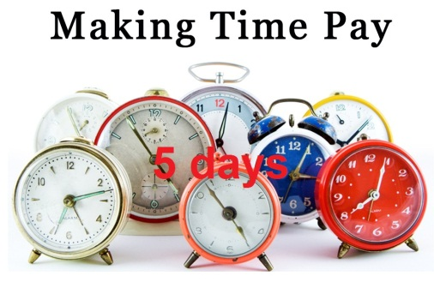

Group 8 - Drop It
Auto System
Check 5-days pay time
Request
Check transaction

Slide 6
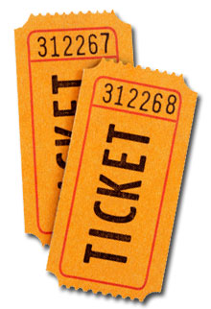

Group 8 - Drop It
Auto System
+
Buy ticket
Not report ticket after 5 days
5 days
Report
Request

