Slide 1
DropIT
team member:
lê khôi phong
đào như tùng
công minh hiếu
nguyễn thanh tùng
đặng quốc duy
supervisor: lâm hữu khánh phương

Slide 2

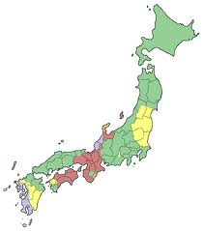

Story in japan

Slide 3
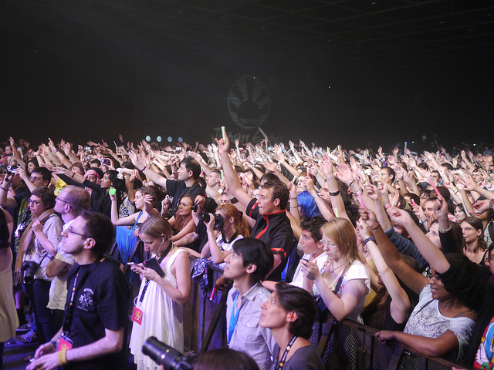

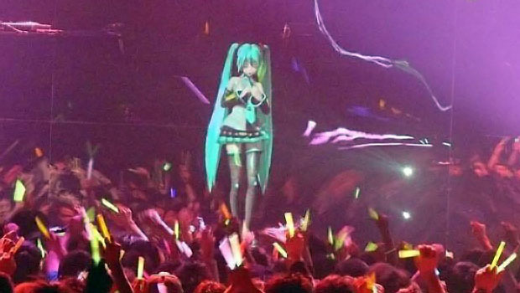
Hundred of events everyday

Slide 4
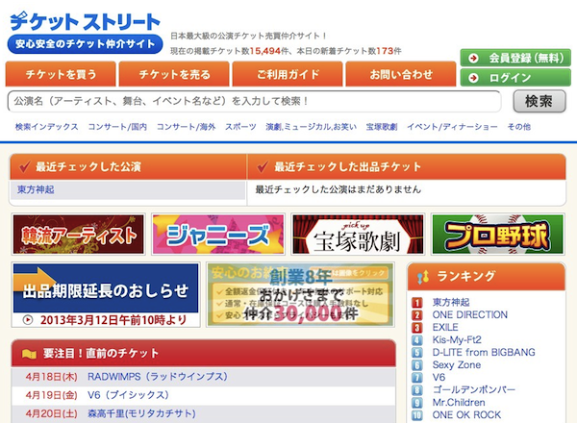
Ticket.st: Miracle startup

Slide 5
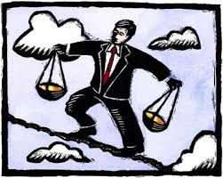
Ticket.st: Miracle startup
Scenario:
Have a chance to buy a ticket for a concert, taking place 6 months from now, you may hesitate to buy because you could have to work overtime or have a critical appointment on that day.

Slide 6
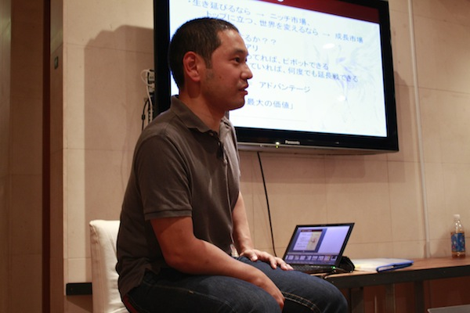
Ticket.st: Miracle startup
C2C marketplace
Focused on buying/selling of show tickets.
Monthly transaction $700,000.
Ticket Street’s Chairman Kei Nishiyama

Slide 7



Ticket.st: Miracle startup
Over 100,000 members
More 5,000 kinds of tickets at all times
“Enormous demand in C2C trading”
“Finding hidden demand”
“The platform provide security, safety, rules”
“Analyze market trends”
“Second-hand business”
Keys:

Slide 8
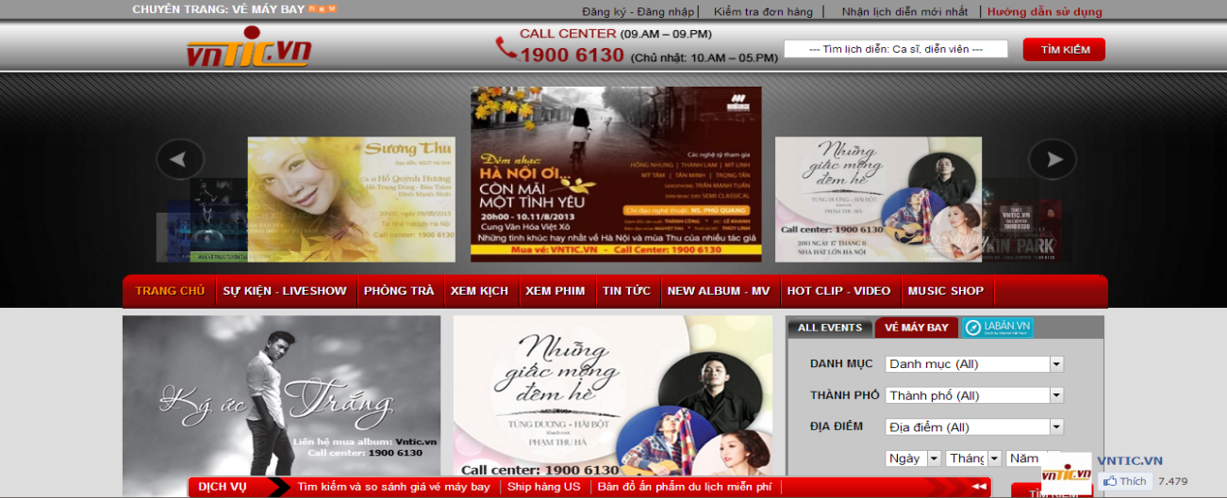
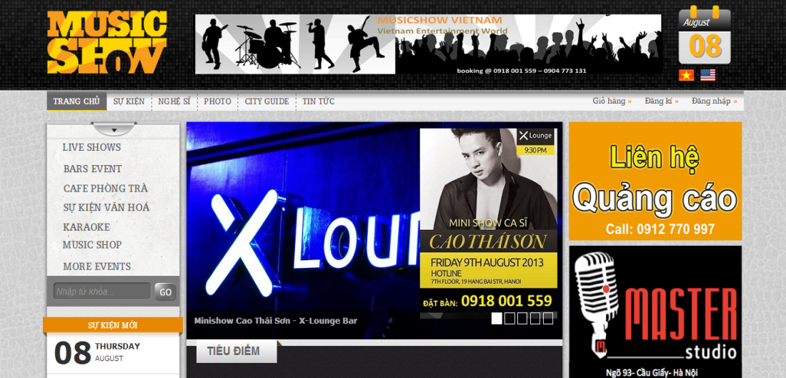
VIETNAM: Market share
Some websites:
vntic.vn
tickboc.vn
silo.vn
musicshow.vn
Problem:
> All B2C model
> Introduce show, event
> Weak online payment (-vntic.vn)

Slide 9
DROPit project
Focus on buy and sell event ticket only
People can resell their unwanted tickets to someone else.
More people know your ticket by trading online.
Request ticket of event easily.
Provide customers prefer a sense of security when buying.
Find special event ticket real-time.
Online payment.
Quick shipping

Slide 10
DROPit project
Main feature:
Buy/Sell ticket
Request ticket
Smart search
Follow event
Real-time notification

Slide 11







Technology & Framework

