Slide 1





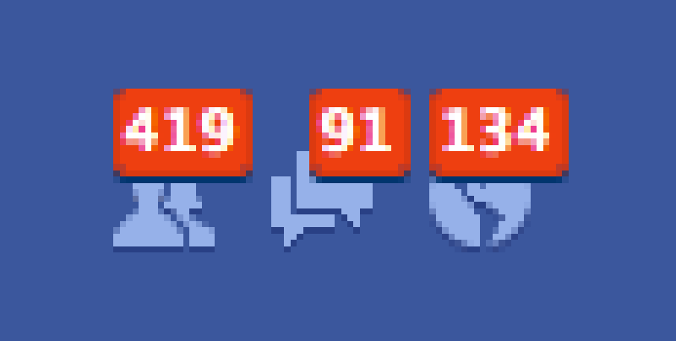
Group 8 - Drop It
Main Features
Follow Event
Sell Ticket
Buy Ticket
Customer A
Notification
Request
Post Ticket
Request Ticket
Customer B
Receive Notification
Customer A

Slide 2
Principals
Main factors (order by important )
Venue – exact matching
Hold Date – proximity matching
Category – exact matching
Event Suggestion
Others
The nearer it is to the event starting time, the more it is appreciated (at maximum 6 hours)
The event which happens at the allowed period of time and happens at the same venue will be likely to receive deduction points
Disadvantages
Event name is not a factor

Slide 3
Implementation
mark+=0.3 If same venue
mark+=0.1 if same category
Plus points will be in accordance with range of time
mark+=0.3 if same venue and in range of time
Suggest if mark >= 0.3
Event Suggestion

Slide 4




Flow
Post Ticket
Follow
Request
Event
Push
If user online add to list
Notification
Notification Repository
Of User
Online User Repository
Check if user online
Push to client

