Slide 1





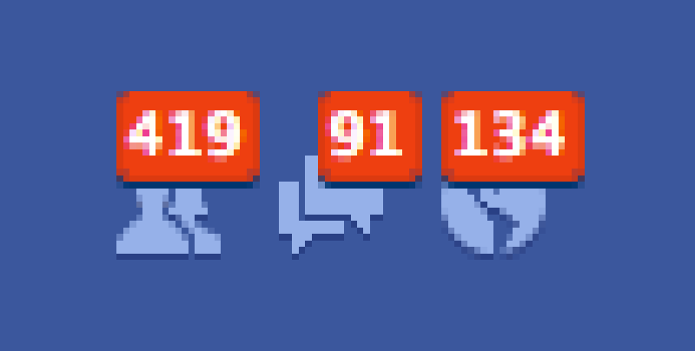
Group 8 - Drop It
Main Features
Follow Event
Sell Ticket
Buy Ticket
Customer A
Notification
Request
Post Ticket
Request Ticket
Customer B
Receive Notification
Customer A

Slide 2
Principals
Main factors (order by important )
Venue – exact matching
Hold Date – proximity matching
Category – exact matching
Event Suggestion
Others

Slide 3
Implementation
mark+=0.3 If same venue
mark+=0.1 if same category
Cộng điểm tương ứng với khoảng cách về thời gian (Tối đa 6h)
mark+=0.3 if same vanue and in range of time
Suggest if mark >= 0.3
Event Suggestion

