Slide 1
{ “username”: “user1”,
“fullName”: “user1”
}
{ “userId”: “id”,
“message”: “hello”
}
User 1
User 1
Create user
Send
{ “username”: “user2”,
“fullName”: “user2”
}
Message service
{ “sender”: “user1”,
“message”: “hello”
}
User 2
User 2
Create user
Response
Workflow simple

Slide 2








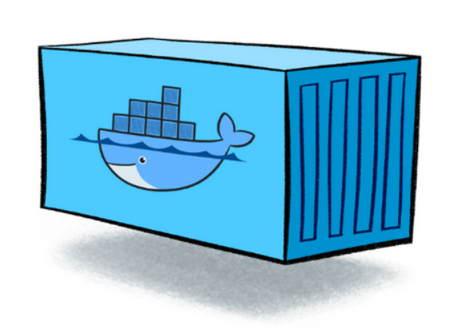










Pull
+
Pull
Create and push
image
Deploy
Container
Create and push
image
Create and push
image
Dockerfile
Dockerfile
HTTPS/443
HTTPS/443
Fetch data
REST API
WS/WSS
Response
Backend
Frontend
Technology design system

Slide 3
Chat Application
Access
Create
Chat Application
Username
Access
Create
User ID
Full name
Access
Description
Create

Slide 4
Username: johnson92
Full name: John Son
User existing
CHAT BOX
User found:
ID: xxxx-xxxx-xxxx
Full name: John Son
All user:
ID: xxxx-xxxx-xxxx
Full name: John Son
ID: xxx-xxxx-xxxx
Full name: David Ben
ID: xxxx-xxxxx-xxxxx
Full name: Nguyen A
Nguyen A: Hello John
You: Hello Nguyen!
David Ben: Hello John
You: Hello David. How are you?
Enter userID
Find by ID
Enter message
Send
UserID: xxxxx-xxxxx-xxxxx

Slide 5
{ “username”: “user1”,
“fullName”: “user1”
}
Database
accessCode: “xxxxx”
Return
Create user
User
Message service
Reject if invalid code
Check
User code
userCode: “CAP_xxxx”
Login
Request
Send mail
Reject if not exist
Message service
User code
Access code
Generate access code
Response
Request
Message service
Generate user code
Create
Return
exists or not
Save
Save
Mail service
Database
Access code
Database
Check user code
Create and Access to Chat Application

Slide 6
Message sent to receiver
User 1
userCode: “CAP_xxxx”
Subscribe topic
Send message
User 2
Subscribe topic
Message service
Send
Send
Alert
After received
new message
Check receiver user
Save
Response
Handle messages
Send to topic
Save message
Database
Simple notification message

Slide 7
Response verifyCode
Response
verifyCode
User 1
Generate verify code
accessCode
Login
Request
Message service
Request
verifyCode
Response
Save
Check
Database
Send mail
Mail service
Send with verifyCode
Access and send verify code to the User (Send Mail service)

