Slide 1
Arranging Schedule
Distributed by Group 4

Slide 2
Members of the group
Nguyễn Văn Huy
Trần Tuấn Phong
Nguyễn Ngọc Khánh
Bùi Hồng Nhật

Slide 3
Table of contents
1
4
2
5
3
6
About this problem
Greedy
What do we need to solve ?
Another way to solve easy problem
CP solution
Further Problem
A method using ortools.
The way to obtain optimal result
Local search
Analysis
Faster way to solve easy problem
A closer look to each algorithm

Slide 4
1
About this problem

Slide 5
Arranging timetable
There are N classes 1, 2, …, N that need to be scheduled. Each class i have: t[i] is the number of lessons, g[i] is the teacher teaching class i and s[i] is the number of students of class i.
There are M rooms 1, 2, …, M and c[i] is the number of seats in the room i.
In a week, there are 5 days (from Monday to Friday), each day is divided into 12 shifts (6 morning shifts and 6 afternoon shifts)
Create a schedule (assign day, shift and room to each class) that satisfies:
Two class having the same teacher need to be scheduled separately.
The number of students in each class has to be smaller than the capacity of the room.
Input:
The first line: N and M.
The next N line, each line write: t(i), g(i) and s(i).
The next line: c(1), c(2), …, c(n).
Output:
Timetable

Slide 6
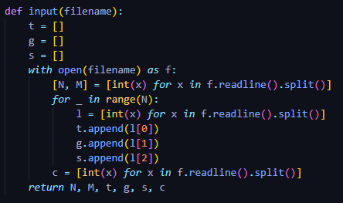
Notations for all algorithms
N: The number of classes
M: The number of rooms
t[i]: The number of shifts in class i
g[i]: The teacher teaching class i
s[i]: The number of students in class i
c[r]: The capacity of room r

Slide 7
CP SOLUTION
2

Slide 8
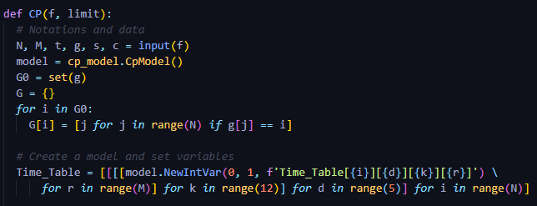
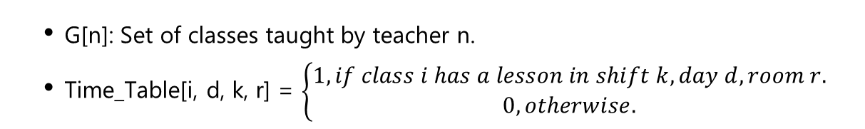
CP Variables
G[n]: Set of classes taught by teacher n.
Time_Table[i, d, k, r] = $\left\{\begin{aligned}1, if class i has a lesson in shift k, day d, room r. \\ 0, otherwise.\end{aligned}\right.$

Slide 9
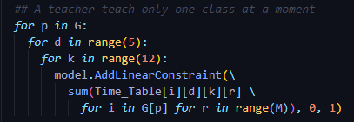
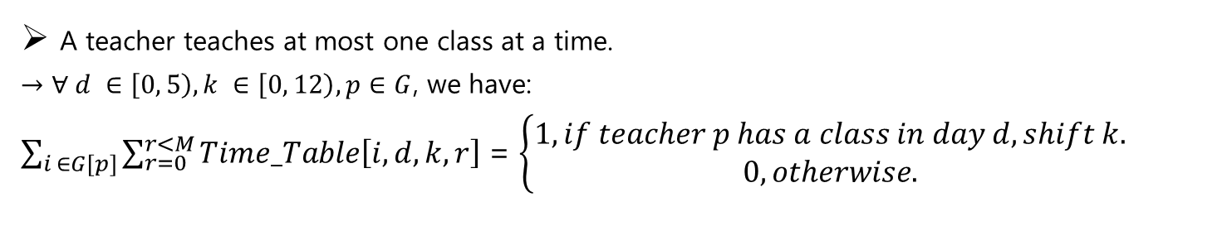
CP Constraints
A teacher teaches at most one class at a time.
$→$ $∀ d ∈\left[0, 5\right), k ∈\left[0, 12\right), p∈G$, we have:
$\sum_{i ∈G[p]}{\sum_{r=0}^{r<M}{Time_Table\left[i, d, k, r\right]}}$ = $\left\{\begin{aligned}1, if teacher p has a class in day d, shift k. \\ 0, otherwise.\end{aligned}\right.$

Slide 10
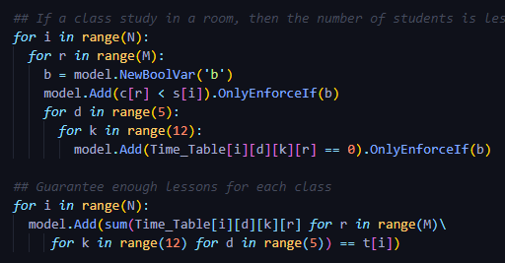
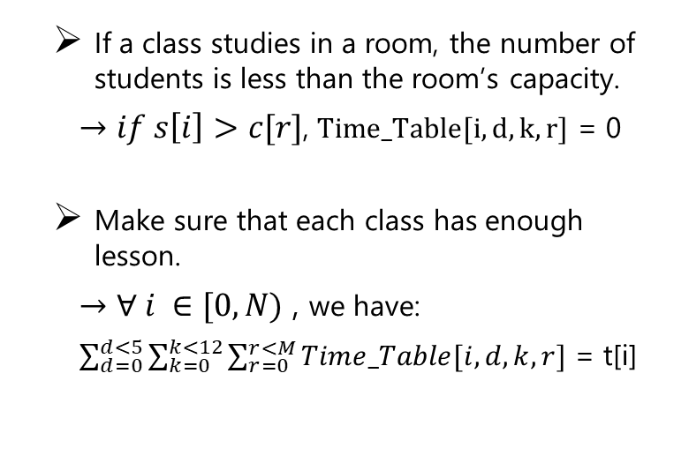
CP Constraints
If a class studies in a room, the number of students is less than the room’s capacity.
$→if s\left[i\right]>c[r]$, $Time_Table[i, d, k, r]$ = 0
Make sure that each class has enough lesson.
$→$ $∀ i ∈[0, N)$ , we have:
$\sum_{d=0}^{d<5}{\sum_{k=0}^{k<12}{\sum_{r=0}^{r<M}{Time_Table[i, d, k, r]}}}$ = t[i]

Slide 11
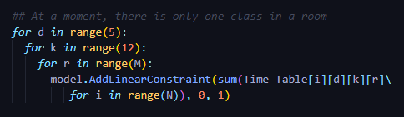
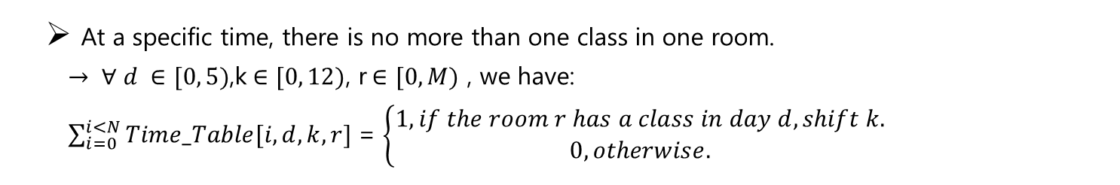
CP Constraints
At a specific time, there is no more than one class in one room.
$→ ∀ d ∈[0, 5)$,k$∈[0, 12)$, r$∈[0, M)$ , we have:
$\sum_{i=0}^{i<N}{Time_Table[i, d, k, r]}$ = $\left\{\begin{aligned}1, if the room r has a class in day d, shift k. \\ 0, otherwise.\end{aligned}\right.$

Slide 12
3
LOCAL SEARCH

Slide 13
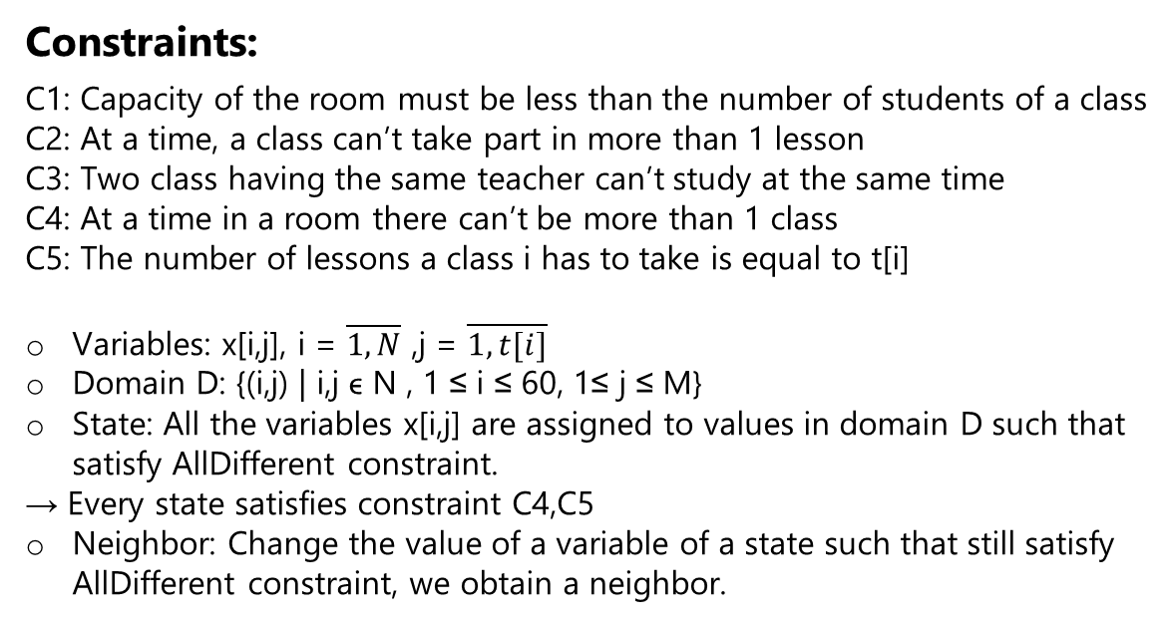
Search space
Constraints:
C1: Capacity of the room must be less than the number of students of a class
C2: At a time, a class can’t take part in more than 1 lesson
C3: Two class having the same teacher can’t study at the same time
C4: At a time in a room there can’t be more than 1 class
C5: The number of lessons a class i has to take is equal to t[i]
Variables: x[i,j], i = $\overline{1, N}$ ,j = $\overline{1, t[i]}$
Domain D: {(i,j) | i,j ϵ N , 1 ≤ i ≤ 60, 1≤ j ≤ M}
State: All the variables x[i,j] are assigned to values in domain D such that satisfy AllDifferent constraint.
→ Every state satisfies constraint C4,C5
Neighbor: Change the value of a variable of a state such that still satisfy AllDifferent constraint, we obtain a neighbor.

Slide 14
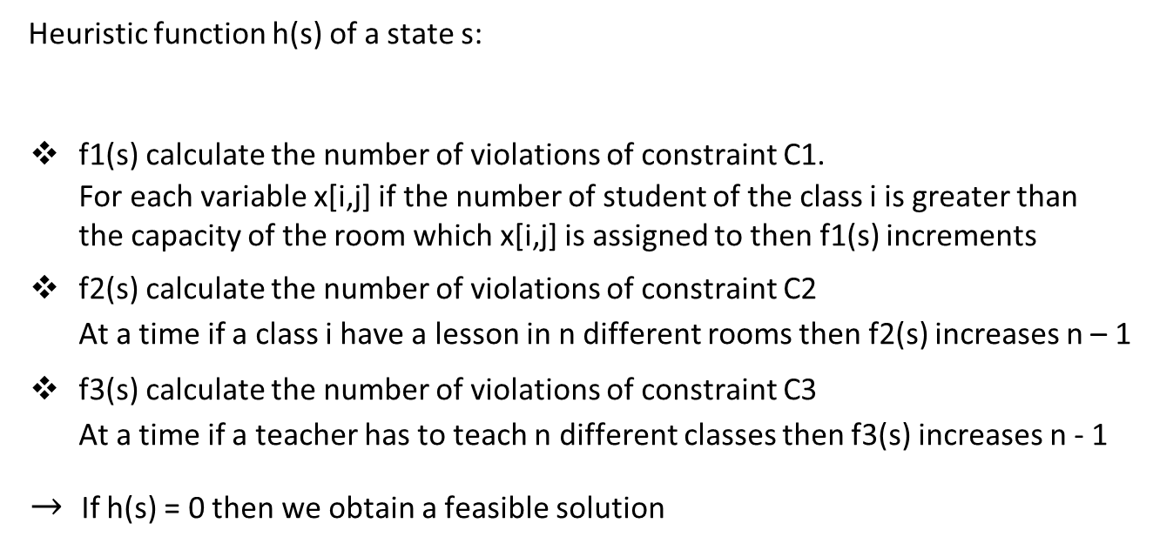
Heuristics
Heuristic function h(s) of a state s:
f1(s) calculate the number of violations of constraint C1.
For each variable x[i,j] if the number of student of the class i is greater than the capacity of the room which x[i,j] is assigned to then f1(s) increments
f2(s) calculate the number of violations of constraint C2
At a time if a class i have a lesson in n different rooms then f2(s) increases n – 1
f3(s) calculate the number of violations of constraint C3
At a time if a teacher has to teach n different classes then f3(s) increases n - 1
$→$If h(s) = 0 then we obtain a feasible solution
h(s) = f1(s) + f2(s) + f3(s)

Slide 15
Hill Climbing Idea
Consider all the neighbors of a current state then choose a neighbor that has minimum heuristic value of all the neighbors. If that neighbor has the heuristic value less than or equal to the current state → continue. Otherwise, the algorithm finishes.

Slide 16
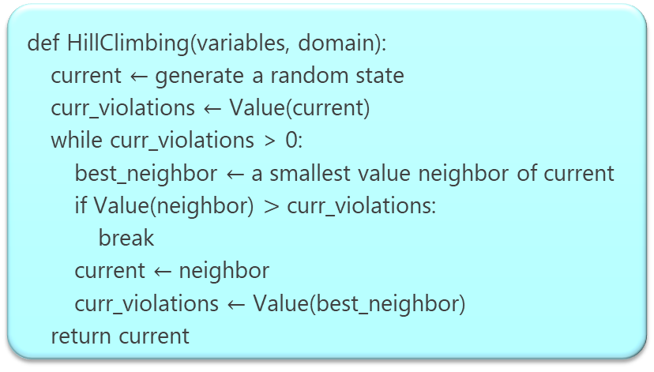
Hill Climbing Pseudocode
def HillClimbing(variables, domain):
current $←$ generate a random state
curr_violations $←$ Value(current)
while curr_violations > 0:
best_neighbor $←$ a smallest value neighbor of current
if Value(neighbor) $>$ curr_violations:
break
current $←$ neighbor
curr_violations $←$ Value(best_neighbor)
return current

Slide 17
Remark
The cardinality of the neighbor set of a given state is too large → the algorithm is slow.
The number of class (N) | The number of room (M) | Execution time
The number of class (N) | The number of room (M) | CP | Hill climbing
15 | 5 | 0.21 | 12.442
25 | 5 | 0.441 | 35.563
35 | 5 | 0.789 | 117.28
45 | 5 | 0.897 | Time exceed limit

Slide 18
Remark
The cardinality of the neighbor set of a given state is too large → the algorithm is slow.
The number of class (N) | The number of room (M) | Execution time
The number of class (N) | The number of room (M) | CP | Hill climbing
15 | 5 | 0.21 | 12.442
25 | 5 | 0.441 | 35.563
35 | 5 | 0.789 | 117.28
45 | 5 | 0.897 | Time exceed limit
The number of class (N) | The number of room (M) | Execution time
The number of class (N) | The number of room (M) | CP | Hill climbing
50 | 2 | 0.307 | 1.087
50 | 4 | 0.785 | 35.777
50 | 6 | 3.105 | 179.667
50 | 8 | 2.045 | 219.503
→ Another approach First Choice Hill Climbing

Slide 19
First Choice Hill Climbing Idea
For each iteration, the algorithm generates a random neighbor of the current state until getting the neighbor such that has the heuristic value less than or equal to the value of the current state.

Slide 20
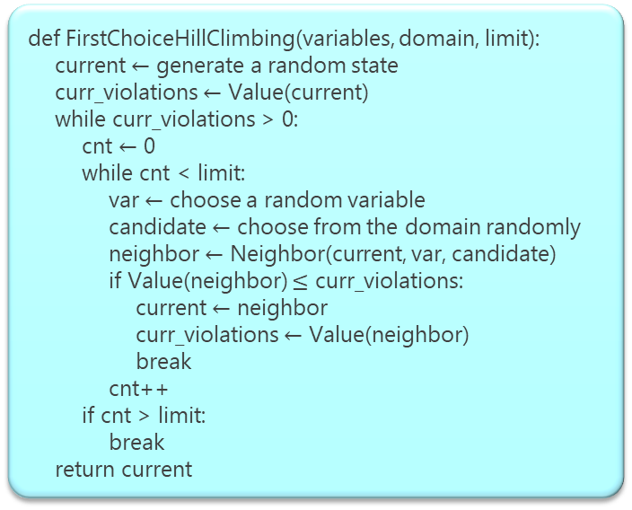
First Choice Hill Climbing Pseudocode
def FirstChoiceHillClimbing(variables, domain, limit):
current $←$ generate a random state
curr_violations $←$ Value(current)
while curr_violations > 0:
cnt $←$ 0
while cnt < limit:
var $←$ choose a random variable
candidate $←$ choose from the domain randomly
neighbor $←$ Neighbor(current, var, candidate)
if Value(neighbor) $≤$ curr_violations:
current $←$ neighbor
curr_violations $←$ Value(neighbor)
break
cnt++
if cnt > limit:
break
return current

Slide 21
Remark
Faster and more complete than the standard Hill Climbing.
Faster than CP ortools when the search space contains many feasible solution
Randomness is a problem.
The number of class (N) | The number of room (M) | Execution time
The number of class (N) | The number of room (M) | CP | Hill climbing | First choice hill climbing
15 | 5 | 0.21 | 12.442 | 0.11
25 | 5 | 0.441 | 35.563 | 0.083
35 | 5 | 0.789 | 117.28 | 0.688

Slide 22
Remark
Faster and more complete than the standard Hill Climbing.
Faster than CP ortools when the search space contains many feasible solution
Randomness is a problem.
The number of class (N) | The number of room (M) | Execution time
The number of class (N) | The number of room (M) | CP | Hill climbing | First choice hill climbing
15 | 5 | 0.21 | 12.442 | 0.11
25 | 5 | 0.441 | 35.563 | 0.083
35 | 5 | 0.789 | 117.28 | 0.688
The number of class (N) | The number of room (M) | Execution time
The number of class (N) | The number of room (M) | CP | Hill climbing | First choice hill climbing
50 | 2 | 0.307 | 1.087 | 0.036
50 | 4 | 0.785 | 35.777 | 0.629
50 | 6 | 3.105 | 179.667 | 0.991

Slide 23
GREEDY
4

Slide 24
Greedy Idea
The idea of this algorithm is quite identical to local search’s algorithm.
Sort the room set in terms of its capacity in increasing order and sort the class set in terms of its number of students in decreasing order → increase the probability to find feasible solution.
At each step, the algorithm tries to assign a class to the largest number of students to a room with the smallest number of capacity and a latest time slot.

Slide 25
Greedy Pseudocode
def greedy( ):
for current_class in classes_sort:
t := the number of shift of current_class
i := the index of current_class
for j in t:
x := Select(current_class)
if x = “FAILURE”:
return “FAILURE”
timetable[i].push(x)
def Select(current_class)
g := The teacher teaches current_class
for p in range(60):
for room in rooms_sort:
if Feasible(current_class, p, room):
return p, room
return “FAILURE”
Notation:
classes_sort: Descendingly sort class based on the number of students.
rooms_sort: Ascendingly sort room based on its capacity.

Slide 26
Remark
Faster than First Choice Hill Climbing when the problem size is big.
Faster than ortools CP when the search space contains many feasible solutions.
The number of class (N) | The number of room (M) | Execution time
The number of class (N) | The number of room (M) | CP | First choice hill climbing | Greedy
50 | 2 | 0.307 | 0.036 | 0.001
50 | 4 | 0.785 | 0.629 | 0.002
50 | 6 | 3.105 | 0.991 | 0.004
50 | 8 | 2.045 | 0.168 | 0.003

Slide 27
Remark
Faster than First Choice Hill Climbing when the problem size is big.
Faster than ortools CP when the search space contains many feasible solutions.
The number of class (N) | The number of room (M) | Execution time
The number of class (N) | The number of room (M) | CP | First choice hill climbing | Greedy
15 | 5 | 0.21 | 0.11 | 0.001
25 | 5 | 0.441 | 0.083 | 0.002
35 | 5 | 0.789 | 0.688 | 0.003
45 | 5 | 0.897 | 0.203 | 0.002
The number of class (N) | The number of room (M) | Execution time
The number of class (N) | The number of room (M) | CP | First choice hill climbing | Greedy
50 | 2 | 0.307 | 0.036 | 0.001
50 | 4 | 0.785 | 0.629 | 0.002
50 | 6 | 3.105 | 0.991 | 0.004
50 | 8 | 2.045 | 0.168 | 0.003

Slide 28
Compare 4 algorithms
The number of class (N) | The number of room (M) | Execution time
The number of class (N) | The number of room (M) | CP | Hill climbing | First choice hill climbing | Greedy
15 | 5 | 0.21 | 12.442 | 0.11 | 0.001
25 | 5 | 0.441 | 35.563 | 0.083 | 0.002
35 | 5 | 0.789 | 117.28 | 0.688 | 0.003
45 | 5 | 0.897 | Time exceed limit | 0.203 | 0.002
55 | 5 | 1.89 | Time exceed limit | 0.317 | 0.003
65 | 5 | 1,751 | Time exceed limit | 0.338 | 0.003
75 | 5 | 2.355 | Time exceed limit | 0.355 | 0.004
85 | 5 | 2.461 | Time exceed limit | 0.435 | 0.004
95 | 5 | 2.265 | Time exceed limit | 0.686 | 0.004
100 | 5 | 4.057 | Time exceed limit | 0.615 | 0.004

Slide 29
Compare 4 algorithms
The number of class (N) | The number of room (M) | Execution time
The number of class (N) | The number of room (M) | CP | Hill climbing | First choice hill climbing | Greedy
50 | 2 | 0.307 | 1.087 | 0.036 | 0.001
50 | 4 | 0.785 | 35.777 | 0.629 | 0.002
50 | 6 | 3.105 | 179.667 | 0.991 | 0.004
50 | 8 | 2.045 | 219.503 | 0.168 | 0.003
50 | 10 | 2.126 | Time exceed limit | 0.566 | 0.004
50 | 12 | 5.123 | Time exceed limit | 1.693 | 0.008
50 | 14 | 3.575 | Time exceed limit | 0.374 | 0.005
50 | 16 | 6.254 | Time exceed limit | 0.645 | 0.008
50 | 18 | 9.244 | Time exceed limit | 6.845 | 0.013
50 | 20 | 8.316 | Time exceed limit | 11.941 | 0.015

Slide 30
5
PROBLEM EXTENSION

Slide 31
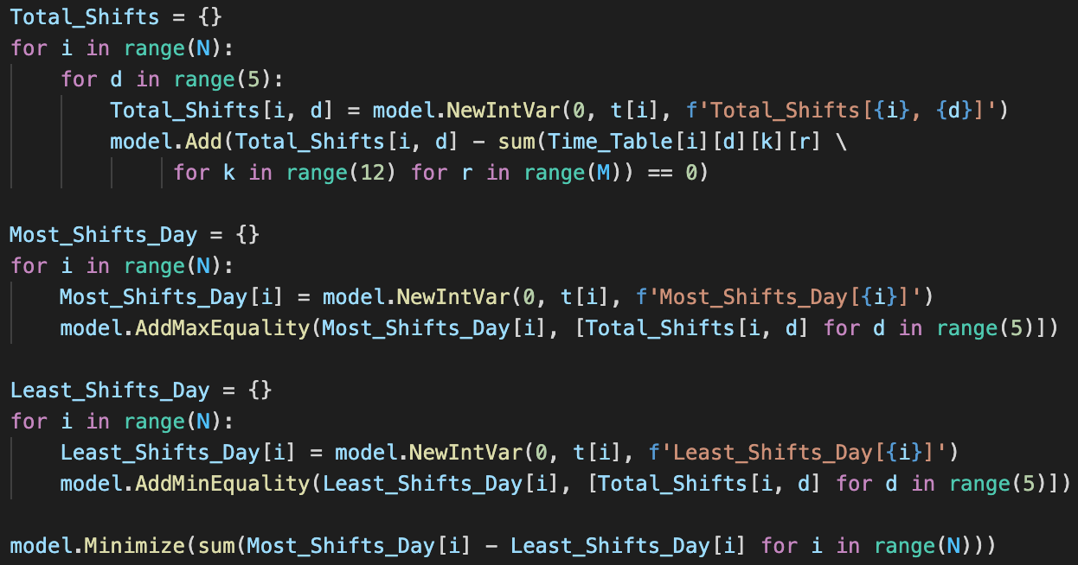
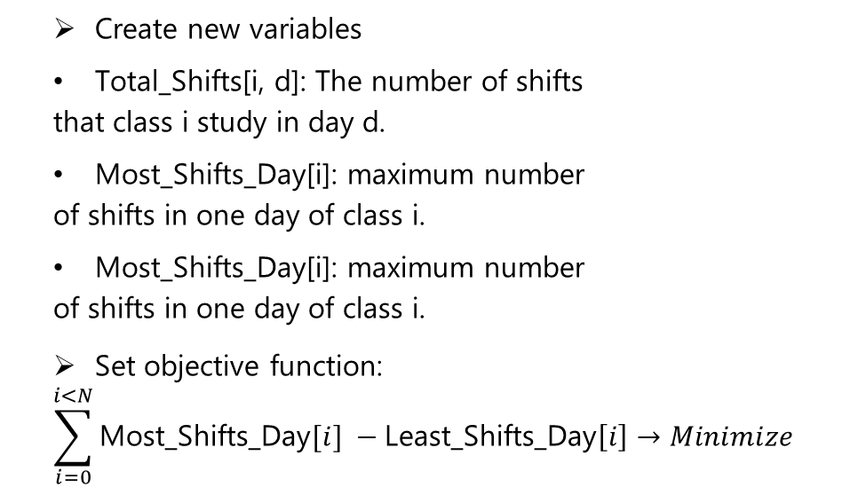
CP Objective Function
Create new variables
Total_Shifts[i, d]: The number of shifts
that class i study in day d.
Most_Shifts_Day[i]: maximum number
of shifts in one day of class i.
Most_Shifts_Day[i]: maximum number
of shifts in one day of class i.
Set objective function:
$$\sum_{i=0}^{i<N}{\text{Most}\text{_}\text{Shifts}\text{_}\text{Day}[i]} −\text{Least}\text{_}\text{Shifts}\text{_}\text{Day}\left[i\right]→Minimize$$

Slide 32
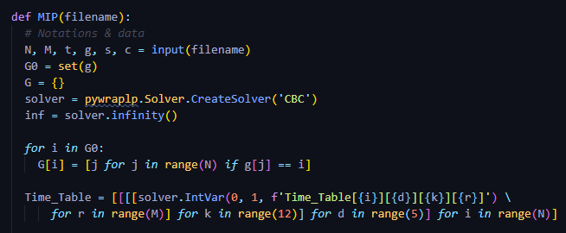

MIP Variables
G[n]: Set of classes taught by teacher n.
Time_Table[i, d, k, r] = $\left\{\begin{aligned}1, if class i has lesson in shift k, day d, room r. \\ 0, otherwise.\end{aligned}\right.$

Slide 33
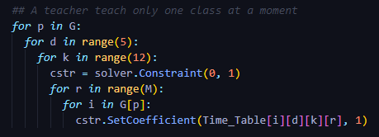
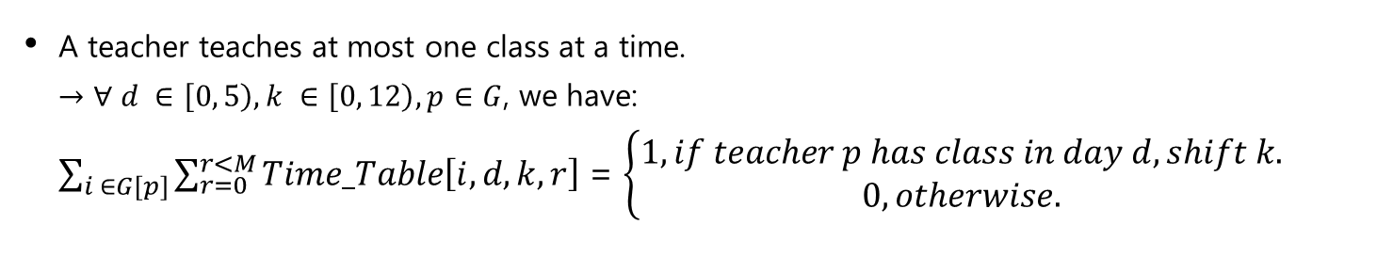
MIP Constraints
A teacher teaches at most one class at a time.
$→$ $∀ d ∈\left[0, 5\right), k ∈\left[0, 12\right), p∈G$, we have:
$\sum_{i ∈G[p]}{\sum_{r=0}^{r<M}{Time_Table\left[i, d, k, r\right]}}$ = $\left\{\begin{aligned}1, if teacher p has class in day d, shift k. \\ 0, otherwise.\end{aligned}\right.$

Slide 34
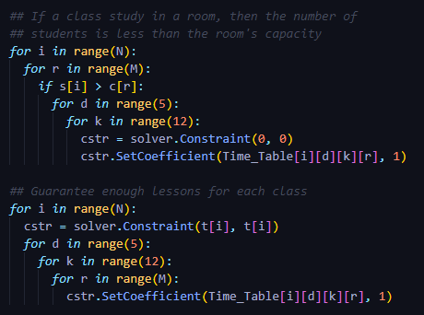
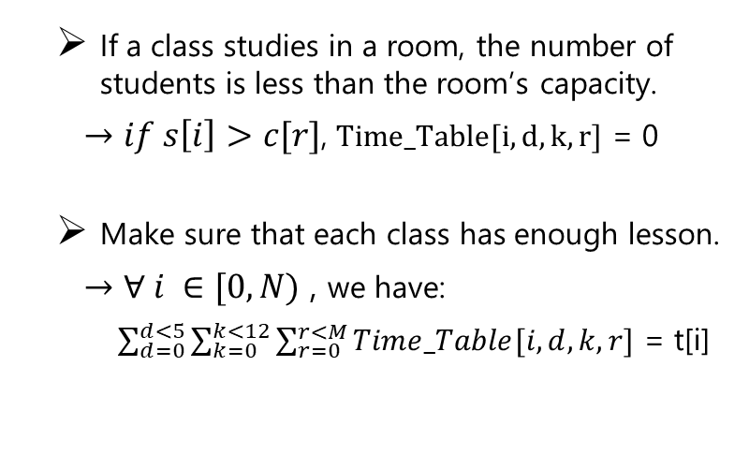
MIP Constraints
If a class studies in a room, the number of students is less than the room’s capacity.
$→if s\left[i\right]>c[r]$, $Time_Table[i, d, k, r]$ = 0
Make sure that each class has enough lesson.
$→$ $∀ i ∈[0, N)$ , we have:
$\sum_{d=0}^{d<5}{\sum_{k=0}^{k<12}{\sum_{r=0}^{r<M}{Time_Table[i, d, k, r]}}}$ = t[i]

Slide 35
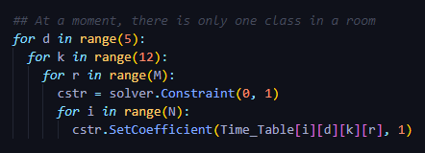
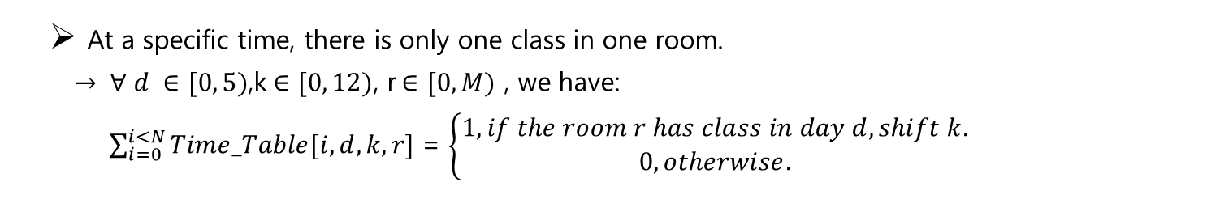
MIP Constraints
At a specific time, there is only one class in one room.
$→ ∀ d ∈[0, 5)$,k$∈[0, 12)$, r$∈[0, M)$ , we have:
$\sum_{i=0}^{i<N}{Time_Table[i, d, k, r]}$ = $\left\{\begin{aligned}1, if the room r has class in day d, shift k. \\ 0, otherwise.\end{aligned}\right.$

Slide 36
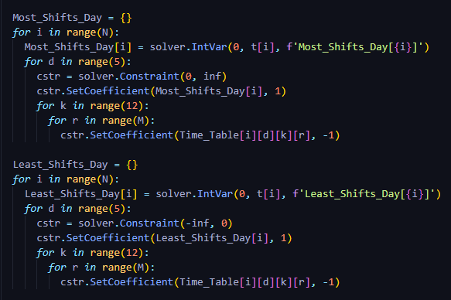
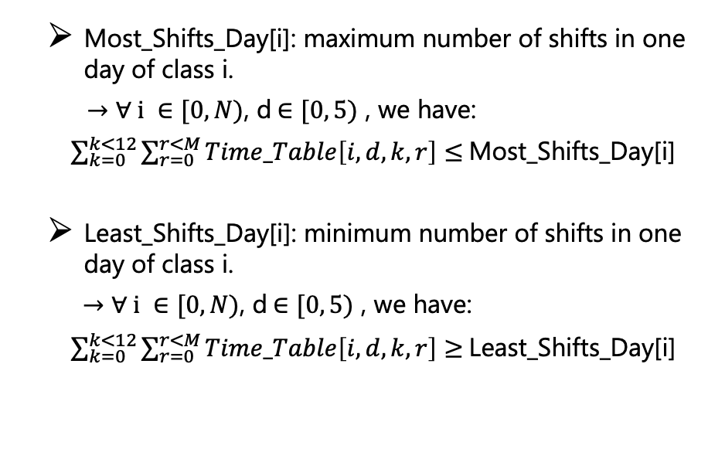
MIP Constraints
Most_Shifts_Day[i]: maximum number of shifts in one day of class i.
$→$ $∀ i ∈[0, N)$, d$∈[0, 5)$ , we have:
$\sum_{k=0}^{k<12}{\sum_{r=0}^{r<M}{Time_Table\left[i, d, k, r\right]}}$ $≤$Most_Shifts_Day[i]
Least_Shifts_Day[i]: minimum number of shifts in one day of class i.
$→$ $∀ i ∈[0, N)$, d$∈[0, 5)$ , we have:
$\sum_{k=0}^{k<12}{\sum_{r=0}^{r<M}{Time_Table\left[i, d, k, r\right]}}$ $≥$Least_Shifts_Day[i]

Slide 37
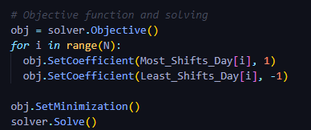
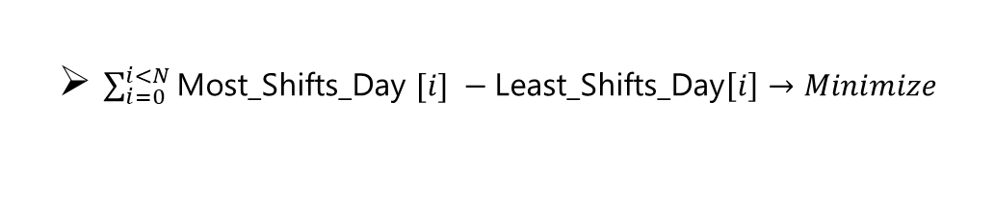
MIP Objective Function
$\sum_{i=0}^{i<N}{\text{Most}\text{_}\text{Shifts}\text{_}\text{Day} [i]} −\text{Least}\text{_}\text{Shifts}\text{_}\text{Day}\left[i\right]→Minimize$

Slide 38
Analysis
6

Slide 39
CP vs MIP
The number of class (N) | The number of room (M) | Execution time |  | F*
 |  | MIP | CP | MIP | CP
20 | 10 | 1.572 | 1.678 | 17.0 | 17.0
30 | 10 | 5.972 | 4.213 | 32.0 | 32.0
40 | 10 | 3.498 | 4.737 | 40.0 | 40.0
50 | 10 | 8.821 | 24.099 | 48.0 | 48.0
60 | 10 | 8.55 | 16.585 | 52.0 | 52.0
70 | 10 | 9.578 | 40.528 | 58.0 | 58.0
80 | 10 | 11.844 | 18.596 | 85.0 | 85.0
90 | 10 | 15.894 | 63.463 | 57.0 | 57.0
100 | 10 | 13.724 | 24.663 | 100.0 | 100.0

Slide 40
CP vs MIP
The number of class (N) | The number of room (M) | Execution time |  | F*
 |  | MIP | CP | MIP | CP
50 | 4 | 4.804 | 1.584 | 40.0 | 40.0
50 | 6 | 3.29 | 2.747 | 21.0 | 21.0
50 | 8 | 4.445 | 4.942 | 50.0 | 50.0
50 | 10 | 4.17 | 5.518 | 50.0 | 50.0
50 | 12 | 10.148 | 29.809 | 36.0 | 36.0
50 | 14 | 6.89 | 10.355 | 50.0 | 50.0
50 | 16 | 8.997 | 23.651 | 34.0 | 34.0
50 | 18 | 6.608 | 7.325 | 50.0 | 50.0
50 | 20 | 9.519 | 14.436 | 50.0 | 50.0

Slide 41
Thanks for your attention!
Do you have any question ?

