Slide 1
Arranging Schedule
Distributed by Group 4

Slide 2
Members of the group
Nguyễn Văn Huy
Trần Tuấn Phong
Nguyễn Ngọc Khánh
Bùi Hồng Nhật

Slide 3
Table of contents
1
4
2
5
3
6
About this problem
Greedy
What do we need to solve ?
Another way to solve easy problem
CP solution
Further Problem
A method using ortools.
The way to obtain optimal result
Local search
More Information
Faster way to solve easy problem
A closer look to each algorithm

Slide 4
1
About this problem

Slide 5
Arranging timetable
There are N classes 1, 2, …, N arranging student schedule. t(i), g(i), s(i) is the number of shift, teacher, the number of student, respectively.
There are M rooms 1, 2, …, M, while c(i) is the number of seat in the room i.
There are 5 school-day in one week (from Monday to Friday), each day consist of 12 shifts (6 morning shifts and 6 afternoon shifts).
Let’s create a student schedule (determine weekday, shift and the room for each class) such that:
Two class having the same teacher need setting in different time.
The number of student in each class is less than room’s capacity.
Input:
The first line: N and M.
The next N line, each line write: t(i), g(i) and s(i).
The next line: c(1), c(2), …, c(n).
Output:
Timetable

Slide 6
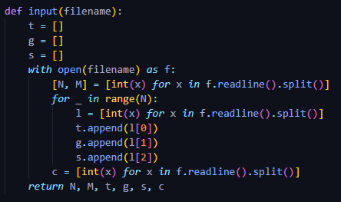
Variables for all algorithm
N: The number of class.
M: The number of room.
t[i]: The number of shift in class i.
g[i]: The teacher teaching class i.
s[i]: The number of student in class i.
c[r]: The capacity of room r.

Slide 7
CP SOLUTION
2

Slide 8
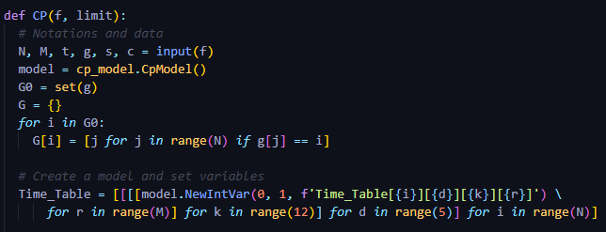
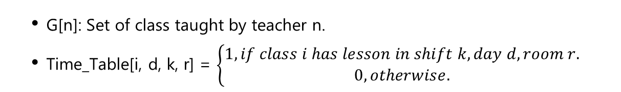
CP Variables
G[n]: Set of class taught by teacher n.
Time_Table[i, d, k, r] = $\left\{\begin{aligned}1, if class i has lesson in shift k, day d, room r. \\ 0, otherwise.\end{aligned}\right.$

Slide 9
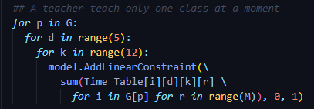
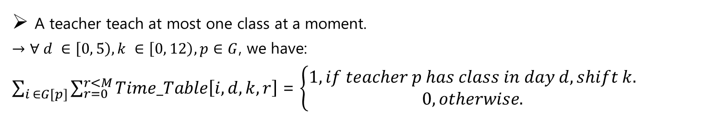
CP Constraints
A teacher teach at most one class at a moment.
$→$ $∀ d ∈\left[0, 5\right), k ∈\left[0, 12\right), p∈G$, we have:
$\sum_{i ∈G[p]}{\sum_{r=0}^{r<M}{Time_Table\left[i, d, k, r\right]}}$ = $\left\{\begin{aligned}1, if teacher p has class in day d, shift k. \\ 0, otherwise.\end{aligned}\right.$

Slide 10
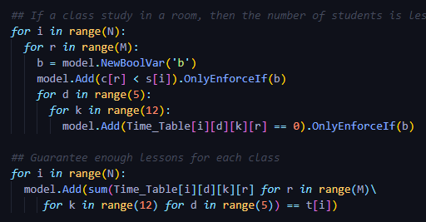
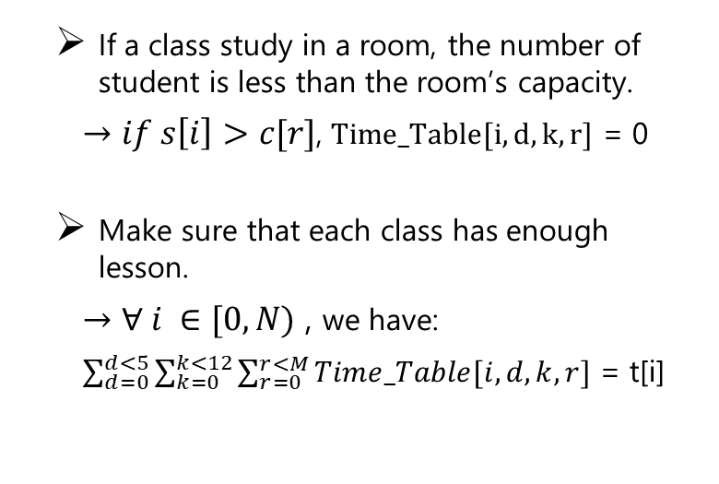
CP Constraints
If a class study in a room, the number of student is less than the room’s capacity.
$→if s\left[i\right]>c[r]$, $Time_Table[i, d, k, r]$ = 0
Make sure that each class has enough lesson.
$→$ $∀ i ∈[0, N)$ , we have:
$\sum_{d=0}^{d<5}{\sum_{k=0}^{k<12}{\sum_{r=0}^{r<M}{Time_Table[i, d, k, r]}}}$ = t[i]

Slide 11
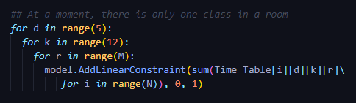
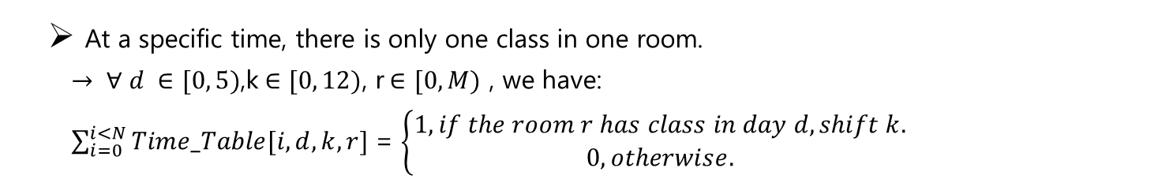
CP Constraints
At a specific time, there is only one class in one room.
$→ ∀ d ∈[0, 5)$,k$∈[0, 12)$, r$∈[0, M)$ , we have:
$\sum_{i=0}^{i<N}{Time_Table[i, d, k, r]}$ = $\left\{\begin{aligned}1, if the room r has class in day d, shift k. \\ 0, otherwise.\end{aligned}\right.$

Slide 12
3
LOCAL SEARCH

Slide 13
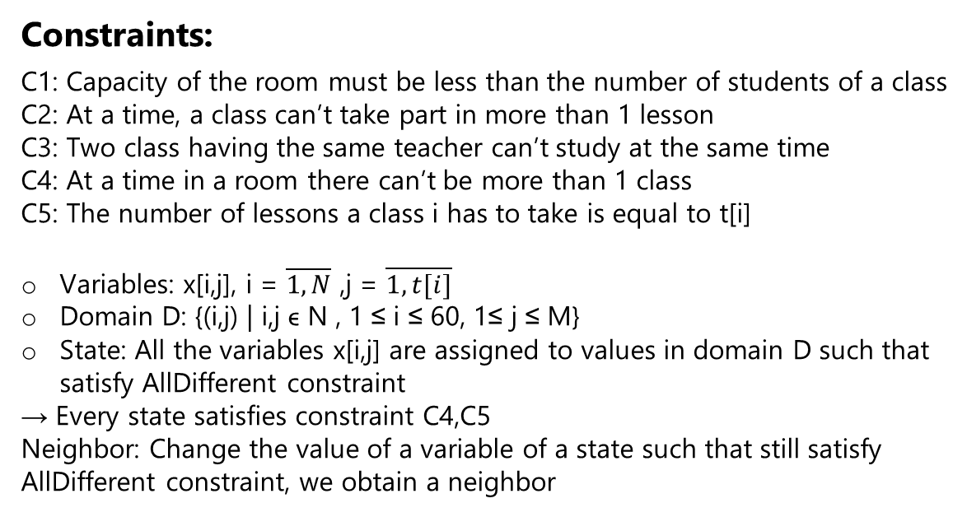
Search space
Constraints:
C1: Capacity of the room must be less than the number of students of a class
C2: At a time, a class can’t take part in more than 1 lesson
C3: Two class having the same teacher can’t study at the same time
C4: At a time in a room there can’t be more than 1 class
C5: The number of lessons a class i has to take is equal to t[i]
Variables: x[i,j], i = $\overline{1, N}$ ,j = $\overline{1, t[i]}$
Domain D: {(i,j) | i,j ϵ N , 1 ≤ i ≤ 60, 1≤ j ≤ M}
State: All the variables x[i,j] are assigned to values in domain D such that satisfy AllDifferent constraint
→ Every state satisfies constraint C4,C5
Neighbor: Change the value of a variable of a state such that still satisfy AllDifferent constraint, we obtain a neighbor

Slide 14
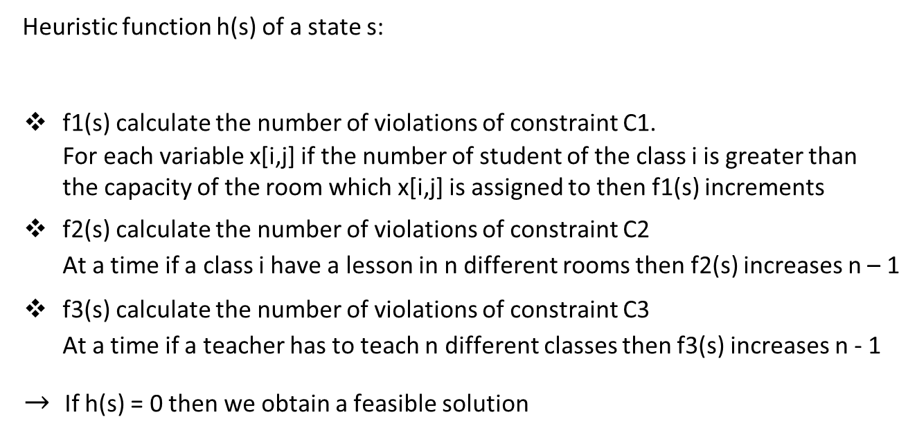
Heuristics
Heuristic function h(s) of a state s:
f1(s) calculate the number of violations of constraint C1.
For each variable x[i,j] if the number of student of the class i is greater than the capacity of the room which x[i,j] is assigned to then f1(s) increments
f2(s) calculate the number of violations of constraint C2
At a time if a class i have a lesson in n different rooms then f2(s) increases n – 1
f3(s) calculate the number of violations of constraint C3
At a time if a teacher has to teach n different classes then f3(s) increases n - 1
$→$If h(s) = 0 then we obtain a feasible solution
h(s) = f1(s) + f2(s) + f3(s)

Slide 15
Hill Climbing Idea
Consider all the neighbors of a current state then choose a neighbor that has minimum heuristic value of all the neighbors. If that neighbor has the heuristic value less than or equal to the current state → continue, otherwise, the algorithm finishes

Slide 16
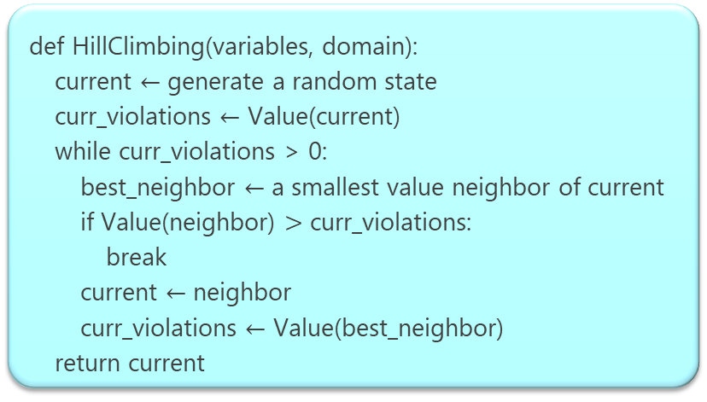
Hill Climbing Pseudocode
def HillClimbing(variables, domain):
current $←$ generate a random state
curr_violations $←$ Value(current)
while curr_violations > 0:
best_neighbor $←$ a smallest value neighbor of current
if Value(neighbor) $>$ curr_violations:
break
current $←$ neighbor
curr_violations $←$ Value(best_neighbor)
return current

Slide 17
Remark
The cardinality of the neighbor set of a given state is too large → the algorithm is slow.
→ Another approach First Choice Hill Climbing
The number of class (N) | The number of room (M) | Execution time
The number of class (N) | The number of room (M) | CP | Hill climbing
15 | 5 | 0.21 | 12.442
25 | 5 | 0.441 | 35.563
35 | 5 | 0.789 | 117.28
45 | 5 | 0.897 | Time exceed limit
The number of class (N) | The number of room (M) | Execution time
The number of class (N) | The number of room (M) | CP | Hill climbing
50 | 2 | 0.307 | 1.087
50 | 4 | 0.785 | 35.777
50 | 6 | 3.105 | 179.667
50 | 8 | 2.045 | 219.503

Slide 18
First Choice Hill Climbing Idea
For each iteration, the algorithm generates a random neighbor of the current state until getting the neighbor such that has the heuristic value less than or equal to the value of the current state

Slide 19
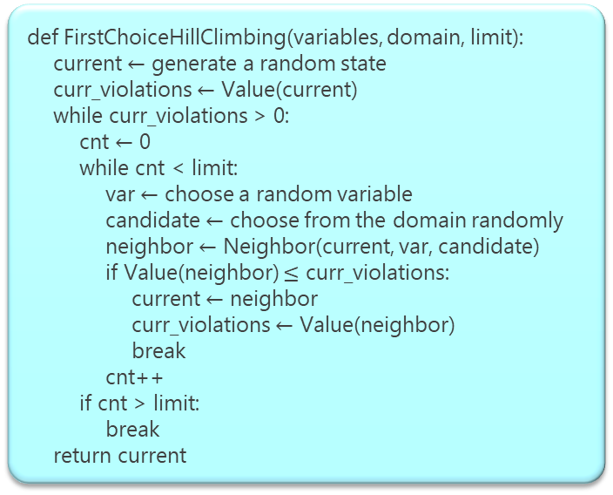
First Choice Hill Climbing Pseudocode
def FirstChoiceHillClimbing(variables, domain, limit):
current $←$ generate a random state
curr_violations $←$ Value(current)
while curr_violations > 0:
cnt $←$ 0
while cnt < limit:
var $←$ choose a random variable
candidate $←$ choose from the domain randomly
neighbor $←$ Neighbor(current, var, candidate)
if Value(neighbor) $≤$ curr_violations:
current $←$ neighbor
curr_violations $←$ Value(neighbor)
break
cnt++
if cnt > limit:
break
return current

Slide 20
Remark
Faster and more complete than the standard Hill Climbing.
Faster than CP ortools when the search space contains many feasible solution and the size of the problem is small.
Randomness is a problem.
The number of class (N) | The number of room (M) | Execution time
The number of class (N) | The number of room (M) | CP | Hill climbing | First choice hill climbing
15 | 5 | 0.21 | 12.442 | 0.11
25 | 5 | 0.441 | 35.563 | 0.083
35 | 5 | 0.789 | 117.28 | 0.688
The number of class (N) | The number of room (M) | Execution time
The number of class (N) | The number of room (M) | CP | Hill climbing | First choice hill climbing
50 | 2 | 0.307 | 1.087 | 0.036
50 | 4 | 0.785 | 35.777 | 0.629
50 | 6 | 3.105 | 179.667 | 0.991

Slide 21
GREEDY
4

Slide 22
Greedy Idea
The idea of this algorithm is quite identical to local search’s algorithm.
Sort the room set in terms of its capacity in increasing order and sort the class set in terms of its number of students in decreasing order → increase the probability to find feasible solution.
At each step, the algorithm tries to assign a class to the largest number of students to a room with the smallest number of capacity and a latest time slot.

Slide 23
Greedy Pseudocode
def greedy( ):
for current_class in classes_sort:
t := the number of shift of current_class
i := the index of current_class
for j in t:
x := Select(current_class)
if x = “FAILURE”:
return “FAILURE”
timetable[i].push(x)
def Select(current_class)
g := The teacher teaches current_class
for p in range(60):
for room in rooms_sort:
if Feasible(current_class, p, room):
return p, room
return “FAILURE”
Notation:
classes_sort: Descendingly sort class based on the number of student.
rooms_sort: Ascendingly sort room based on its capacity.

Slide 24
Remark
Faster than First Choice Hill Climbing when the problem size is big
Faster than ortools CP when the search space contains many feasible solutions

Slide 25
Compare 4 algorithms
The number of class (N) | The number of room (M) | Execution time
The number of class (N) | The number of room (M) | CP | Hill climbing | First choice hill climbing | Greedy
15 | 5 | 0.21 | 12.442 | 0.11 | 0.001
25 | 5 | 0.441 | 35.563 | 0.083 | 0.002
35 | 5 | 0.789 | 117.28 | 0.688 | 0.003
45 | 5 | 0.897 | Time exceed limit | 0.203 | 0.002
55 | 5 | 1.89 | Time exceed limit | 0.317 | 0.003
65 | 5 | 1,751 | Time exceed limit | 0.338 | 0.003
75 | 5 | 2.355 | Time exceed limit | 0.355 | 0.004
85 | 5 | 2.461 | Time exceed limit | 0.435 | 0.004
95 | 5 | 2.265 | Time exceed limit | 0.686 | 0.004
100 | 5 | 4.057 | Time exceed limit | 0.615 | 0.004

Slide 26
Compare 4 algorithms
The number of class (N) | The number of room (M) | Execution time
The number of class (N) | The number of room (M) | CP | Hill climbing | First choice hill climbing | Greedy
50 | 2 | 0.307 | 1.087 | 0.036 | 0.001
50 | 4 | 0.785 | 35.777 | 0.629 | 0.002
50 | 6 | 3.105 | 179.667 | 0.991 | 0.004
50 | 8 | 2.045 | 219.503 | 0.168 | 0.003
50 | 10 | 2.126 | Time exceed limit | 0.566 | 0.004
50 | 12 | 5.123 | Time exceed limit | 1.693 | 0.008
50 | 14 | 3.575 | Time exceed limit | 0.374 | 0.005
50 | 16 | 6.254 | Time exceed limit | 0.645 | 0.008
50 | 18 | 9.244 | Time exceed limit | 6.845 | 0.013
50 | 20 | 8.316 | Time exceed limit | 11.941 | 0.015

Slide 27
5
FURTHER PROBLEM

Slide 28
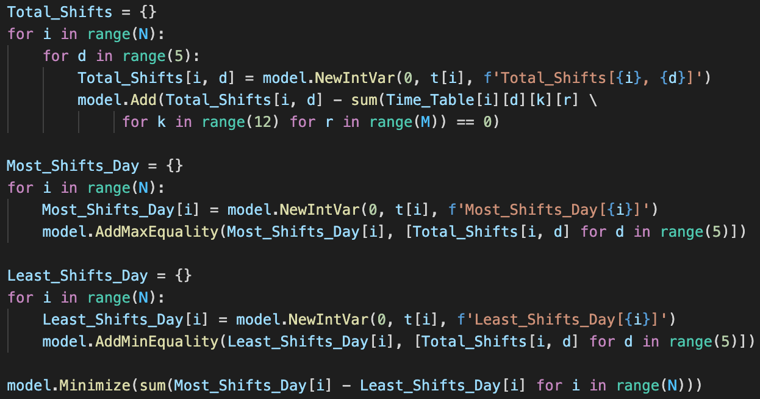
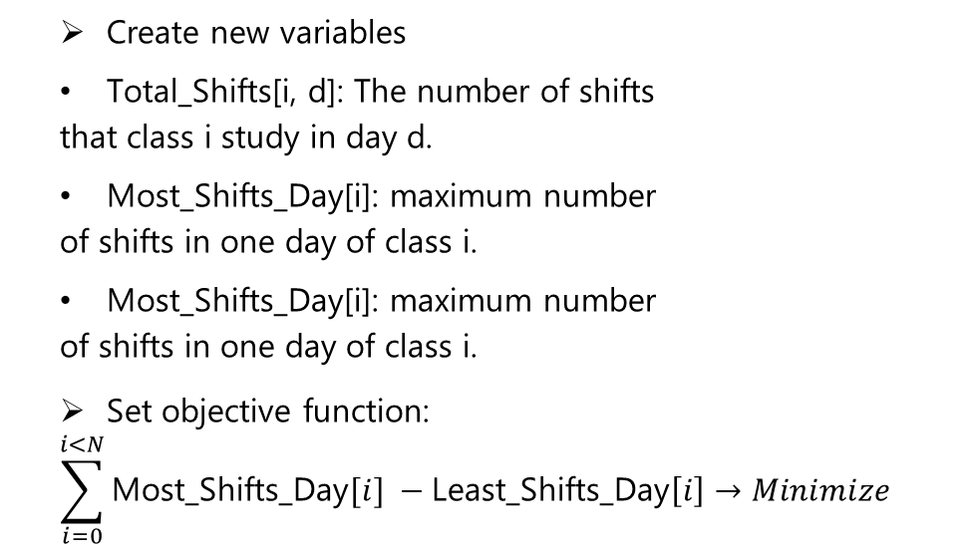
CP Objective Function
Create new variables
Total_Shifts[i, d]: The number of shifts
that class i study in day d.
Most_Shifts_Day[i]: maximum number
of shifts in one day of class i.
Most_Shifts_Day[i]: maximum number
of shifts in one day of class i.
Set objective function:
$$\sum_{i=0}^{i<N}{\text{Most}\text{_}\text{Shifts}\text{_}\text{Day}[i]} −\text{Least}\text{_}\text{Shifts}\text{_}\text{Day}\left[i\right]→Minimize$$

Slide 29
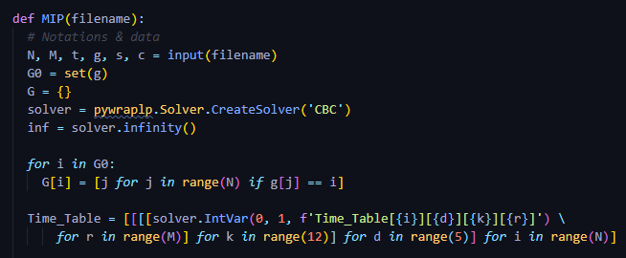

MIP Variables
G[n]: Set of class taught by teacher n.
Time_Table[i, d, k, r] = $\left\{\begin{aligned}1, if class i has lesson in shift k, day d, room r. \\ 0, otherwise.\end{aligned}\right.$

Slide 30
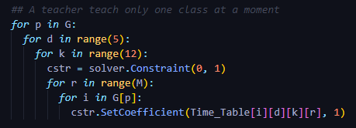
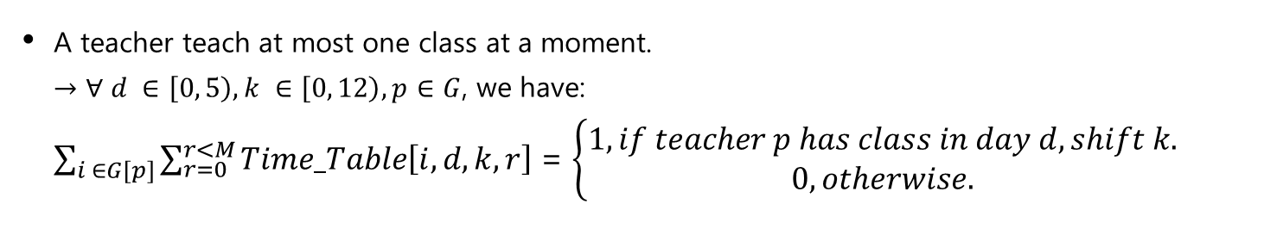
MIP Constraints
A teacher teach at most one class at a moment.
$→$ $∀ d ∈\left[0, 5\right), k ∈\left[0, 12\right), p∈G$, we have:
$\sum_{i ∈G[p]}{\sum_{r=0}^{r<M}{Time_Table\left[i, d, k, r\right]}}$ = $\left\{\begin{aligned}1, if teacher p has class in day d, shift k. \\ 0, otherwise.\end{aligned}\right.$

Slide 31
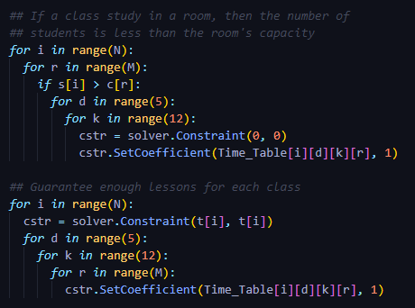
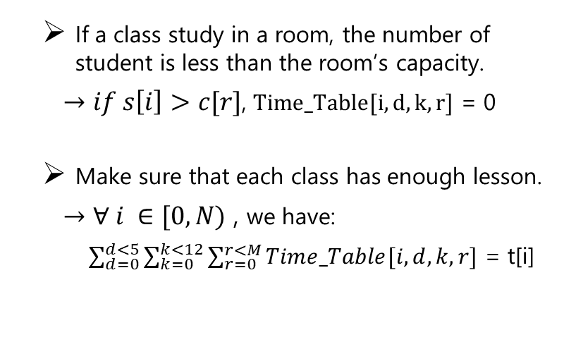
MIP Constraints
If a class study in a room, the number of student is less than the room’s capacity.
$→if s\left[i\right]>c[r]$, $Time_Table[i, d, k, r]$ = 0
Make sure that each class has enough lesson.
$→$ $∀ i ∈[0, N)$ , we have:
$\sum_{d=0}^{d<5}{\sum_{k=0}^{k<12}{\sum_{r=0}^{r<M}{Time_Table[i, d, k, r]}}}$ = t[i]

Slide 32
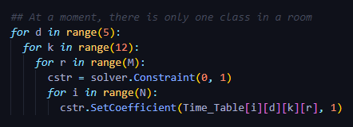
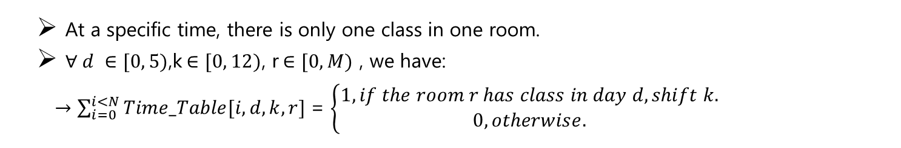
MIP Constraints
At a specific time, there is only one class in one room.
$∀ d ∈[0, 5)$,k$∈[0, 12)$, r$∈[0, M)$ , we have:
$→\sum_{i=0}^{i<N}{Time_Table[i, d, k, r]}$ = $\left\{\begin{aligned}1, if the room r has class in day d, shift k. \\ 0, otherwise.\end{aligned}\right.$

Slide 33
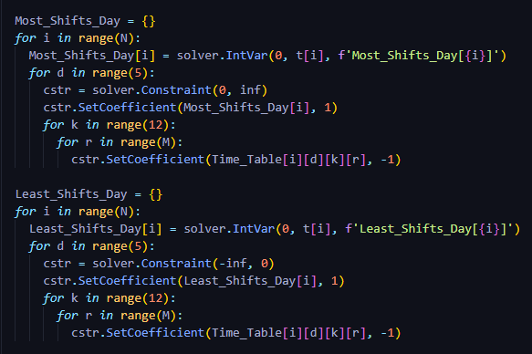
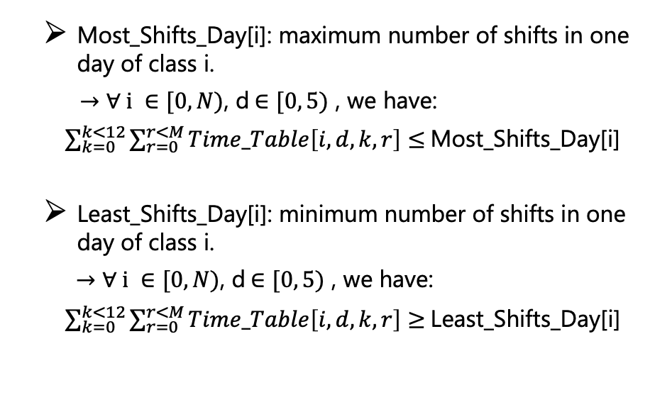
MIP Constraints
Most_Shifts_Day[i]: maximum number of shifts in one day of class i.
$→$ $∀ i ∈[0, N)$, d$∈[0, 5)$ , we have:
$\sum_{k=0}^{k<12}{\sum_{r=0}^{r<M}{Time_Table\left[i, d, k, r\right]}}$ $≤$Most_Shifts_Day[i]
Least_Shifts_Day[i]: minimum number of shifts in one day of class i.
$→$ $∀ i ∈[0, N)$, d$∈[0, 5)$ , we have:
$\sum_{k=0}^{k<12}{\sum_{r=0}^{r<M}{Time_Table\left[i, d, k, r\right]}}$ $≥$Least_Shifts_Day[i]

Slide 34
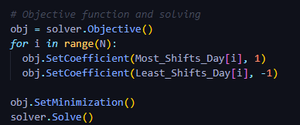
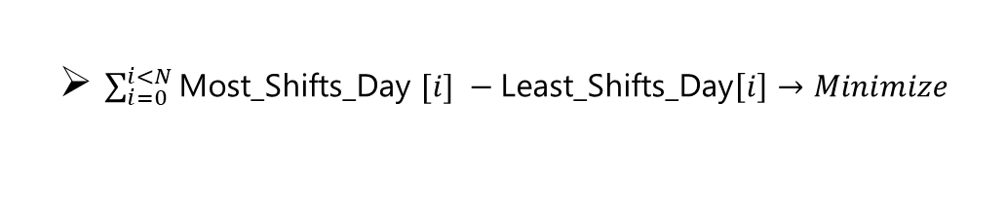
MIP Objective Function
$\sum_{i=0}^{i<N}{\text{Most}\text{_}\text{Shifts}\text{_}\text{Day} [i]} −\text{Least}\text{_}\text{Shifts}\text{_}\text{Day}\left[i\right]→Minimize$

Slide 35
CP vs MIP
The number of class (N) | The number of room (M) | Execution time |  | F*
 |  | MIP | CP | MIP | CP
20 | 10 | 1.572 | 1.678 | 17.0 | 17.0
30 | 10 | 5.972 | 4.213 | 32.0 | 32.0
40 | 10 | 3.498 | 4.737 | 40.0 | 40.0
50 | 10 | 8.821 | 24.099 | 48.0 | 48.0
60 | 10 | 8.55 | 16.585 | 52.0 | 52.0
70 | 10 | 9.578 | 40.528 | 58.0 | 58.0
80 | 10 | 11.844 | 18.596 | 85.0 | 85.0
90 | 10 | 15.894 | 63.463 | 57.0 | 57.0
100 | 10 | 13.724 | 24.663 | 100.0 | 100.0

Slide 36
CP vs MIP
The number of class (N) | The number of room (M) | Execution time |  | F*
 |  | MIP | CP | MIP | CP
50 | 4 | 4.804 | 1.584 | 40.0 | 40.0
50 | 6 | 3.29 | 2.747 | 21.0 | 21.0
50 | 8 | 4.445 | 4.942 | 50.0 | 50.0
50 | 10 | 4.17 | 5.518 | 50.0 | 50.0
50 | 12 | 10.148 | 29.809 | 36.0 | 36.0
50 | 14 | 6.89 | 10.355 | 50.0 | 50.0
50 | 16 | 8.997 | 23.651 | 34.0 | 34.0
50 | 18 | 6.608 | 7.325 | 50.0 | 50.0
50 | 20 | 9.519 | 14.436 | 50.0 | 50.0

