Slide 1
Arranging Schedule
Distributed by Group 4

Slide 2
Members of the group
Nguyễn Văn Huy
Trần Tuấn Phong
Nguyễn Ngọc Khánh
Bùi Hồng Nhật

Slide 3
Table of contents
1
4
2
5
3
6
About this problem
Greedy
What do we need to solve ?
Another way to solve easy problem
CP solution
MIP solution
A method using ortools.
Another method using ortools
Local search
More Information
Faster way to solve easy problem
A closer look to each algorithm

Slide 4
1
About this problem

Slide 5
Arranging timetable
There are N classes 1, 2, …, N arranging student schedule. t(i), g(i), s(i) is the number of shift, teacher, the number of student, respectively.
There are M rooms 1, 2, …, M, while c(i) is the number of seat in the room i.
There are 5 school-day in one week (from Monday to Friday), each day consist of 12 shifts (6 morning shifts and 6 afternoon shifts).
Let’s create a student schedule (determine weekday, shift and the room for each class) such that:
Two class having the same teacher need setting in different time.
The number of student in each class is less than room’s capacity.
Input:
The first line: N and M.
The next N line, each line write: t(i), g(i) and s(i).
The next line: c(1), c(2), …, c(n).
Output:
Timetable

Slide 6
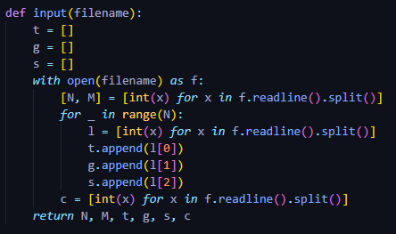
Variables for all algorithm
N: The number of class.
M: The number of room.
t[i]: The number of shift in class i.
g[i]: The teacher teaching class i.
s[i]: The number of student in class i.
c[r]: The capacity of room r.

Slide 7
CP SOLUTION
2

Slide 8
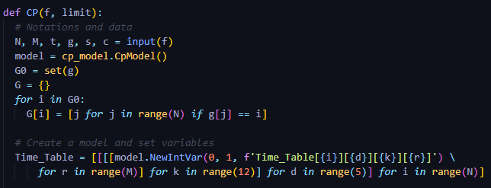
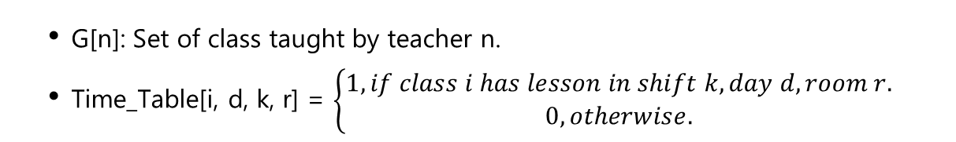
CP Variables
G[n]: Set of class taught by teacher n.
Time_Table[i, d, k, r] = $\left\{\begin{aligned}1, if class i has lesson in shift k, day d, room r. \\ 0, otherwise.\end{aligned}\right.$

Slide 9
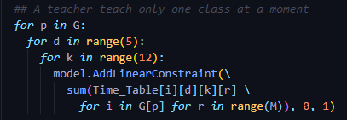
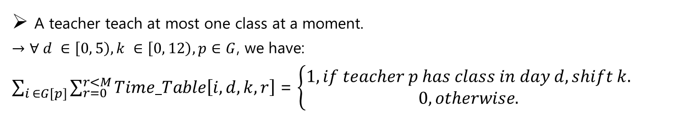
CP Constraints
A teacher teach at most one class at a moment.
$→$ $∀ d ∈\left[0, 5\right), k ∈\left[0, 12\right), p∈G$, we have:
$\sum_{i ∈G[p]}{\sum_{r=0}^{r<M}{Time_Table\left[i, d, k, r\right]}}$ = $\left\{\begin{aligned}1, if teacher p has class in day d, shift k. \\ 0, otherwise.\end{aligned}\right.$

Slide 10
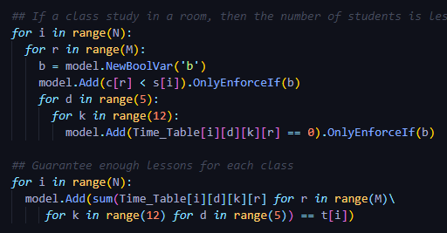
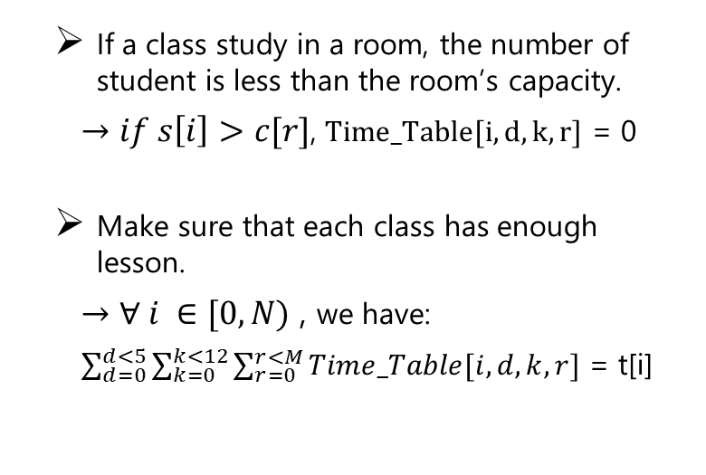
CP Constraints
If a class study in a room, the number of student is less than the room’s capacity.
$→if s\left[i\right]>c[r]$, $Time_Table[i, d, k, r]$ = 0
Make sure that each class has enough lesson.
$→$ $∀ i ∈[0, N)$ , we have:
$\sum_{d=0}^{d<5}{\sum_{k=0}^{k<12}{\sum_{r=0}^{r<M}{Time_Table[i, d, k, r]}}}$ = t[i]

Slide 11
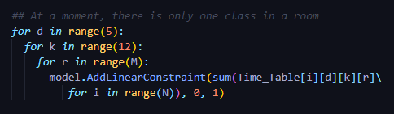
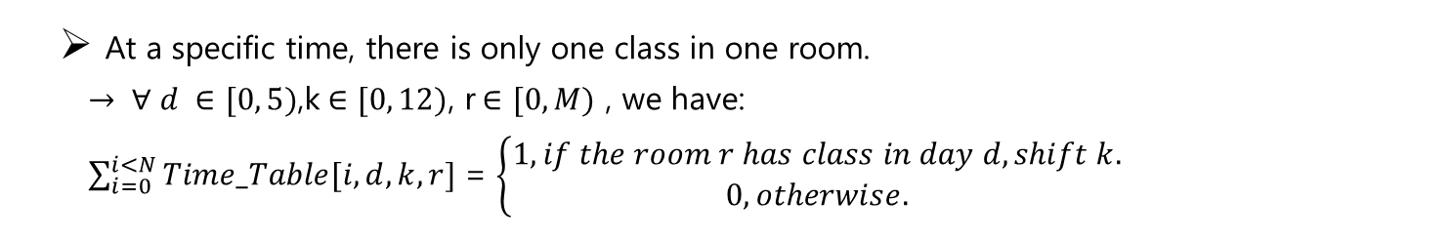
CP Constraints
At a specific time, there is only one class in one room.
$→ ∀ d ∈[0, 5)$,k$∈[0, 12)$, r$∈[0, M)$ , we have:
$\sum_{i=0}^{i<N}{Time_Table[i, d, k, r]}$ = $\left\{\begin{aligned}1, if the room r has class in day d, shift k. \\ 0, otherwise.\end{aligned}\right.$

Slide 12
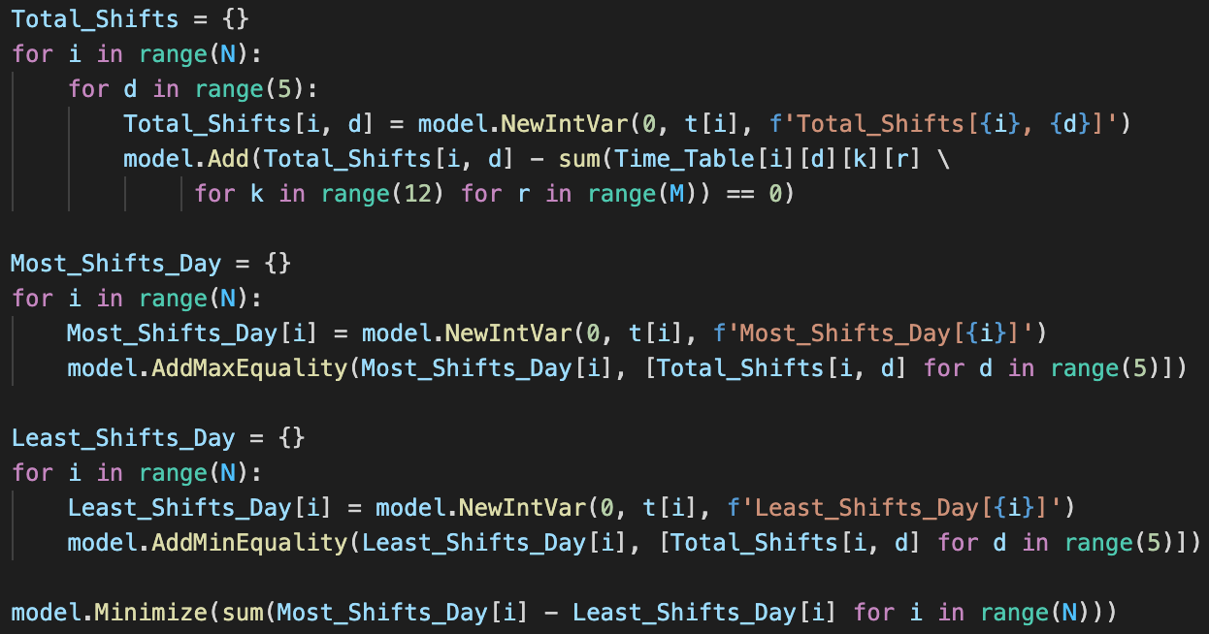
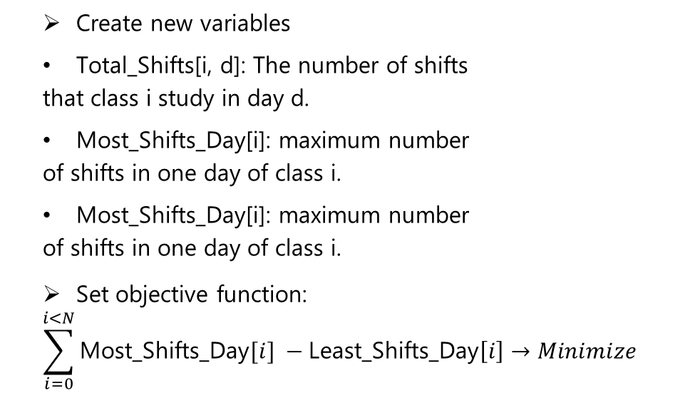
CP Objective Function
Create new variables
Total_Shifts[i, d]: The number of shifts
that class i study in day d.
Most_Shifts_Day[i]: maximum number
of shifts in one day of class i.
Most_Shifts_Day[i]: maximum number
of shifts in one day of class i.
Set objective function:
$$\sum_{i=0}^{i<N}{\text{Most}\text{_}\text{Shifts}\text{_}\text{Day}[i]} −\text{Least}\text{_}\text{Shifts}\text{_}\text{Day}\left[i\right]→Minimize$$

Slide 13
3
LOCAL SEARCH

Slide 14
First Choice Hill Climbing pseudocode
Def FirstChoiceHillClimbing(variables, domain, limit):
current = generate a random state
curr_violations = Value(current)
while curr_violations > 0:
cnt = 0
while cnt < limit:

Slide 15
GREEDY
4

Slide 16
Greedy Idea
To arrange the timetable for every class, we have to arrange 1st shift, 2nd shift, 3rd shift, … for each class such that our arrangement satisfies the constraint: One teacher teaches at most one class at a specific time, the number of student needs to be less than the room’s capacity and one room has at most one class.

Slide 17
Greedy Pseudocode
def greedy():
timetable = [ ]
for i in range(N):
timetable.push([ ])
for j in t[i]:
x := ChooseTimeAndRoom(timetable)
if x = None:
return “FAILURE”
timetable[i].push(x)
return timetable
def ChooseTimeAndRoom(timetable)
for i in range(60):
for j in M:
if Feasible:
return i, j
return None
Notation:
N: The number of class
M: The number of room
Feasible: Check the constraint. If satisfy all, return True, else False.

Slide 18
5
MIP SOLUTION

Slide 19
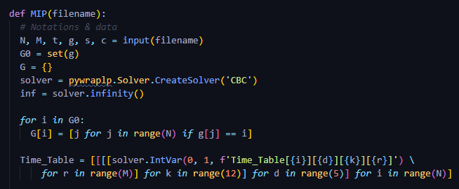

MIP Variables
G[n]: Set of class taught by teacher n.
Time_Table[i, d, k, r] = $\left\{\begin{aligned}1, if class i has lesson in shift k, day d, room r. \\ 0, otherwise.\end{aligned}\right.$

Slide 20
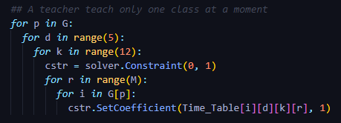
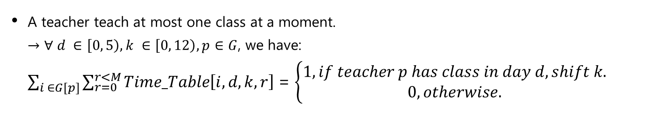
MIP Constraints
A teacher teach at most one class at a moment.
$→$ $∀ d ∈\left[0, 5\right), k ∈\left[0, 12\right), p∈G$, we have:
$\sum_{i ∈G[p]}{\sum_{r=0}^{r<M}{Time_Table\left[i, d, k, r\right]}}$ = $\left\{\begin{aligned}1, if teacher p has class in day d, shift k. \\ 0, otherwise.\end{aligned}\right.$

Slide 21
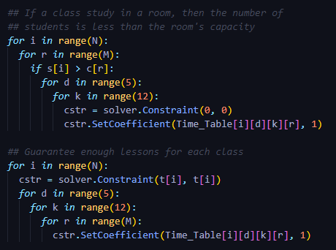
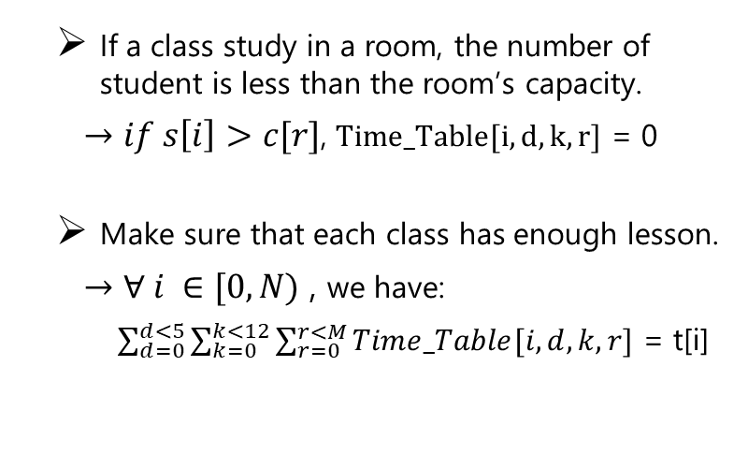
MIP Constraints
If a class study in a room, the number of student is less than the room’s capacity.
$→if s\left[i\right]>c[r]$, $Time_Table[i, d, k, r]$ = 0
Make sure that each class has enough lesson.
$→$ $∀ i ∈[0, N)$ , we have:
$\sum_{d=0}^{d<5}{\sum_{k=0}^{k<12}{\sum_{r=0}^{r<M}{Time_Table[i, d, k, r]}}}$ = t[i]

Slide 22
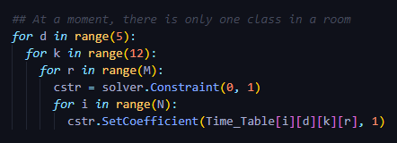
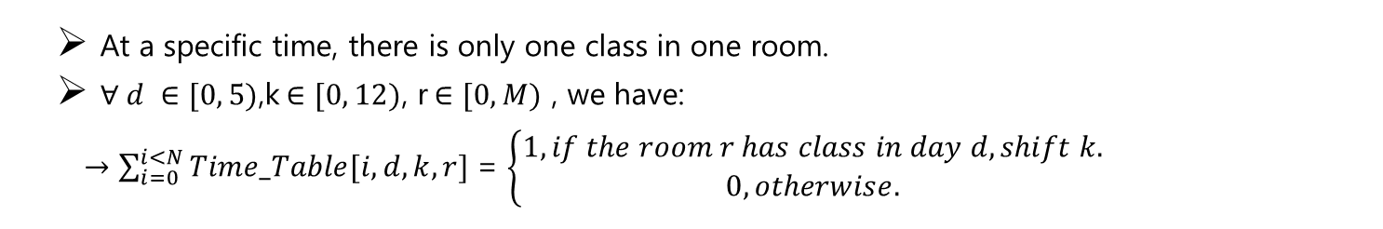
MIP Constraints
At a specific time, there is only one class in one room.
$∀ d ∈[0, 5)$,k$∈[0, 12)$, r$∈[0, M)$ , we have:
$→\sum_{i=0}^{i<N}{Time_Table[i, d, k, r]}$ = $\left\{\begin{aligned}1, if the room r has class in day d, shift k. \\ 0, otherwise.\end{aligned}\right.$

Slide 23
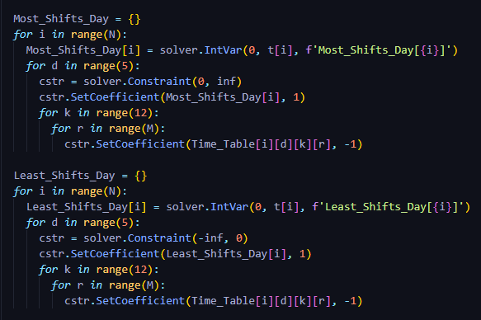
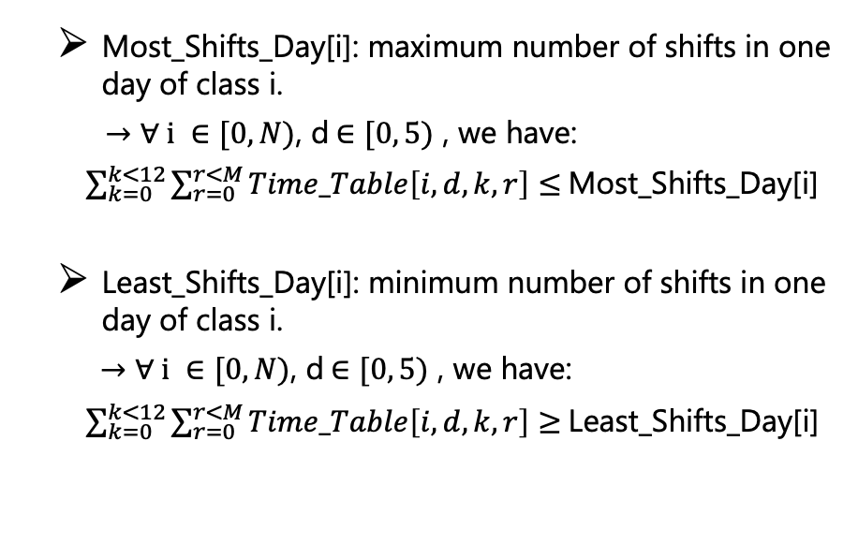
MIP Constraints
Most_Shifts_Day[i]: maximum number of shifts in one day of class i.
$→$ $∀ i ∈[0, N)$, d$∈[0, 5)$ , we have:
$\sum_{k=0}^{k<12}{\sum_{r=0}^{r<M}{Time_Table\left[i, d, k, r\right]}}$ $≤$Most_Shifts_Day[i]
Least_Shifts_Day[i]: minimum number of shifts in one day of class i.
$→$ $∀ i ∈[0, N)$, d$∈[0, 5)$ , we have:
$\sum_{k=0}^{k<12}{\sum_{r=0}^{r<M}{Time_Table\left[i, d, k, r\right]}}$ $≥$Least_Shifts_Day[i]

Slide 24
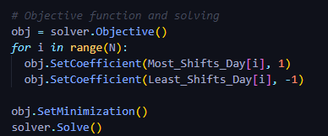
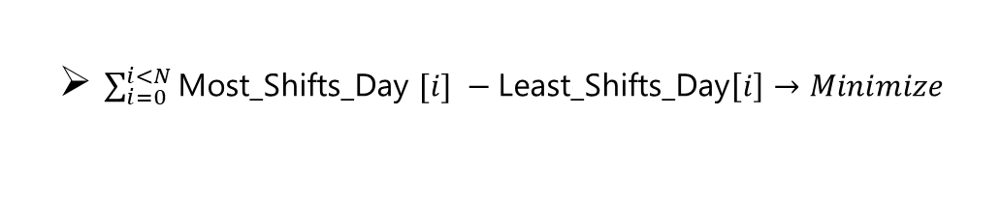
MIP Objective Function
$\sum_{i=0}^{i<N}{\text{Most}\text{_}\text{Shifts}\text{_}\text{Day} [i]} −\text{Least}\text{_}\text{Shifts}\text{_}\text{Day}\left[i\right]→Minimize$

