Slide 1

KICK OFF MEETING
Get off to a good start !
CLIENT: Prudential Assurance Vietnam (PVA)
DATE : Monday, 03rd April 2023
PARTICIPANTS:
DKSH:
Mr. Nguyen Duc Thanh – Software Engineering Manager
Amaris:
Mr. Nguyen Van Quang – Software Engineer Consultant
Mr. Huynh Tam Hao – Team Manager
CLIENT: Prudential Assurance Vietnam (PVA)
DATE : Monday, 03rd April 2023
PARTICIPANTS:
DKSH:
Mr. Nguyen Duc Thanh – Software Engineering Manager
Amaris:
Mr. Nguyen Van Quang – Software Engineer Consultant
Mr. Huynh Tam Hao – Team Manager

Slide 2
Project context
Main tasks / targets:
Role:
devops
Apply the knowledge of OOP, Java, Spring boot, Spring JPA, Spring schedule, Microservices, Postgres, Oracle, MongoDB, etc. to develop products’ features.
Be familiar with tools: Intellji, Kafka, Flowable...
Understand the business flows/ system concepts. , Spring schedule, Microservices, Postgres, Oracle, MongoDB, etc. to de , Spring schedule, Microservices, Postgres, Oracle, MongoDB, etc. to de
Be well-engaged with team / stakeholders.
Attitude: honest, transparent, proactive.
novapo | Date
Project Kick-off | 03.04.2023
1st week Catchup | 10.04.2023
1st moth Catchup | 08.05.2023
1st Performance Follow-up | 30.05.2023
Quarterly Performance Follow-up | Every 3 months starting from 30.05.2023
Timeline: Follow timeline of release
Expectation:
Qualified output corresponding with the assigned tasks.
Good team engagement, integration and collaboration.
Escalation points:
Mr. Nguyen Duc Thanh – Software Engineering Manager
Mr. Nguyen Tran Huy Tan – Technology Delivery Manager
Mr. Le Ba Trong Khang – Software and Data Engineering Manager

Slide 3
Project context
Main tasks / targets:
Role: Software Engineer
Apply the knowledge of OOP, Java, Spring boot, Spring JPA, Spring schedule, Microservices, Postgres, Oracle, MongoDB, etc. to develop products’ features.
Be familiar with tools: Intellji, Kafka, Flowable...
Understand the business flows/ system concepts.
Practice with various partners in team to get familiar with the delivery process.
Perform the assigned tasks well.
Be well-engaged with team / stakeholders.
Attitude: honest, transparent, proactive.
Timeline: Follow timeline of release
Expectation:
Qualified output corresponding with the assigned tasks.
Good team engagement, integration and collaboration.
Escalation points:
Mr. Nguyen Duc Thanh – Software Engineering Manager
Mr. Nguyen Tran Huy Tan – Technology Delivery Manager
Mr. Le Ba Trong Khang – Software and Data Engineering Manager
Follow-up Schedule | Date
Project Kick-off | 03.04.2023
1st week Catchup | 10.04.2023
1st moth Catchup | 08.05.2023
1st Performance Follow-up | 30.05.2023
Quarterly Performance Follow-up | Every 3 months starting from 30.05.2023

Slide 4
PROJECT FOLLOW UP / REVIEW
Template & Rules
Catch Up meeting to keep track on project
Amaris's role to be force of proposal, ideas
Ensure consultant involvement & interest
Support improvement to the project
MAAP – Yearly Appraisal
Reviews are used to measure performance
Each review is a milestone of THE MAAP
Linked to career, training, salary increase
Service fees revised annually
Process & Frequency
30 minutes meeting every 1 to 3 months
Survey sent by email to be fulfilled by Client
Plan next review at the end of current one

Slide 5
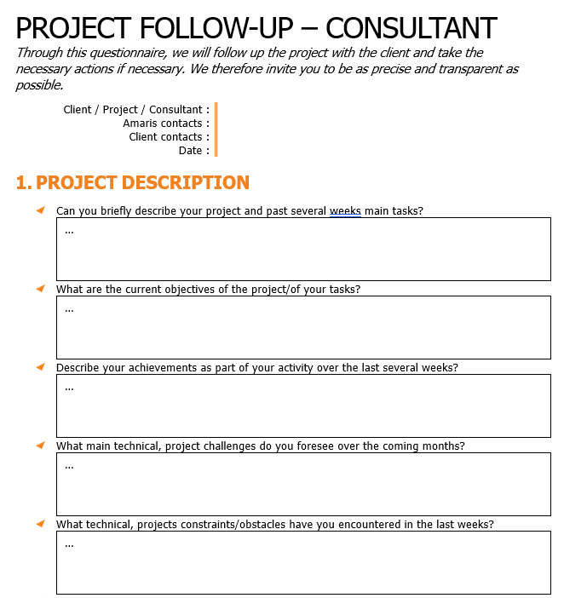
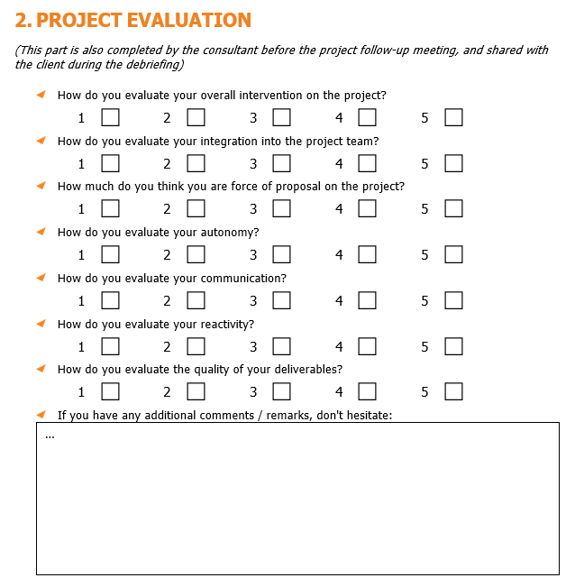
PROJECT FOLLOW UP / REVIEW

Slide 6



HOLIDAYS – TIMESHEET – MPR – OT
HOLIDAYS
TIMESHEET
MPR
OT
1
2
3
4
1. CLIENT MANAGER validation required
2. AMARIS MANAGER validation required
Holidays < 3 days - > submit your request on the application 1 week before
Holidays ≥3 days - > submit your request 3 weeks before
Submit before the 20th OF THE MONTH AT NOON
Update if needed BY THE LAST DAY OF THE MONTH AT NOON
Timesheet of previous month is not modifiable BEFORE THE 5TH OF THE MONTH
To be signed by your MANAGER and YOUR CLIENT
Uploaded on TIMESHEET before THE LAST DAY OF EACH MONTH
The OVERTIME should be requested by CLIENT
If requested by CONSULTANT, should be approved by client
In both cases, the PROCESS will be the same :
CONSULTANT email To CLIENT and Cc. AMARIS for request

Slide 7

EQUIPMENT & LOGISTICS
IT equipment – laptop provided by Prudential
Access card – provided by Prudential
Working hours: 9:00 am – 6:00 pm
Uniform/ security equipment – freestyle

Slide 8
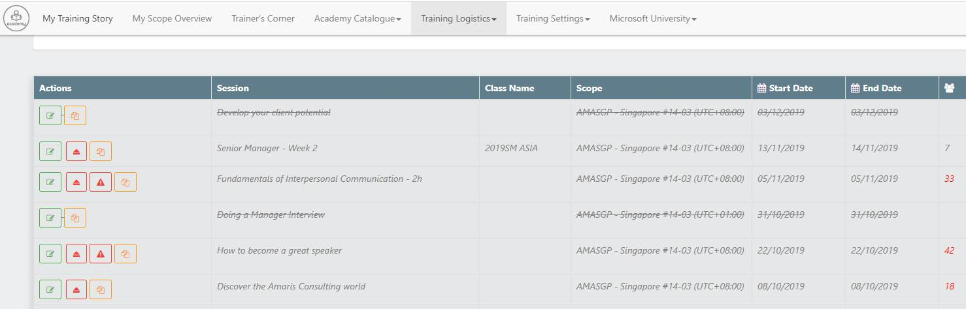


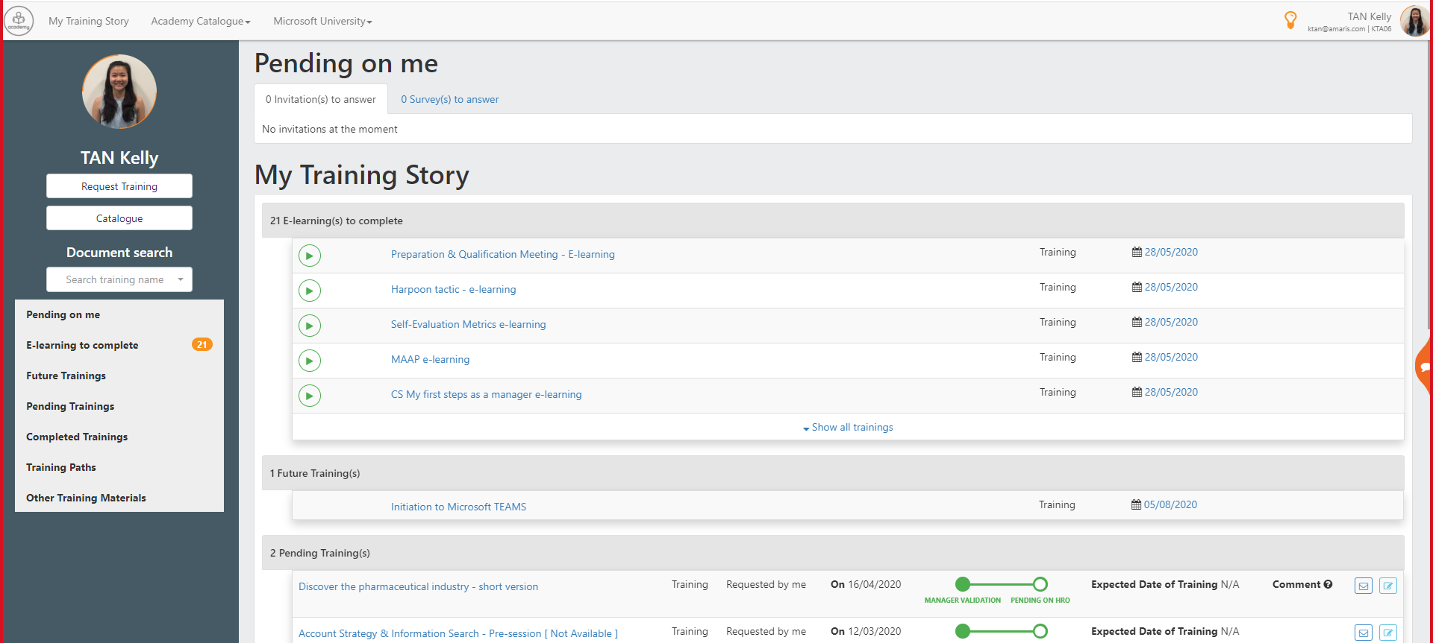


SKILLS DEVELOPMENT
MANTU ACADEMY offers a large range of trainings that can be requested by the consultant or his manager on our internal application.
For trainings during office hours an upfront request will be sent to the Client
Onboarding
Soft Skill
Technical Skills
Project management
Engineering
Telecommunication
Team Leader
Productivity tools
Etc..
E-learning
Webinar
Face-to-face

Slide 9


