Slide 1
Project
Sentiment Classification

Slide 2
Table of Contents
01
02
03
04
Introduction
Data Preprocessing
Model
Evaluation

Slide 3
01
Introdution

Slide 4
Introduction
Sentiment classification is the automated process of identifying opinions in text and labeling them as positive, or negative, based on the emotions customers express within them. Using NLP to interpret subjective data, sentiment classification can help you understand how customers feel about your products, services, or brand.

Slide 5
02
Data Preprocessing

Slide 6
Data
Text file
Train
Test
Comment & Evaluate
16086 samples
Comment & Evaluate
1000 samples

Slide 7
Normalization
Convert to lowercase
Remove accents
Standardize sentiment words
Remove stretched characters
Remove punctuations and noise
Normalize emojis
A
B
C

Slide 8
Example
Before
After
- Chất lượng sản phẩm ok.💕
- Ghế chắc chắn
- Ưng ý ❤ sẽ ủng hộ nhiều đơn hàng nữa. Đóng gói sản phẩm rất đẹp và chắc chắn
- chat luong san pham ok positive
- ghe chac chan
- ung y positive se ung ho nhieu don hang nua. dong goi san pham rat dep va chac chan

Slide 9
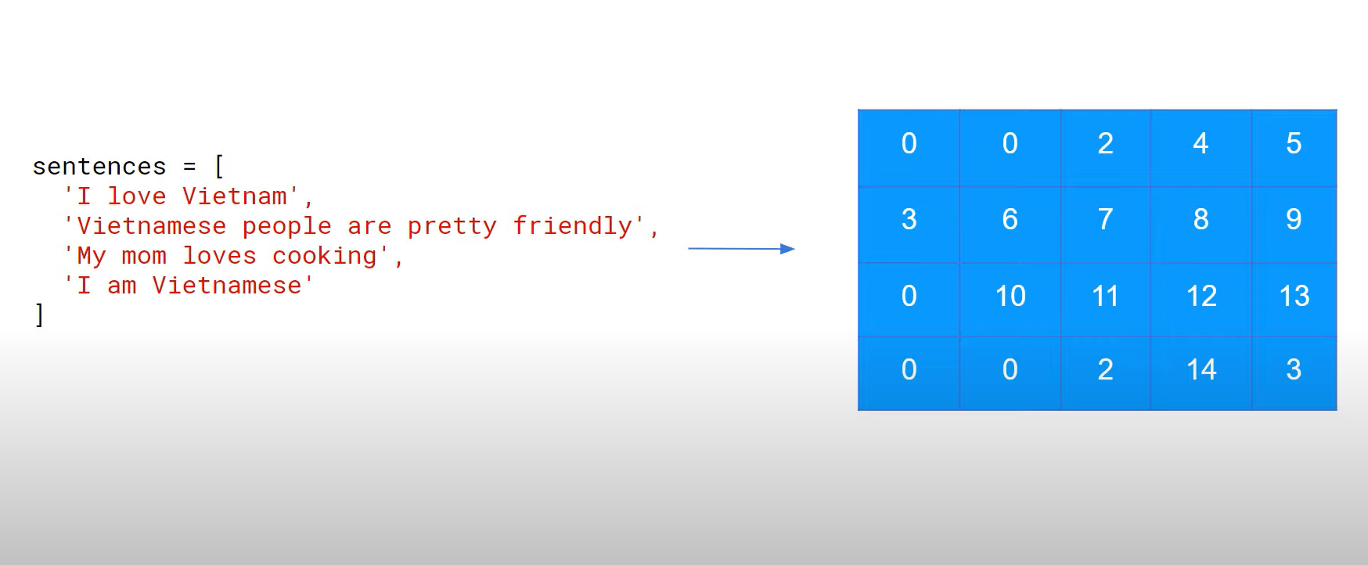
Tokenization

Slide 10
Example
Before
After
[8, 9, 4, 5, 78, 20, 0, 0, 0, 0]
[417, 27, 21, 0, 0, 0, 0, 0, 0, 0]
[15, 16, 4, 5, 3, 10, 13, 27, 21, 19]
- Chất lượng sản phẩm ok.💕
- Ghế chắc chắn
- Ưng ý ❤ sẽ ủng hộ nhiều đơn hàng nữa

Slide 11
03
Model

Slide 12
Input
Output
(1, 100)
(1, 100, 32)
(1, 32)
(1, 10)
Global Average Pooling 1D
Dense
Layer-10
+ Relu
Dense
Layer-1
+ Sigmoid
Embedding

Slide 13
Embedding
(1 x 100 )
One hot
X
(1 x 100 x vocab_size)
(1 x 100 x 32)
(1 x vocab_size x 32)

Slide 14
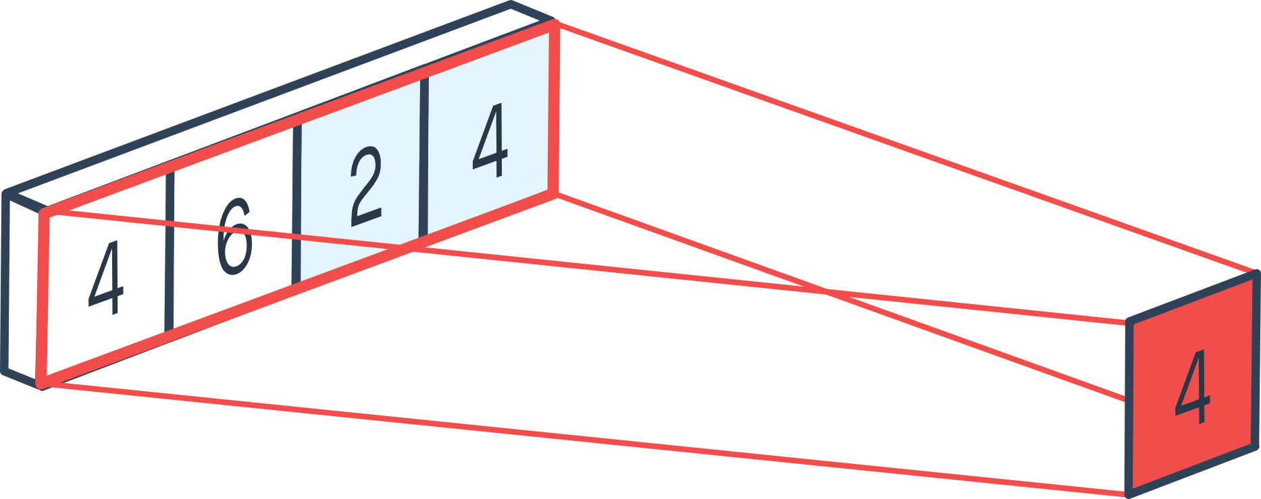
Global Average Pooling 1D

Slide 15
Global Average Pooling 1D
(1 x 32)
(1 x 100 x 32)

Slide 16



Dense Layers
…
…
$$Layer∈R^{32}$$
$$Layer∈R^{10}$$
Output $∈R^{1}$

Slide 17
04
Evaluation

Slide 18
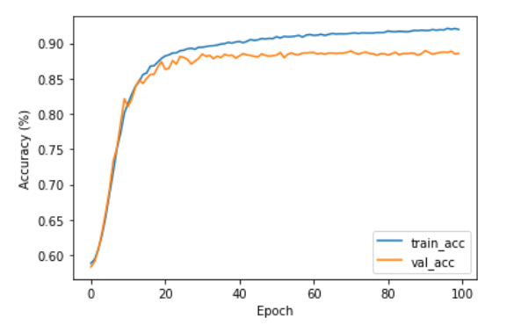
Accuracy
Train
92.01 %
Validation
88.54 %

Slide 19
Thank You
Do you have any questions? youremail@freepik.com +91 620 421 838 Google.com.vn
Please keep this slide for attribution

Slide 20


