Slide 1
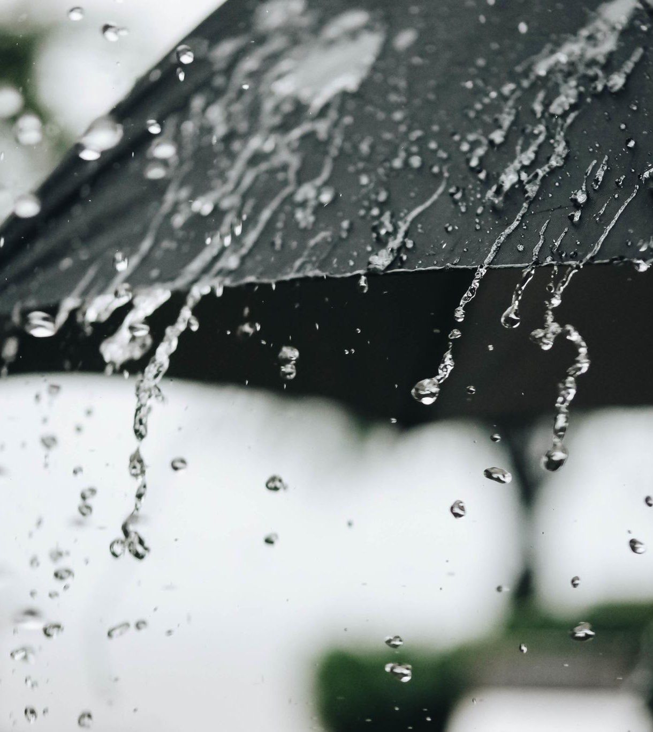
The Benefits of a cold shower

Slide 2
Benefits
Increase endorphins (Glückshormone)
Improves circulation
Fight off common illnesses

Slide 3

How to start
Cold for a short time
Start warm

Slide 4
Personal Experience
2023

