Slide 1





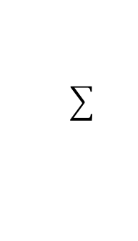



1
$$w_{0}$$
$$x_{1}$$
$$w_{1}$$
$$w_{2}$$
$$y$$
$$x_{2}$$
$$w_{D}$$
$$x_{D}$$
Inputs
Weights
Sum
Non-Linearity
Output

