Slide 1

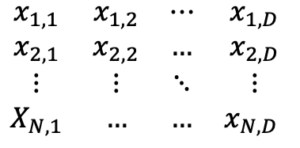


N Samples
D Dimensions/Features each
K number of classes
Source of confusion: Vectors are considered as column vectors by convention, therefore scalar products
and matrix products have the objects in different order sometimes. For example:
$$z=w^{T}∙x$$
but
$$Z=X∙W$$
feature 1
feature D
Target T
Also sometimes as an indicator matrix [0,1]
T: NxK
$$\begin{matrix}x_{1,1} & x_{1,2} & ⋯ & x_{1,D} \\ x_{2,1} & x_{2,2} & … & x_{2,D} \\ ⋮ & ⋮ & ⋱ & ⋮ \\ X_{N,1} & … & … & x_{N,D} \end{matrix}$$
sample 1
$$\begin{matrix}t_{1} \\ t_{2} \\ ⋮ \\ t_{N}\end{matrix}$$
sample N

Slide 2




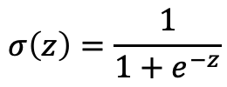



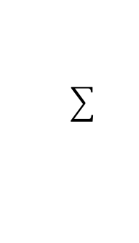



Forward Pass
Inputs
Weights
Sum
Non-Linearity
Output
Bias term $b$
1
$$w_{0}$$
$$x_{1}$$
$$w_{1}$$
$$w_{2}$$
$$y$$
$$x_{2}$$
$$w_{D}$$
$$x_{D}$$
$$z=w^{T}∙x+w_{0}$$
$$σ\left(z\right)=\frac{1}{1+e^{−z}}$$

Slide 3




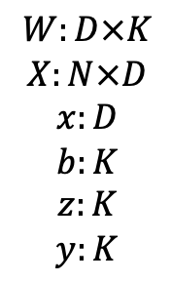

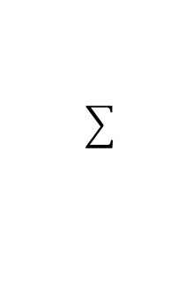





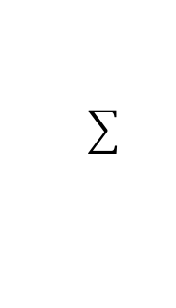
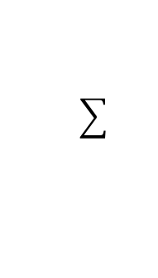




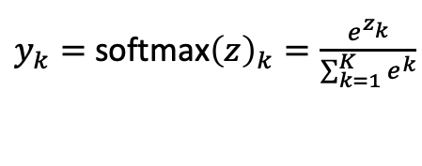


Dimensions
Forward Pass on sample $x_{n}$ (1 row of $X$)
$$W:D×K$$
$$X:N×D$$
$$x:D$$
$$b:K$$
$$z:K$$
$$y:K$$
Inputs
Weights
Sum
Non-Linearity
Output
$$b_{1}$$
argmax
$$x_{1}$$
$$w_{1,1}$$
$$w_{1,2}$$
$$y_{k=1}$$
$$b_{2}$$
$$x_{2}$$
$$w_{1,K}$$
softmax
$$y_{k=2}$$
$$w_{D,1}$$
$$o$$
…
$$b_{K}$$
…
$$x_{D}$$
$$y_{k=K}$$
$$z=W^{T}∙x+b$$
$y_{k}=$softmax${\left(z\right)}_{k}=\frac{e^{z_{k}}}{\sum_{k=1}^{K}{e^{k}}}$

