Slide 1

HH MANAGER
Developed by InazumaThree

Slide 2
The Product
power manager
Personal schedule
Recipe ideas

Slide 3

Power Manager
Save Power
Visualize Devices
Manage Status

Slide 4
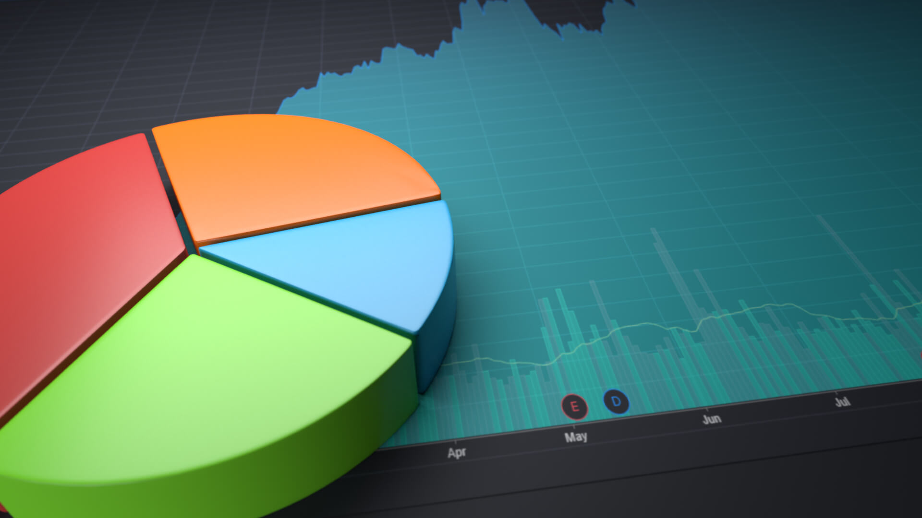
Personal Schedule
Organize your time
Keep track of your activities
Interactive Usage

Slide 5

Recipe Ideas
Get Recipe Ideas
Stop Food Waste

Slide 6

How To Help Our Society
Minimize Energy Consumption
Organize Your Time Better
Stop Wasting Food

Slide 7
Competition
Two apps, one for IOS and one for Android, only expiration dates trackers
No app that does both tracking and recipe suggestions
Only one application that does Energy Management
Our application keeps track of the date and time of the last usage

Slide 8

Many features incorporated in ONE

Slide 9

Great addition to any Electronics Company
Software incorporated in the environment of products from the same company
Create a Household ecosystem for clients

Slide 10

Future Developments
AI technology
Notifications
Communication Between Devices
Statistics Inside the App
Incorporate Restaurants/Donation Centers

Slide 11

Plans for The Future
Launch the Software in Collaboration with an investor
Long Term Profit
Short Term High Exposure
Simplify People’s Homes

Slide 12

THANK YOU FOR YOUR ATTENTION

