Slide 1


Cloud Native Applications
Spring Cloud Connectors
Notes:
Resting slide on screen before you begin presenting.

Slide 2
Spring Cloud, Goals
Abstraction over cloud services and application environment
Implementation for multiple cloud platforms
Cloud Foundry
Local testing, simulates a cloud-like environment
Extensibility with modification to core
Cloud Connector
Service Creator
Notes:
Service Discovery is one of the key tenets of a microservice based architecture.
In distributed systems, application dependencies cease to be a method call away.
Trying to hand configure each client or use some form of convention can be very difficult to do and can be very brittle.

Slide 3
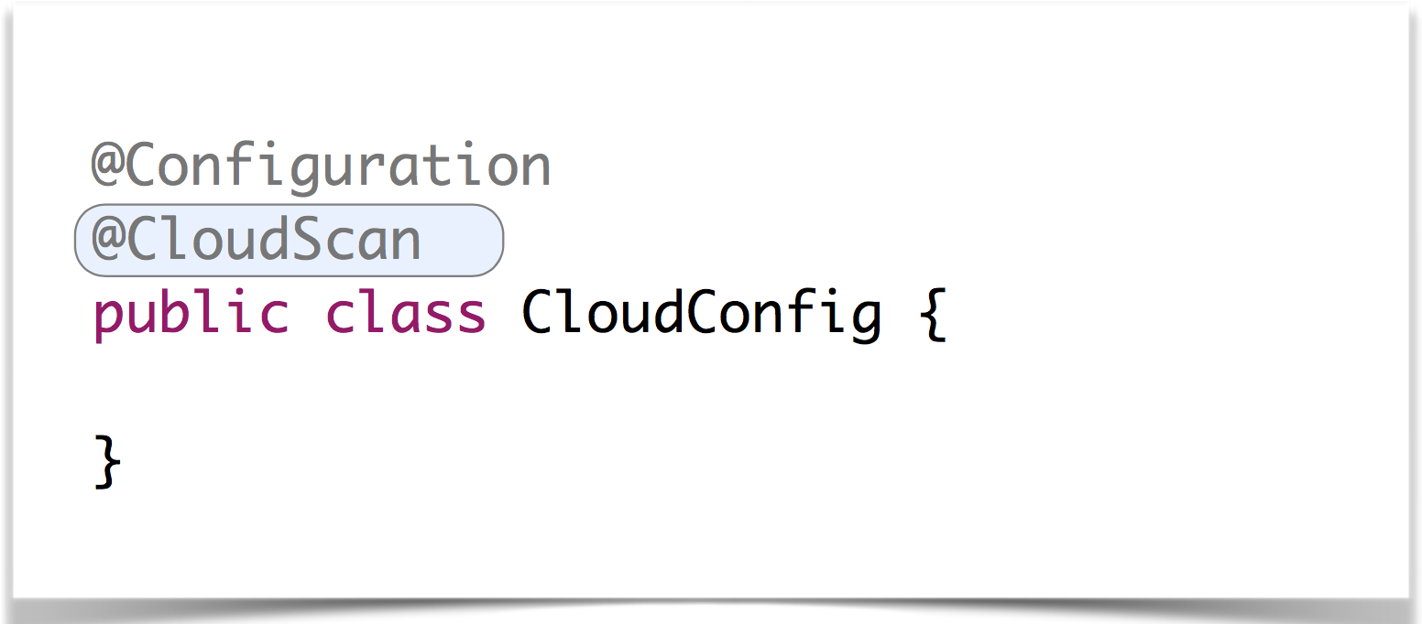
Scanning for Services
@Profile ({"mysql-cloud", "postgres-cloud”})

Slide 4
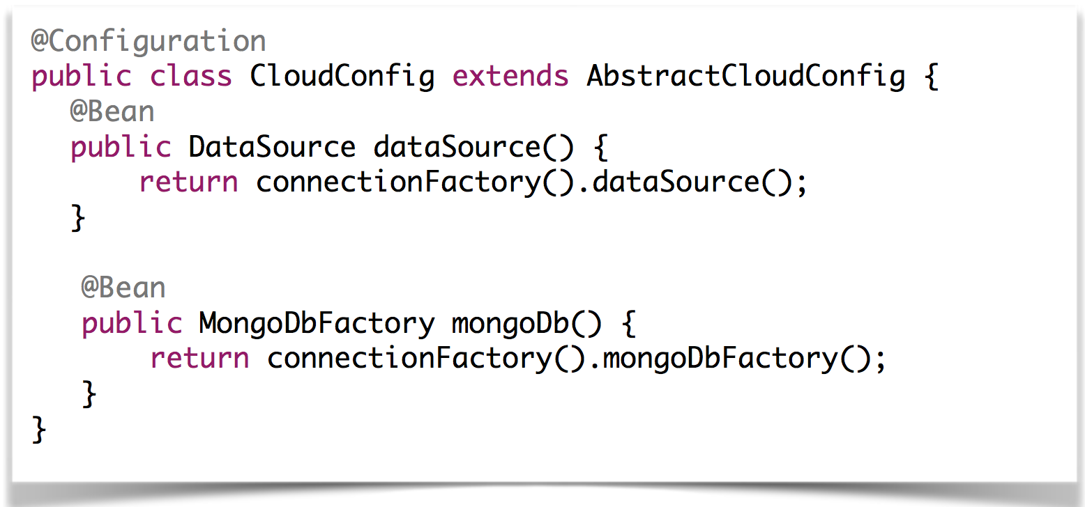
Taking Control

Slide 5
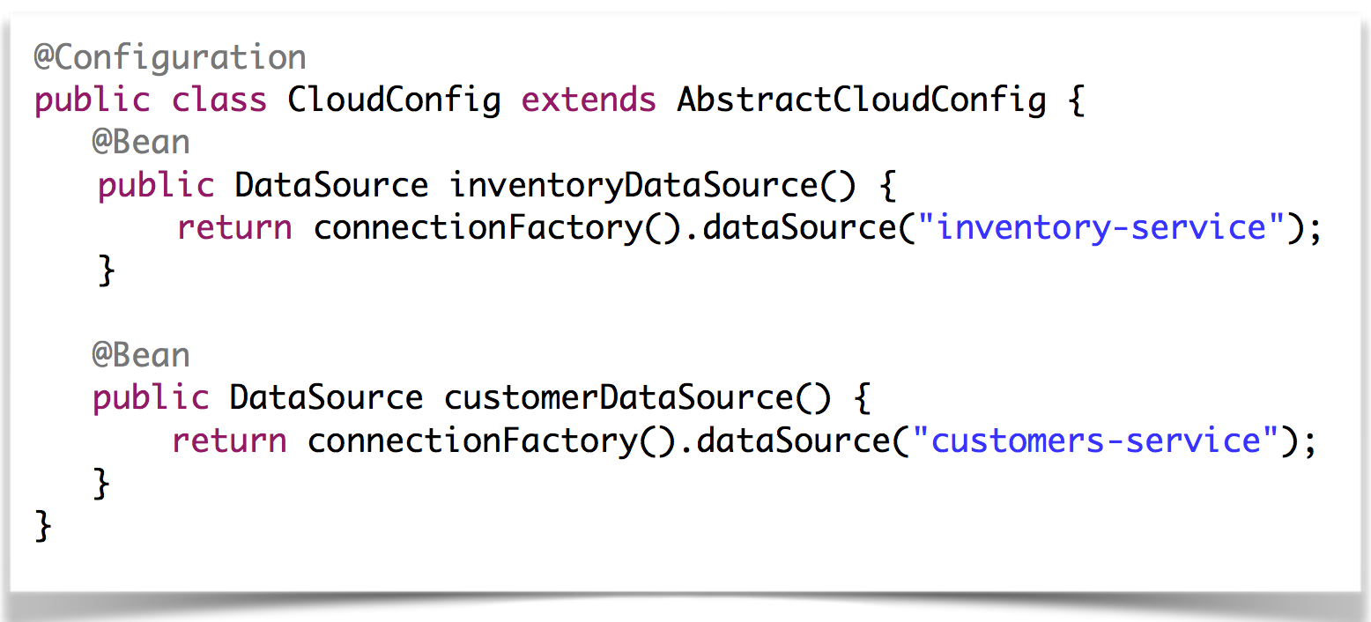
Taking Control – Working with Specific Services

Slide 6
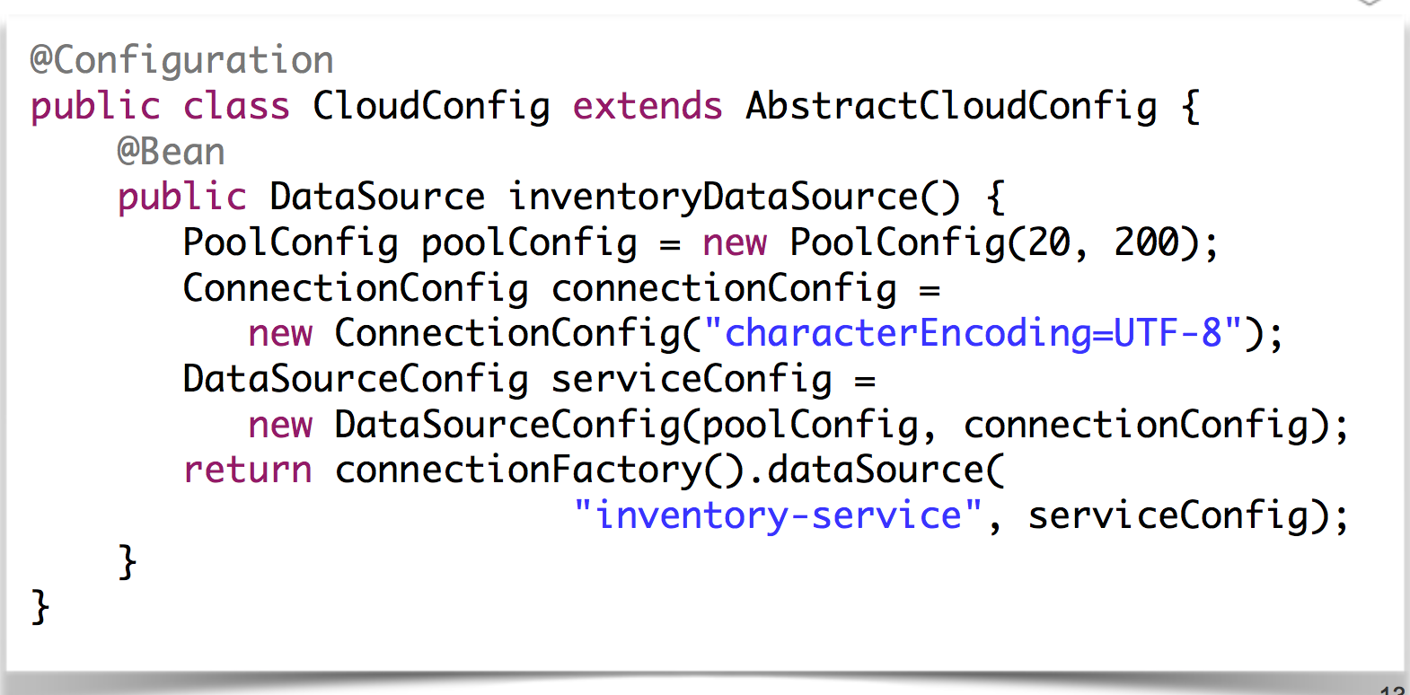
Taking Control – Configuring Services

Slide 7
Clouds Connectors Supported
Cloud Connectors
Cloud Foundry
Heroku
Local configuration

Slide 8
Services Connectors Supported
Service Connectors
RabbitMQ
Relational DB – DB2, MySQL, Oracle, PostgreSQL, SQL Server
MongoDB
Redis

Slide 9

DEMO

