Slide 1


Cloud Native Applications
Distributed Tracing – Sleuth and Pipkin
Notes:
Resting slide on screen before you begin presenting.

Slide 2
Distributed Service Challenges
Microservice architectures are great! … but what about troubleshooting?
We need a way to follow the stream of execution from end to end.
Distributed Tracing is HARD
Local is fine, but systems behave differently under load in the wild. Netflix has services that can only be adequately tested in production.
Notes:
Service Discovery is one of the key tenets of a microservice based architecture.
In distributed systems, application dependencies cease to be a method call away.
Trying to hand configure each client or use some form of convention can be very difficult to do and can be very brittle.

Slide 3
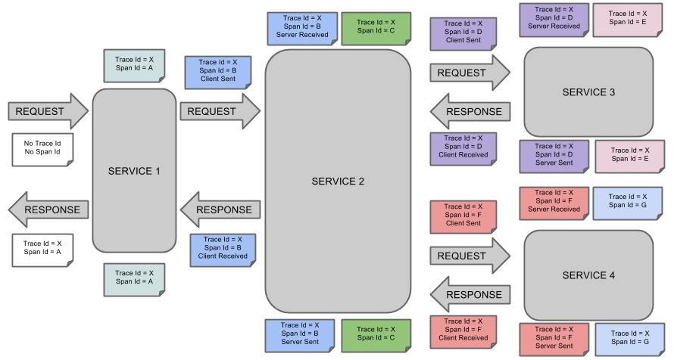
Distributed Tracing with Sleuth and Pipkin
Notes:
Service instances in the registry all have to send heartbeats to keep their registrations up to date
Clients also have an in-memory cache of eureka registrations (so they don’t have to go to the registry for every single request to a service)

Slide 4
Sleuth
Instruments calls to RestTemplates, FeignClients, Hystrix Calls, Spring Cloud Stream Messages - whatever it can get its hands on.
Makes the trace data available to any sleuth-aware application

Slide 5
Zipkin
Ingests Sleuth Data
Stores the data
Presents it in a usable format

Slide 6
Terminology

Slide 7
Terminology
Span - basic unit of work. Identified by a 64 bit UID. Keep track of timing information
Trace - a set of Spans forming a tree-like structure
Annotation - records the existence of an event in time, e.g., cr = ‘Client Received’, ss = ‘Server Sent’
Notes:
The server is easily embeddable in a Spring Boot application using the@EnableConfigServer annotation.
Application configuration data is stored in a backend
Git, Subversion and File System backends are supported
Git is the default backend. It's great for auditing changes and managing upgrades
Setting the git backend is done via the spring.cloud.config.server.git.uriconfiguration property

Slide 8
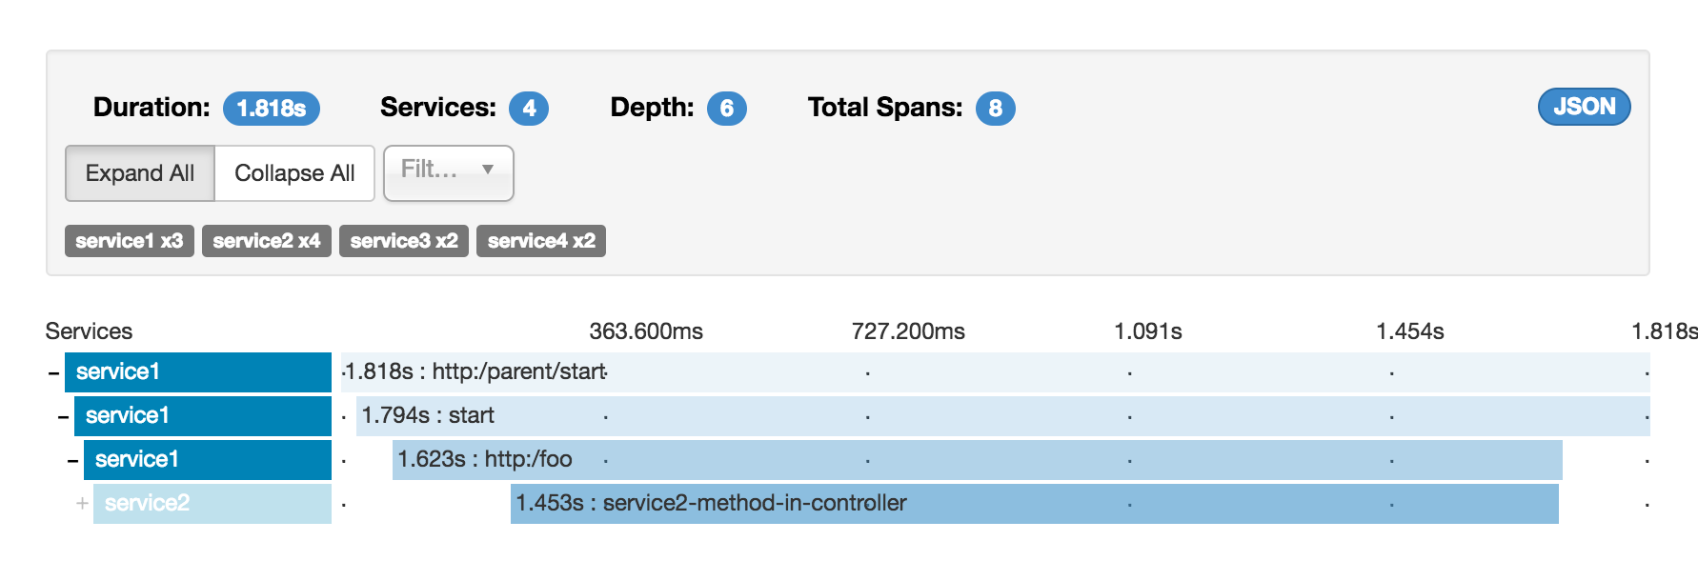
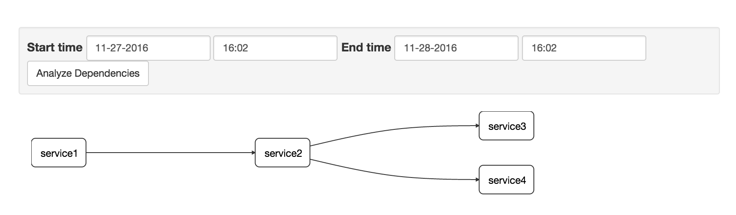
Zipkin UI

Slide 9

Lab

