Slide 1
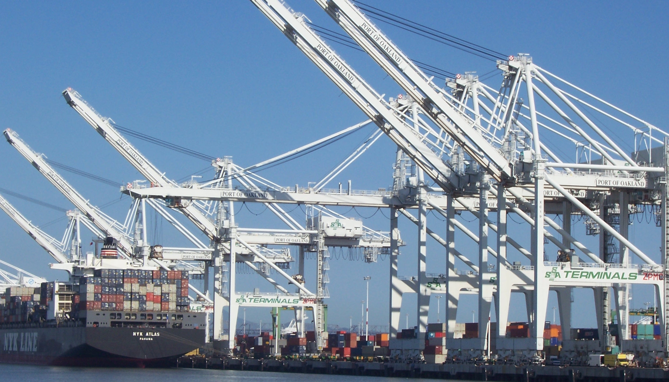



Pivotal Cloud Foundry
PCF Buildpacks

Slide 2
Staging and Buildpacks
Buildpacks are responsible for preparing the machine image for an application.
}
Application
Buildpack
Container
Libraries
Droplet
DEA
Runtime
Operating System

Slide 3
Platform Runtime – Application Frameworks
Container image
application layer
PCF buildpacks provide full support and maintenance for 3 of the 4 layers of the container stack
Devs can focus on just the app code
PCF creates the container image for you
runtime layer*
Dev Supported
PCF Supported
OS image
App container
Ops Supported
linux host & kernel
* Devs may bring a custom buildpack
Notes:
Introduction to buildpacks
Here we can compare and contrast with other container solutions like docker. We can bring up the advantages on the fact the container is built on the fly and that the buildpack provides consistency in building, updating and patching container images. Sometimes infrastructure people get’s concerned about the fact we bring our own OS images (stemcells) in regards to their “special” security and other needs. We need to find a subtle way to explain these “special” needs are often part of the problem. We should defer any detail security discussion as it can get hairy.

Slide 4


Runtime Benefits With PCF
runtime layer
6 Language Runtimes Maintained with Buildpacks
Java, Node, Python, PHP, Ruby, Go
Enterprise Support with Buildpacks
or Docker Images
Enterprise Middleware Support
Apache Tomcat Support from #1 Committer
Enterprise Framework Support
Spring is the #1 Enterprise Java Framework

Slide 5
Buildpack Flavors
Buildpacks installed into a Cloud Foundry instance or loaded from an external location at app deployment time
Buildpacks provided by public Cloud Foundry
Java Buildpack
Cloud Foundry Community Buildpack
Write you own
Java
Ruby
Node.js
Binary (e.g .NET)
Go
Python
PHP
Staticfile
Notes:
Java
Ruby
Node.js
Custom Build packs

