Slide 1
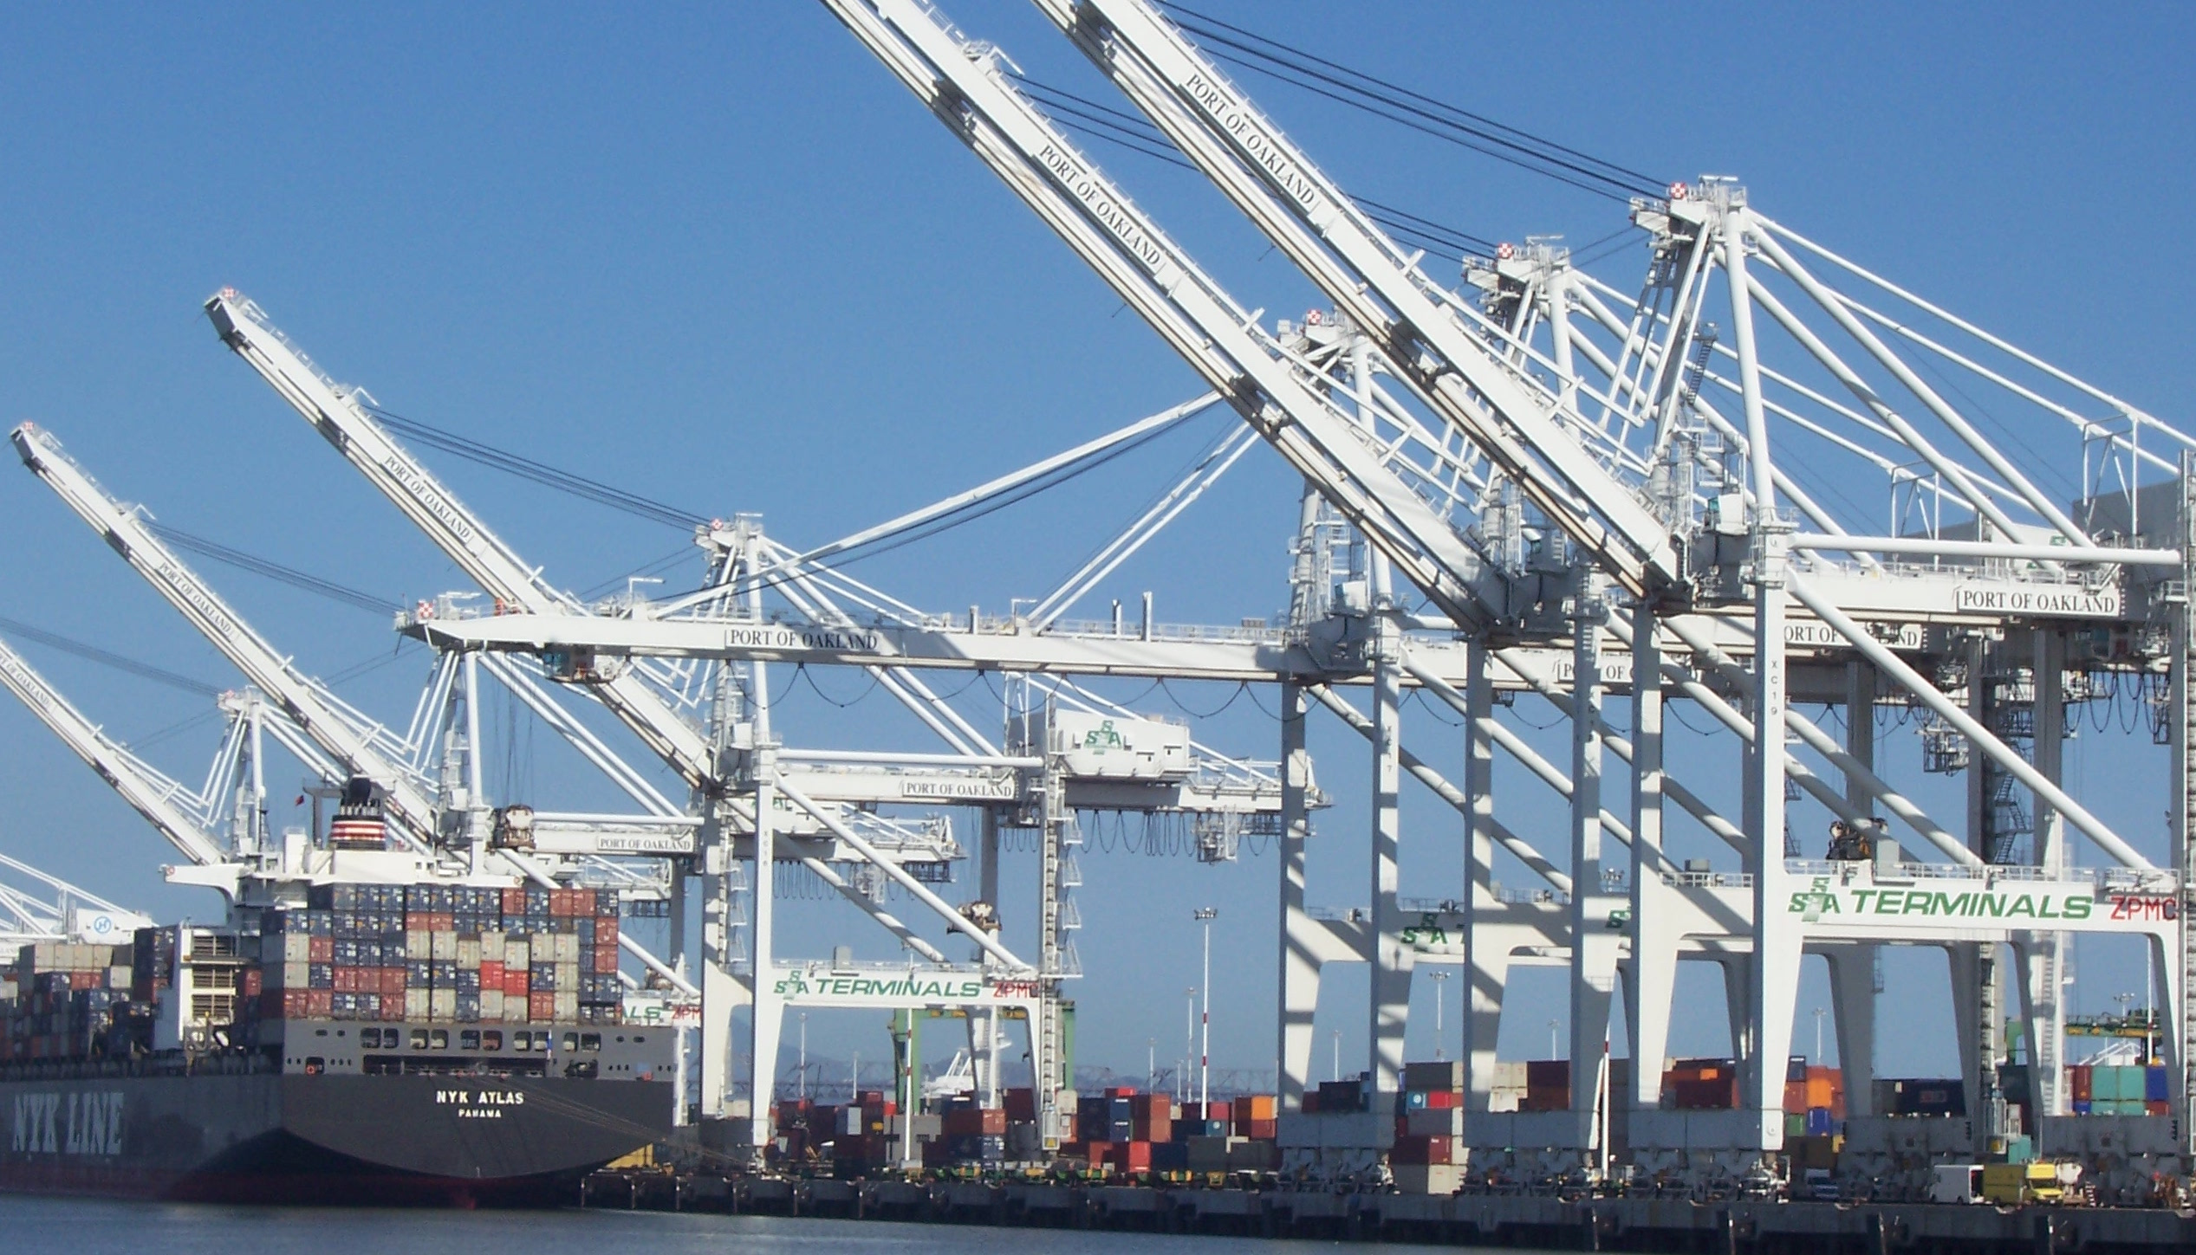



Pivotal Cloud Foundry
PCF 101

Slide 2
The Whole Stack
Notes:
Now you have seen for your selves how easy it is to relive ITOPS from the burdon of managing so many apps! You know know first hand how to better utilize your developer talent to maximize innovation.
So what’s going on under the hood?
The elastic runtime is where apps are pushed, staged, deployed, and managed.
BOSH is used for the orchestration of the entire system.
High availability comes in several flavors too.
Now lets discover together how elegant of a solution PCF really is!
--
You should never give this presentation to folks who have not seen a basic CF demo. You want to use the push of an app, with a service binding (i.e. spring-music) as the backstory for this deck.
The story line for this deck is:
you’ve seen us deploy and scale and app; we want to show you how it’s done.
This deck is intended to instill confidence in our customers, that they can trust their application to our platform. Cloud foundry is implemented with well understood patterns for distributed, web-based computing that result in extreme scalability and resilience. We know cloud and distributed systems.
We have two main layers:
The part that runs your apps (the elastic runtime)
And a whole ‘nother, kickass system, BOSH, that manages the elastic runtime and services
Let’s see how the elastic runtime deploys your app, supports service bindings and scales your app.
Let’s then see how BOSH deploys clusters, such as the elastic runtime, and services.
BUT that’s not all! Now show that the platform does SO much more than just deploy apps or clusters. → The four levels of HA.
Point out similarity of patterns between the ERS and BOSH. These are some of the patterns for distributed systems. This instills confidence.

Slide 3


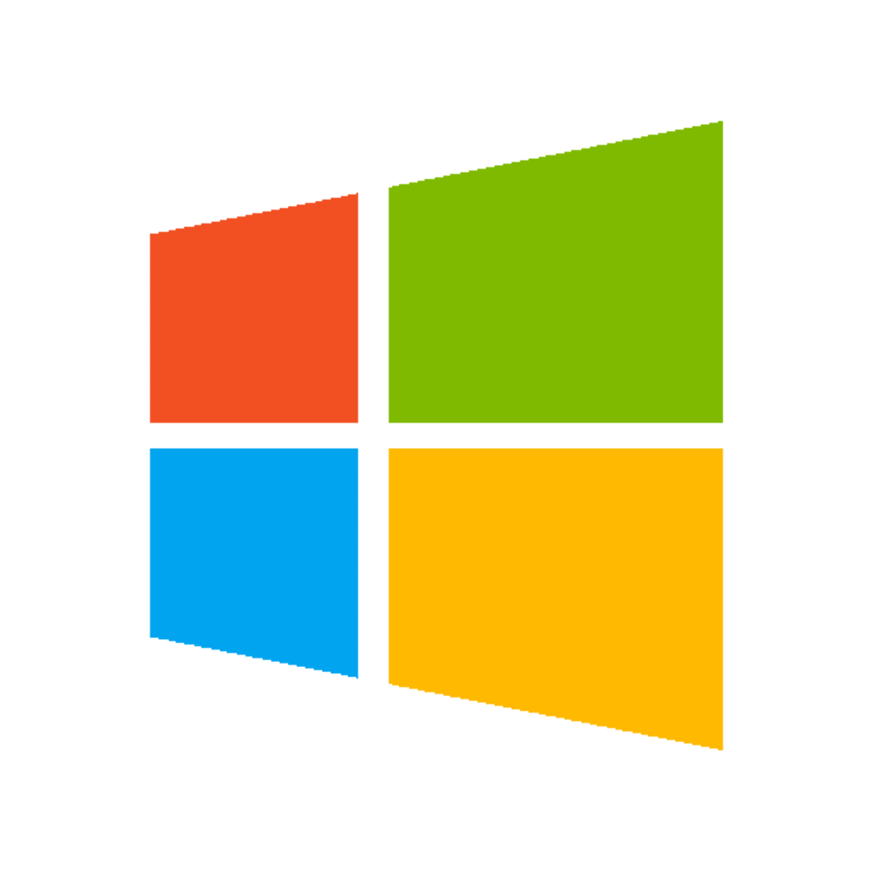
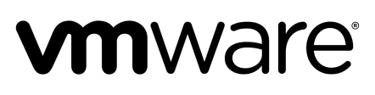

A Multi-Cloud Platform: Cloud Foundry
Jenkins Service
(CI)
Elastic
Container
Runtime
Agile Microservices
Redis
MySQL
Rabbit MQ
DataStax
Cassandra
Elastic managed runtime service integrated into leading data services; all scaled and managed by CF BOSH
Cloud Foundry BOSH
Multi-Cloud Declarative Service Deployment, Operations
Azure
Notes:
Here we have a birds eye view of PCF
-- Deployed over your favorite IaaS solution is our Elastic Runtime – a set of microservices that defines PCF
-- Several application services are integrated into the platform like Jenkins, Messaging, Caching, Hadoop, etc, the list is always growing!
-- The deployment is managed by OSS Cloud Foundry BOSH which we simplify via Ops Manager, a web based management interface
----
When I can, I like to whiteboard this picture – interactive.
Start with the elastic runtime
Managed by BOSH
IaaS agnostic
Other services/clusters managed by BOSH – KV Store, … and even partners, i.e. Jenkins.

Slide 4




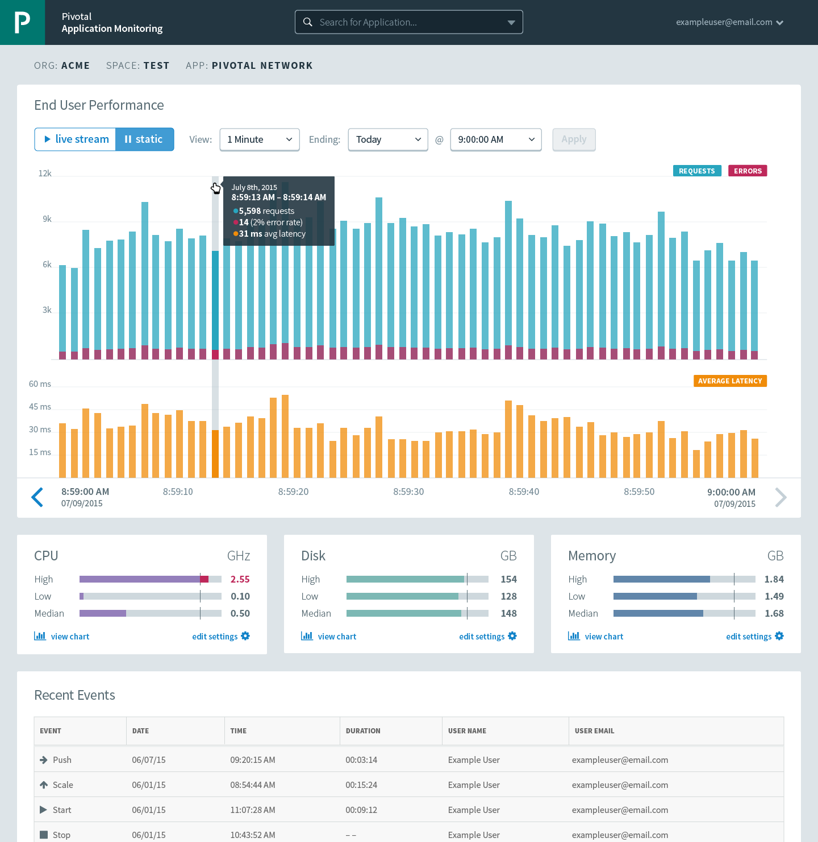



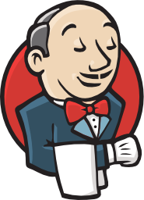

Cloud Foundry: An Application-centric Platform
Mobile Services
Centralized Log Management
Networking
& Load Balancing
Auto-Scaling
APM & Tracing
APPLICATION
Health management
Full Stack CI/CD platform
Notes:
So Spring Boot/Cloud meant create apps fast – But Dev & Ops is asking Day2 questions -
How do you do logging, routing, apm, scaling, and lifecycle management of all these apps.
Enter CF Runtime
best in class container management
integrated agentless logging
with APM
auto scaling
Effortless runtime with minimum human operational overhead. We run 1000s of apps and 10,000s containers on PWS with 6 guys.
But we realized that stopping there wasn't enough

Slide 5
Pivotal Cloud Foundry Architecture
Platform Runtime (Elastic Runtime)
Services
Routing
Container Scheduling
Service Discovery
Configuration
Database
Application Framework
Big Data
12 Factor Apps
Microservices
RESTful Services
Circuit Breakers
Object Storage
Mobile
Spring Boot
Ruby on Rails
Node.js
.NET
Build CI
Logging & Metrics
Messaging
User Provided
Operations
Zero Downtime Deployments
Failover & Recovery
Scaling
Security Patching
Platform
Upgrades
Notes:
Before diving into BOSH we introduce the major components of the platform. Then we explain the platform infrastructure automation capabilities in the context of our structured (or opinioned) platform. The following BOSH sections would explained in more detail.
PCF is made of 3 major components – Operations (Ops Manager), Platform Runtime (Elastic Runtime) and Services. All, mostly deployed, by BOSH
Now we’ll briefly talks about the components

Slide 6
Elastic Container Runtime
Technical Drill Down
Notes:
Now dive into the ERS
http://docs.pivotal.io/pivotalcf/concepts/architecture/

Slide 7

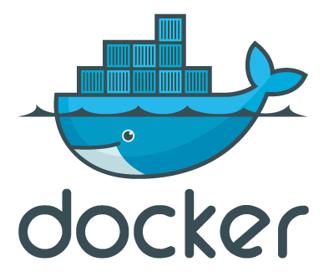
Pivotal Cloud Foundry
Login Server
OAuth 2.0 Server (UAA)
Platform Access
Ops Manager
Ops Manager UI
Elastic Container Runtime
Ops Manager Director
Cloud Controller
Blobstore
Brain
Operations Manager
CELL
CELL
Auctioneer
Service
Rep
Exec.
Rep
Exec.
Converger
Service Broker
Service Nodes
Garden
.NET
Dynamic Router
BBS
Service
Metron Agent
etcd
Service
Metron Agent
Service Broker
Loggregator
Container Access
Service Nodes
Logging / Metrics
Application
Access
Traffic Controller
Service
Doppler
Log Firehose
SSH Proxy
BOSH - Automation Layer
Azure

Slide 8

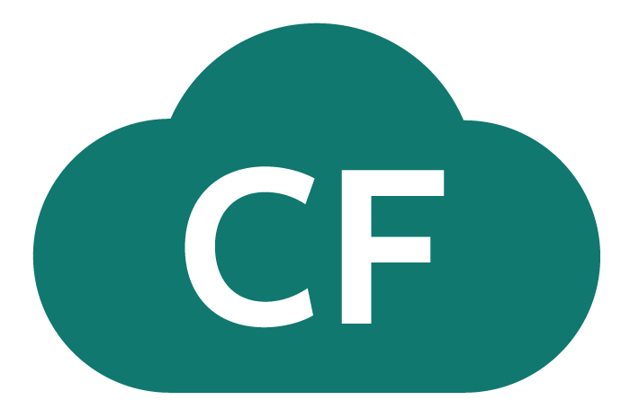
D e m o
Notes:
Push an App, show the logs

Slide 9

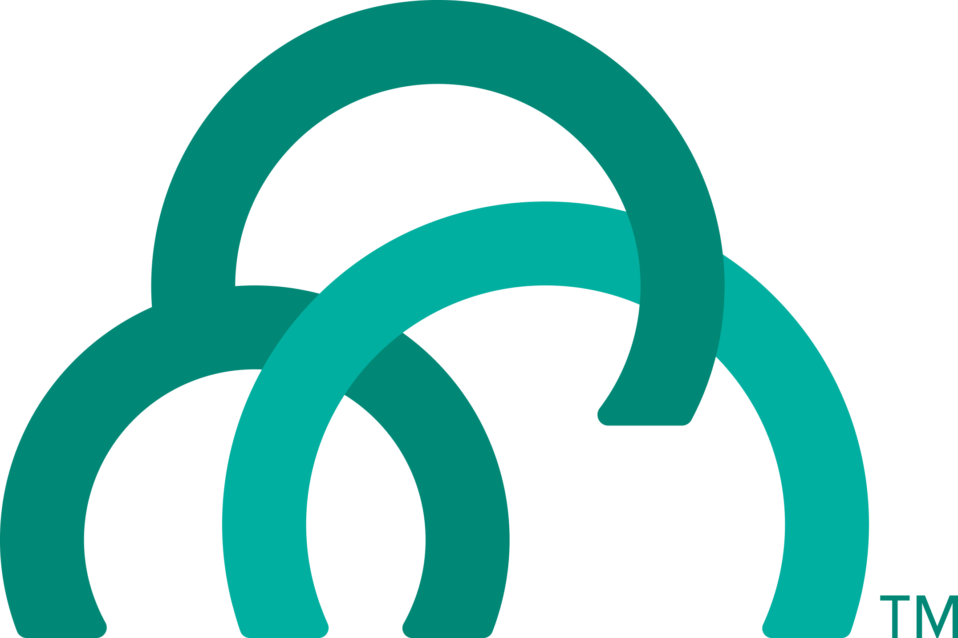
Overview: Pushing an Application
Blobstore
DB
Service
credentials
Upload app bits and metadata
Stage
Cloud Controller
Service Broker Node(s)
Deploy
push app
+ app MD
Cloud Controller Bridge
BBS / etcd
Create and bind services
Stage application
Deploy application
Manage application health
Router
CELL
Brain
DEA
DEA
Auctioneer
+
=
Task
LRP
Runtime
Notes:
Cloud Foundry PaaS
An application runs in a CELL, which is a droplet execution agent. The Cloud Controller orchestrates the routing and lifecycle of all DEAs in the pool. Routers manage application traffic. Health Manager reports mismatched application states to the CC. A service gateway provides an interface for services (native or external). A messaging bus manages all system communication. Apps are accessed directly through the router while web and CLI clients (e.g., vmc, STS) access Cloud Controller via RESTful services.

Slide 10
Creating and Binding a Service
Service
credentials
DB
CLI
create service (HTTP)
Cloud Controller
create service (HTTP)
Service
Broker
reserve resources
Data
Service
Router
bind service (HTTP)
bind service (HTTP)
obtain connection data
Runtime
http://docs.pivotal.io/pivotalcf/services/

Slide 11
Staging an Application
Staging Request
Task
Blobstore
Cloud Controller
Cloud Controller Bridge
BBS / etcd
Service
credentials
CELL Auction
Brain
DB
Auctioneer
Router
CELL
System
Buildpacks
Detect
Compile
Upload
No
Yes
Python
+
=
Java
Runtime

Slide 12



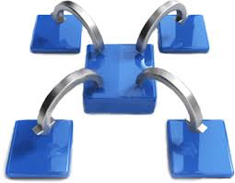
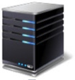

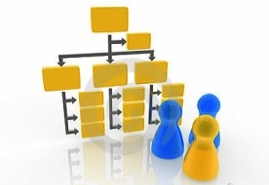









Pivotal CF: Technical Capabilities
Automatic App Server & OS Configuration with Buildpacks (“just push your app”)
Application
Containerization & Cluster Scheduling
Application Network Security Groups
App Health Management, Load Balancing,
Rapid Scaling, Availability Zones
Application to Services Binding and Access
Policy, Identity and Roles Management
Logging as a service,
Application metrics & performance,
Metric based scaling
Native & Extended Data, Mobile and Platform Services
IaaS Provisioning, Scaling & Configuration
Deploy, Operate, Update & Scale with minimal downtime on choice of IaaS
Notes:
Key Platform Capabilities
On Demand Scaling
Application Health Management
Dynamic Routing & Load Balancing
Log and Metric Aggregation
Security
WHAT
Pivotal CF is next generation middleware that delivers 9 things that are typically delivered via point software products.
We provision operating systems and middleware.
We deliver workload density without compromising application performance.
We ensure that applications have appropriate network security safe guards to prevent security threats.
We support application connections to external sources including databases and legacy middleware.
We provide 4 levels of HA, with built in load balancing for scale in/out
We support multi-tenant environments so that each line of business can operate with a discrete quota and isolated system access.
We provision next generation data services including NOSQL databases, traditional databases and hadoop clusters.
We provide horizontal and vertical scaling for the underlying IaaS so that you can scale your infrastructure in lock step with your Business.
We provide a built-in log aggregation service, built-in APM metrics and utilization based auto-scaling so that you can monitor the health of your applications and scale out without human or 3rd party tool intervention.
I am going to cover each of these 9 capabilities in more detail, but it’s important to note the impact of this collection of capabilities. The following slides will include information on CAPEX and OPEX reduction. We will also discuss how you can deliver faster time to value while holding the line on infrastructure cost.

