Slide 1
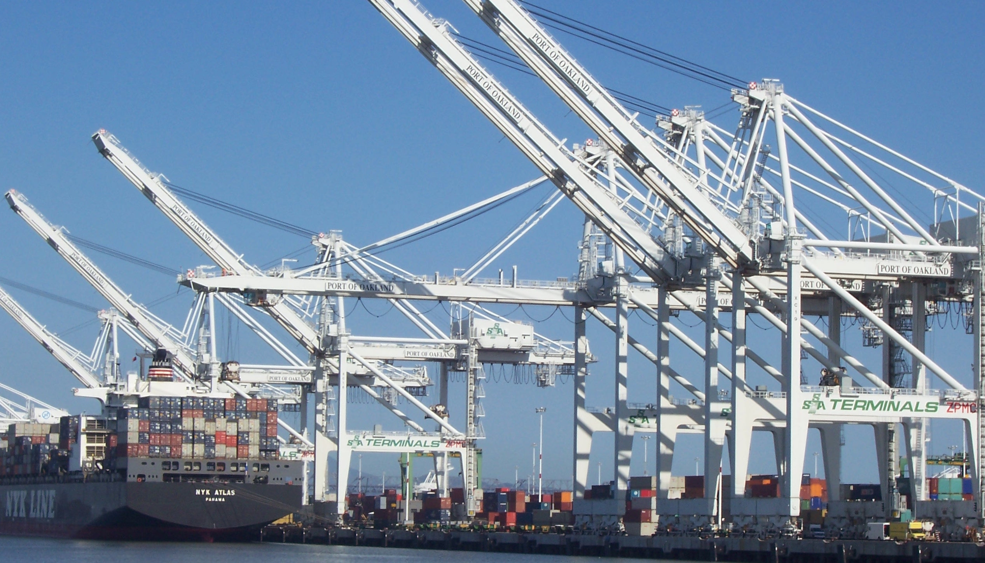


Pivotal Cloud Foundry
Containers

Slide 2




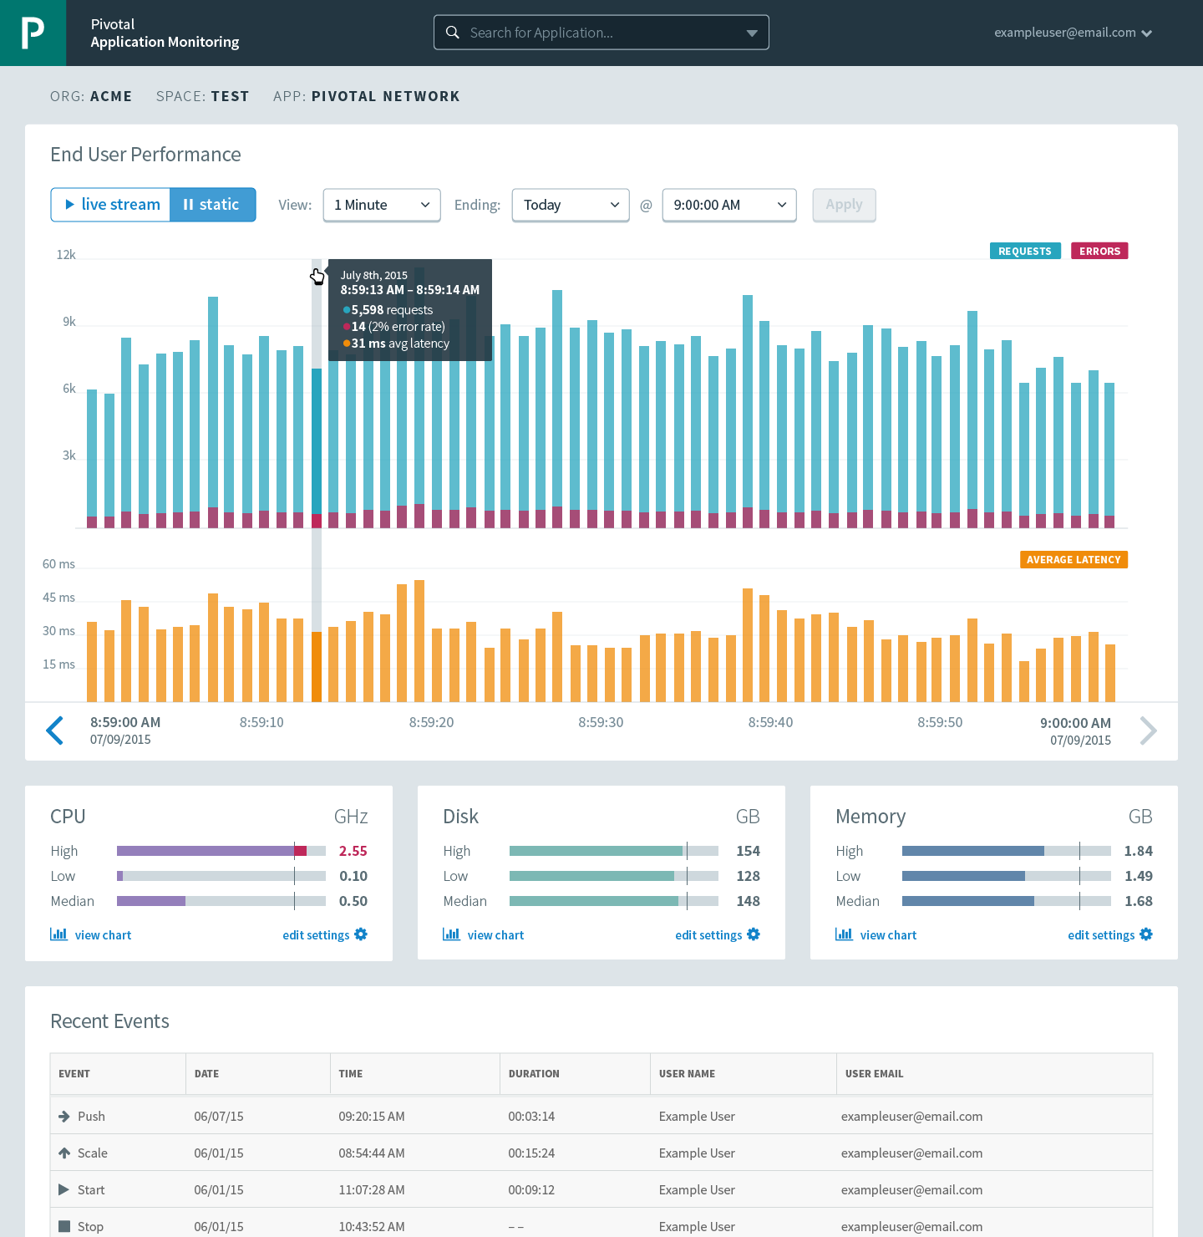




Cloud Foundry: An Application-centric Platform
Mobile Services
Centralized Log Management
Networking
& Load Balancing
Auto-Scaling
APM & Tracing
APPLICATION
Health management
Full Stack CI/CD platform
Notes:
So Spring Boot/Cloud meant create apps fast – But Dev & Ops is asking Day2 questions -
How do you do logging, routing, apm, scaling, and lifecycle management of all these apps.
Enter CF Runtime
best in class container management
integrated agentless logging
with APM
auto scaling
Effortless runtime with minimum human operational overhead. We run 1000s of apps and 10,000s containers on PWS with 6 guys.
But we realized that stopping there wasn't enough

Slide 3





A Multi-Cloud 3rd Platform: Cloud Foundry
Jenkins Service
(CI)
Elastic
Container
Runtime
Agile Microservices
Redis
MySQL
Rabbit MQ
DataStax
Cassandra
Elastic managed runtime service integrated into leading data services; all scaled and managed by CF BOSH
Cloud Foundry BOSH
Multi-Cloud Declarative Service Deployment, Operations
Azure
Notes:
Here we have a birds eye view of PCF
-- Deployed over your favorite IaaS solution is our Elastic Runtime – a set of microservices that defines PCF
-- Several application services are integrated into the platform like Jenkins, Messaging, Caching, Hadoop, etc, the list is always growing!
-- The deployment is managed by OSS Cloud Foundry BOSH which we simplify via Ops Manager, a web based management interface
----
When I can, I like to whiteboard this picture – interactive.
Start with the elastic runtime
Managed by BOSH
IaaS agnostic
Other services/clusters managed by BOSH – KV Store, … and even partners, i.e. Jenkins.

Slide 4

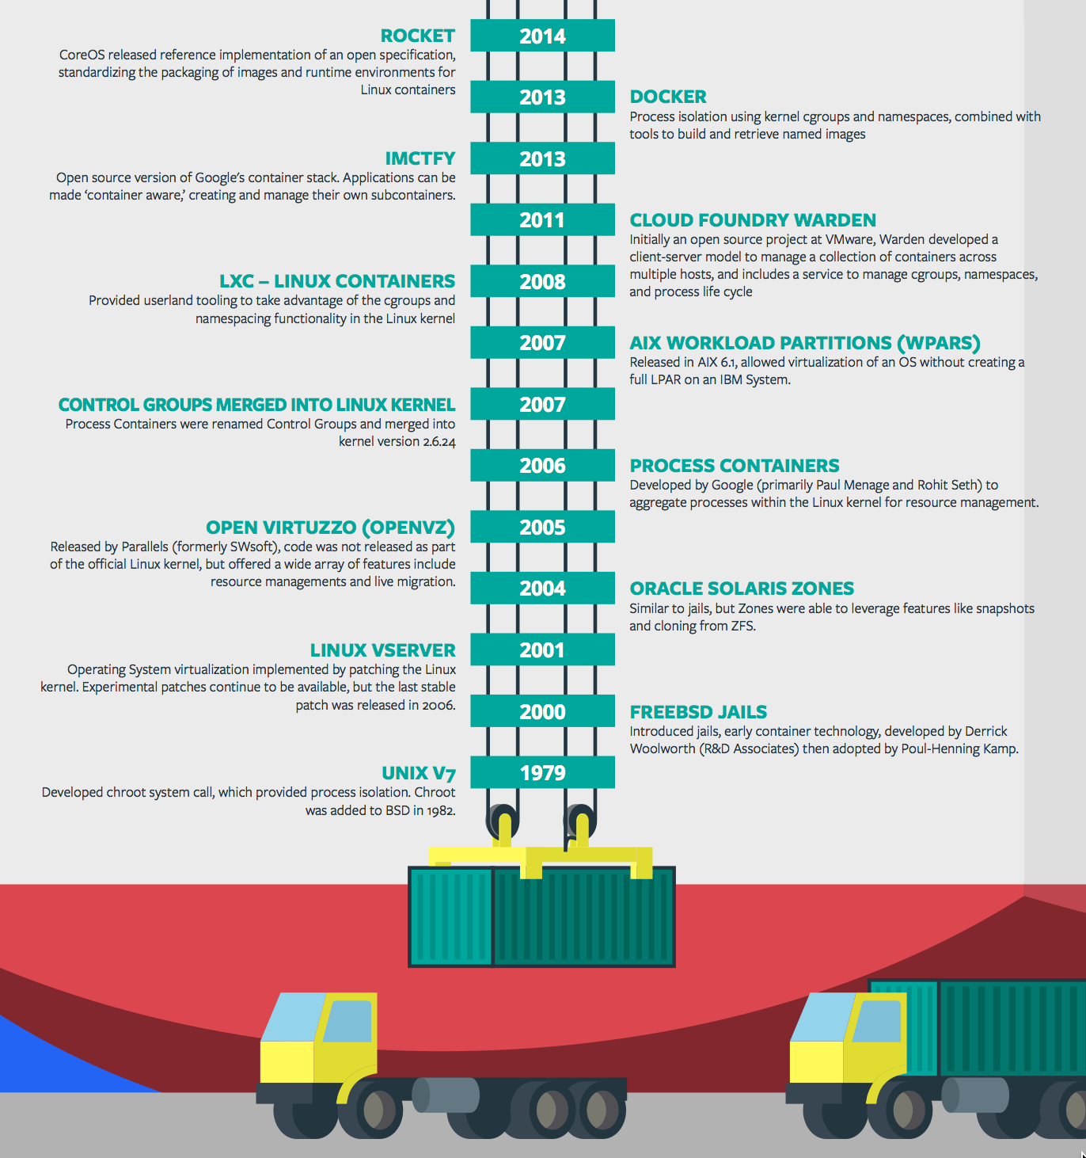
Containers - History
CONTAINERS!!!!
Containers are not new
CF has used containers since it’s inception
CF supports multiple container technologies as first class citizens including Docker, Warden, Garden and runC
Notes:
History of Docker
- 2006 Google to use containers they built cgroups and namespaces and pushed it to the Linux kernel
- cgroups and namespaces give you isolation (Resource Isolation and Namespace isolation)
- dotCloud and LXC fragmentation
- libcontainer created to address application portability and standard API across linux distros BUT controlled by Docker
- Open Container Project (Docker/dockerfile, CoreOS/appc). Standardiized on runC
- Standardizing the file format (dockerfile + appc = filesystem)
- Standardizing the runtime (libcontainer = runC)
- Container (Isolation + Files/metadata + Processes)

Slide 5
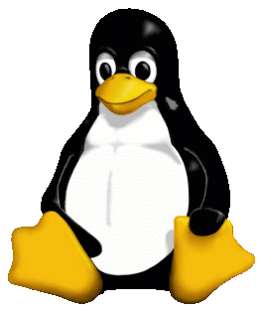
Container Isolation
shared resources
resource isolation
kernel
namespace isolation
Cell
process F
process A
process E
process B
process D
process C
tenant 1
tenant 2
tenant 3
Notes:
----- Meeting Notes (2/10/16 13:49) -----
modify to represent the cell, and change tenants to containers

Slide 6


Container Isolation
CPU
resource isolation
namespace isolation
cgroups
process D
process F
process F
process E
process A
process E
process B
process D
process C
A Linux kernel feature that limits, accounts for, and isolates the resource usage of a collection of processes
tenant 1
tenant 2
tenant 3
Notes:
Cgroups - A Linux kernel feature that limits, accounts for, and isolates the resource usage of a collection of processes

Slide 7
Container Isolation
PID
2
3
4
2
2
3
resource isolation
namespace isolation
PID namespace
process F
The PID namespace provides isolation for the allocation of process identifiers (PIDs), lists of processes and their details.
process A
process E
process B
process D
process C
tenant 1
tenant 2
tenant 3
Notes:
PID namespace - provides isolation for the allocation of process identifiers (PIDs), lists of processes and their details.

Slide 8
Customize the Container Experience
Buildpacks
Containers
Developer brings customized app
Developer brings customized app
Platform buildpacks provide standard runtime*
Developer brings runtime container image
Platform provides fixed OS container image
Developer brings container OS image
Platform provides fixed host OS Kernel
Platform provides fixed host OS Kernel
App container
* Devs may bring a custom buildpack
Notes:
Kubernetes doesn’t have buildpacks

Slide 9
The App-Container Approach - Scaling
Blobstore
Cloud Controller
Container Management - DIEGO
Router
Access App
Brain
Cell
Cell
Cell
Platform Runtime
Notes:
https://github.com/cloudfoundry-incubator/diego-design-notes
At the core of Diego
A distributed scheduling algorithm which orchestrates where containers go and hence where application instance processes are run
Optimizing for application workloads
Implements Demand Driven scheduling of workload
Auctioneer says "I have N pieces of work, who wants them?"
Worker cells then join an auction and the winning cell of each auctioned-off piece of work gets that piece of work
Components of Diego
Tasks & Long Running Processes (LRPs)
Tasks: are processes that are run once and have a finite running time. This might be a script or job to process a piece of data
LRP: This might be a web-server or some other service that continuously accepts input and processes
Tasks are not included in Auction
Cells
Cells are where the Tasks and LRPs are run
These are most analogous to DEAs in the current Cloud Foundry architecture.
Generally one Cell per VM
Brain – implements the core scheduling (auction algorithm) functionality of Diego
Bulletin Board System/Store (BBS)
Where state of Diego cluster is stored
Up to date cache of cluster state
“Holds” CF actions
Start/Stop instances
Start one-off task processes
Backed by ETCD which acts as consistent store
Components of Diego Brain
Auctioneer – holds auctions for LRPs and Tasks
Also determines which instances are removed when scaling down
Converger - Keeps cluster state consistent using eventually consistent model
Ensures cluster state is consistent with the desired state, that is, performs convergence
Provides fault tolerance for Tasks and LRPs
Updates BBS with state of cluster
Places requests on BBS
Metric Server – Reads from Metron agents, publishes them to Doppler
Components of Diego Cell
Rep - Represents Cell in Diego
Mediates all communication with BBS where cluster state is maintained
Participates in auction to accept Tasks/LRPs
Runs Tasks & LRPs by working with Executor
Executor –
Implements HTTP API to Create and Delete Containers
Implements Executor Actions such as Run, Download, Upload, Parallel etc
Streams Stdout & Stderr to Metron agent running in the Cell
Garden – the Linux container for Diego
Garden API – the Linux Garden API implementation
Garden-Linux – the Linux container backend implementation
Isolates network, disk, memory, CPU; performs resource management
Runs droplets, tasks, other containers (Docker)
Metron Agent - Forwards application logs and application/Diego metrics to doppler (loggregator)

