Slide 1




Cloud Native Applications
Workshop Kickoff

Slide 2

Welcome!

Slide 3
Logistics
Breaks
Lunch
‘The Facilities’
Email & Cellphone Etiquette
Questions

Slide 4
Speakers
Paul Hopper
Platform Architect, Pivotal (phopper@pivotal.io)
Chris Busch
Platform Architect, Pivotal (cbusch@pivotal.io)
Jenny McLaughlin
Platform Architect, Pivotal (jmclaughlin@pivotal.io)

Slide 5
Agenda
Introduction
Cloud Native Introduction - Industry Trends and Overview including: 12 Factor Apps, DevOps, Microservices and Cloud Platforms
Cloud Native Platform - An overview of Cloud Foundry (PCF) and its Architecture
Break (around 10 AM)
Services Made Easy - PCF Services (Database, Messaging, etc.) and the Marketplace
Developer Workshop - Hands-on pushing code with PCF
Wrap Up, Q/A, & Feedback
Notes:
At 11:30 get setup to do the install

Slide 6
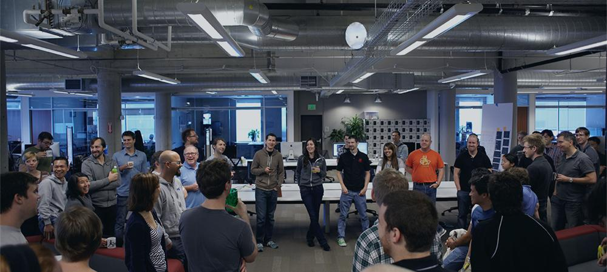
Introductions
Name, Team, Apps

