Slide 1


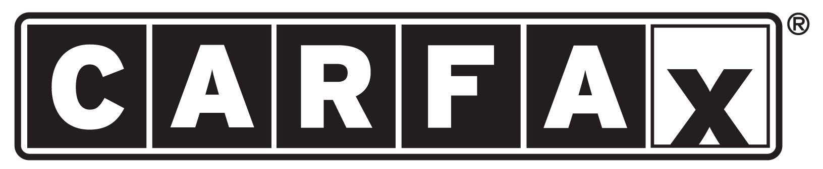

Cloud Native Applications
Workshop Kickoff

Slide 2

Welcome!

Slide 3
Logistics
Breaks
Lunch
‘The Facilities’
Email & Cellphone Etiquette
Questions

Slide 4
Speakers
Paul Hopper
Platform Architect, Pivotal (phopper@pivotal.io)
Chris Busch
Platform Architect, Pivotal (cbusch@pivotal.io)

Slide 5
Workshop, Goals
Focus on application code
Easy and quick deployment; no lengthy exchanges with Ops
Greater control over deployment
Quick and timely updates to production
Creating applications that are optimized for the cloud

Slide 6
Workshop, Outcomes
Comfort with cf CLI & deploying to PCF
Increased familiarity with operations and the platform
Ability to configure and provision services
Understanding of using PCF for logging and metrics

Slide 7
Agenda
Introduction
Cloud Native Introduction
Industry Trends and Overview including: 12 Factor Apps, DevOps, Microservices and Cloud Platforms
Cloud Native Platform
An overview of Cloud Foundry (PCF) and its Architecture
Break (around 10 AM)
Services Made Easy
PCF Services (Database, Messaging, etc.) and the Marketplace
Developer Workshop - Hands-on pushing code with PCF
Wrap Up, Q/A, & Feedback
Notes:
At 11:30 get setup to do the install

Slide 8
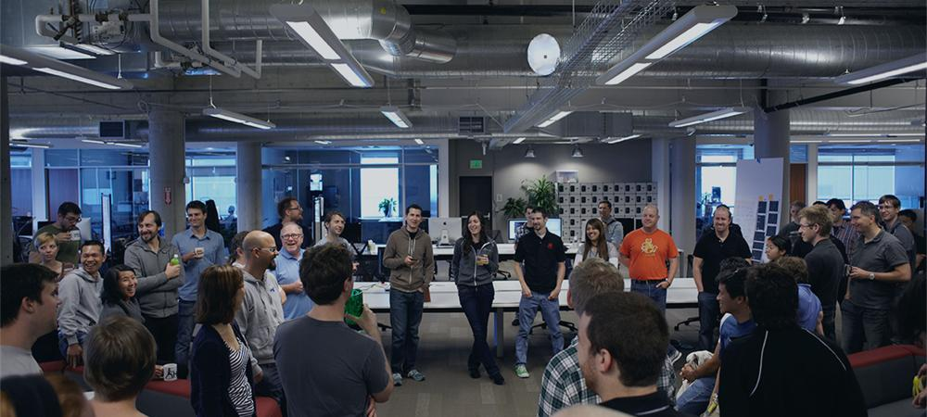
Introductions
Name, Team, Apps

