Slide 1



Cloud Native Workshop
Introduction to Spring Data Rest
Pivotal Cloud Foundry
Notes:
Cloud native applications, and bringing microservice architectures into production in the enterprise.

Slide 2

Spring Data Rest
Review Spring Data
Spring Data Rest

Slide 3

What type of data?
Spring Data
Spring Data JPA
Spring Data MongoDB
Spring Data Redis
Spring Data Solr
Spring Data GemFire
Spring Data Rest

Slide 4
Import the required dependency
Add the JPA starter to the pom.xml
<dependency>
<groupId>org.springframework.boot</groupId>
<artifactId>spring-boot-starter-data-jpa</artifactId>
</dependency>

Slide 5
Repositories
Tired of Creating/Maintaining Boilerplate Code?
Use Spring Repositories. CRUD support added with no implementation required.
public interface CrudRepository<T, ID extends Serializable> extends Repository<T, ID> {
// Saves the given entity
<S extends T> S save(S entity);
// Returns the entity identified by the given id.
T findOne(ID primaryKey);
// Returns all entities.
Iterable<T> findAll();
// Deletes the given entity.
void delete(T entity);
// … more functionality omitted.
}

Slide 6
Defining your own repository interface
Extend from the given repository and provide the domain and id classes:
public interface CitiesRepository extends JpaRepository<Cities, Long>{
}

Slide 7
Add required methods as needed
public interface PersonRepository extends JpaRepository<User, Long> {
List<Person> findByEmailAddressAndLastname
(EmailAddress emailAddress, String lastname);
// Enables the distinct flag for the query
List<Person> findDistinctPeopleByLastnameOrFirstname
(String lastname, String firstname);
List<Person> findPeopleDistinctByLastnameOrFirstname
(String lastname, String firstname);
// Enabling ignoring case for an individual property
List<Person> findByLastnameIgnoreCase(String lastname);
}

Slide 8
Query creation from method names
Strip prefixes : find...By, read...By, and get..By
Introducing clause: Distinct
First By acts as a delimiter to indicate start of criteria
And and Or
Between, LessThan, GreaterThan, Like
IgnoreCase

Slide 9
@Query as an alternative to keywords
A JPA based repository using the @Query annotation.
public interface UserRepository extends JpaRepository<User, Long> {
@Query("select u from User u where u.emailAddress = ?1")
User findByEmailAddress(String emailAddress);
}

Slide 10
Spring Data Rest
Review Spring Data
Spring Data Rest

Slide 11
Spring Data Rest
The goal of the Spring Data REST project is to provide a solid foundation on which to expose CRUD operations to your repository managed entities using plain HTTP REST semantics.

Slide 12
Import the required dependency
Add the Spring Data Rest starter to the pom.xml:
<dependency>
<groupId>org.springframework.boot</groupId>
<artifactId>spring-boot-starter-data-rest</artifactId>
</dependency>

Slide 13
Export repositories
public interface OrderRepository extends CrudRepository<Order, Long> {
List<Order> findByDate(@Param("date") Date date);
}
For this repository, Spring Data REST exposes a collection resource at /orders.
The path is derived from the un-capitalized, pluralized, simple class name of the domain class being managed.
It also exposes an item resource for each of the items managed by the repository under the URI template /orders/{id}.
Custom queries are exported to /search. E.g. /search/findByDate

Slide 14
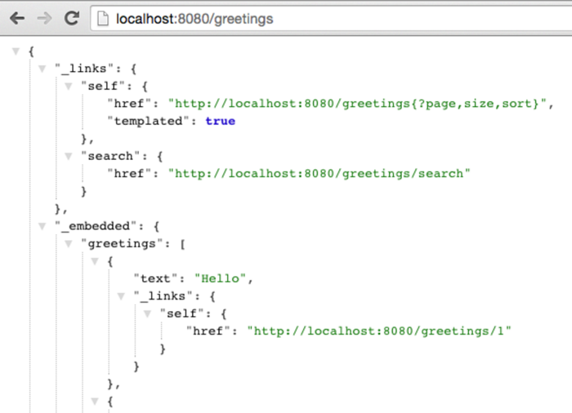
RESTful API

Slide 15
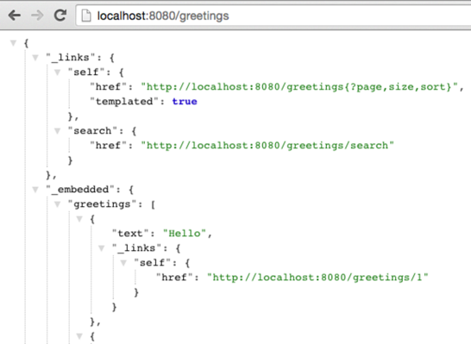
HATEOAS (Hypermedia as the Engine of Application State)
Provides information to navigate the REST interface dynamically by including hypermedia links with responses
Differs from SOA based systems and WSDL-driven interfaces, in that a separate fixed specification is distributed
HAL - Hypertext Application Language

Slide 16
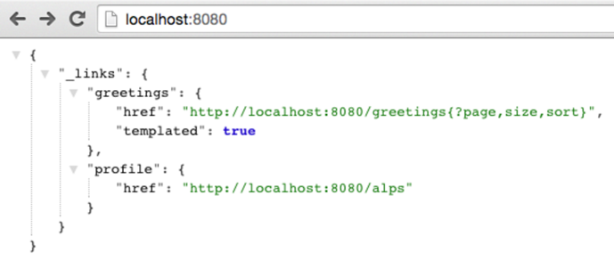
ALPS (Application-Level Profile)
Alps is a data format for defining simple descriptions of application-level semantics.
Provides metadata on how interact with the system.
Provides details on domain representation, operations

Slide 17
ALPS explained
...
}, {
"id" : "get-persons",
"name" : "persons",
"type" : "SAFE",
"rt" : "#person-representation"
}, {
"id" : "delete-person",
"name" : "person",
"type" : "IDEMPOTENT",
"rt" : "#person-representation"
}, {
"id" : "patch-person",
"name" : "person",
"type" : "UNSAFE",
"rt" : "#person-representation"
}, {
"id" : "update-person",
"name" : "person",
"type" : "IDEMPOTENT",
"rt" : "#person-representation"
}, {
"id" : "get-person",
"name" : "person",
"type" : "SAFE",
"rt" : "#person-representation"
} ]
}
http://localhost:8080/alps/persons
{
"version" : "1.0",
"descriptors" : [ {
//representation of domain
"id" : "person-representation",
"descriptors" : [ {
"name" : "firstName",
"type" : "SEMANTIC"
}, {
"name" : "lastName",
"type" : "SEMANTIC"
}, {
"name" : "id",
"type" : "SEMANTIC"
}]
}, {
"id" : "create-persons", //operations
"name" : "persons",
"type" : "UNSAFE",
"rt" : "#person-representation"
...

