Slide 1




Cloud Native Applications
Workshop Kickoff

Slide 2

Welcome!

Slide 3
Logistics
Breaks
Lunch
‘The Facilities’
Email & Cellphone Etiquette
Questions

Slide 4
Speakers
Paul Hopper
Platform Architect, Pivotal (phopper@pivotal.io)
Jenny McLaughlin
Platform Architect, Pivotal (jmclaughlin@pivotal.io)

Slide 5
Workshop, Goals
Focus on application code
Easy and quick deployment; no lengthy exchanges with Ops
Greater control over deployment
Quick and timely updates to production
Creating applications that are optimized for the cloud

Slide 6
Workshop, Outcomes
Comfort with cf CLI & deploying to PCF
Increased familiarity with operations and the platform
Ability to configure and provision services
Understanding of using PCF for logging and metrics

Slide 7
Agenda
Introduction
Installing Pivotal Cloud Foundry
Pivotal Cloud Foundry Overview
Lunch
Spring Boot, Profiles and Actuator with Labs
Spring Data / REST on Cloud Foundry with Labs
Pivotal Cloud Foundry Day 2 Operations
Wrap Up, Q/A, & Feedback
Notes:
At 11:30 get setup to do the install

Slide 8
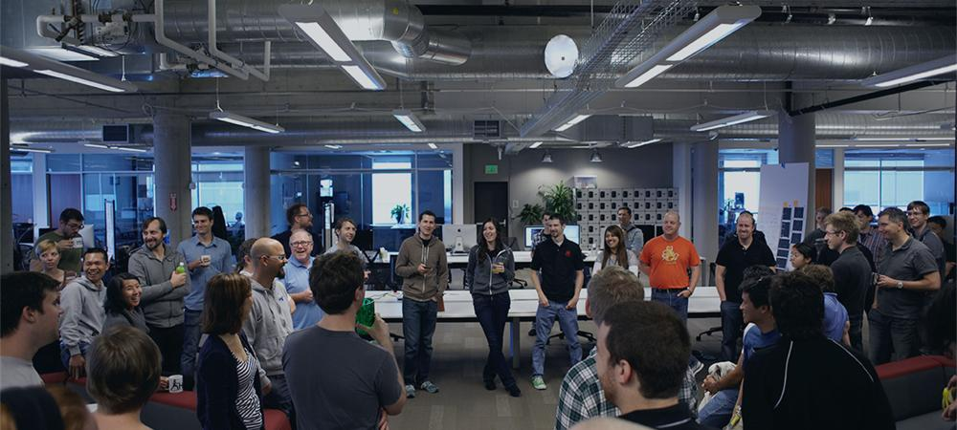
Introductions
Name, Team, Apps

