Slide 1




Spring Data REST

Slide 2
Topics in this Session
Review Spring Data
Spring Data REST

Slide 3
What Types of Data Stores?
Spring Data
JPA
MongoDB
Redis
Solr
GemFire
KeyValue
REST
Community
Aerospike
Cassandra
Couchbase
DynamoDB
Elasticsearch
Neo4J

Slide 4
Import the Required Dependency
Add the JPA starter to the pom.xml
<dependency>
<groupId>org.springframework.boot</groupId>
<artifactId>spring-boot-starter-data-jpa</artifactId>
</dependency>
Notes:
Maven is just one option. You can also use Gradle or Ant/Ivy

Slide 5
Repositories
Tired of creating / maintaining Boilerplate Code?
Use Spring Repositories
CRUD support added with no implementation required
public interface CrudRepository<T, ID extends Serializable> extends Repository<T, ID> {
// Saves the given entity
<S extends T> S save(S entity);
// returns the entity identified by the given id
T findOne(ID primaryKey);
// returns all entities
Iterable<T> findAll();
// deletes the given entity
void delete(T entity);
// .. more functionality omitted.
}

Slide 6
Add Required Methods As Needed
public interface PersonRepository extends JpaRepository<User, Long> {
List<Person> findByEmailAddressAndLastName
(EmailAddress emailAddress, String lastname);
// enables the distinct flag for the query
List<Person> findDistinctPeopleByLastnameorFirstname
(String lastname, String firstname);
List<Person> findPeopleDistinctByLastnamefOrFirstname
(String lastname, String firstname);
// enabling ignoring case for individual property
List<Person> findByLastnameIgnoreCase(String lastname);
}

Slide 7
@Query as an Alternative to Keywords
A JPA based repository using the @Query annotation
public interface UserRepository extends JpaRepository<User, Long> {
@Query(“select u from User u where u.emailAddress = ?1)
User findByEmailAddress(String emailAddress);
}

Slide 8
Other Repositories
@Repository
public interface MongoAlbumRepository extends MongoRepository<Album, String>, AlbumRepository {
…
}

Slide 9

Lab

Slide 10
Topics in this Session
Review Spring Data
Spring Data REST

Slide 11
Spring Data REST
Goal is to provide a solid foundation on which to expose CRUD repositories to your repository managed entities using plain HTTP REST semantics

Slide 12
Import the Required Dependency
Add the Spring Data REST started to the pom.xml
<dependency>
<groupId>org.springframework.boot</groupId>
<artifactId>spring-boot-starter-data-rest</artifactId>
</dependency>
Notes:
Maven is just one option. You can also use Gradle or Ant/Ivy

Slide 13
Exporting Repositories
For this repository, Spring Data REST exposes a collection resource at /orders
The path is derived from the uncapitalized, pluralized, simple class name of the domain class being managed
It also exposes an item resource for each of the items managed by the repository under the URI template /orders/{id}
Custom queries are exported to /search, e.g. /search/findByDate
public interface OrderRepository extends CrudRepository<Order, Long> {
List<Order> findByDate(@Param(“date”) Date date);
}

Slide 14
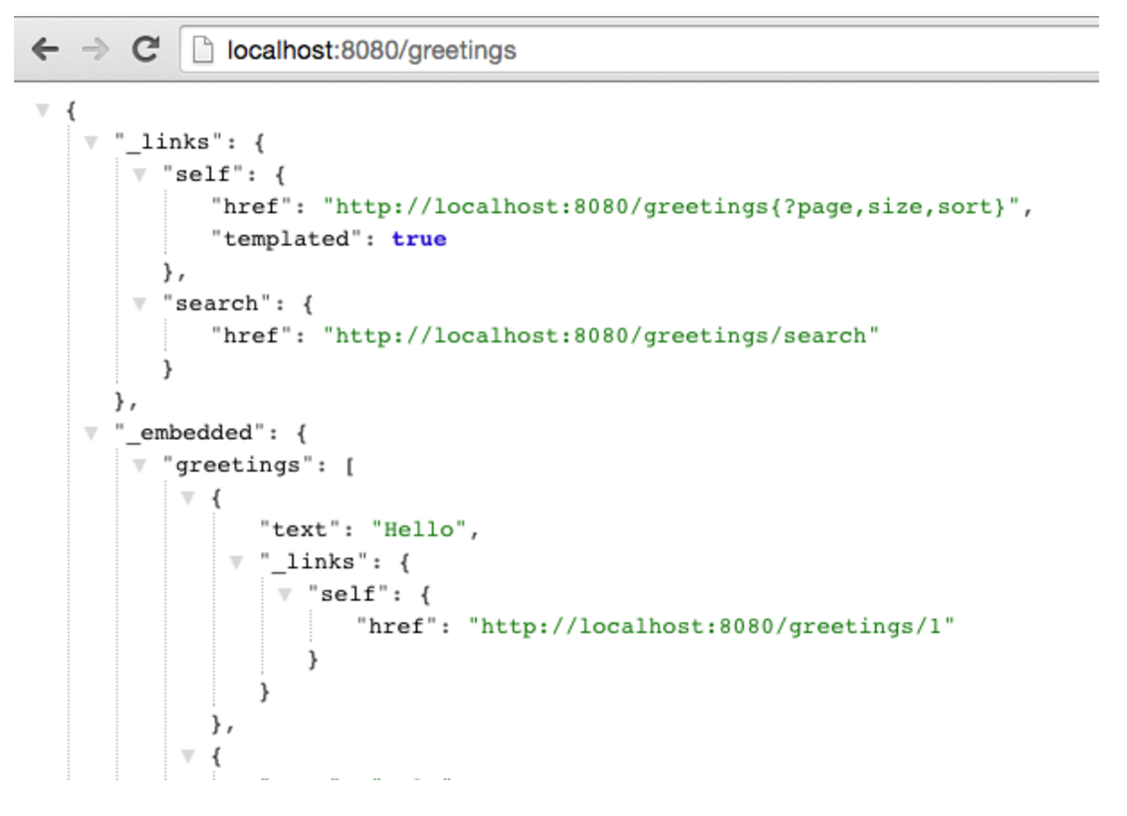
RESTful API

Slide 15
HATEOAS (Hypermedia as the engine of application state)
Provides information to navigate the REST interface dynamically by including hypermedia links with responses
Differs from SOA based systems and WSDL-driven interfaces, in that a separate fixed specification is distributed
HAL – Hypertext Application language

Slide 16
Lab

