Slide 1


PCF Operations Workshop –
Service Overview
Paul Hopper
Platform Architect
Notes:
Good afternoon everyone and thank you for taking the time to meet with me to discuss how Pivotal is helping companies build modern software

Slide 2
PCF Introduction
Services Overview
Role Based Access Control
Application Scaling
Application Health
Operations Workshop Agenda

Slide 3
Cloud Native Application Platform - Services
Professional Services for Agile, CI/CD
Cloud Native
Data Services
BDS
Services
Pivotal
Labs
Pivotal Cloud Foundry
PCF
Mobile
Services
Spring
Cloud
Services
Cloud Native
Mobile Services
Cloud Native
Application Framework

Slide 4
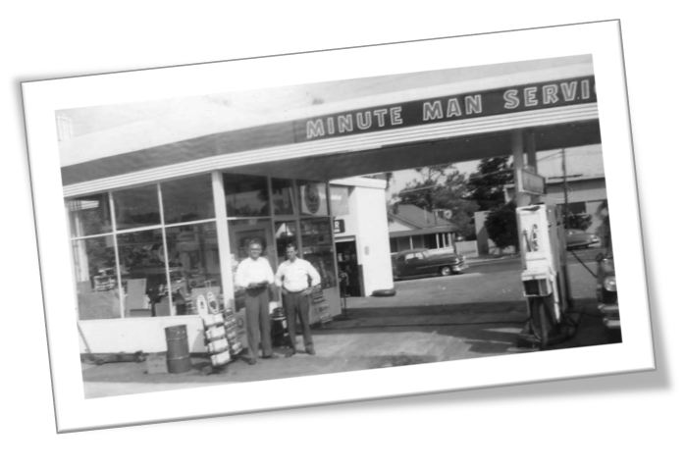
What is a Service
Allows resources to be easily provisioned on-demand
Typically middleware, frameworks, and other “components” necessary for applications
Can be a persistent, stateful layer

Slide 5

Two Types of Services
Managed - Fully integrated, with full lifecycle management
User-Provided – Created and managed external to the platform

Slide 6
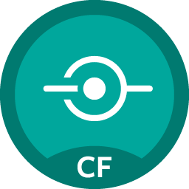
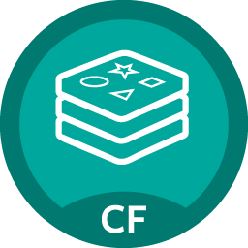
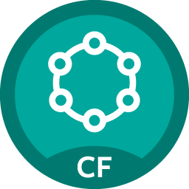




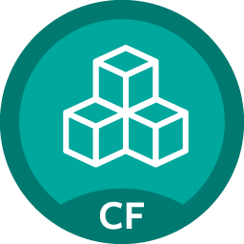


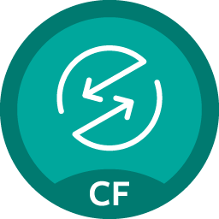


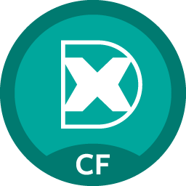


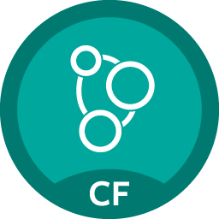


Pivotal Cloud Foundry Services
Mobile
Data
Other
Spring Cloud
API Gateway
Redis
DataStax Cassandra
Config Server
RabbitMQ
Push Notification
MySQL
GemFire
Jenkins Enterprise
Service Directory
Data Sync
Session state caching
Circuit Breaker
PivotalHD
Spring XD
App Distribution
Single Sign-on
Neo4j
MongoDB

Slide 7
Service Broker
Flexible, RESTful API
Allows Service Authors to provide self-provisioning Services to developers
Cloud Controller
Create
Service Broker
Service Nodes
Bind
Connect
Diego
Apps

Slide 8
Creating and Binding a Service
Service
credentials
DB
CLI
create service (HTTP)
Cloud Controller
create service (HTTP)
Service
Broker
reserve resources
Data
Service
Router
bind service (HTTP)
bind service (HTTP)
obtain connection data
Pivotal Cloud Foundry
Elastic Runtime
Notes:
An application runs in a Diego, which is a droplet execution agent. The Cloud Controller orchestrates the routing and lifecycle of all Diego in the pool. Routers manage application traffic. Health Manager reports mismatched application states to the CC. A service gateway provides an interface for services (native or external). A messaging bus manages all system communication. Apps are accessed directly through the router while web and CLI clients (e.g., vmc, STS) access Cloud Controller via RESTful services.

Slide 9

Pivotal Cloud Foundry Services
Operated ‘as a Service’
Configured and integrated to enable push button deployment
Full lifecycle management - software updates and patching
Bind to apps through an easy-to-use interface
Common view into access control and audit trails across a breadth of services
EASY
Notes:
In many organizations, provisioning of data and messaging services for applications can take weeks, if not months because of the number of teams, administrators and exchange of credentials involved. We are striving to address this problem by providing a common model for services deployment via Pivotal Cloud Foundry that developers can easily find and their applications bind to – and scale those services as needed.
PCF Services allow administrators to provide pre-defined database and middleware services, and this gives developers the ability to rapidly deploy a software product from a menu of options without the typical slow and manual provisioning process. This is also done in a consistent and supportable way. PCF Services are managed and operated ‘as a Service,’ and this means they are automatically configured upon request. The provisioning process also incorporates full lifecycle management support, like software updates and patching.
This automation removes the overhead from developers, who are often saddled with service configuration responsibility. It makes administrators’ lives easier and addresses security risks by standardizing how services are configured and used.

Slide 10
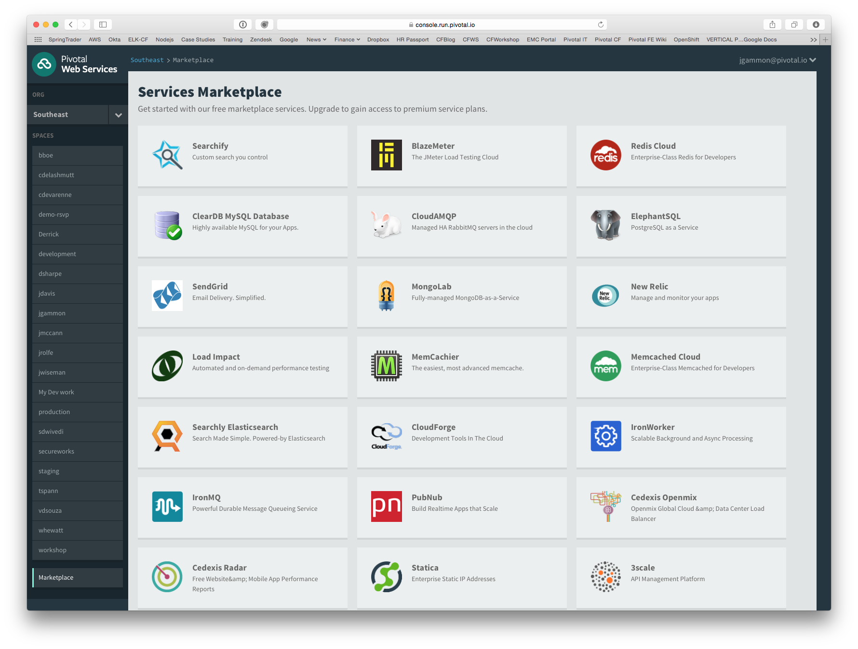
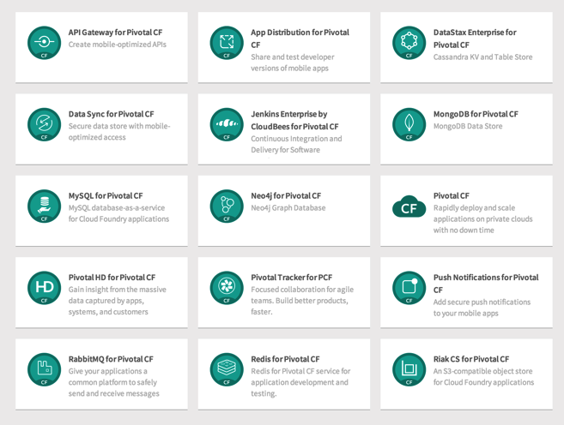
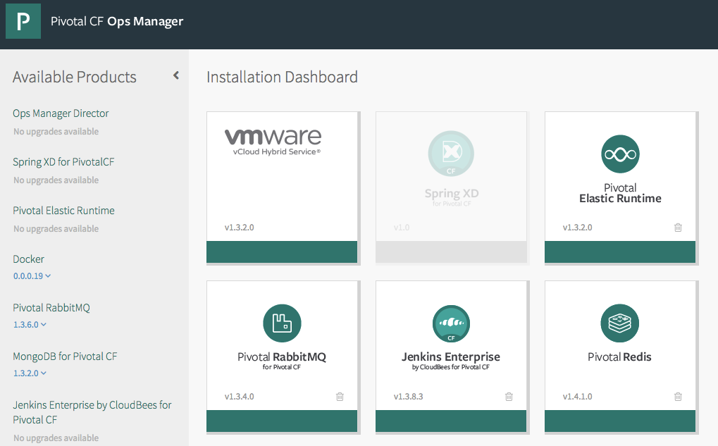
PCF Marketplace
Broad Services Ecosystem
Easy accessibility
Quick, self-provisioning

Slide 11
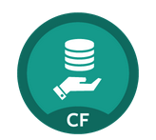
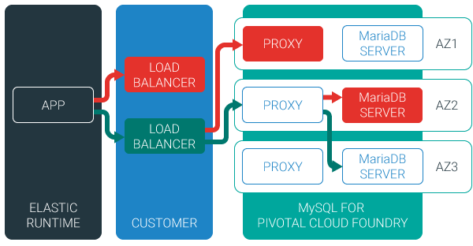
MySQL for Pivotal Cloud Foundry
Relational Database as a Service for Your Applications
Minimized effort to create, configure, and manage a MySQL cluster
Multi-node cluster
Data replication across nodes
Failover functionality ensures app traffic only routed to healthy nodes
Notes:
Deployed with a multi-node cluster; Balanced across Availability zones
Highly Available
Data replication
Failover functionality
Customizable plans
Secure - Different credentials to each application, operators can revoke access selectively!

Slide 12

Redis for Pivotal Cloud Foundry
Advanced Key-Value Store and Cache as a Service
Pre-provision a pool of Redis VMs
Supports persistence to disk
Consolidated logging and monitoring
VM health monitoring, and recovery
User Application
Binding
Instance (Redis process)
VM
VM
VM
VM
Pre-provisioned VMs in the ‘pool’
Ready to be created as instances and bound with apps
Notes:
Developers can quickly develop features for their applications such as:
live, in-memory caching for very fast reads
real-time computation on data structures
ranked lists and leaderboards
publishing and subscribing
queuing

Slide 13
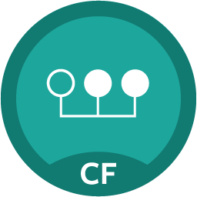
Session State Caching (SSC) by GemFire
Another advanced Key-Value Store and Cache as a Service, for managing Sessions
Configure, manage, monitor, and consume GemFire in a client/server topology
A turn-key GemFire session replication cache service optimized for Java buildpack apps deployed in Tomcat
  No need to modify your app
  Tomcat from the java buildpack “knows” how to use the service
  GemFire pre-configured for session replication
Session state management independent from app servers
  App servers can come and go without affecting session lifetime
  Not affected by load balancing

Slide 14

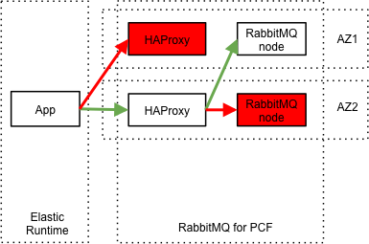
RabbitMQ for Pivotal Cloud Foundry
Apps safely send and receive messages at scale
Messaging broker for communication between servers, applications and devices
Highly available queues, flexible routing, support for multiple protocols and client libraries
Wide range of client libraries, in all languages
Push button deployment and upgrades of a RabbitMQ Cluster

Slide 15
User Provided Services
Scenario: a Kafka broker cluster backed by single Zookeeper instance
$ cf cups kafka-broker-cluster -p '{"topic":"here","brokerList":"192.168.33.21,192.168.33.22,192.168.33.23","zkNodes":"192.168.33.21,192.168.33.22,192.168.33.23"}’
$ cf services
Getting services in org pcfdev-org / space pcfdev-space as admin...
OK
name service plan bound apps last operation
---------------------------
a_mysql p-mysql 512mb kafka-producer create succeeded
kafka-broker-cluster user-provided
consumer
Kafka
zookeeper
producer
Kafka
producer
Kafka
Port: 9092
Port: 2181

Slide 16
User Provided Services
Scenario: a Kafka broker cluster backed by single Zookeeper instance
╰─$ cf cups kafka-broker-cluster -p '{"topic":"here","brokerList":"192.168.33.21,192.168.33.22,192.168.33.23","zkNodes":"192.168.33.21,192.168.33.22,192.168.33.23"}’
Creating user provided service kafka-broker-cluster in org pcfdev-org / space pcfdev-space as admin...
OK
╰─$ cf bind-service kafka-producer kafka-broker-cluster
Binding service kafka-broker-cluster to app kafka-producer in org pcfdev-org / space pcfdev-space as admin...
OK
TIP: Use 'cf restage kafka-producer' to ensure your env variable changes take effect
consumer
Kafka
zookeeper
producer
Kafka
producer
Kafka
Port: 9092
Port: 2181

